Slide 1
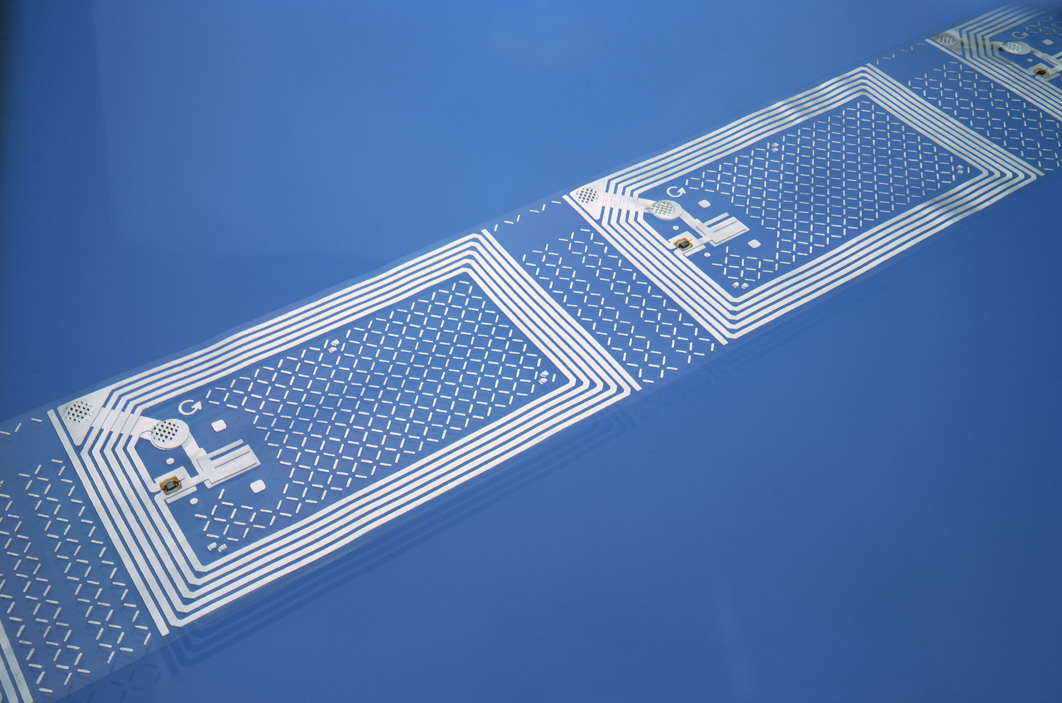
CATE 4103
Teaching Strategies
2014 University of Arkansas
Vinson Carter

Slide 2
Notecard Intro Activity
What is your program area (BUED, FACS, or
TEED)?
2. Where are you from?
3. What is your favorite food?
4. What is your favorite movie?
What is the most exciting thing you did this
summer?
6. Where do you see yourself in 5 years?

Slide 3
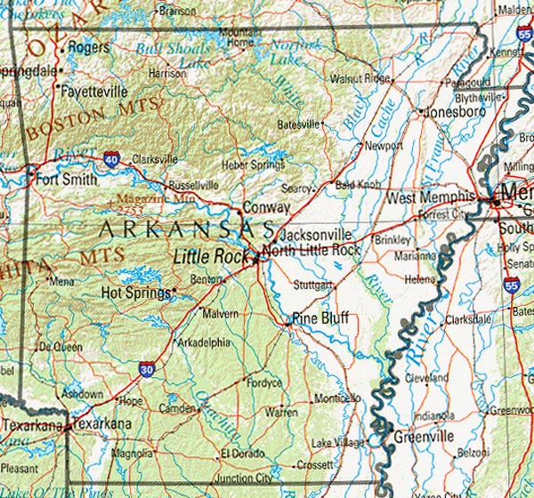
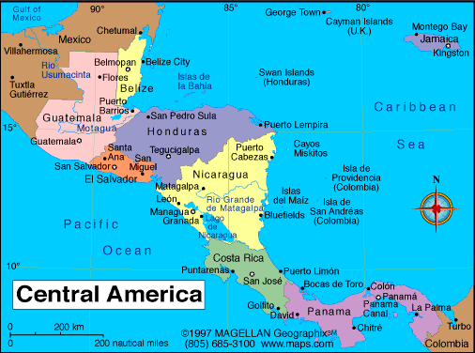

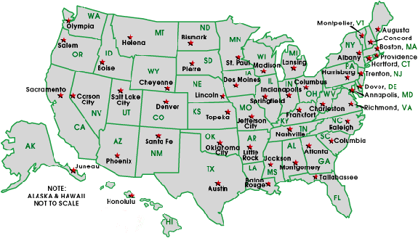

Slide 4
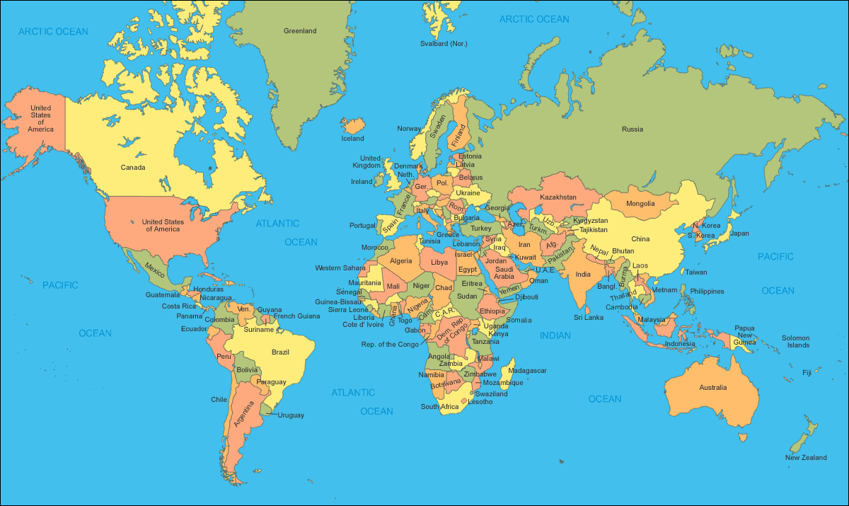

Slide 5
Praxis
Praxis I must be completed before you can begin your internship. If passing scores are not presented by the first day of your spring internship (usually January 3rd) you will not be able to begin your student teaching. Your student teaching will defer to the Fall 2014 semester. There are no exceptions. This is a university and state requirement.

Slide 6
Background Checks
Leah Chamberlain
leahc@uark.edu
575-4932

Slide 7
Cooperative Learning Model (CleM)
1. Individual Written Work
Each person should do something in writing BEFORE they move to group activity. Everyone should bring something to the table.

Slide 8
2. Small Group Work
Divide into small groups. I like 2 or 3, any more than that and I think they are hard to manage and it takes too long, but it might work for you. Heterogeneous grouping seems to work the best. Besides it is most like the real world where you rarely get to choose who you have to work with.

Slide 9
3. Large Group Discussion
It is best if the teacher only mediates or arbitrates and does not get involved, it helps keep more students engaged.
4. Solve a Real Problem
Extension comes from taking what they have learned and making a Real World application of the learning.

Slide 10
What is teaching?
How would you define teaching?
What are the characteristics of a great teacher?

Slide 11
What is Teaching
“the actions of someone who is trying to assist others to reach their potential in all aspects of development” (Moore, 2001)
Teaching is an art—a creative, spontaneous act, a special sense of knowing what to do in the classroom.
Teaching is a science—a deep knowledge of content, a solid understanding of teaching and learning, a mastery of skills that produce learning.

Slide 12
Important theoretical contributions…
John Dewey (1859-1952)
child-centered curriculum
activities focused on real-life
Constructivism
students construct knowledge through “doing” and “reflecting”
Joyce, Weil, and Calhoun (2003)
models of teaching
strategies and procedures that motivate,
define expectations, and involve
students in learning

Slide 13
What is an effective teacher?
An effective teacher is…
Dynamic
Self-monitoring
Reflective
Organized
Effective teachers know and understand…
Subject matter
Student learning
Teaching methods

Slide 14
Skill areas for effective teaching
Quality planning and preparation
Positive classroom environment
Proven instructional techniques
Professional behavior
(Danielson, 1996, 2007)

Slide 15
Dispositions and attitudes…
Effective Teachers……
are their true selves with students.
have positive expectations for all students.
care about their students.
are excited about teaching and learning.
value diversity.
are willing to collaborate.

Slide 16
Effective teachers must consider…
the unique needs of students.
the role of parents in the learning process.
the role of the community in supporting the
education of students.

Slide 17
Challenges in Preparing to Teach
Local, state, and federal regulations
Professional teaching standards
Licensure/certification requirements
Teacher testing

Slide 18
No Child Left Behind Act of 2001
Accountability
Highly, qualified teachers
High-stakes testing
Equitable learning for all students
Increased support for early learners
Parent/caregiver communication
Low performing schools penalized

Slide 19
Standards-based Teaching
National Council for Accreditation of Teacher Education (NCATE or CATE)
National Board for Professional Teaching Standards (NBPTS)
Interstate New Teacher Assessment and Support Consortium (INTASC)
Educational Testing Service (ETS)

Slide 20
Educational Law and Effective Teaching
Student rights
Brown v. Board of Education of Topeka
Civil Rights Act – 1964 (PL 88-352)
PL 94-142 and PL 101-476
Section 504 of the Vocational
Rehab Act of 1973
*Separate (segregated) is not equal
*Authorized support for desegregation
*Individuals with Disabilities Act (IDEA)
*Free, appropriate education
for disabled students

Slide 21
(cont.)
Child Abuse and Neglect
Child Abuse Prevention Treatment Act (CAPTA)
mandatory reporting
local Child Protective Service
(CPS)

Slide 22
(cont.)
Student Privacy
Family Educational Rights and Privacy Act (FERPA)
Grants student access to school records
Prevents school release of records without written consent (with many exceptions)
Several records are exempt from FERPA

Slide 23
(cont.)
Corporal Punishment
Corporal punishment banned in 27 states and the District of Columbia
Highly debated issue
Varies in form

Slide 24
(cont.)
Teachers’ Rights
First Amendment Right to Free Speech
Teacher behavior often challenged in courts
Other rights: right to privacy, freedom of religion, and freedom of association

Slide 25
Teacher Licensure/Certification
…the process by which teachers receive state permission to teach.
Ensures the quality of our teaching force.
Successful completion of an approved teacher education program (culminating in at least a bachelor’s degree) is required by all states.
Currently, alternative routes to
licensure are being explored
in many states.

Slide 26
Homework
Due 9/4
Locate and print the frameworks for your content area
BUED – Business Law I, Introduction to Marketing, Sports and Entertainment Marketing, Fashion Merchandising, or Retailing
TEED – Engineering and Technology Education
Join ACTE/Arkansas ACTE

