Slide 1
TEED 4103 Engineering Design for Technology Education: Capstone
The Capstone experience is typically completed by senior students within the TEED major and is designed to elicit opportunities for educational reflection and synthesis of knowledge and skills as well as preparation for student teaching.
Analysis of engineering design, focus on design processes, physical and computer modeling, & materials processing.

Slide 2
Industrial Technology Licensure
Praxis Information - http://test.uark.edu/.
Candidates may now use either ACT, SAT, or GRE scores in lieu of the Praxis Core if they meet the following cut scores:
Praxis Core – Reading (156), Math (150), and Writing (162)
ACT – Composite (24), Reading (22), Math (22), and Writing (22)
SAT - Composite (1090), Reading (510), Math (510), and Writing (510)
GRE - Reading (142), Math (142), and Writing (3.5)
This fall you need to take the Praxis II – Subject Matter – Technology Education
Test Code – 5051
Qualifying Score – 159
and Praxis II – Principles of Learning & Teaching – 7-12
Test Code – 5624
Qualifying Score – 157

Slide 3
2015-2016 Mentor Teacher Placements
Candidate | Mentor | District | School | Contact
Lyndsey Strange | Richard Newberry | Springdale | Southwest JHS | rnewberry@sdale.org
Michael Allen | Kristian Cartwright | Fayetteville | Woodland JHS | kristian.cartwright@fayar.net
Stefan Palmer | Earl Rowe | Springdale | George JHS | erowe@sdale.org
Jayston Landon | Randal Dickinson | Fayetteville | Fayetteville HS | Randal.dickinson@fayar.net

Slide 4
STL
CCSS
NGSS
ACE
ADE
STEM
CTE
ITEEA
ISEA
ACTE
ATEE
ETE
PLTW
EITE
TTPGTAIE
The Teacher’s Pocket Guide to Acronyms in Education

Slide 5
STL - Standards for Technological Literacy
CCSS - Common Core State Standards
NGSS - Next Generation Science Standards
ACE - AR Department of Career Education
ADE - AR Department of Education
STEM – Science, Technology, Engineering, & Mathematics
CTE – Career & Technical Education
ITEEA - International Technology & Engineering Educators Association
ISEA – International STEM Education Association
ACTE – Association for Career & Technical Education
ATEE - Arkansas Technology & Engineering Educators
ETE - Engineering & Technology Education
PLTW - Project Lead the Way
EITE – Exploring Industrial Technology Education

Slide 6
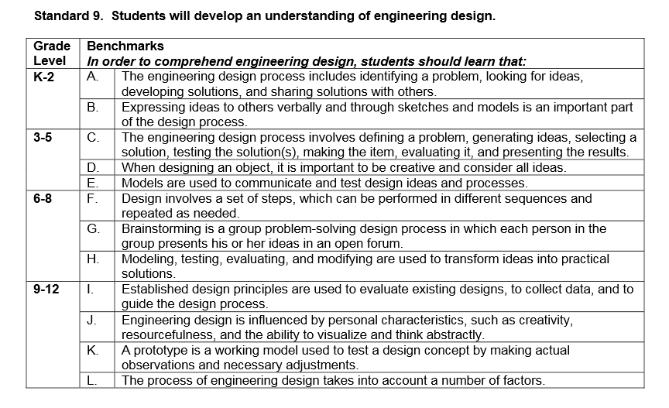


Slide 7
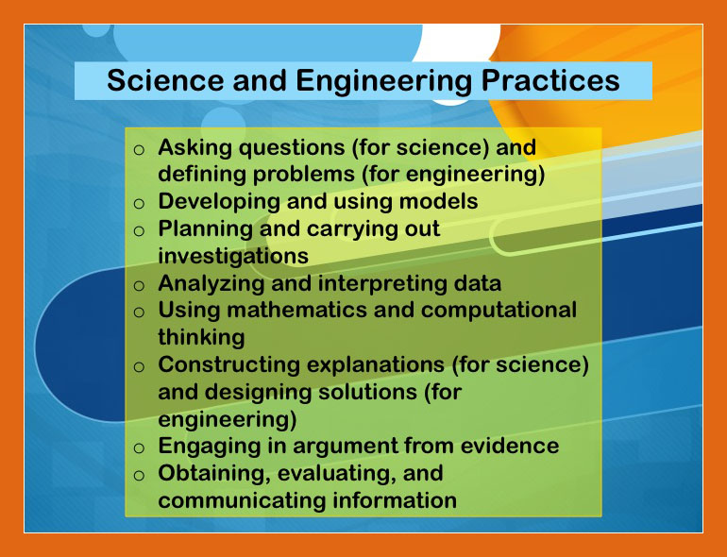

Slide 8
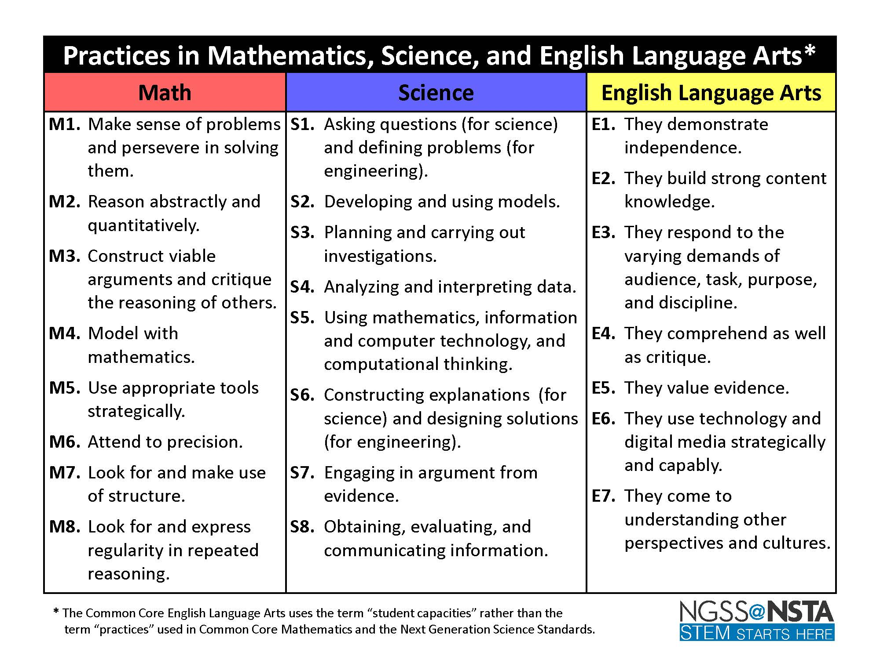

Slide 9
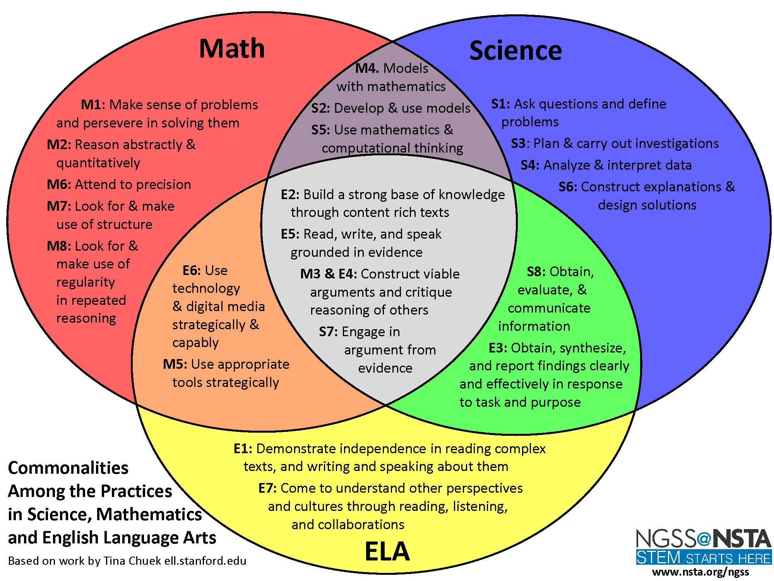

Slide 10
For Thursday -Read pages 1-5 in the Product Design Curriculum Packet -Contact your mentor teacher to introduce yourself -Begin brainstorming ideas for your product design project

