Slide 1
Curriculum Design for STEM Education
Understanding By Design
Developing Standards-based Curriculum

Slide 2
The Problem
“Even good students don’t always display a deep understanding of what is taught even when conventional tests certify success.”
(Wiggins & McTighe)

Slide 3

A Curriculum Fable
One time the animals had a school. The curriculum consisted of running, climbing, flying and swimming, and all the animals took all the subjects. The duck was good in swimming; better in fact than his instructor, and he made passing grades in flying, but he was practically hopeless in running. Because he was low in this subject, he was made to stay after school and drop his swimming class in order to practice running. He kept this up until he was only average in swimming. But average is acceptable, so nobody worried about that except the duck. The eagle was considered a problem pupil and disciplined severely. He beat all the others to the top of the tree in the climbing class, but he used his own way of getting there. The rabbit started out at the top of the class in running, but he had a nervous breakdown and had to drop out of school on account of so much make-up work in swimming. The squirrel led the climbing class, but his flying teacher made him start flying lessons from the ground instead of the top of the tree down, and he developed "charley horses" from over-exertion at the take-off and began getting C's in climbing and D's in running. The practical prairie dogs apprenticed their offspring to a badger when the school authorities refused to add digging to the curriculum. At the end of the year, an abnormal eel that could swim well, run, climb, and fly a little, was made valedictorian.

Slide 4
In schools, we spent a great deal of time discussing concepts
And, far too little time developing concepts deeply

Slide 5
Most science and math classes allow much time to practice procedures
But, few spend enough time applying concepts to solve real-world problems
Or, time being innovative or creative with the new concepts

Slide 6
The Questions
How often do you allow your students to apply newly learned concepts to solve a real-world problem in their community?
Answer: Develop curricula that makes a difference
Example: Perhaps you are teaching a lesson on mechanical systems (gears, pulleys, bearings, etc.)
Suggestions: After introducing mechanical systems, ask them to use the new information to build a mechanically-powered water pump, or a pedal-powered generator, or a pedal powered grinder, or some other device that might be needed in the community.

Slide 7
Curriculum That Makes a Difference
Focus on a topic that matters
Use instructional methods that engage
Cause deep and enduring learning related to an important standard
  Is it important enough to remember when the student is 50 years old?

Slide 8
What is Backward Design (BD)
BD Begins with the end in mind
  Starting with a clear understanding of the destination
  Making sure that you are taking steps in the right direction (Stephen Covey)
  Is justifiable and reliable

Slide 9
Unfortunately, Many Teachers
Begin with a favored lesson, time-honored activities (or the next page in the text)
Backward design starts with the end (the desired results).
What would I accept as evidence that students have attained the desired understandings and/or abilities?

Slide 10
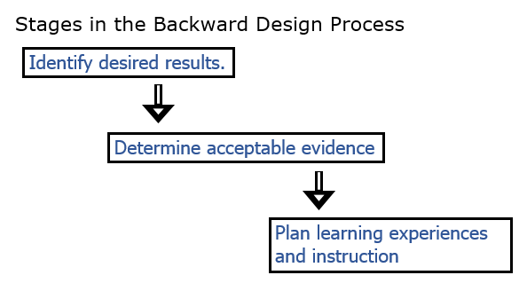
Backwards Design Process

Slide 11
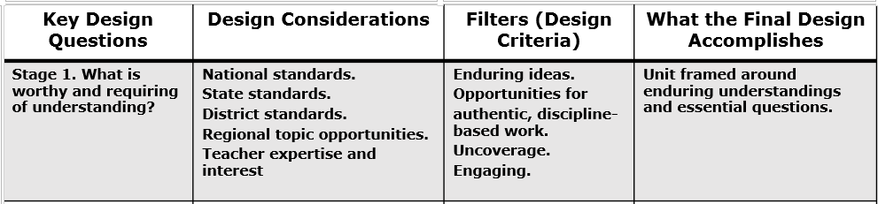
Stage One: Backward Design

Slide 12
How do teachers decide what content should be taught?
-standards/frameworks

Slide 13
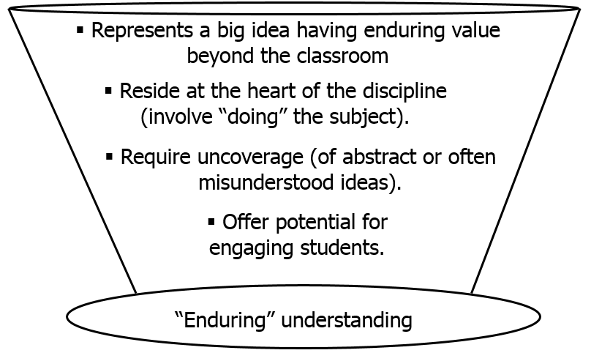
Should a Lesson be Taught
4 filters to determine worthiness

Slide 14
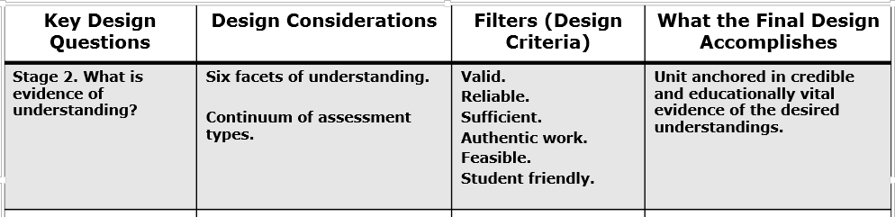
Stage 2: Backwards Design

Slide 15
Six Facets of Understanding
Facet 1:
A student who really understands, can explain.
  Can provide complex, insightful and credible reasons.
  Can make distinctions, argue for and justify central ideas
  Can avoid common misunderstandings
  Can personalize the information
Facet 2:
A student who really understands, can interpret.
  Can make powerful, meaningful interpretations and translations
  Can read between the lines
  Can use historical and biographical information to make ideas more relevant

Slide 16
Six Facets of Understanding
Facet 3:
A student who really understands, can apply.
  Can extend what he/she knows to realistic, hands-on situations
  Can make adjustments along the way
  Can apply knowledge in a variety of settings
Facet 4:
A student who really understands, sees in perspective.
  Can critique and justify a position
  Understanding the history of an idea
  Know the limits as well as the power of an idea
  Can see through biased arguments

Slide 17
Six Facets of Understanding
Facet 5:
A student who really understands, demonstrates empathy.
  Can appreciates another’s situation
  Can see when even flawed ideas are plausible
  Can describe how an idea could be misunderstood by others
  Can listen and hear what others often do not
Facet 6:
A student who really understands, reveals self-knowledge.
  Can recognize own prejudices and style
  Can think about thinking
  Can question his/her own convictions
  Can self-assess
  Can accept feedback/criticism without defensiveness

Slide 18
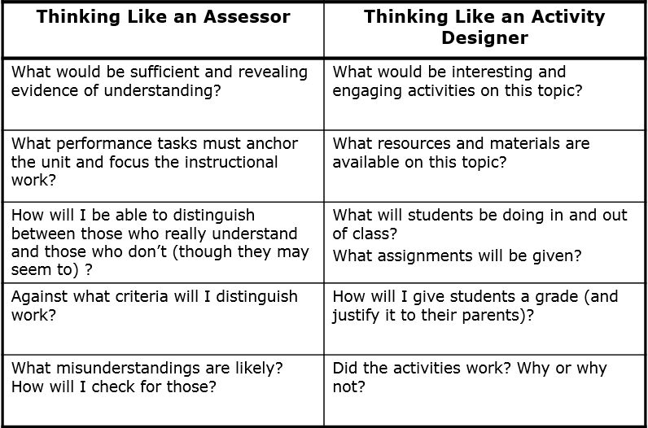
Two Different Approaches

Slide 19
Thinking Like the Assessor
Does not come naturally to most teachers
We unconsciously jump to the activity once we have a target
Backwards design demands that we short-circuit the natural instinct that leads most of us to develop the activity first

Slide 20
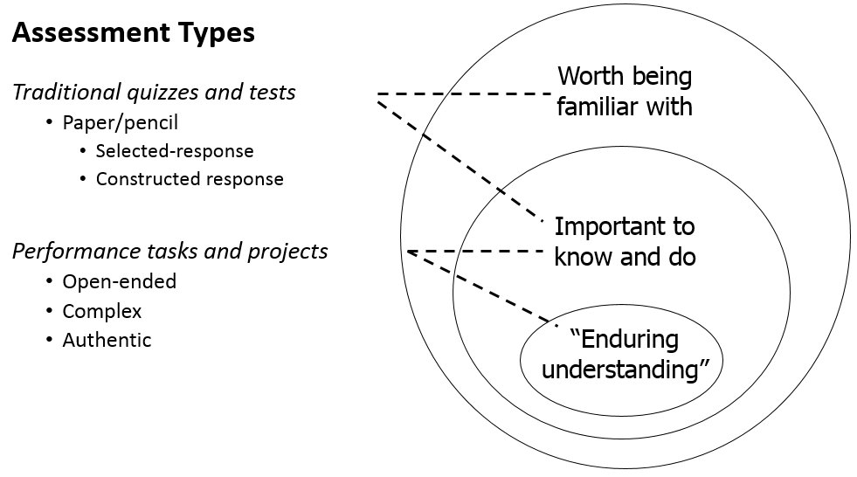
Types of Assessments

Slide 21
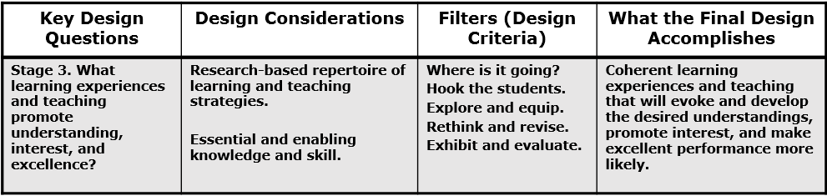
Stage 3: Backwards Design
WHERETO MODEL

Slide 22
Use the WHERETO MODEL in instructional planning
W- Ensure the students know WHERE the unit is headed and WHY
H- HOOK students in the beginning; HOLD their attention throughout
E- EQUIP students with necessary experiences, tools, knowledge, and know-how to meet performance goals
R- Provide students with numerous opportunities to RETHINK their big ideas, REFLECT on progress, and REVISE their work
E- Build in opportunities for students to EVALUATE progress and self-assess
T- Be TAILORED to reflect individual talents, interests, styles, and needs
O- Be ORGANIZED to optimize deep understanding, not superficial coverage

Slide 23
Key Questions for Instructional Design
What facts, concepts, principles and skills will students need to achieve in lessons?
What activities will equip students with needed knowledge/skills?
What materials/resources are available?

Slide 24
How Will You?
Bring abstract ideas and far-away facts to life?
Students must see knowledge and skill as building blocks—not just isolated lessons

Slide 25
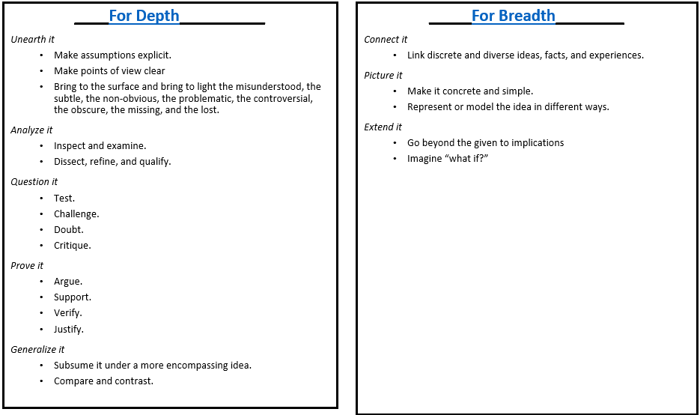
Blending Breadth and Depth

Slide 26
Teaching in a UBD Environment
More learning through less teaching
Suspends instructional planning
  Specific lessons are not developed until the last phase. This runs counter to the habits of many
BD demands that we set goals and establish assessments first

Slide 27
Wisdom Can’t be Told
Understanding is more stimulated than learned
It grows from questioning oneself and being questioned by others
Students must figure things out, not simply wait to be told!
  This requires the teacher to alter their curriculum and teaching style

Slide 28
Teaching for Understanding Requires:
Routinely using teaching methods from all three general types
  Didactic: Direct instruction (used to dispense factual information)
  Coaching: Teachers providing feedback and guidance to students as they work
  Constructivist: Allowing the student to “construct their own learning” by solving their own problems.

Slide 29
Direct and Indirect Teaching Approaches
It is not an either-or proposition
  As a teacher:
    When should we present the facts that we know?
    When should we force to students to discover the information on their own?
    When should we allow practice while we coach?
  These are the key questions for teachers of understanding and STEM teachers

Slide 30
We Should. . .
Use direct instruction and focused coaching for discrete, unproblematic, and enabling knowledge and skill
Use indirect teaching for those ideas that are subtle, easily misunderstood, and those ideas that need some personal inquiry, testing and verification

Slide 31
Guidelines for Student Autonomous Learning
Engage students in inquiry and inventive work as soon as possible
Use the text as a reference—not a syllabus
Ask more questions/answer fewer
Make it clear that there are no stupid questions

Slide 32
Guidelines for Student Autonomous Learning
Ask naïve questions and let the students correct you
Raise questions with many possible answers and push students to answer in multiple ways
Demand final performances (speech, presentation, project demonstration)
Continually assess for understanding

Slide 33
Performance Based Assessment
Guidelines for Assessing for Understanding
Performance-based assessments require students to apply knowledge and skills.
PBA’s present students with hands-on tasks or other performance-based activities that students must complete individually or in small groups;
Work is evaluated using pre-established criteria:
  A performance task (actual prompt or activity)
  A scoring rubric (scoring guide consisting of pre-established performance criteria)
  Direct observation of student skills and capabilities (very different from pencil-and-paper tests)

