Slide 1
Introduction to
Integrated STEM Education

Slide 2
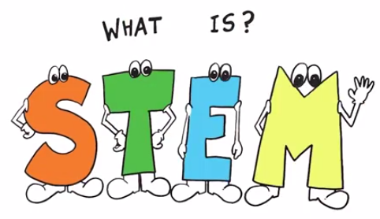
STEM = Science, Technology, Engineering, & Mathematics
Science – Discover and describe
    A better understanding of life (What is)
Technology – Invent and innovate
    Improving the natural world
Engineering – Control, modify, or design materials, processes, and systems
    What could be
Mathematics –Symbolic language for representing reality
    Making sense of the world with numbers

Slide 3

4 Pillars of STEM
STEM is an approach to teaching that’s larger than its constituent parts
STEM removes the traditional barriers erected between the four disciplines, by integrating the four subjects into one cohesive curriculum
The STEM Challenge

Slide 4
STEM Jobs
According to the U.S. Department of Education, all STEM jobs in the U.S. will increase 14 percent between now and 2020, accounting for millions of positions. Yet, data shows that 3 million of those jobs will go unfilled.

Slide 5
Considering a Job in STEM
Only 16 percent of American high school seniors are proficient and interested in a STEM career. Partly because of this, the U.S. ranks 25th in math and 17th in science among industrialized nations.

Slide 6
The Problem
Just as the nation’s economic engines and national security measures have come to rest squarely on the shoulders of science, technology, engineering, and mathematics (STEM), American students are recoiling from these disciplines in record numbers.

Slide 7
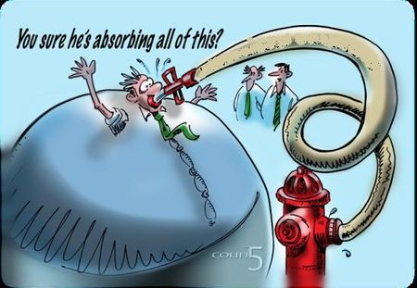
Current State OF STEM
Many students not receiving an adequate STEM education
Focus often on specialty or magnet high schools
STEM subjects not taught everyday in many schools
  29% of K-5 teachers report teaching science two or fewer days per week
The STEM Challenge

Slide 8

In their current form, schools:
Emphasize solving problems correctly—not creatively!
  20 year process of minimizing creativity
  Tests, grades, college admission, degrees, etc. are emphasized
Target and reward
  Logical thinkers
  Factual competence
  Math and science skill

Slide 9
Preparation for Life
STEM prepares students for life, regardless of the profession they choose to follow. STEM teaches students how to think critically and how to solve problems — skills that can be used throughout life.

Slide 10

The Critical Part of STEM
Improved STEM programs can create individuals capable of new solutions and better decisions
  Increased science and math capability is not enough
  Experiences centered on design, innovation, engineering, and technology increase creativity, inventiveness, ingenuity, and imagination capabilities
These characteristics are fostered in STEM centered learning experiences
The STEM Challenge

Slide 11
A Tall Order
Preparing the next-generation to succeed in life is a tall order. And, we will substantially fail if we don’t teach children how to think critically and solve ill-structured problems.

Slide 12
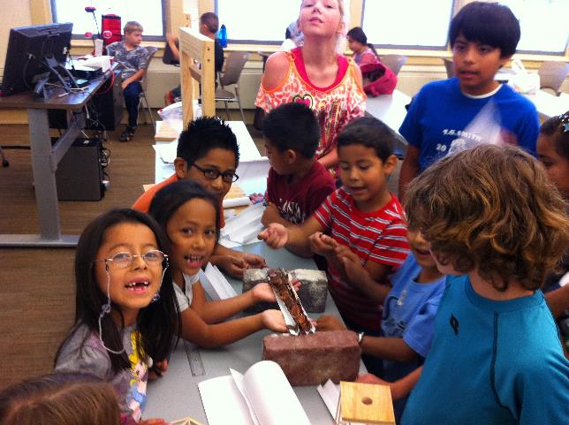
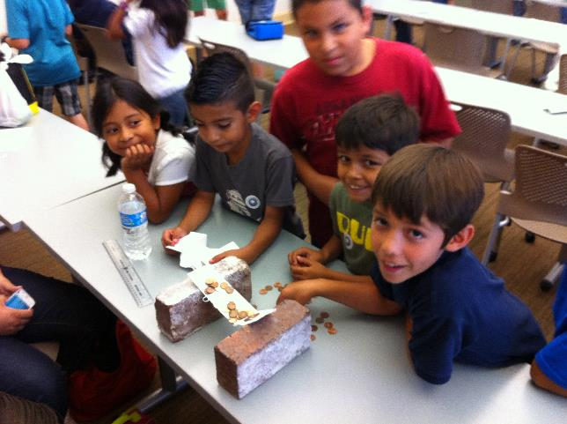
STEM doesn’t have to be expensive

Slide 13
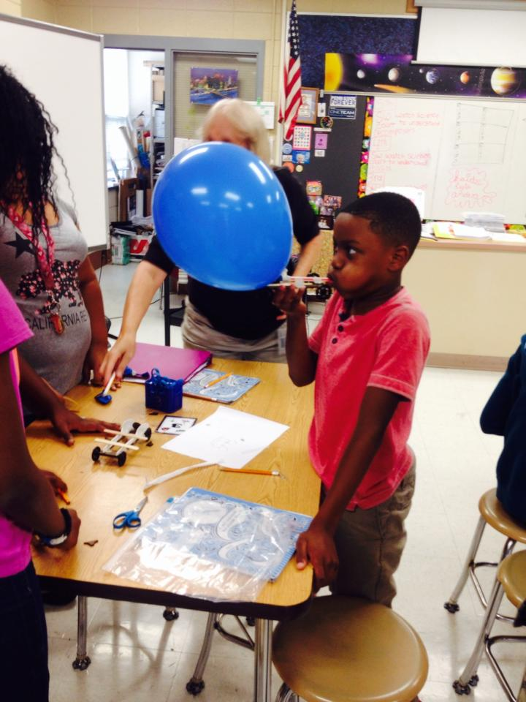
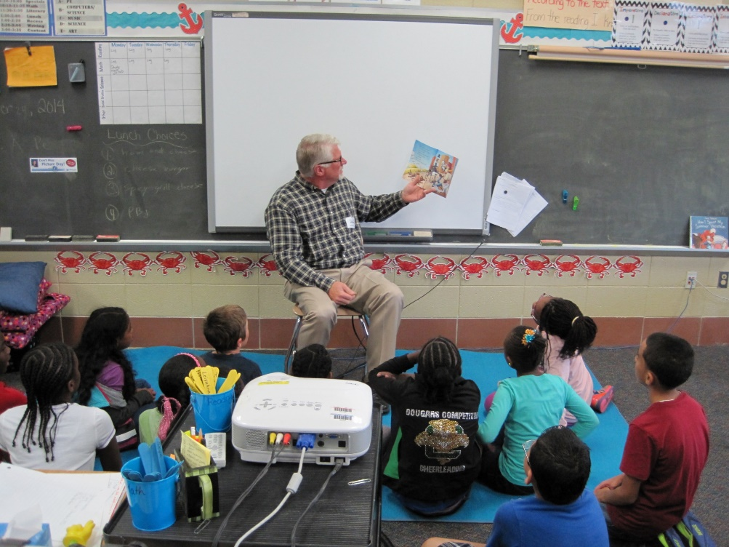
Connecting Literature w/STEM

Slide 14
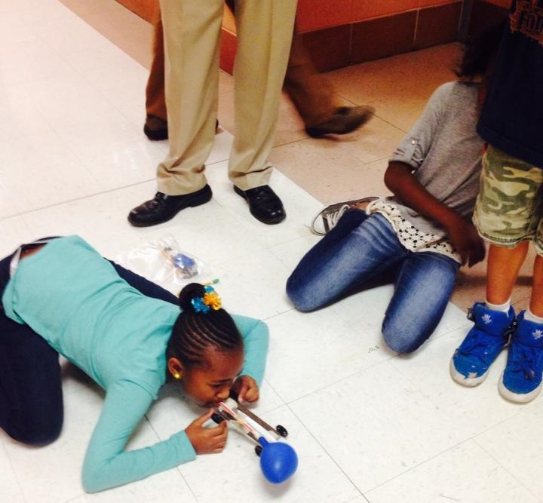
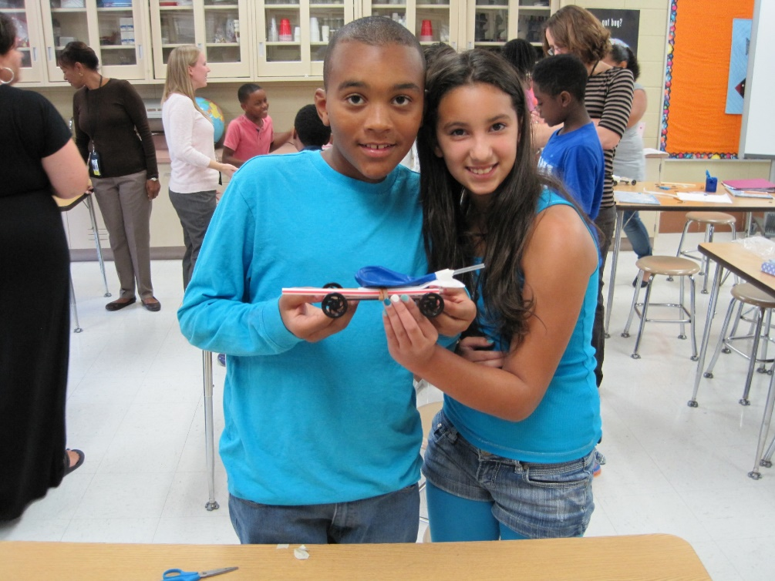
Implementing STEM

Slide 15
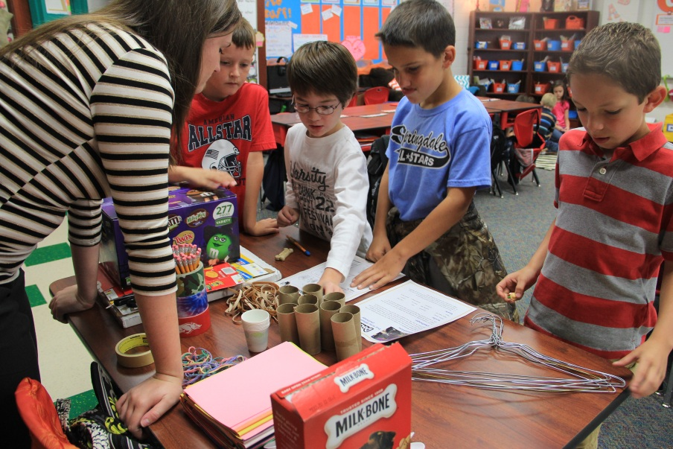
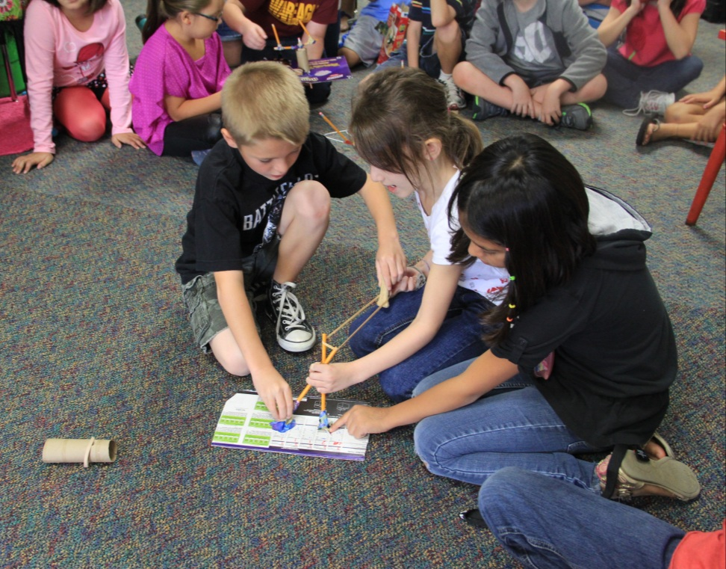
PBL & STEM in Action

Slide 16
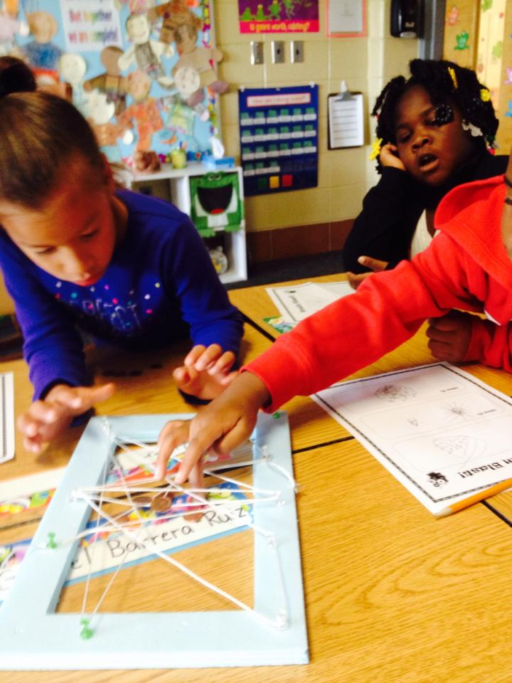
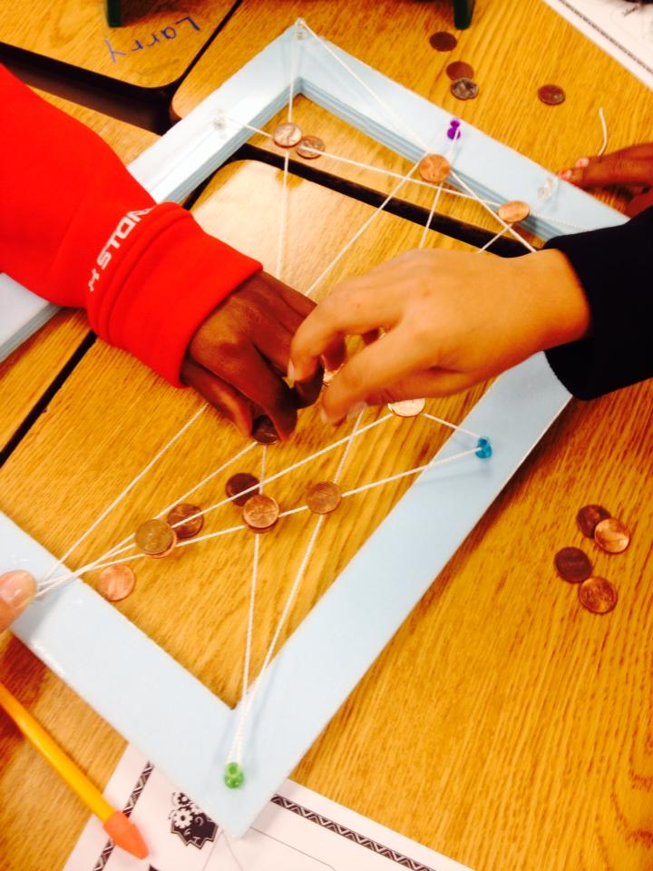

Slide 17
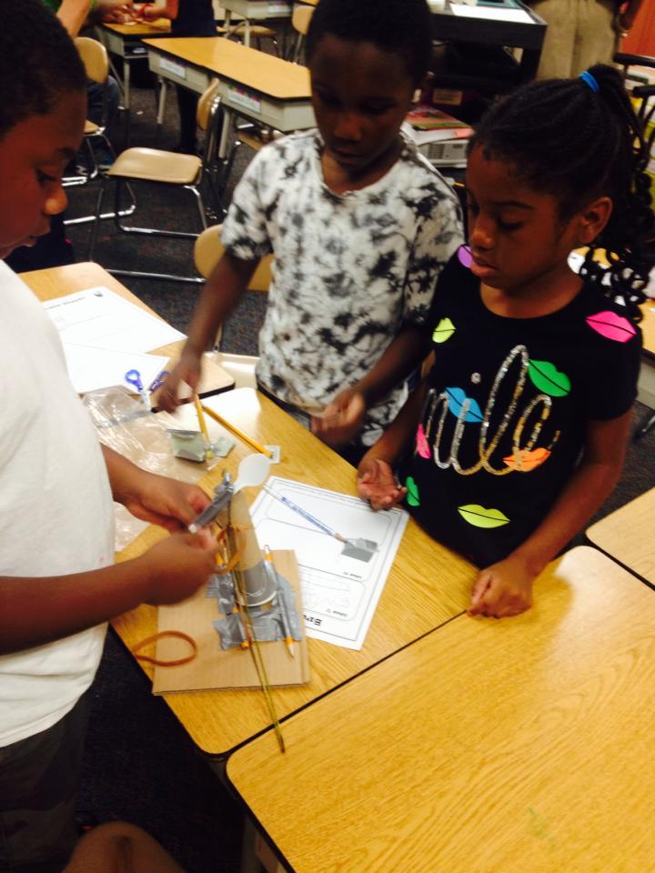
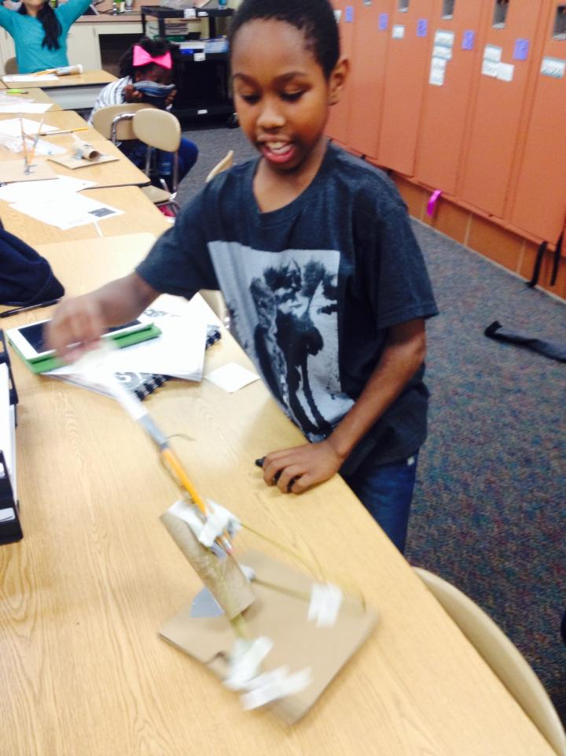
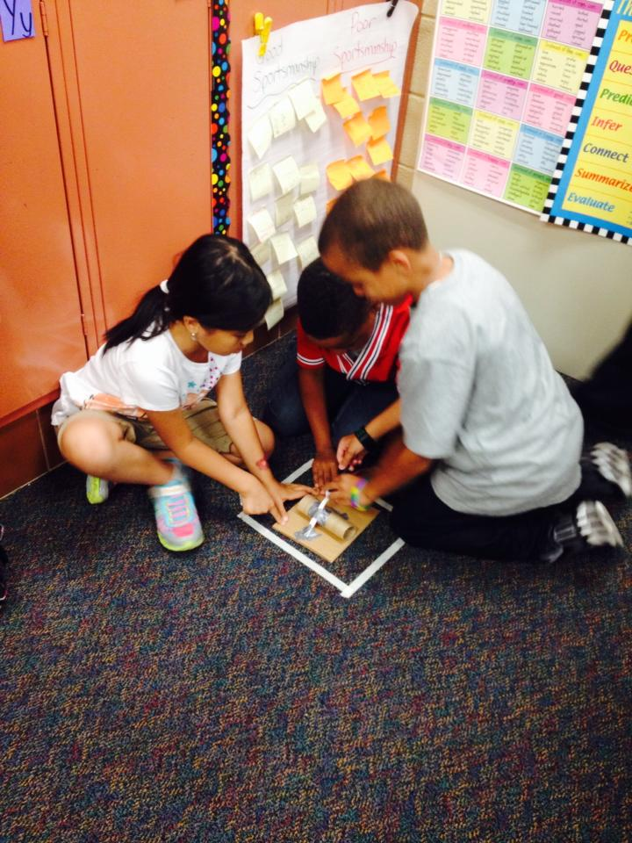

Slide 18
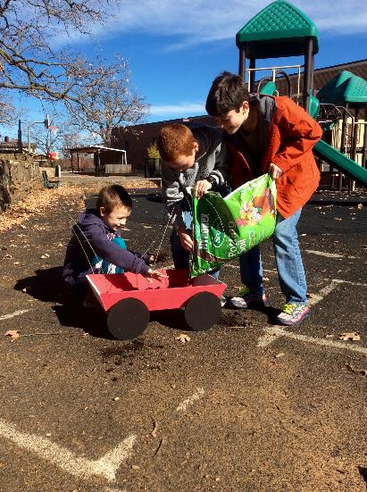
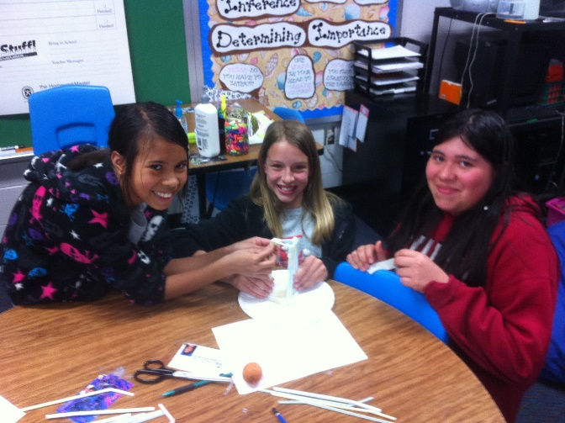

Slide 19
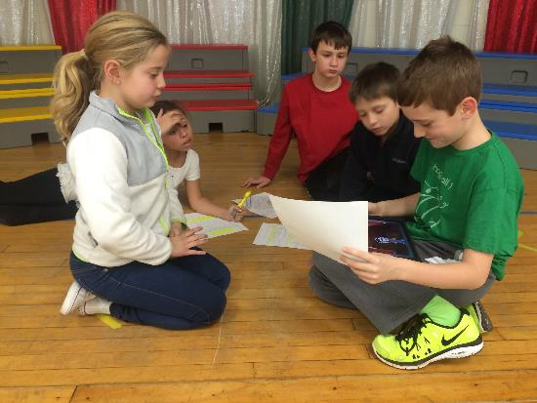
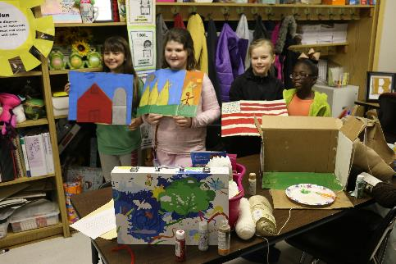

Slide 20
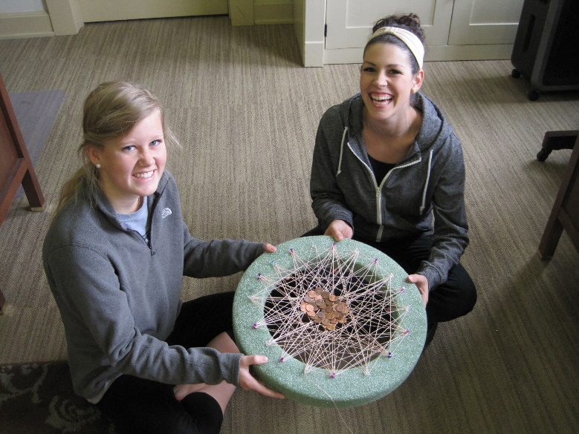
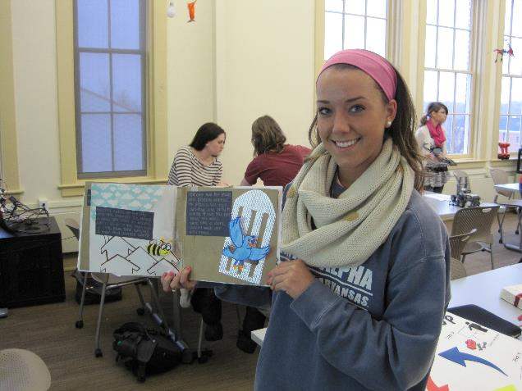
Pre-service Teachers Develop STEM Lessons

Slide 21
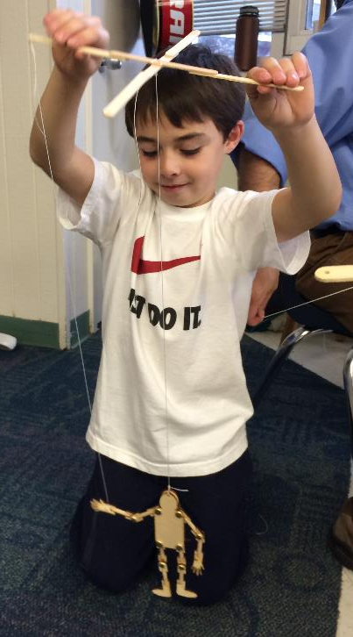
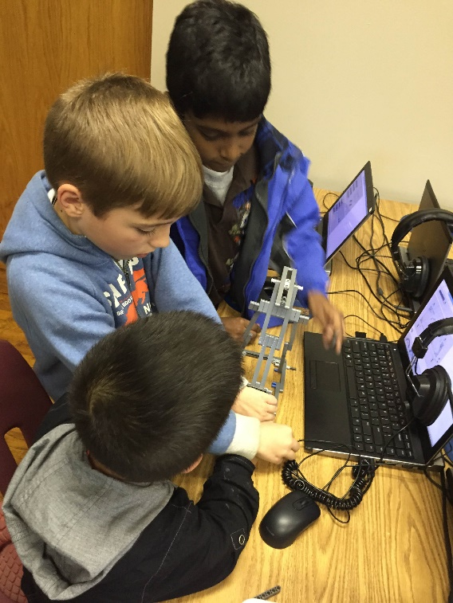
Developing/Testing STEM Curricula

Slide 22
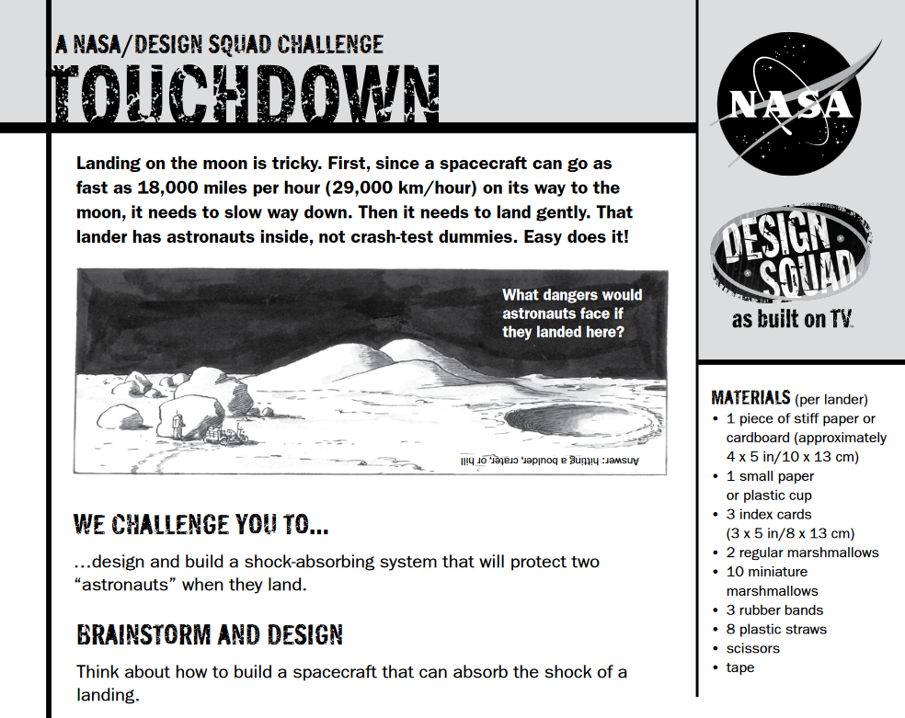

Slide 23
Currently, STEM is Not A Focal Point
Today, PK-12 education does not focus enough on teaching children to solve real world problems and is not interdisciplinary, nor collaborative enough in its approach

Slide 24
What We Need in Schools
STEM content integrated in all courses;
More engaged learning/less lecture;
More Ill-structured problem solving;
More strategies that cause students to seek STEM content answers;
More underrepresented populations engaging in STEM; and,
More collaborative learning experiences.

Slide 25
We Need to Emphasize
Critical thinking
Problem solving ability development
Leadership/teamwork development
Ethics and responsibility
Invention, imagination, and ingenuity
Communication skill development

Slide 26
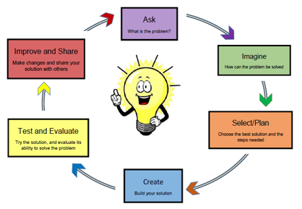
The Inclusion of Engineering Design
Why is this important?
  Invention and innovation
  Generate & research ideas
Source of Ideas?
  Interrogating our Personal Bank of Knowledge (Mental Warehouse)
  Existing Common Body of Knowledge
Quality of the Design?
  Different points of view

Slide 27

Message from STEM Kids

Slide 28
How do we Change the Status Quo?
First, recognize that there is a problem.
  Too many Americans don't see the real-life value of STEM.
The U.S. economic advantage is centered on our ability to innovate/create new ideas
  Integrated STEM education can supply that product.
Innovation is what allows the U.S. to compete.
  Creating new marketable ideas starts with STEM education.

Slide 29
What do STEM Teachers Do?
STEM teachers pose problems and combine problem solving with project-based learning across disciplines.
Developing students’ critical thinking, communication, assessment, and inquiry skills.

Slide 30
Using Real-World Problems
Real-world problem-solving is the essence of STEM lessons. Solving real-world problems causes students to use/expand higher-order thinking skills.
Identifying creative, real-world problems for students is the essence of STEM teaching.

Slide 31
Good STEM Lessons…
Accomplish these things:
Apply math/science through authentic, hands-on learning
Include the use/creation of technology
Require the use of the engineering design loop
Require collaborative teamwork
Emphasize math/science/technology standards
Address real-world problems

Slide 32
What do Students Gain?
Creativity – Thinking on their feet, ‘outside the box.’
Confidence – Building confidence needed to thrive in a competitive workplace.
Problem Solving –Without realizing it, students are consistently challenged to solve problems. This develops skills in reasoning and understanding.

Slide 33
What do Students Gain?
Focus – Balancing listening/contributing involves a great deal of concentration/focus.
Communication – Defending ideas/theories is a core skill and one that is required throughout life.
Receiving Constructive Feedback – Feedback is part of learning/part of life (not everyone gets a trophy!)

Slide 34
What do Students Gain?
Collaboration – Students work together, share responsibility, and compromise with others to accomplish a common goal.
Dedication – Students practice developing healthy work habits (on-time, prepared, respecting the contributions of others).
Accountability – Understanding that their actions affect other people.

