Slide 1
Technology Apps for PBL

Slide 2

Send your students on a goose chase!

Slide 3
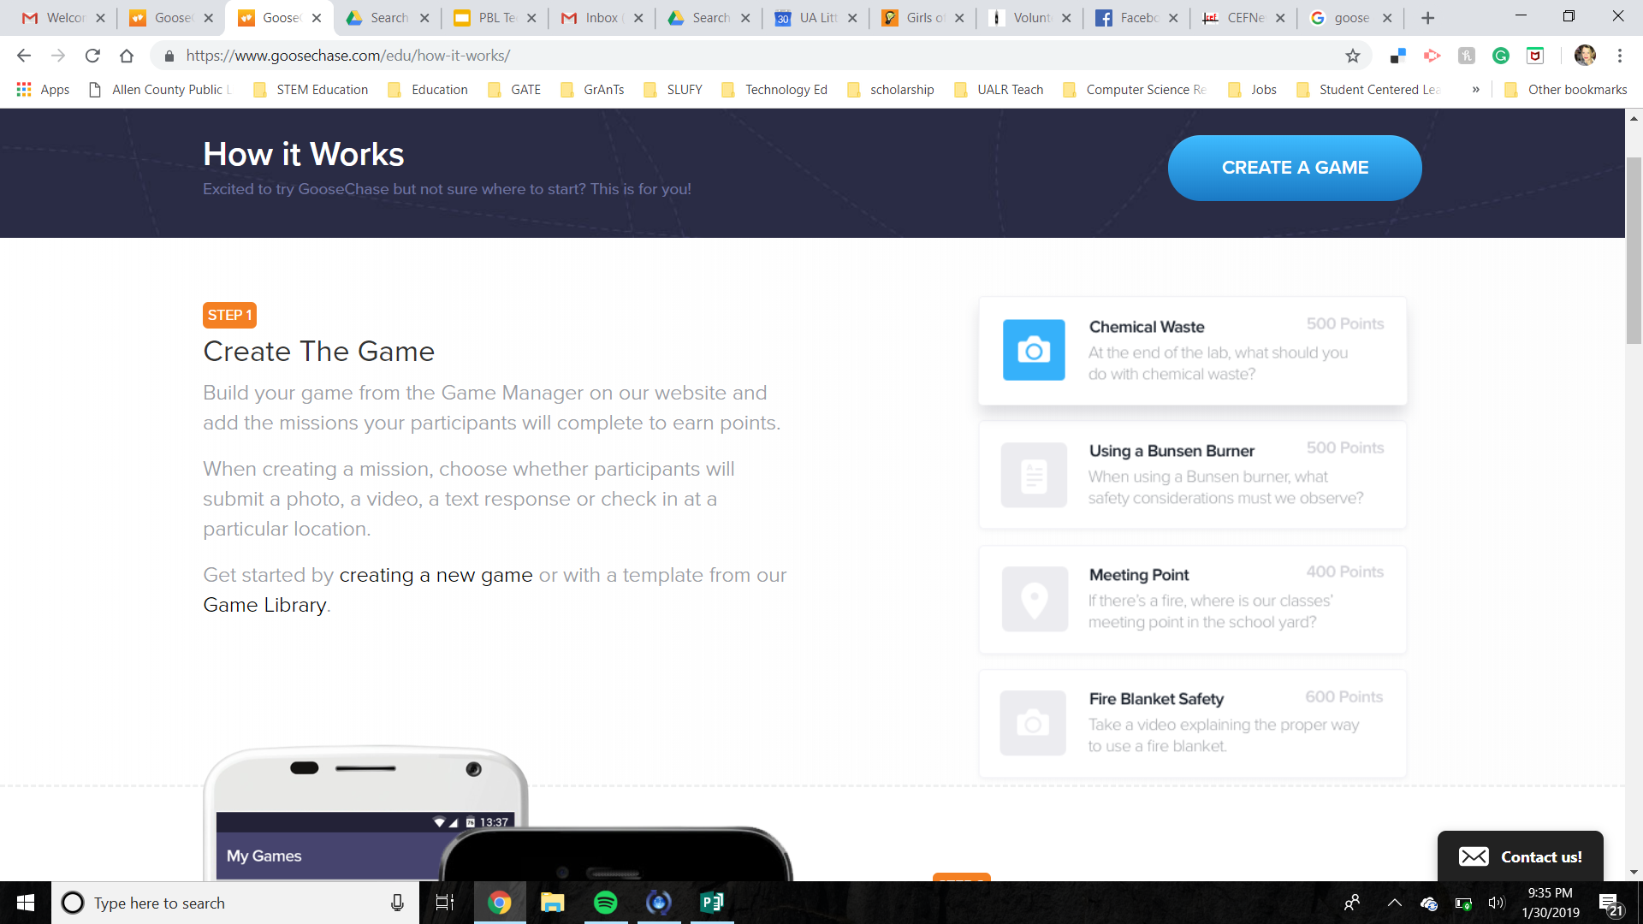
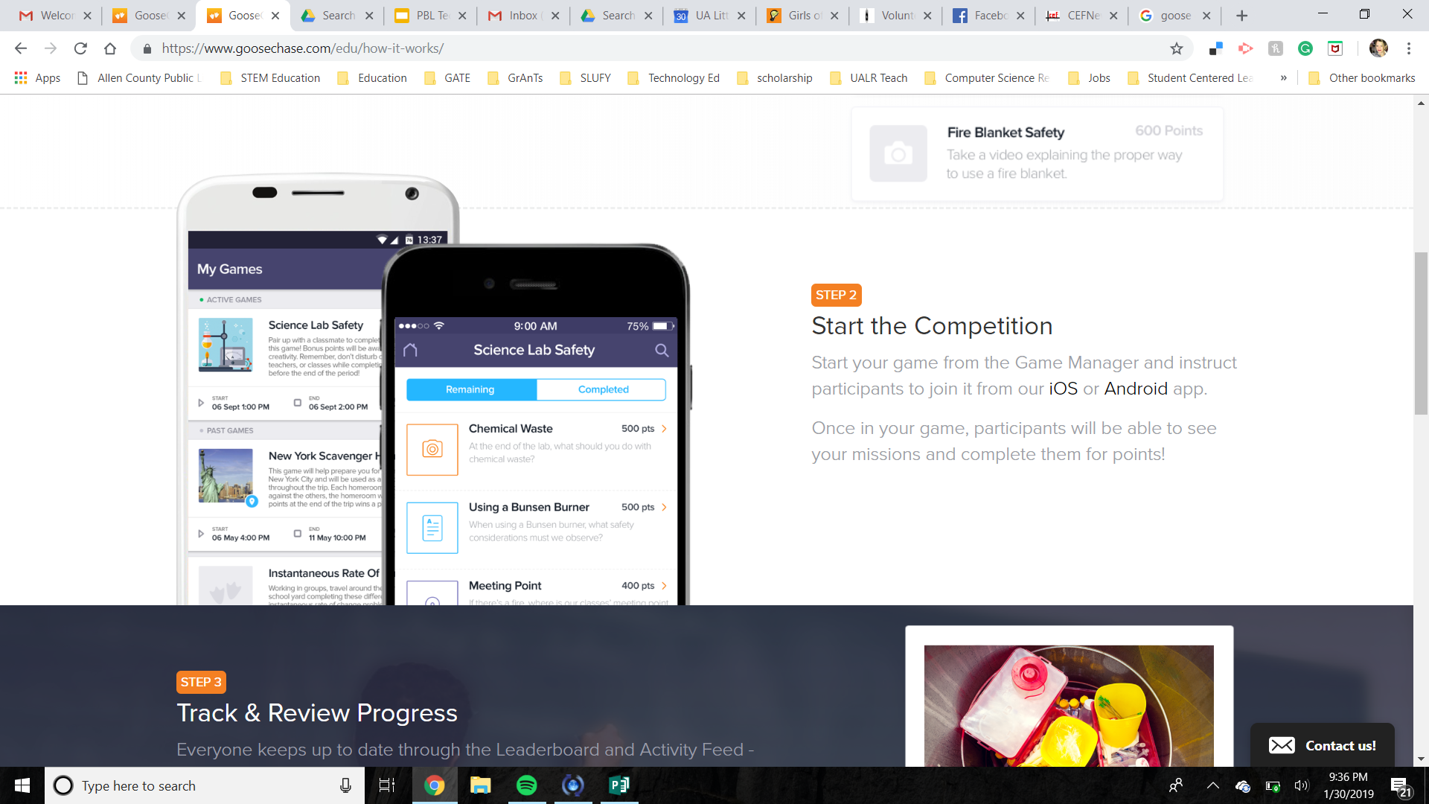
How it works …

Slide 4
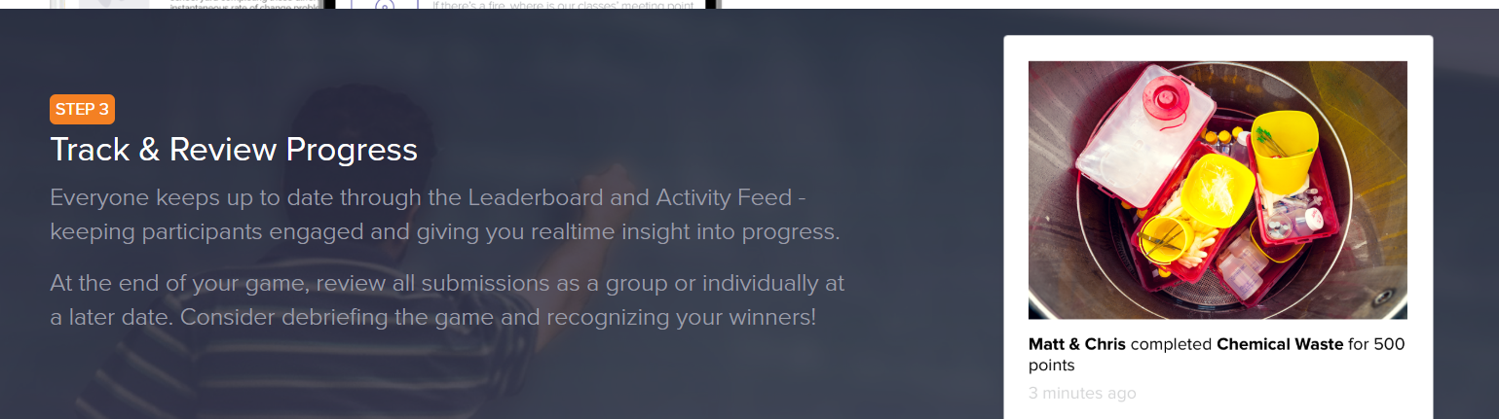

Slide 5
Possible Uses ….
Formative Assessment:
Project Checkpoint
Concept review
Mini lesson - introduce new concept
Virtual Field Trip

Slide 6
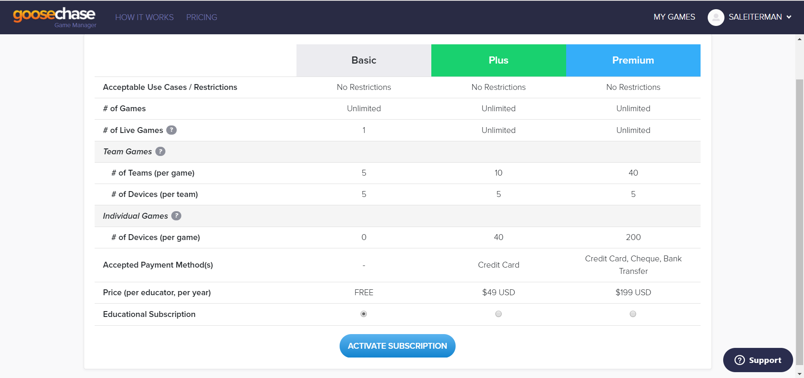

Slide 7
LET’S PLAY!

Slide 8
LET’S TRY IT!
We’re going on a GooseChase!
To participate in this workshop’s GooseChase hunt:
Form a team! (groups of 2 or 3 please)
Open the GooseChase app. (or download by searching “GooseChase” in the AppStore / PlayStore)
Create a GooseChase account.
Search for “Who are you? Who am I?”
Create/join your team. (only one person needs to create the team)\
Game Code: 21677K PW: PBL123
Start completing missions!

Slide 9
LET’S TRY IT!
Debrief
What missions did you find most difficult? Why?
Did your team work well together? How could you work more effectively?
What missions were most enjoyable? Why?
Are there any missions you’d like to go back and revisit? Why?
How would you/your team participate differently next time?

Slide 10
GOOSECHASE BEST PRACTICES
Collaborate with your team
How might you you use GooseChase?
Make a list of possibilities with examples
Notes:
Closed Responses → For specific things (textbook content, etc.)
Open Ended → Great for student information.

