Slide 1
Problem/Project-based Learning
“If you want to build a ship, don’t herd people together to collect wood and don’t assign them tasks and work, but rather teach them to long for the endless immensity of the sea.”
–Antoine-Marie-Roger de Saint- Exupery Author of The Little Prince

Slide 2
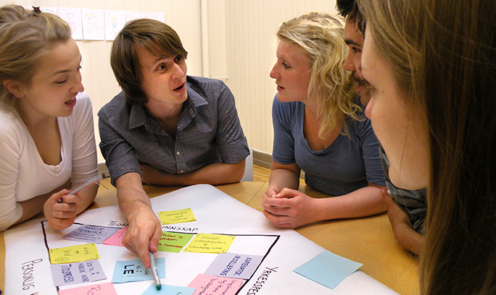
What is PBL?
Problem-based learning: Students develop a solution to a problem/issue
Project-based learning: Students develop a tangible artifact
  Project/problem-based instruction has become popular because of its impact on student learning
  It is focused on experimental learning organized around the investigation/resolution of messy, holistic, and real-world problems
  Creates a learning environment that facilitates deeper understanding

Slide 3
Through PBL, Students Learn:
Problem solving skills
Self-directed learning skills
To find and use appropriate resources
Critical thinking
Measurable knowledge
To perform under stress
Social and ethical skills
Self-sufficiency skills
Facility with computer
Leadership skills
Team membership skills
Communication skills
Proactive thinking
Workplace skills

Slide 4

The Impact of PBL on Learners?
Increased Motivation
PBI engages students in learning through the attraction/pull of engaging problem. Students make a personal investment in the outcome.
Increased Curriculum Relevance:
PBI offers students an obvious answer to their questions. Ex: “Why do we need to learn this information?” “What connection does school work have to the real world?”

Slide 5
The Impact of PBL on Learners?
Increased Exposure to Higher Order Thinking
The ill-structured problem scenario calls upon creative thinking by suspending the guessing game of: “What’s the answer that the teacher wants me to find?”
Increased Personal Responsibility for Learning
Students gather information and assess its validity, in bringing the problem to acceptable closure with evidence to support decisions.
"The illiterate of the 21st century will not be those who cannot read and write, but those who cannot learn, unlearn and relearn." Alvin Toffler

Slide 6

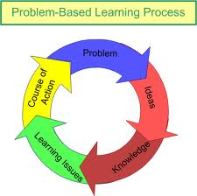
Why PBL?
PBL is a superior methodology for promoting student engagement in the learning process.

Slide 7
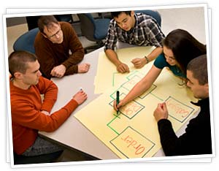
What Makes PBL Effective?
Educators present the problem or situation first, and it serves as the organizing center and context for learning.
The problematic situation has common characteristics:
  Ill-structured and messy
  Often changes with the addition of new info
  Not solved easily or with a specific formula
  It does not result in one right answer

Slide 8
What Does PBL Look Like in the Classroom?
Process | Purpose
Students read and address problem, without background preparation. | *Teaches students to encode and organize information in useful ways. *Allows students to find what they know and what they don't know. *Misconceptions can be corrected in discussion of the problem. *Mimics the real life context they will face as doctors.
Students discuss and analyze problem using prior knowledge and resources available. Teacher poses questions: i.e., Do you need more information? Are you sure of the facts or will a review be helpful? Do you think more information on this area would be helpful? | *Development of cognitive skills for problem-solving process *Development of self-monitoring skills to identify the learning needs *Development of habitual student-initiated questioning
Students decide what they need to know and where they might best find the information. They decide which resources to use (people, published papers, etc.). | *Self-directed study
Students revisit problem with new information and knowledge acquired during self-study. Students critique learning resources used. Group decides appropriate hypotheses and critiques prior performance. | *New organization of information to problem-solve. *Self-assessment *Peer-assessment
Students should think about how what they learned has added to their understanding | *Reflection *Self-assessment

Slide 9

Historical Background
PBL was first applied in medical schools, which was used to help test the knowledge of graduates.
Medical professionals need to keep up with new information in their field, and the skill of life-long learning is important- so PBL was well suited for this area.

Slide 10
Why Use PBL in Your Classroom?
Students retain little in traditional lecture form.
Students often do not appropriately use the knowledge learned.
Since students forget much content, instructors should create a mental warehouse that can be retrieved in future professional practice.
PBL creates 3 conditions that information theory links to retrieval: (1) Activation; (2) Similarity; and, (3) Opportunity to elaborate

Slide 11
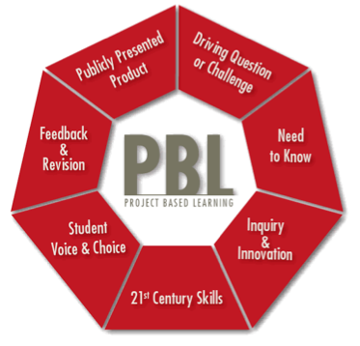
How does PBL Relate to Best Practices?

Slide 12
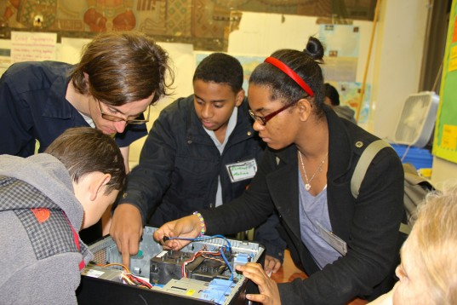
Practical Guide to PBL
Design authentic problems/tasks.
Design problem to reflect the complexity of the environment.
Anchor learning to larger task or problem.
Support learner ownership.
Design the learning environment to support and challenge learners' thinking.
Use performance-based testing methods.
Provide opportunity for support and reflection on both the content and learning process.

Slide 13
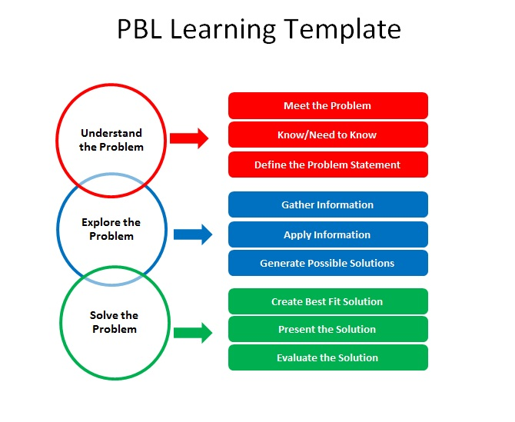

Slide 14
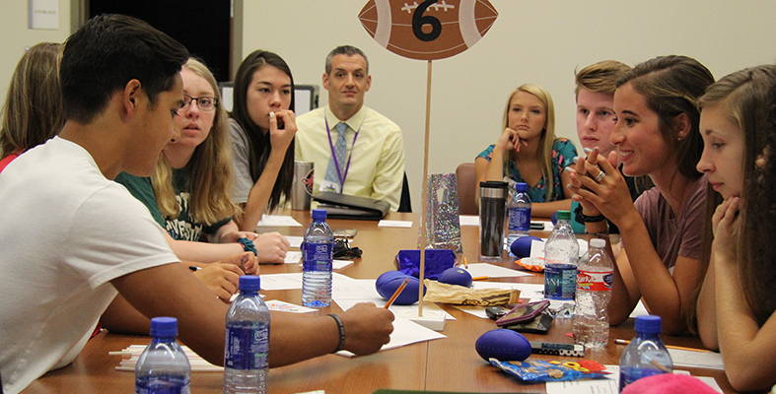
What Does the Student do in PBL?
The individual student has an active role in learning.
Students have responsibility for their own learning by identifying what they currently know and what they will need to learn.
Students progress through a series of logical steps when completing a PBI lesson.

Slide 15

Step 1
Define and clarify the problem by restating the problem in their own words and then determining what knowledge and skills they will need to solve the problem.

Slide 16

Step 2
Gather research that will help you solve the problem.
  This may include internet, discussions, library research, etc.

Slide 17
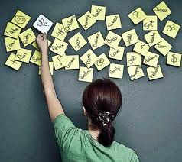
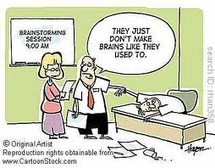
Steps 3 and 4
Brainstorm
Analyze
Try and produce as many different solutions as possible.
Make thumbnail sketches that crystalize thoughts.
Students will do this by gathered research, prior knowledge and common sense.
Analyze the solutions previously brainstormed, combine them, dissect them and move one idea forward as a potential solution.

Slide 18
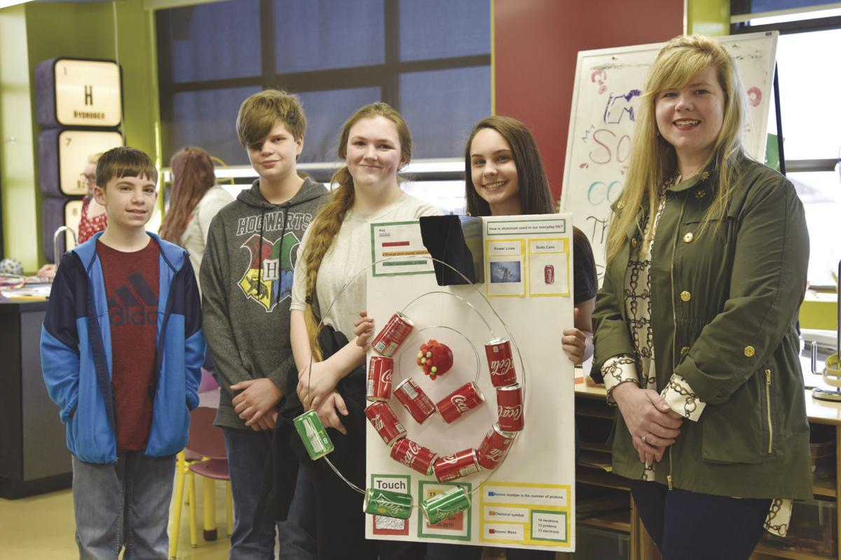
Steps 5 and 6
Construct and present the potential solution.

Slide 19

Last one… Step 7
Evaluate the degree to which the potential solution solved the given problem.

Slide 20
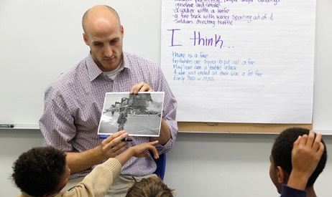
Role of the Instructor
Planning the problems, sequencing projects, and proving feedback.
Relinquish the role of dispenser of information
Acting as metacognitive coaches, servings as models, thinking aloud with students.
Good technique: Answering questions with additional questions.

Slide 21



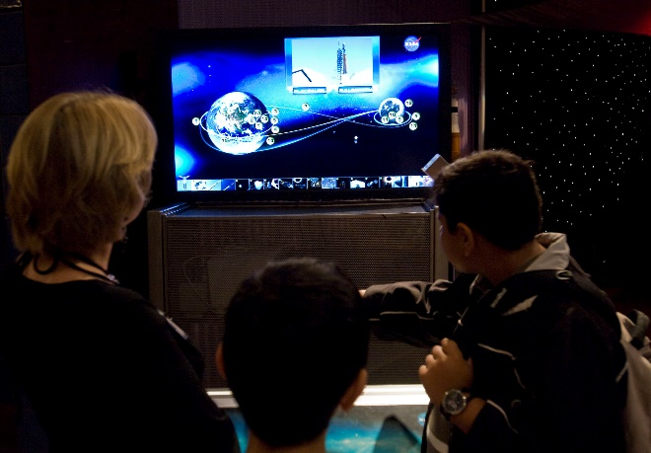
Where do the Problems Come from?
The teacher creates the plan and gathers ideas for scenarios from almost anywhere.
  Literature
  T.V.
  News programing
  Newspaper articles
  Altering traditional lessons to problem based

Slide 22
Dig deeper @
https://www.pblworks.org/

