Slide 1
World Learning
Submit a Grant Proposal to Extend this Experience to your Home Country

Slide 2
Fulbright World Learning Grant Program
After working with a Fulbright Scholar during 2017, I worked with an educator from the Republic of Moldova to submit a grant proposal.
The grant was funded.
The grant provided the funds that allowed me to travel to Moldova and present to various educator groups
  I met with and presented to educational leaders, political leaders, professors, teachers, university students, elementary students, secondary students, teacher organizations, ministry of education leaders, and others.

Slide 3
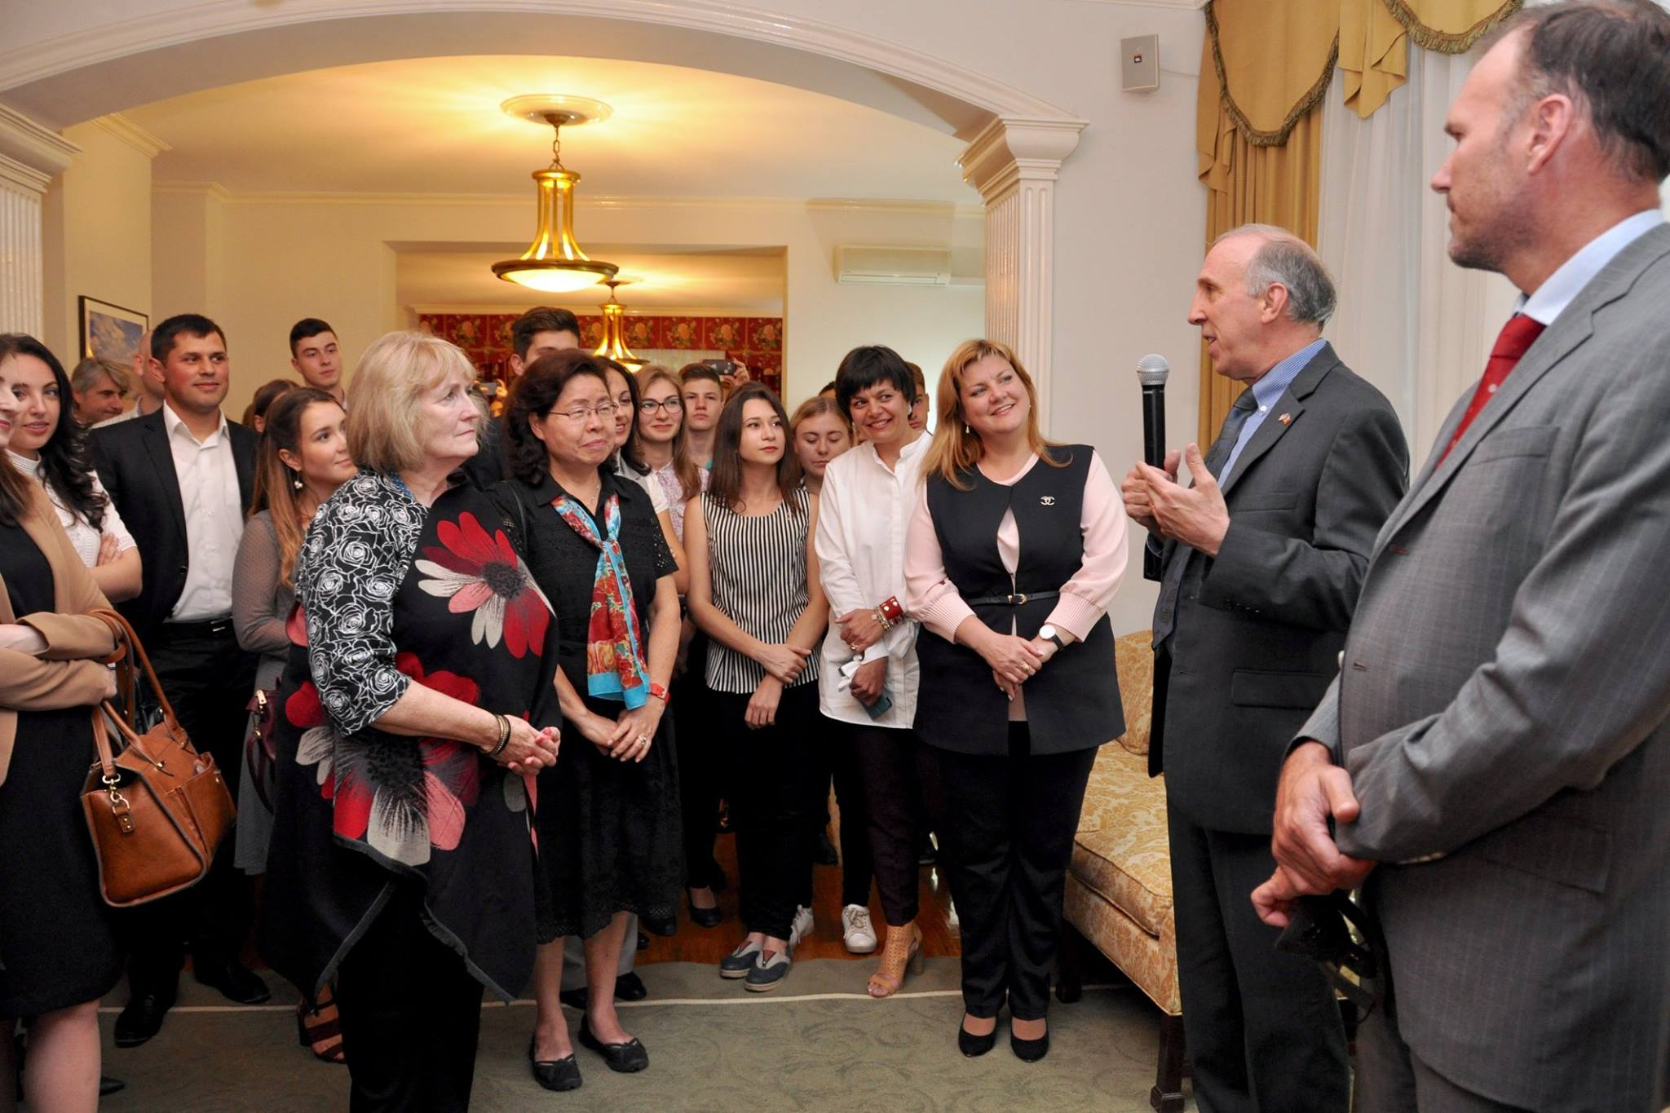
Met the U.S. Ambassador & Staff

Slide 4
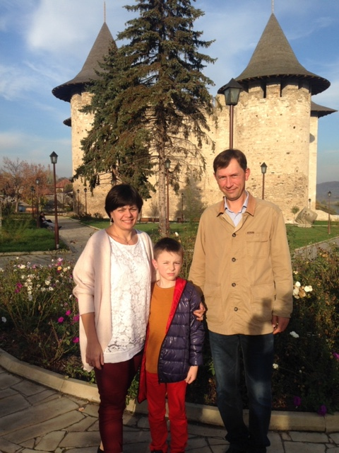
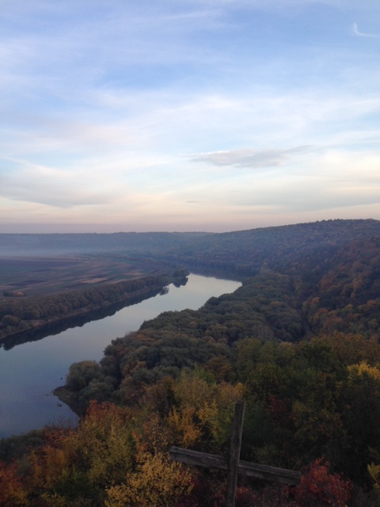
My Hosts:
Victoria and Sergei
Soroca, Moldova

Slide 5
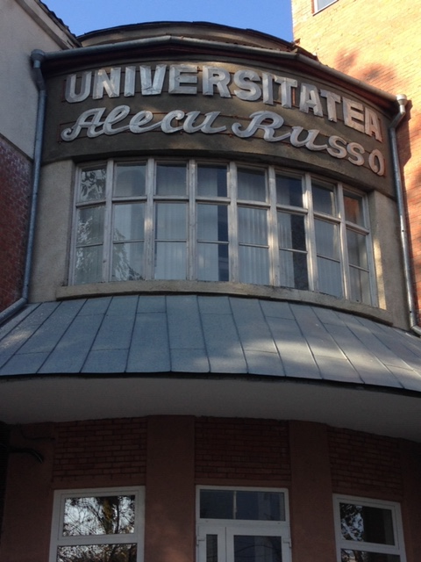
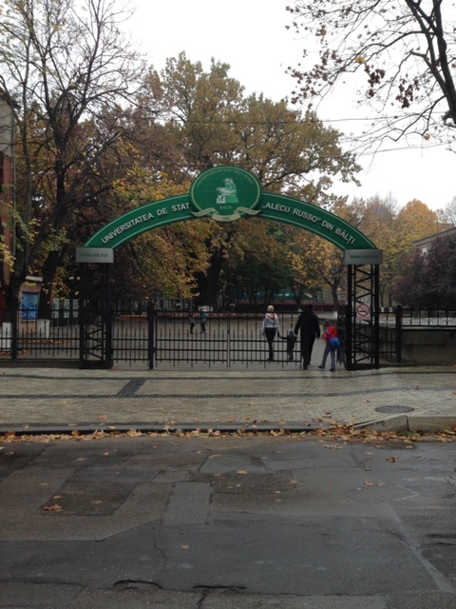
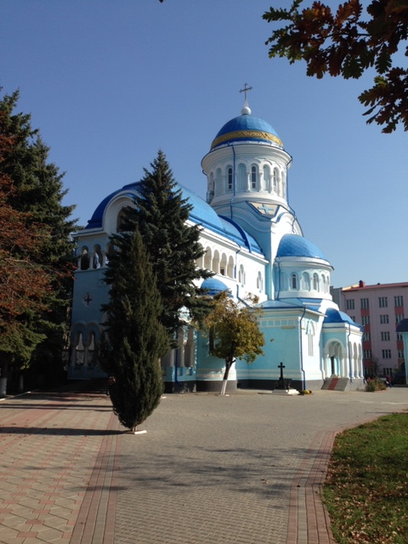
Alecu Russo State University, Balti, Moldova

Slide 6
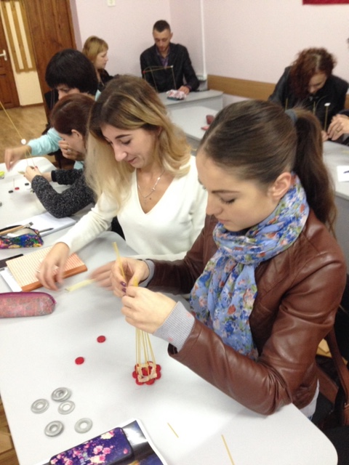
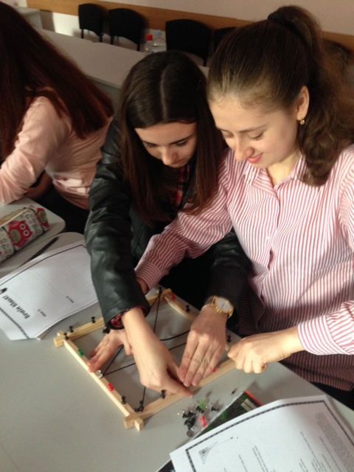
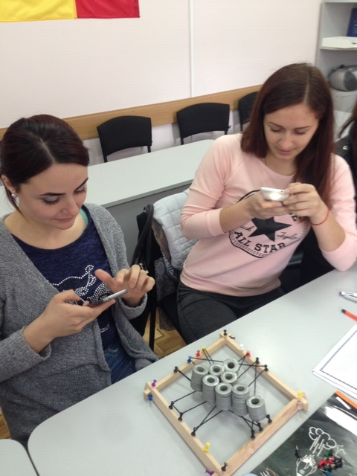
Pre-service Teachers Alecu Russo State University

Slide 7
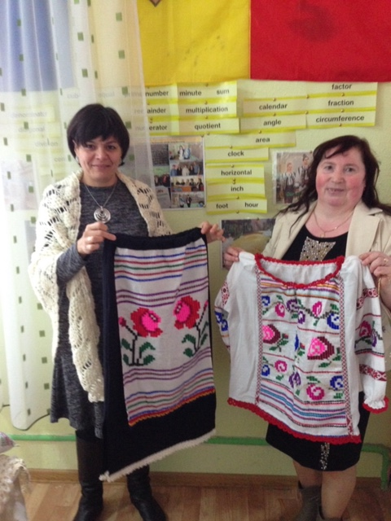
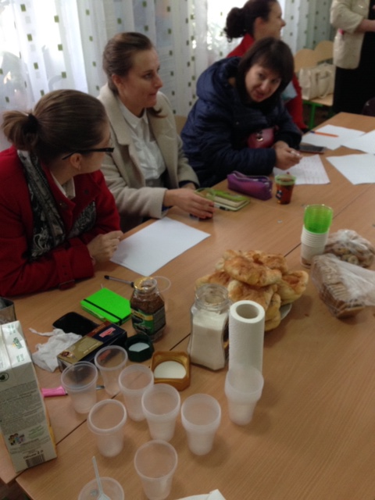
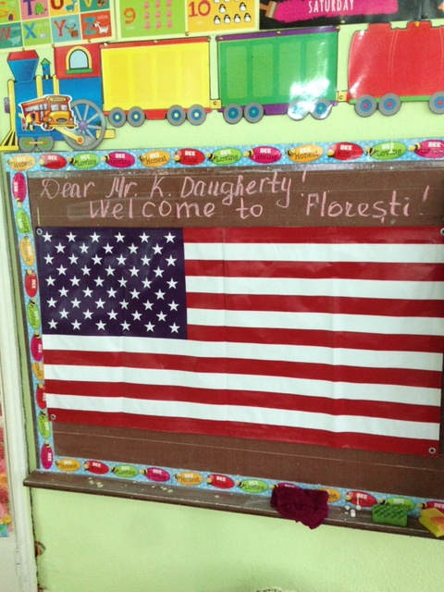
Teacher Professional Development, Floresti, Moldova

Slide 8
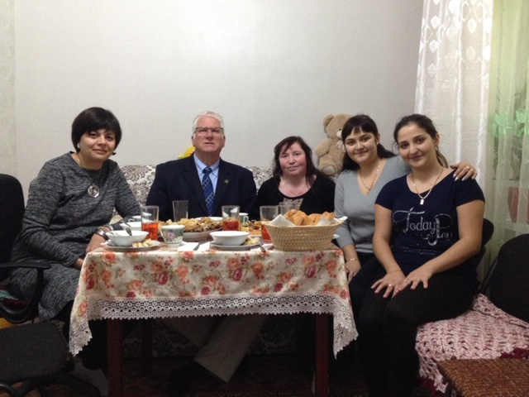
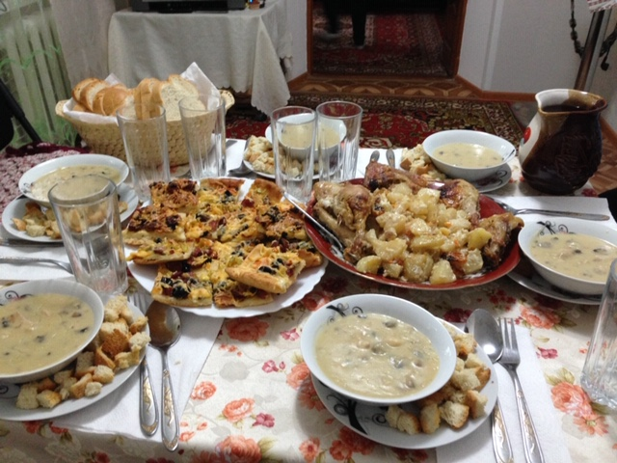
Home Stay Meal

Slide 9
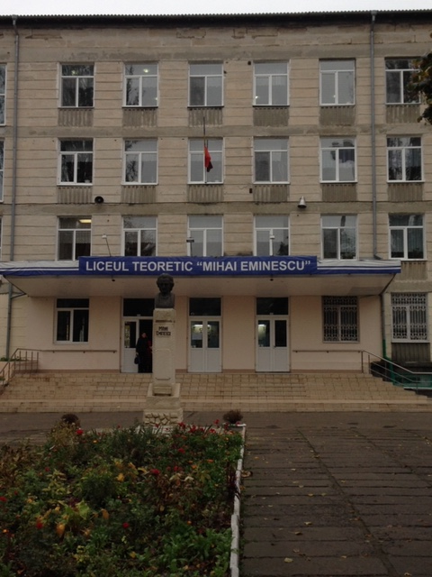
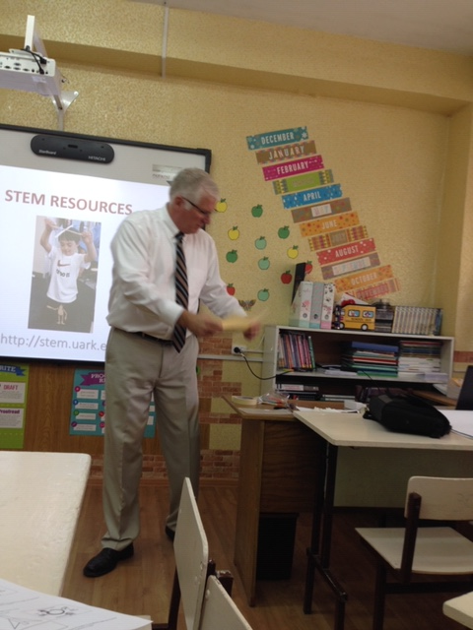
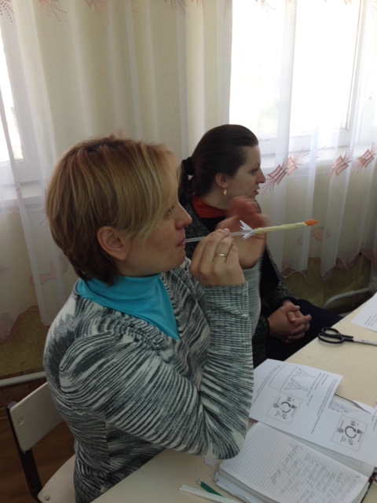
Secondary School Teacher In-service

Slide 10
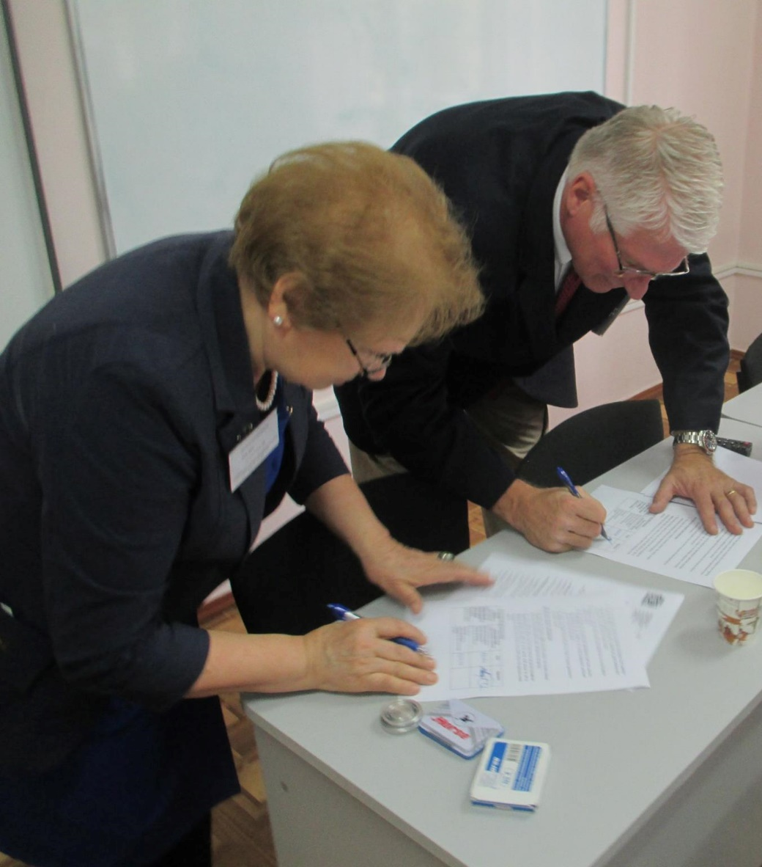
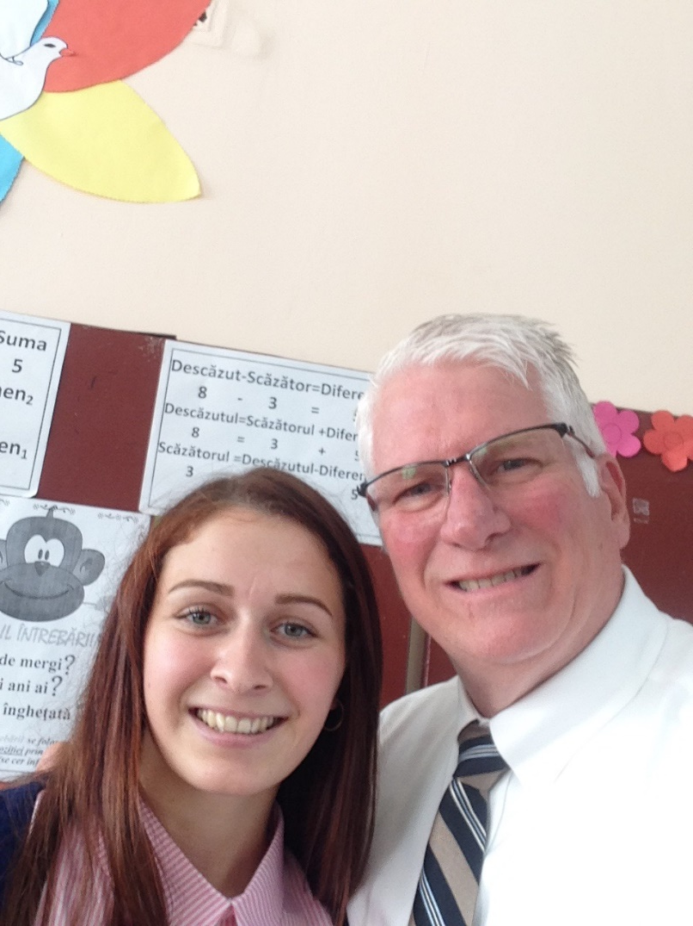
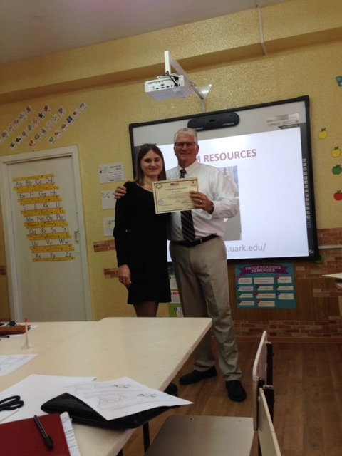
Presented Many Certificates

Slide 11
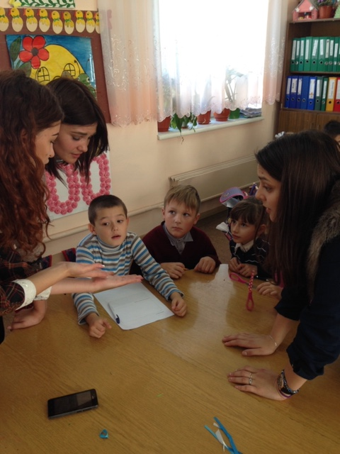
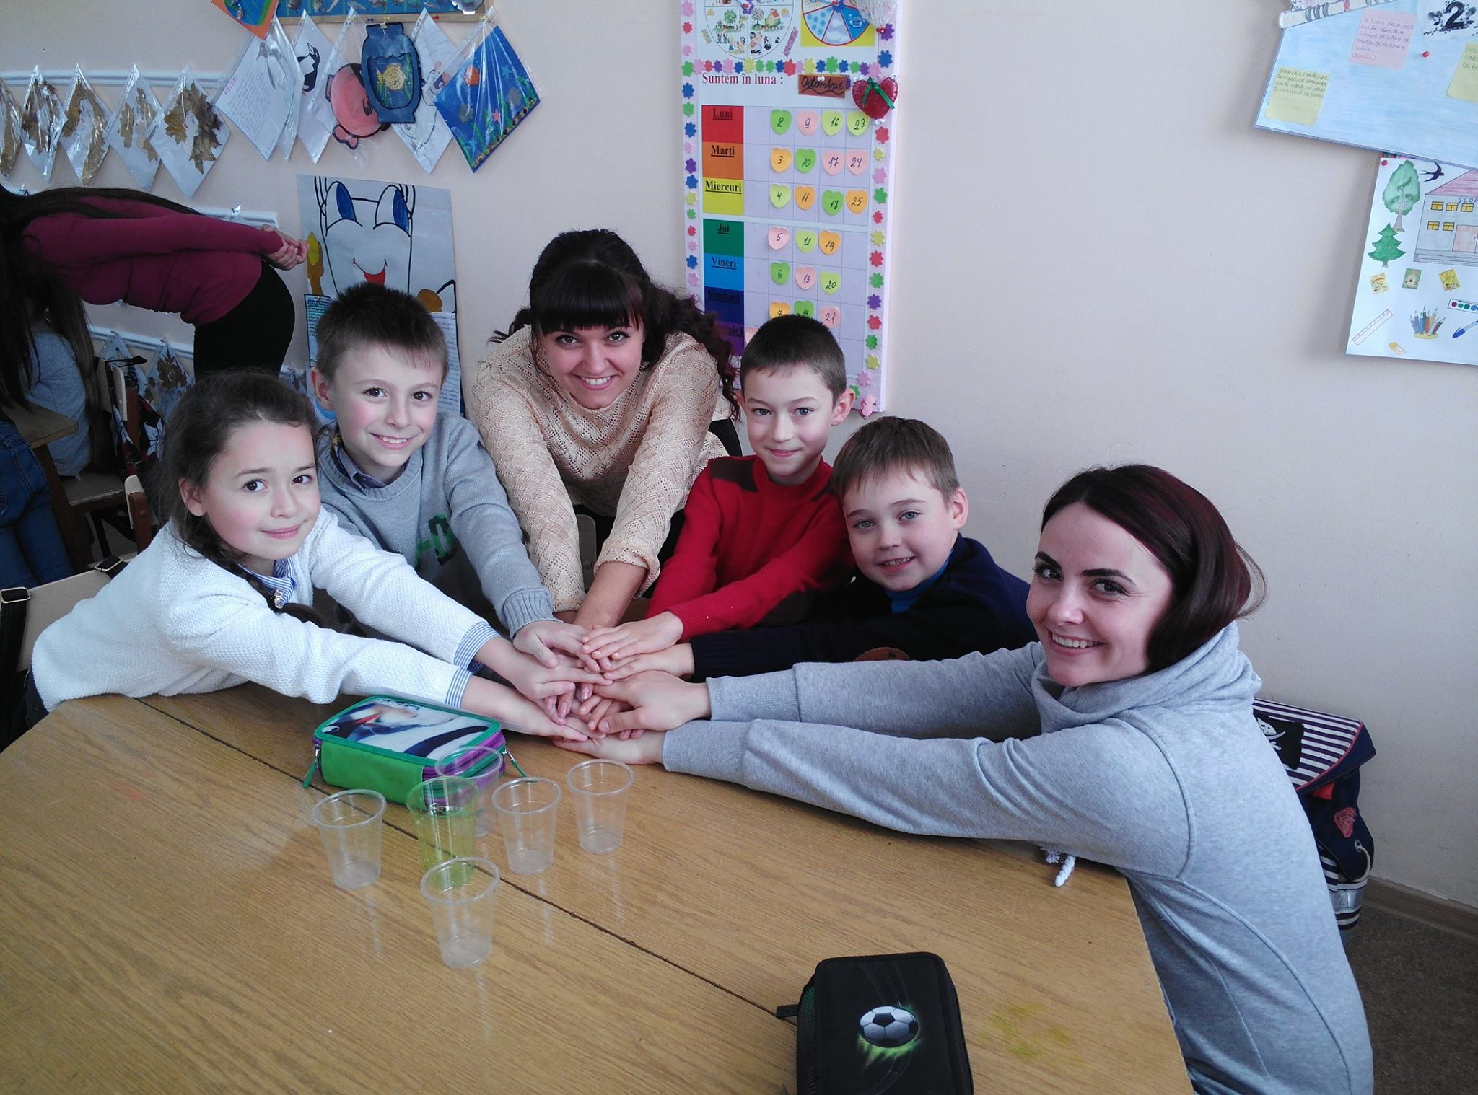
Primary School Activity

Slide 12

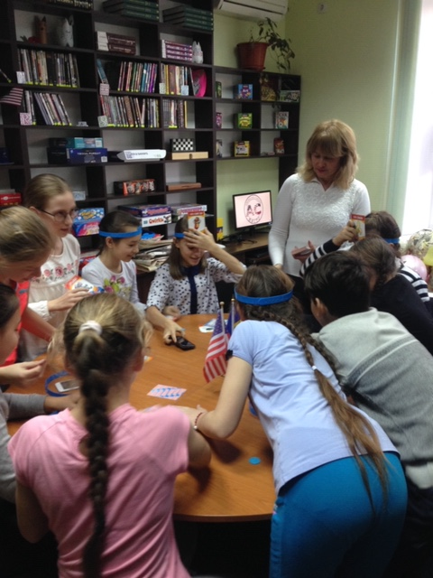
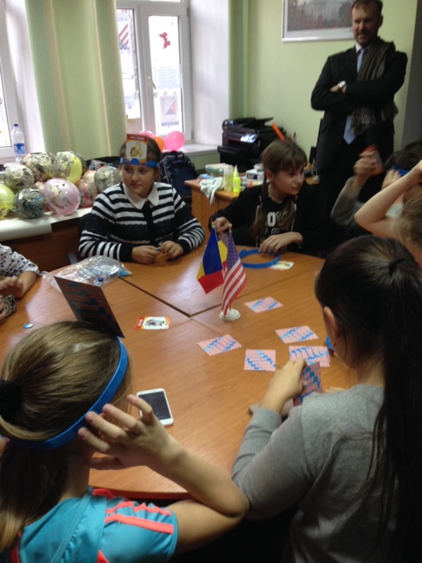
After School Activity, U.S. Embassy

Slide 13
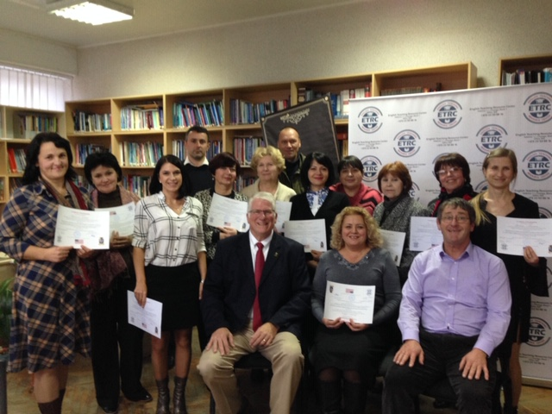
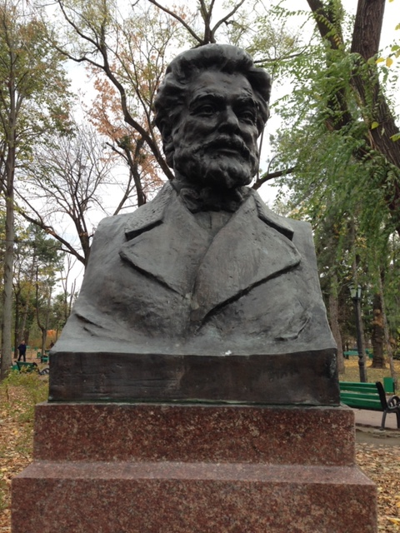
Ion Creanga State University, Chisinau, Moldova

Slide 14
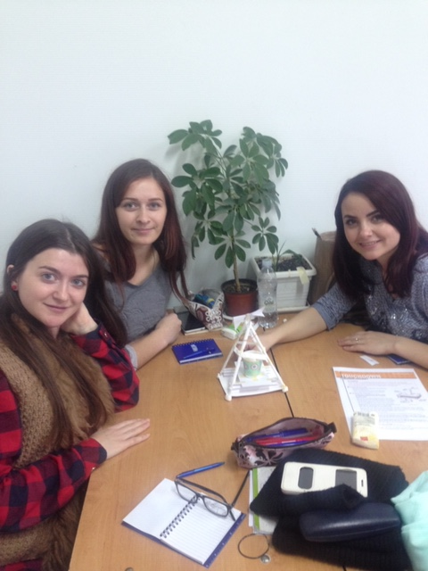
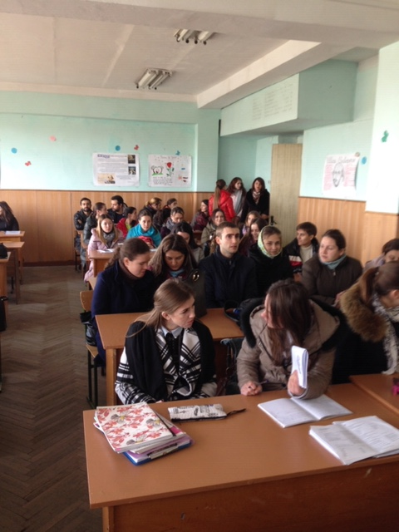
Pre-service Teachers, Ion Creanga

Slide 15
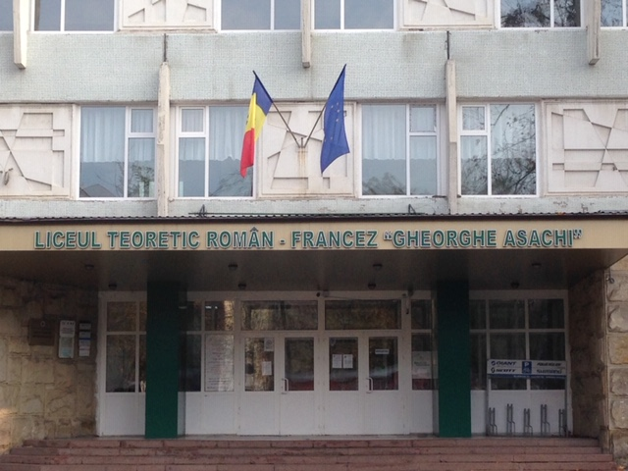
Secondary Teacher Professional Development

Slide 16
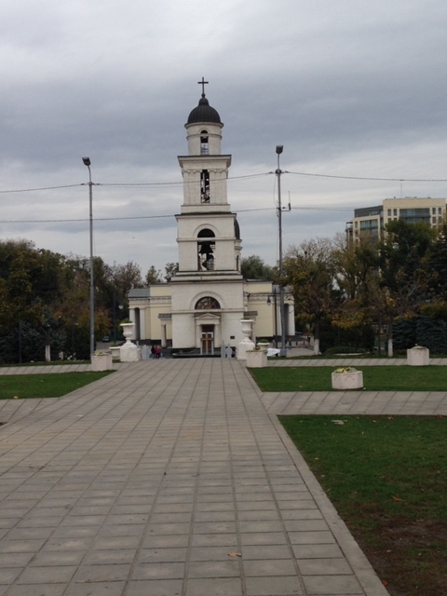
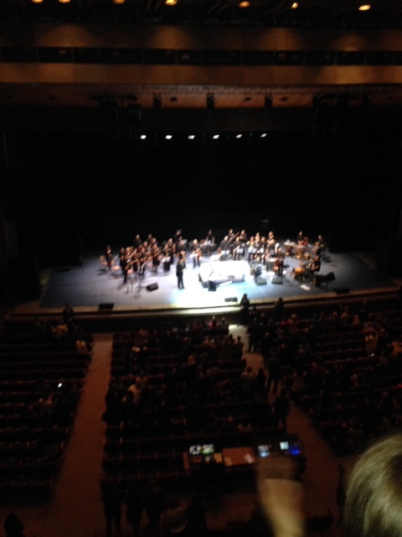
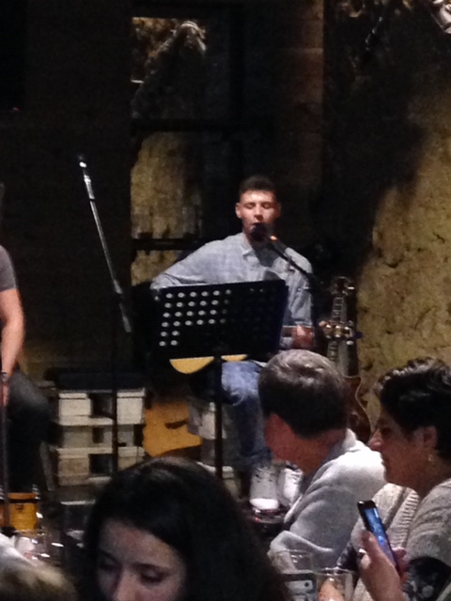
Cultural Visits, Chisinau

Slide 17
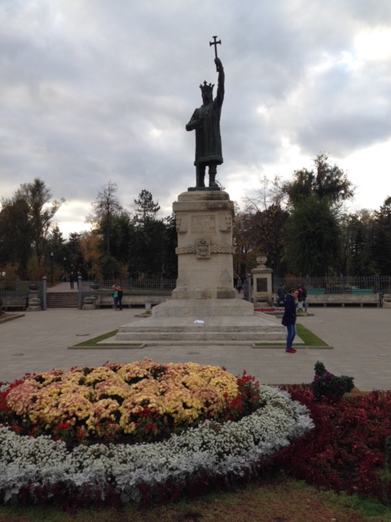

Cultural Visits, Chisinau

Slide 18
Consider Writing A Grant
Several grant options available from the Department of State, Fulbright, and others
Most are simple proposals
All require you to partner with a U.S. colleague
All will require you to develop a plan, goals, events
You will receive more information during your exit conference next week
Grants cover the costs (housing, food, transportation) for bringing a guest speaker(s) to your country, your school, your city, your region.
Speaking engagements, professional development for teachers, professional development for students, meeting with ministries of education
Most are developed in collaboration with the U.S. Embassy in your country

Slide 19
What PD Activities Can you Envision?
Teacher professional development
Students presentations
Pre-service teacher professional development
Meetings and/or presentations with educational leaders
Meetings and/or presentations with political leaders
Meetings and/or presentations with after-school student groups
Speeches at professional teacher/educator conferences
Establishment of MOU’s
Other

Slide 20
What Cultural Activities Can you Envision?
How can you introduce a visitor to your country?
What sites should they see?
Who should they meet?
What would you want the visitor to know about your country?
How could you develop meetings/events that would assist your educational goals?
How can you help a visitor understand your culture?

Slide 21
Logistics
What would be the best time of the year for the visit?
Are there annual events that would impact the visit?
Where would they stay (housing)?
How would they be transported from location to location within your country (private car, taxi, bus)?
Where would they be located (cities, regions, towns)?
Would they visit other schools? Universities? Regions?
How would you balance instructional time and cultural time?
Who could help you put together a worthy schedule?

