Slide 1
The Quick Challenge

Slide 2
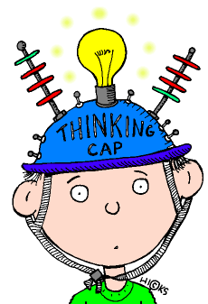
The Quick Challenge is …
Designed to engage the students’ attention at the beginning of class and draw them into the lesson.
Sometimes called the “anticipatory set,” the “hook activity,” or the “bell ringer”, it pulls student into the lesson.

Slide 3

Characteristics of the Quick Challenge
  Similar to a hook activity
  Differs from the anticipatory set or bell ringer in that it is activity-based
  Short: 10-15 minutes maximum
  Directly tied to the daily content/standards
  Usually not graded
  Usually, first exposure to the concept

Slide 4

Launched at the Beginning of Class
Directs student attention to the learning tasks at hand.
It exposes the students to concepts they are about to learn.
It is NOT about rote drill and kill.

Slide 5
Quickly Engages Students in the Topic
Expands upon student life experiences & background knowledge.
Puts students in a receptive mode.
Draws out major concepts to be learned
Introduces concepts to be learned
Engages students early
Provides purpose

Slide 6

Thus, the Quick Challenge Should …
create an organizing framework for the ideas, curiosities, principles, or information that is to follow.

Slide 7
The Quick Challenge is also used anytime a different activity or new concept is being introduced.

Slide 8

Successful, Quick Challenges should:
Help the student get mentally or physically ready for the lesson.

Slide 9

The Quick Challenge should include:
Motivation for learning
Transfer of learning
Glimpse of new content
Purpose for learning
The learning itself

Slide 10

How will you challenge your students and prepare them to learn?
Here are some Quick Challenge examples -

Slide 11
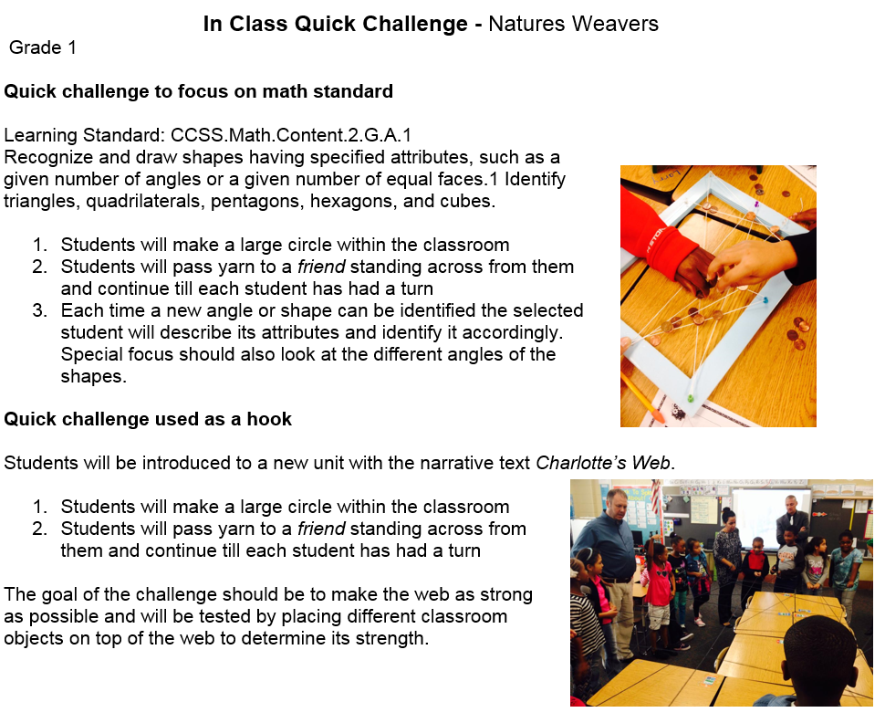

Slide 12
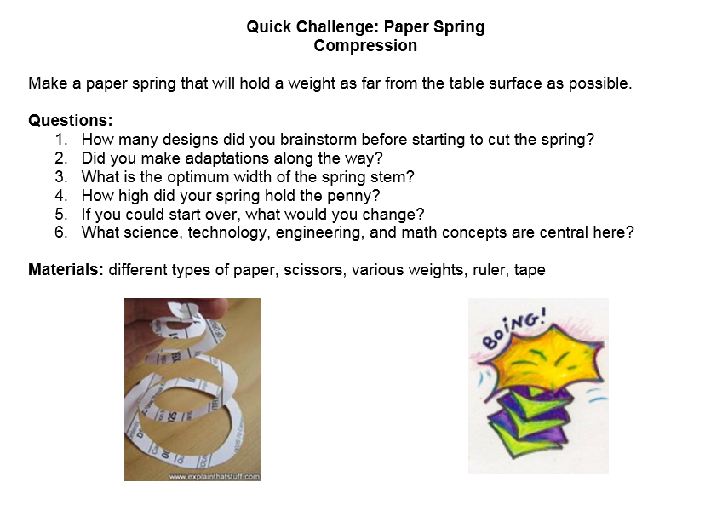

Slide 13
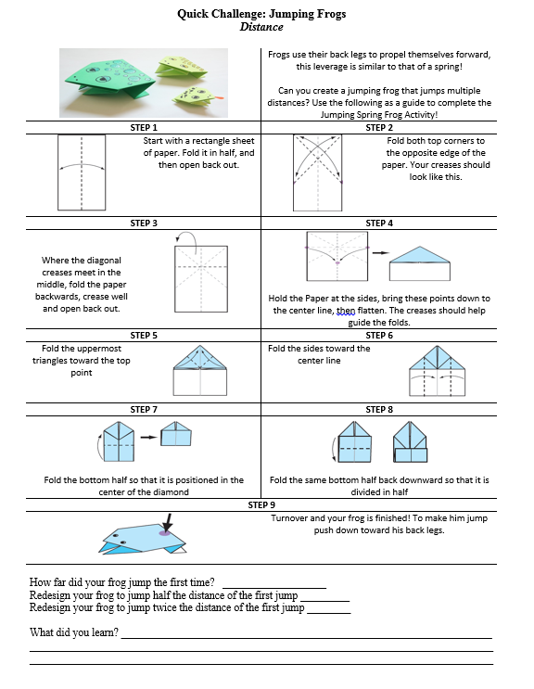
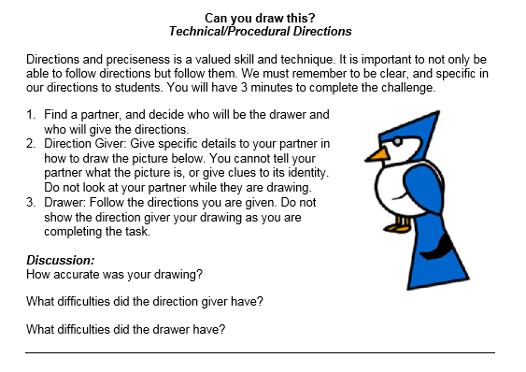

Slide 14
