Slide 1
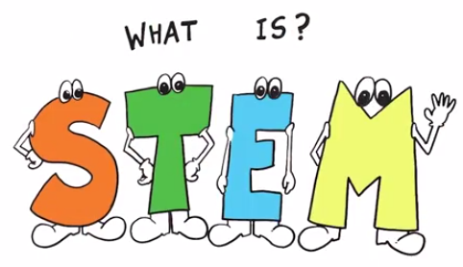
STEM 4033
Introduction to Education

Slide 2

AGENDA
Welcome
What do you know about STEM?
Introductions & Building Relationships through Team-Building Activities
Course Information (Syllabus, Calendar, Weekly Expectations)
Discussion… Intro to STEM Education- The What and the Why!

Slide 3
STEM = Science, Technology, Engineering & Mathematics
Science – Discover and Describe
A search to gain a better understanding of life (What is…?)
The study of the natural world
Technology – Invent and Innovate
How to improve the natural world
Any product made by humans to meet a want or need
Engineering – Control, Modify, and Design
Use of materials, processes, and systems (What could be?)
The design process that kids use to solve problems
Mathematics –Symbolic Language to Represent Reality
Make sense of the world with numbers
The language of numbers, shapes & quantities that seems to irrelevant to many students

Slide 4

4 Pillars of STEM
STEM removes the traditional barriers erected between the four disciplines of Science, Technology, Engineering & Mathematics by integrating them into one cohesive curriculum.
Pillar One: Create a STEM Culture
Pillar Two: Empower STEM Teachers
Pillar Three: Integrate Business & Education
Pillar Four: Ensure High Quality Stem Experiences

Slide 5
The Problem Facing STEM Education
Just as the nation’s economic engines and national security measures have come to rest squarely on the shoulders of science, technology, engineering, and mathematics (STEM), American students are recoiling from these disciplines in record numbers. Only 16% of American high school seniors are proficient and interested in a STEM career. The United States is trailing behind other industrialized nations in math (25%) and science (17%).

Slide 6
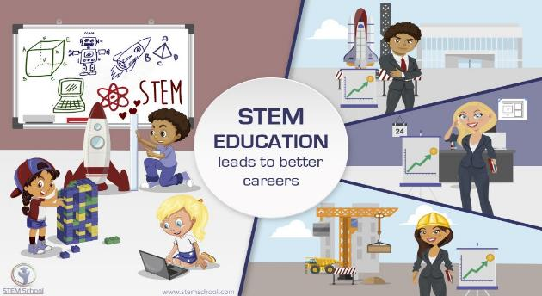
STEM Career Paths
According to the U.S. Department of Education, all STEM jobs in the U.S. will increase 14 percent between now and 2020, which will result in millions of jobs. Yet, data shows that 3 million of those jobs will go unfilled!

Slide 7
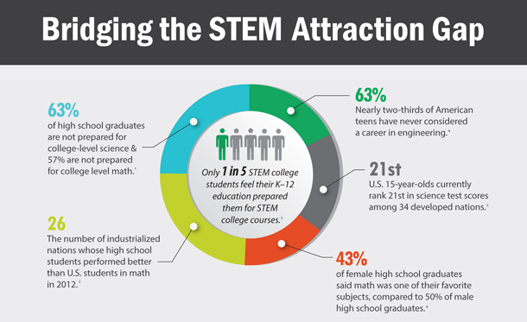

Slide 8
Rising to the Challenge
The problems we face in the 21st century are complex. We need a generation of diverse problem solvers that are able to tackle the big challenges and to invent the solutions, products and even sectors that will define this century. This will remain just an aspiration unless today’s students are inspired and guided by an equally powerful group of science, technology, engineering and math (STEM) teachers.

Slide 9

Current State OF STEM Education in Today’s Schools
Many students not receiving an adequate STEM experiences that are interdisciplinary.
STEM specialization is often the focus for charter and magnet high schools.
STEM content areas are often not taught everyday in many schools
29% of K-5 teachers report teaching science two or fewer days per week

Slide 10

STEM Education Needs to be the Focus in Today’s Schools…
PK-12 Education is not focusing on solving real world problems. The emphasis is on solving problems correctly—not creatively!
20 year process of minimizing creativity
Tests, grades, college admission, degrees, etc. are emphasized
Teachers are rewarding skills that are not helping our students become problem solvers.
Logical thinkers
Factual competence
Math and science skill
Experiences that require collaboration, critical thinking, problem solving, innovation, creativity and engagement are KEY aspects of STEM Education!

Slide 11

A Need for Growing a Strong STEM Workforce: Developing Tomorrow’s Leaders & Problem Solvers Sixty percent of U.S. employers are having difficulties finding qualified workers to fill vacancies at their companies.

Slide 12
Skills that Prepare for Life
STEM prepares students for life, regardless of the profession they choose. STEM teaches students how to think critically and how to solve problems — skills that can be used throughout life.

Slide 13

The Critical Aspect of STEM
Improved STEM programs can create individuals capable of new solutions and better decisions.
Increased science and math capability is not enough
Experiences centered on design, innovation, engineering, and technology increase creativity, inventiveness, ingenuity, and imagination capabilities
These characteristics are fostered in STEM- centered learning experiences.
The STEM Challenge

Slide 14
What We Need in Schools
Interdisciplinary experiences in STEM content areas
More engagement/ less lecture and skill/drill
More ill-structured problem solving
More strategies that cause students to seek STEM-based content answers
More underrepresented populations engaging in STEM
More collaborative learning experiences

Slide 15
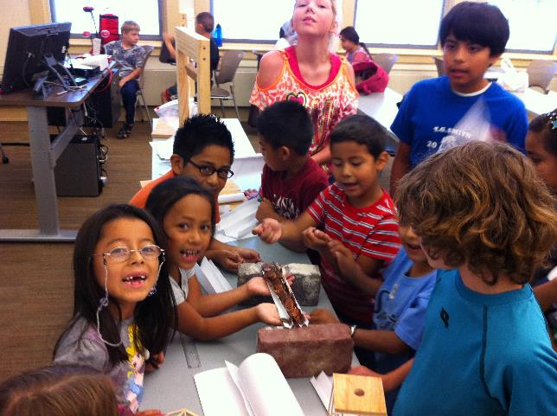
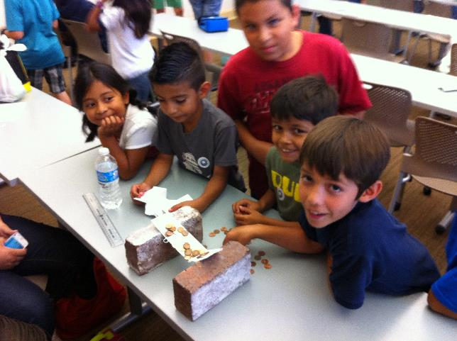
STEM doesn’t have to be expensive!

Slide 16
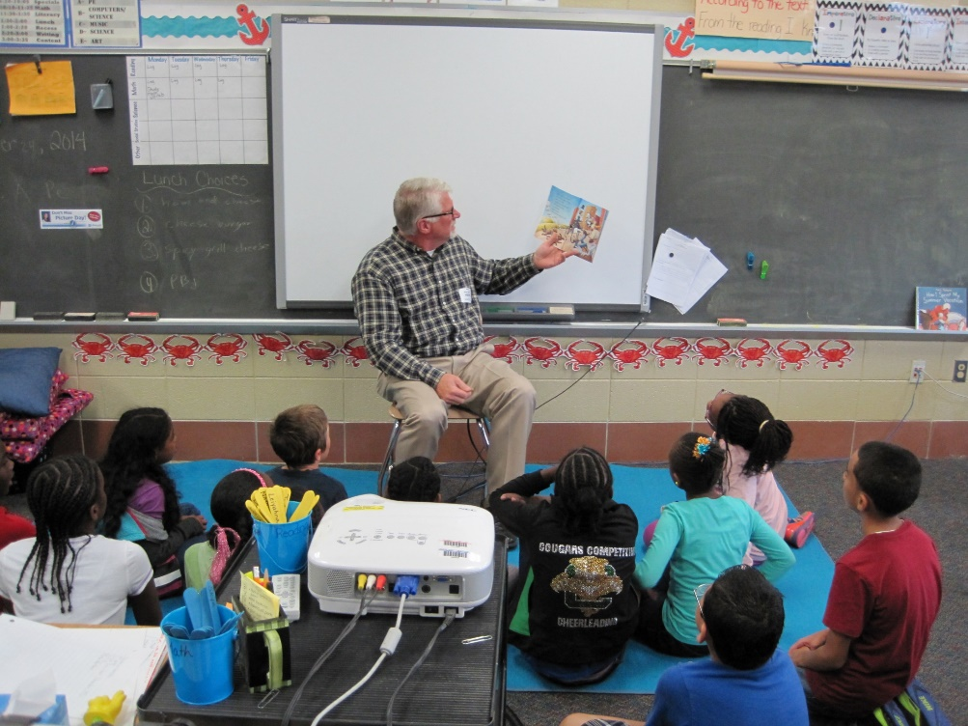
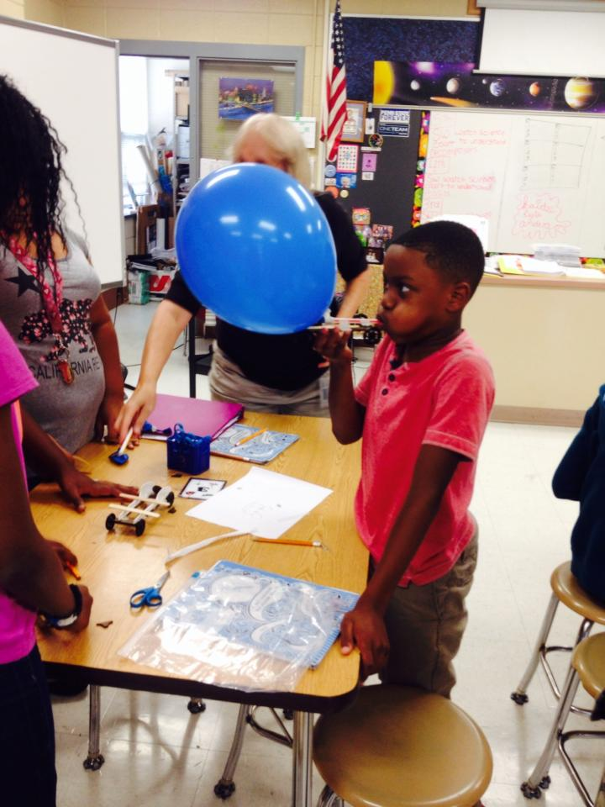
Integrating Literature with STEM

Slide 17
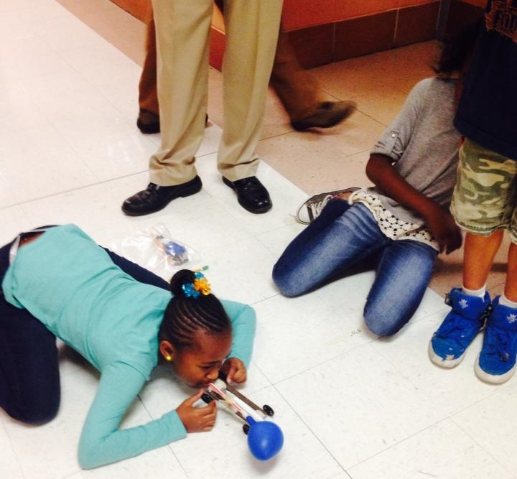
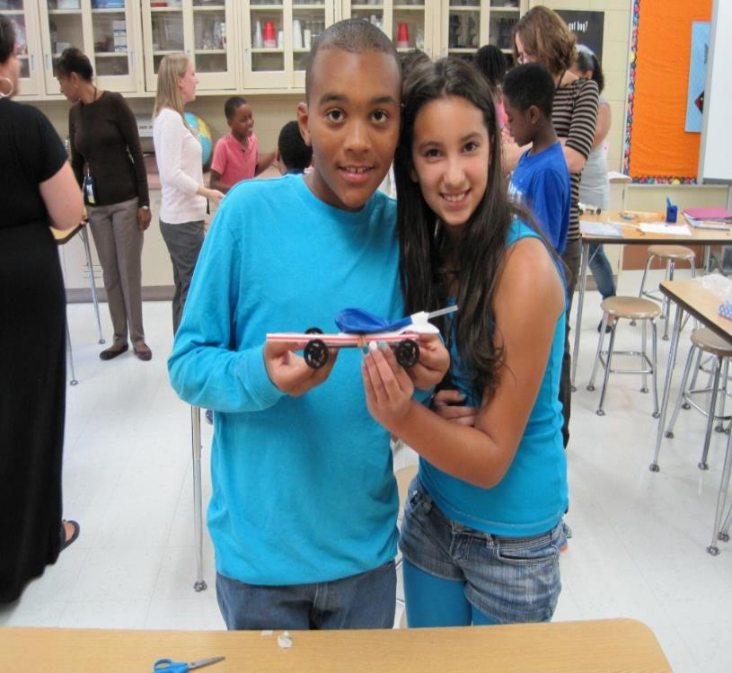
Implementing STEM Design Challenges

Slide 18
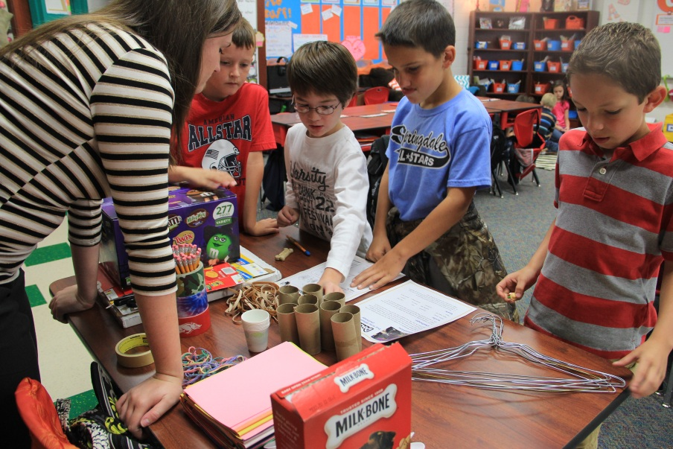
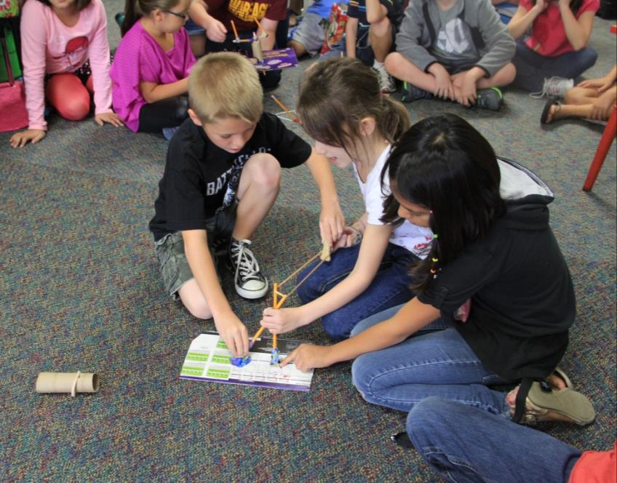
Project Based Learning & STEM in Action

Slide 19
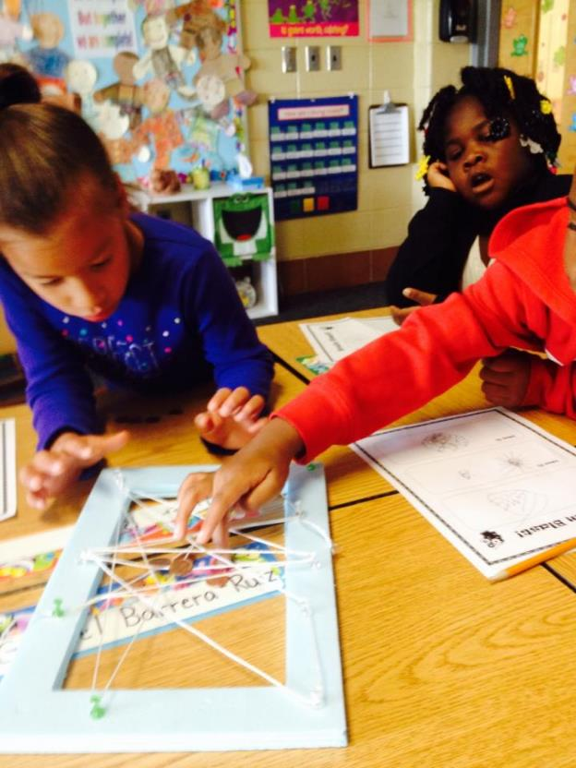
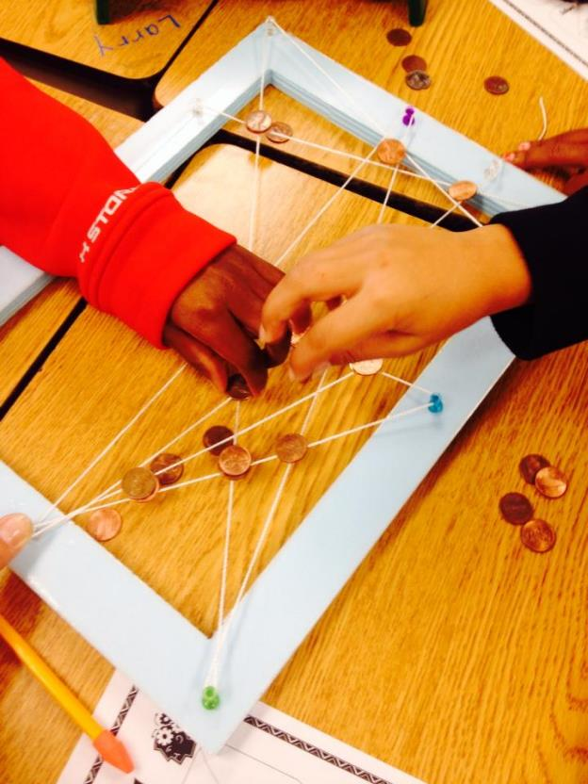
Collaboration
Engagement

Slide 20
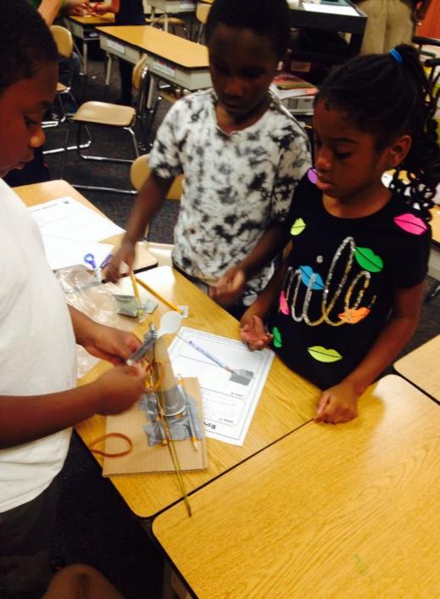
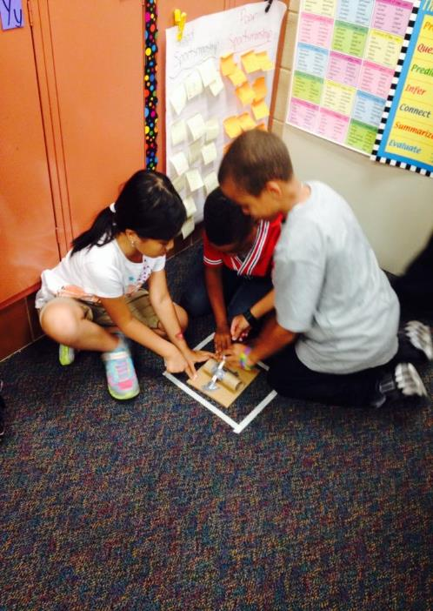
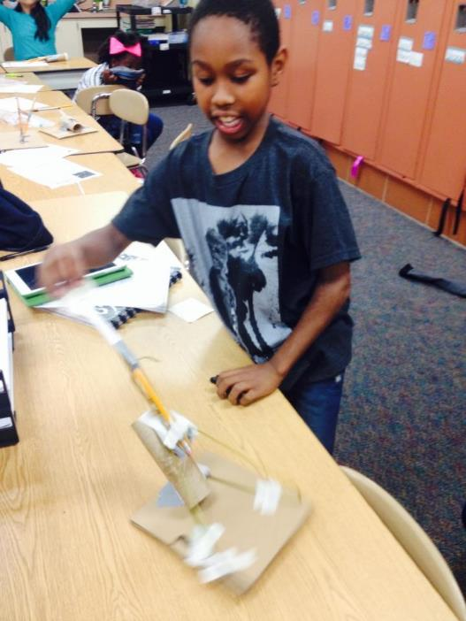
Creativity, Imagination and Invention

Slide 21

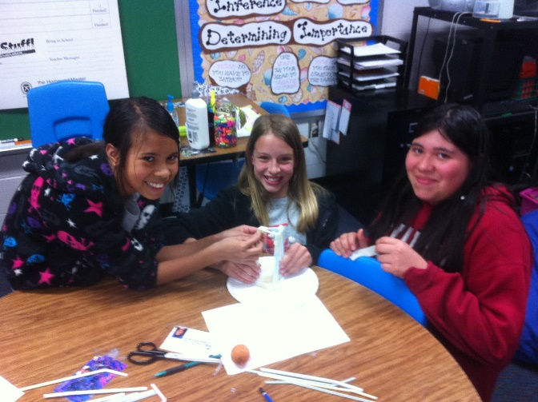
Innovation and Communication

Slide 22
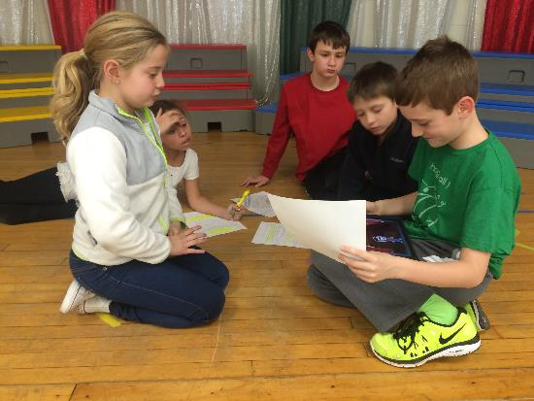
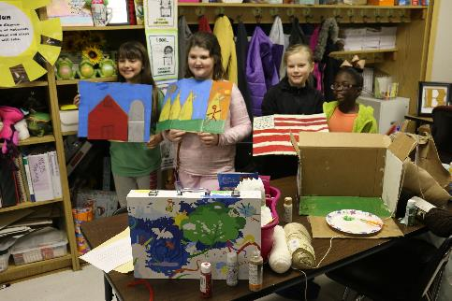
Leadership & Responsibility
Problem Solving & Critical Thinking

Slide 23
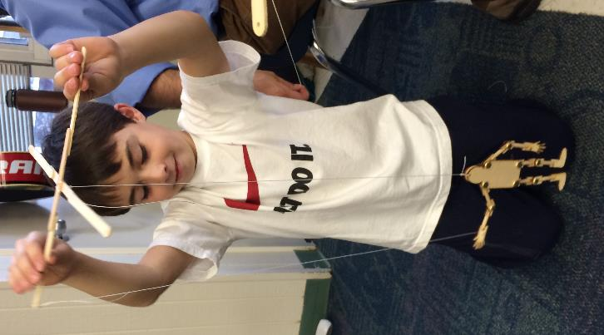
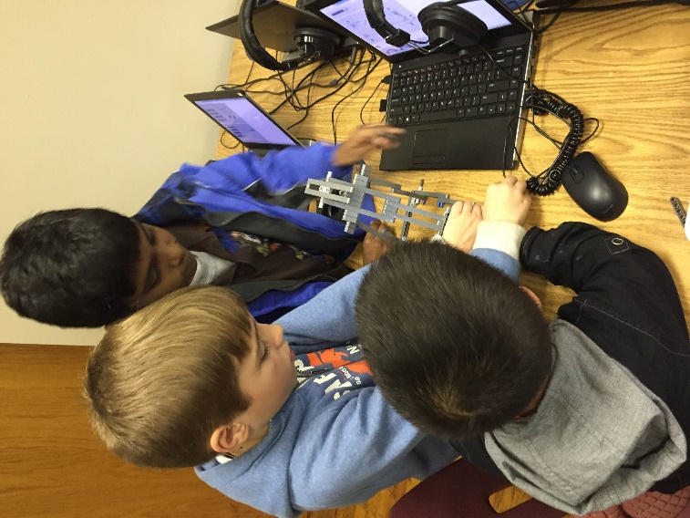
Developing &Testing STEM Inventions

Slide 24
A Tall Order
Preparing the next-generation to succeed in life is a tall order. And, we will substantially fail if we don’t teach children how to think critically and solve ill-structured problems.
"We must help teachers rise to the challenge of the new standards, increase their impact and find new ways to work together, learn together and tackle the STEM teaching challenge together."

Slide 25
How do we Change the Status Quo?
Awareness of the challenge
Too many Americans don't see the real-life value of STEM Education
The U.S. economic advantage is centered on our ability to innovate/create new ideas
Integrated STEM education can support this type of thinking
Innovation is what allows the U.S. to compete
Creating new marketable ideas begins with STEM education

Slide 26

A Message from STEM Kids… Our Future Leaders!

Slide 27

What do STEM Teachers Do?
STEM teachers pose problems and combine problem solving with project-based learning across disciplines.
Developing students’ critical thinking, communication, assessment, and inquiry skills.

Slide 28
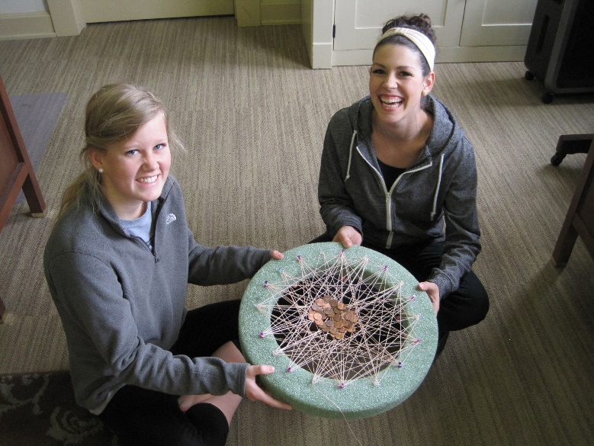
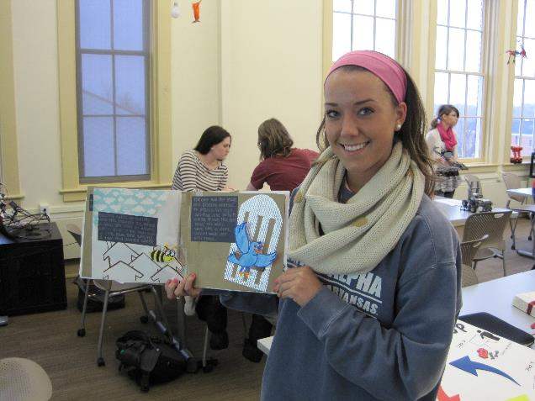
Teachers Candidates Designing STEM Lessons

Slide 29
More Emphasis On…
Critical Thinking
Problem Solving
Leadership & Teamwork
Ethics & Responsibility
Invention, Imagination & Ingenuity
Communication Skills

Slide 30
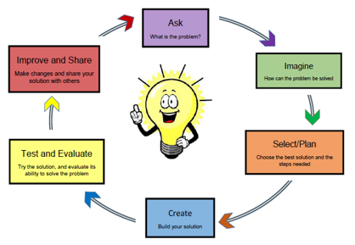
The Inclusion of Engineering Design
Why is this important?
Invention and innovation
Generate & research ideas
Source of Ideas?
Interrogating our Personal Bank of Knowledge (Mental Warehouse)
Existing Common Body of Knowledge
Quality of the Design?
Different points of view

Slide 31
Using Real-World Problems
Real-world problem-solving is the essence of STEM lessons. Solving real-world problems causes students to use/expand higher-order thinking skills.
Identifying creative, real-world problems for students is the essence of STEM teaching.

Slide 32
Good STEM Lessons…
Accomplish these things:
Apply math/science through authentic, hands-on learning
Include the use/creation of technology
Require the use of the engineering design loop
Require collaborative teamwork
Emphasize math/science/technology standards
Address real-world problems

Slide 33
What do Students Gain?
Creativity – Thinking on their feet, ‘outside the box.’
Confidence – Building confidence needed to thrive in a competitive workplace.
Problem Solving –Without realizing it, students are consistently challenged to solve problems. This develops skills in reasoning and understanding.

Slide 34
What do Students Gain?
Focus – Balancing listening/contributing involves a great deal of concentration/focus.
Communication – Defending ideas/theories is a core skill and one that is required throughout life.
Receiving Constructive Feedback – Feedback is part of learning/part of life (not everyone gets a trophy!)

Slide 35
What do Students Gain?
Collaboration – Students work together, share responsibility, and compromise with others to accomplish a common goal.
Dedication – Students practice developing healthy work habits (on-time, prepared, respecting the contributions of others).
Accountability – Understanding that their actions affect other people.

Slide 36
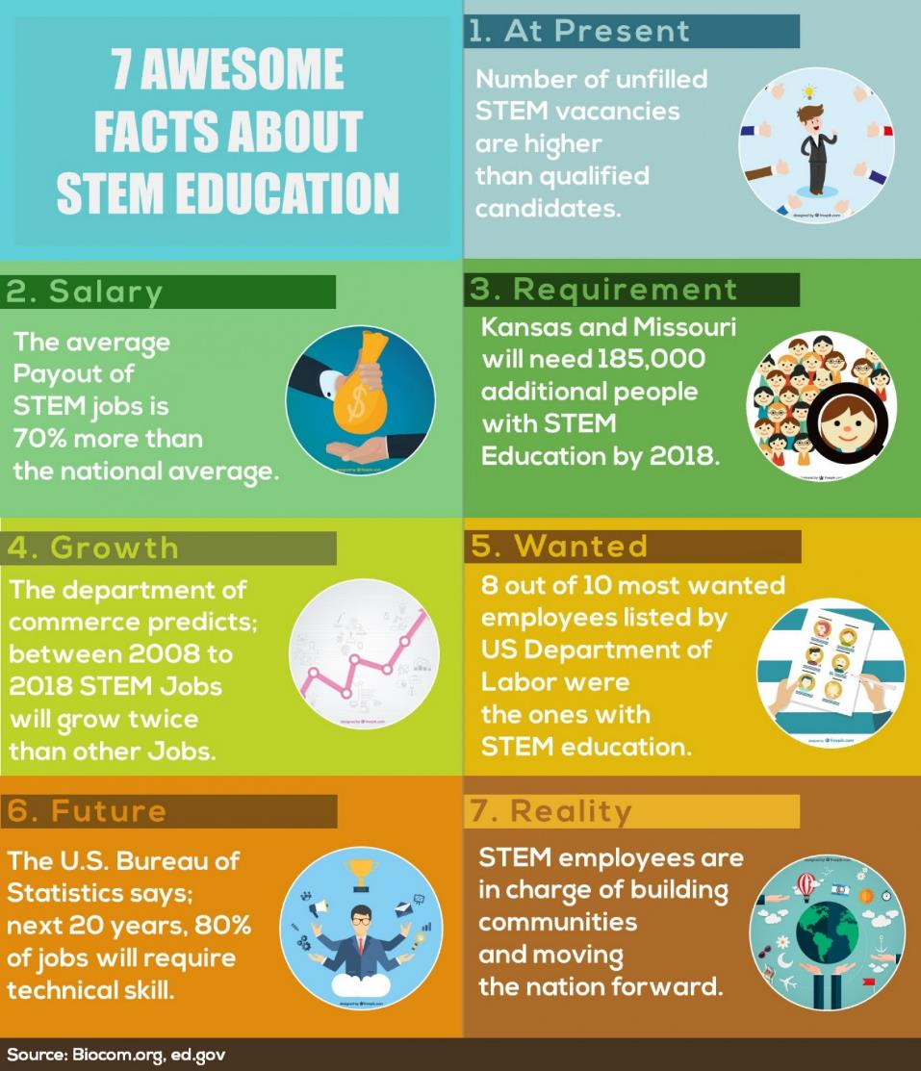

Slide 37
