Slide 1
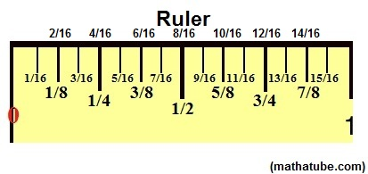
Measure Twice, Cut Once

Slide 2
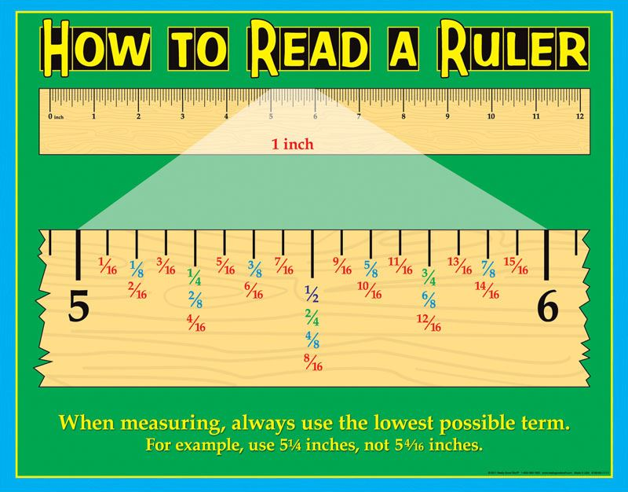

Slide 3
Three Simple Steps to Add Fractions
Step 1: Make sure the bottom numbers (the denominators) are the same.
Step 2: Add the top numbers (the numerators), put that answer over the denominator.
Step 3: Simplify the fraction (if needed)

Slide 4
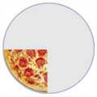
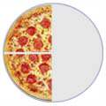
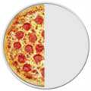
Adding Fractions
¼ | + | ¼ | = | 2/4 | = | ½

Slide 5
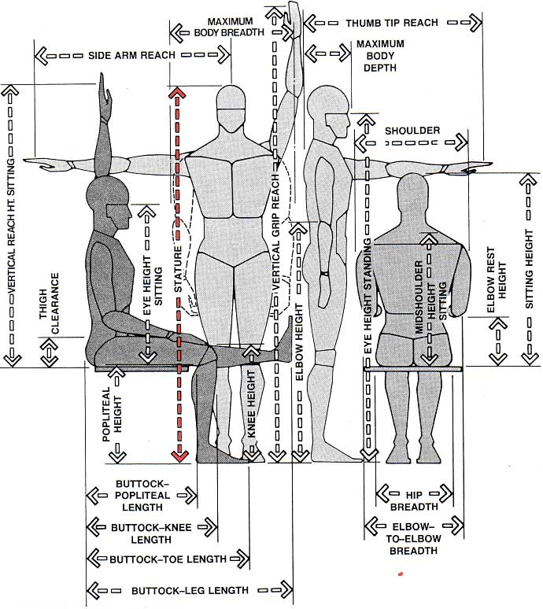
Anthropometrics
How many different ways can we measure a human? Weight, length, width, strength, reach, circumference, others
The study of human measurement is called anthropometrics
We use inches and fractions for shorter measurements, feet for larger measurements, and yards for long distances—then rods and miles.

Slide 6
Some Conversions that you
Should Know (English System):
1 foot = 12 inches
1 yard = 3 feet
1 Rod = 5.5 yards
1 mile = 1760 yards, or 320 rods, or 5,280 feet
1 gallon = 16 cups
1 gallon = 4 quarts

Slide 7
Anthropometric Measurements
Collect at least five anthropometric measurements of your partner—be precise
Stature
Vertical grip reach
Buttock-leg length
Eye height sitting
Side reach sitting

Slide 8
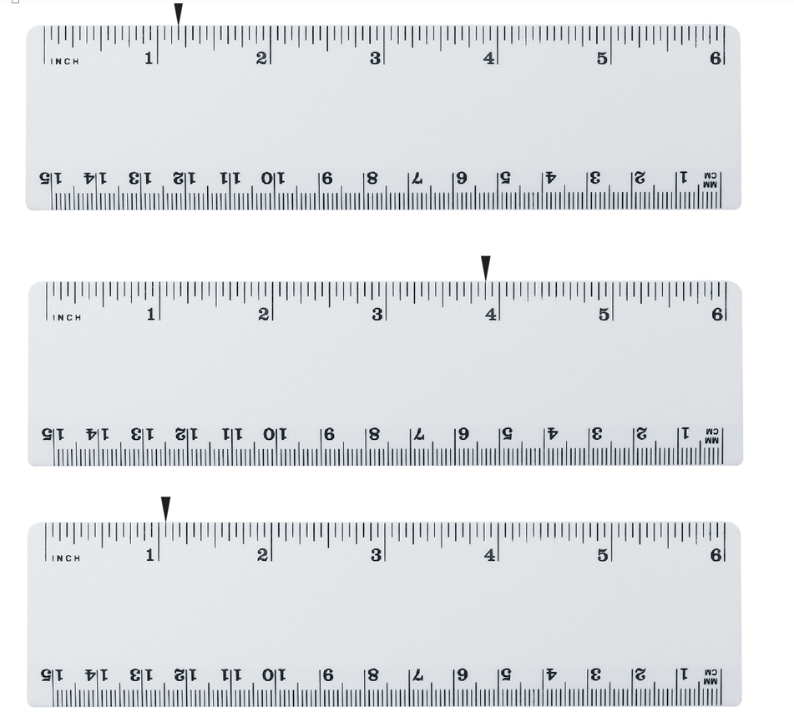

Slide 9
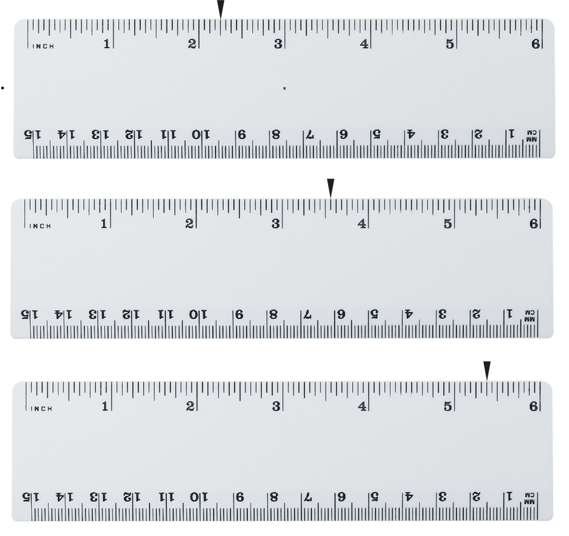

Slide 10
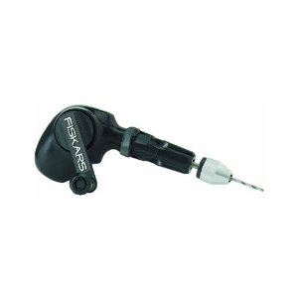
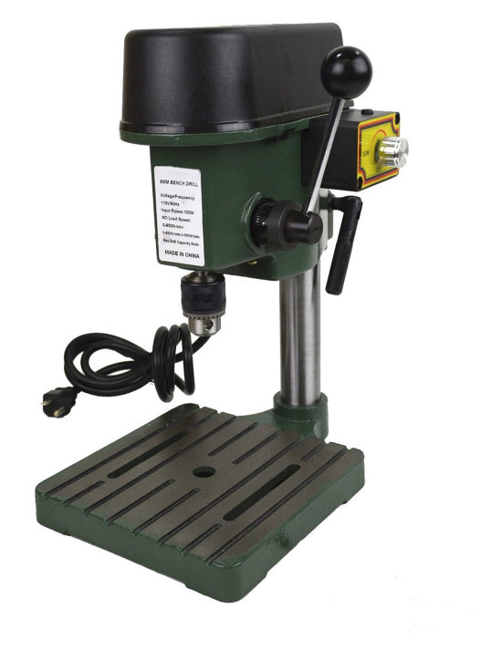
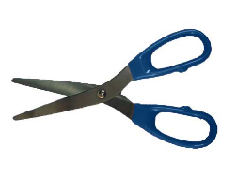
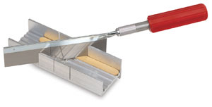
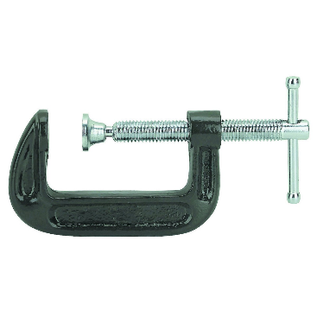
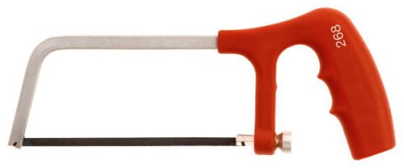
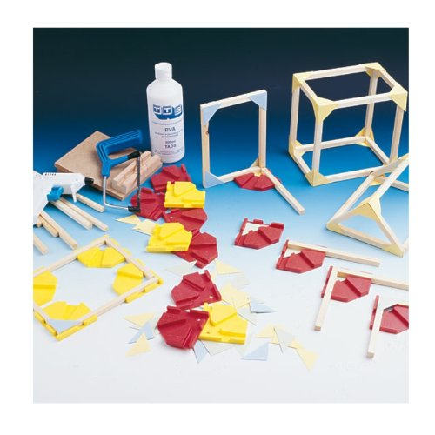
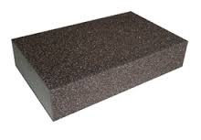
Tools
Scissors
Razor Saw
Hand Drill
Miter Box
Drill Press
Hack Saw
C-clamp
Sanding Sponge
Lynx Jointer

Slide 11
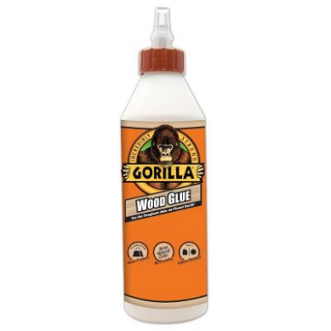
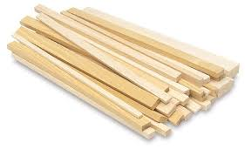
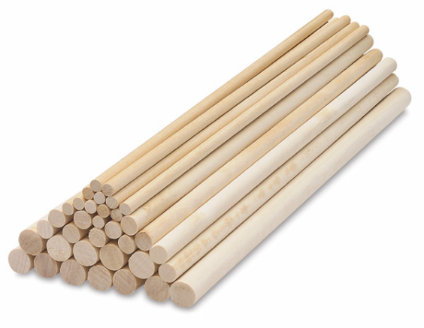

Materials
Wood Glue
Wood (Dimensional Lumber)
Notecard/Cardstock
Dowel Rods

Slide 12

Processes
Gluing
Sanding
Measuring
Cutting
Drilling
Clamping

