Slide 1
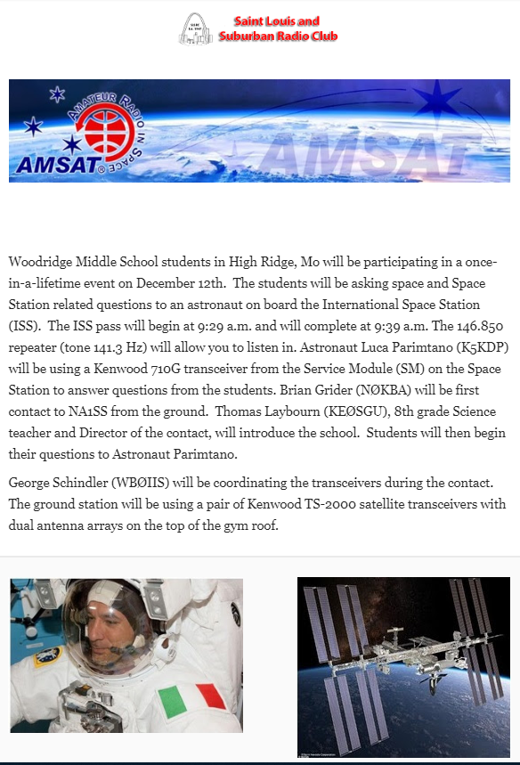

Slide 2

Education Resources

Slide 3
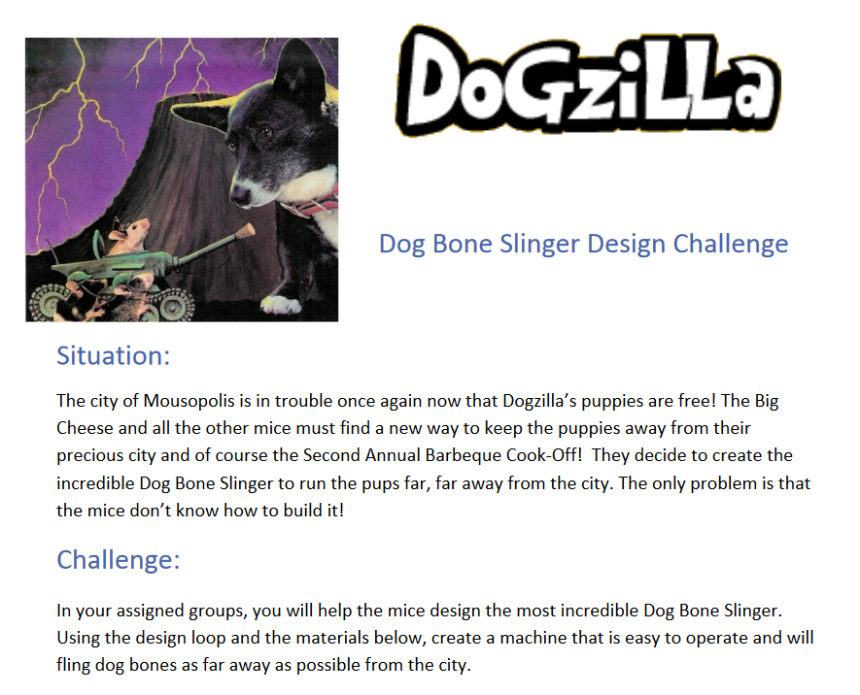

University of Arkansas STEM Education
http://stem.uark.edu/

Slide 4
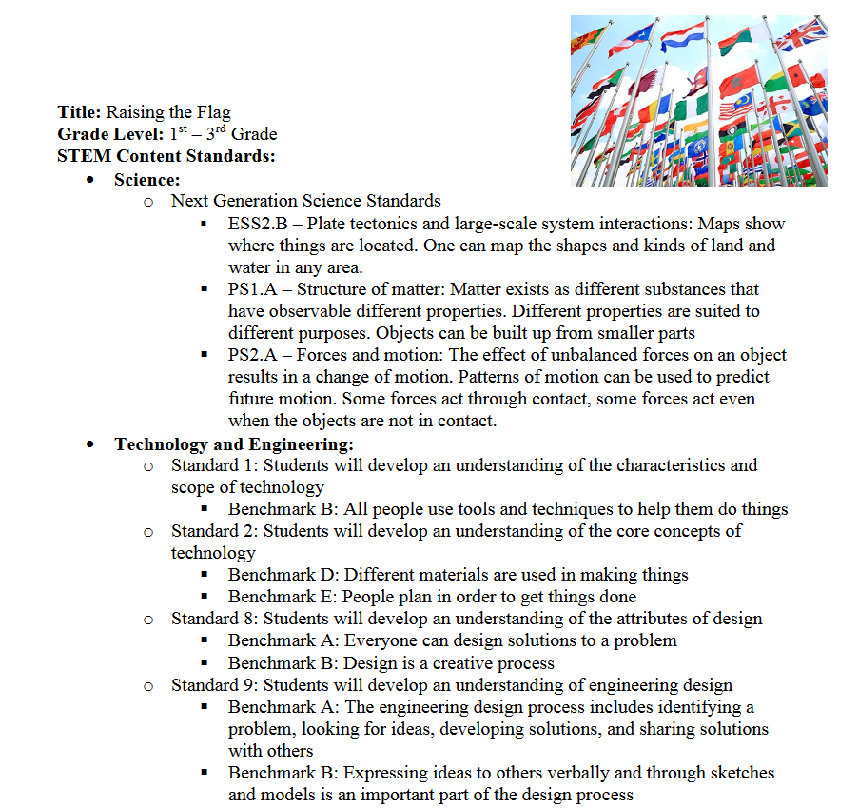
University of Arkansas STEM Education
http://stem.uark.edu/

Slide 5
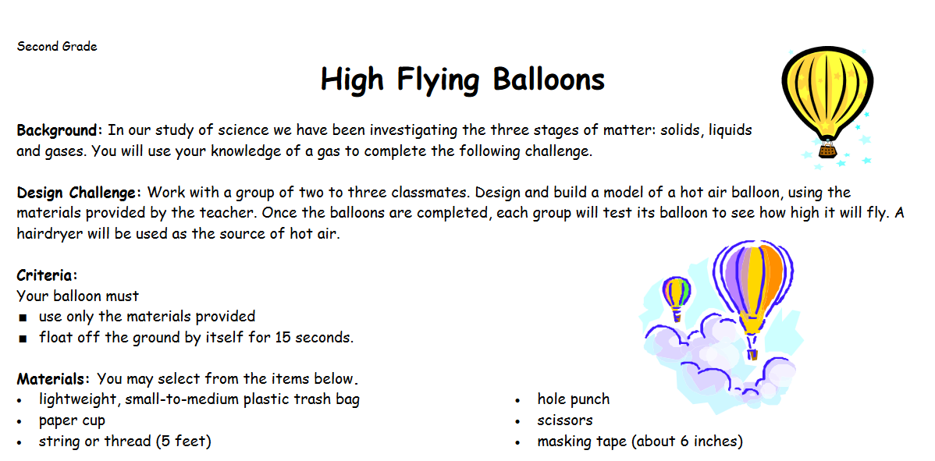

Virginia Children’s Engineering Council
http://www.childrensengineering.org/index.php

Slide 6
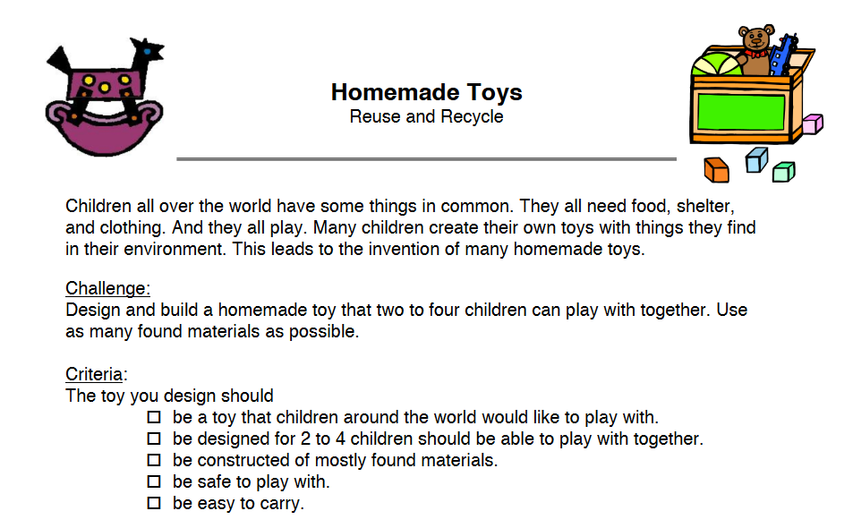

Children’s Engineering
http://www.childrensengineering.com/

Slide 7
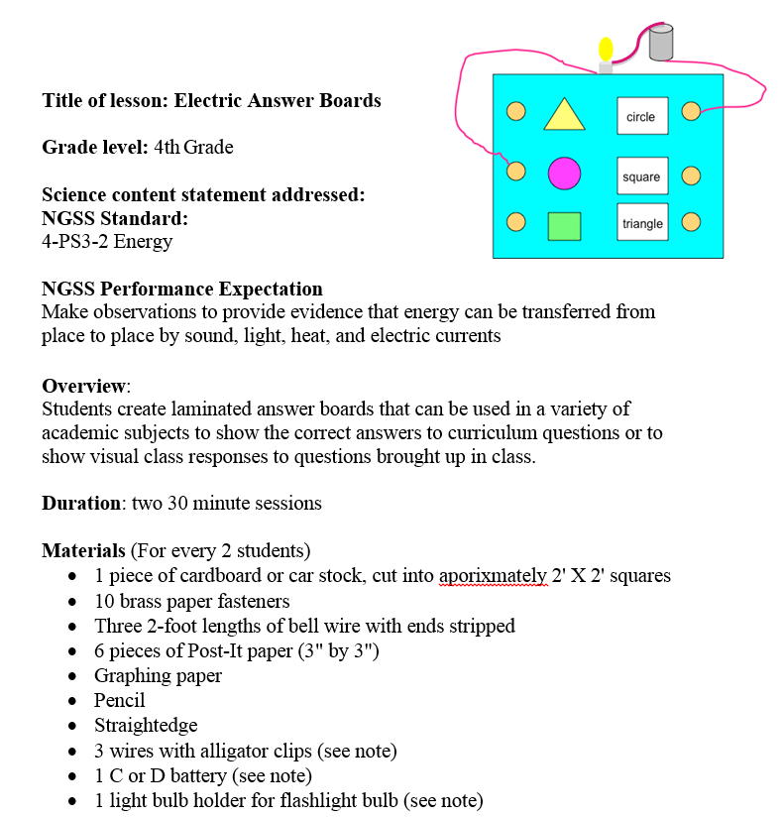

STEM is Elementary
http://www.stemiselementary.com/

Slide 8
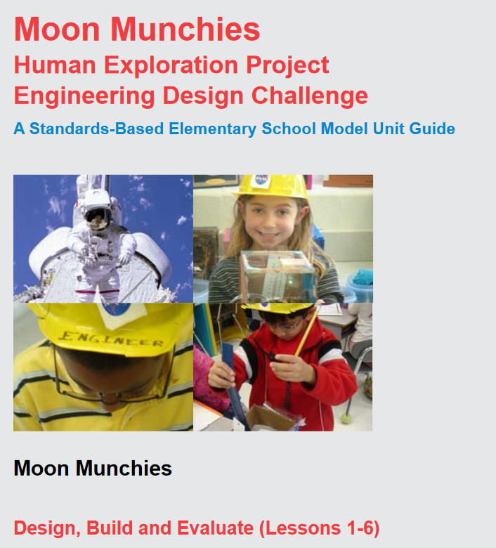

NASA Education Resources
https://www.nasa.gov/education/resources

Slide 9
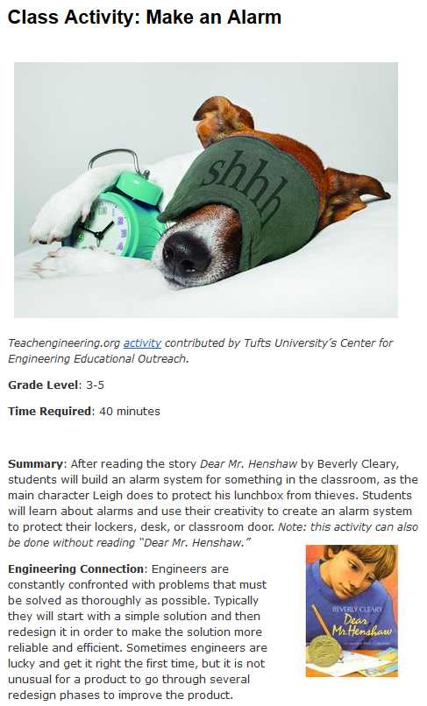

Engineering Go for it (eGFI)
http://teachers.egfi-k12.org/

Slide 10
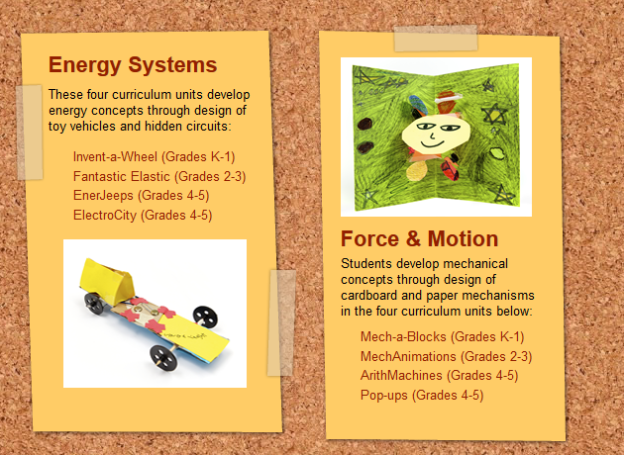

City Technology
http://www.citytechnology.org/
Fantastic Elastic

Slide 11
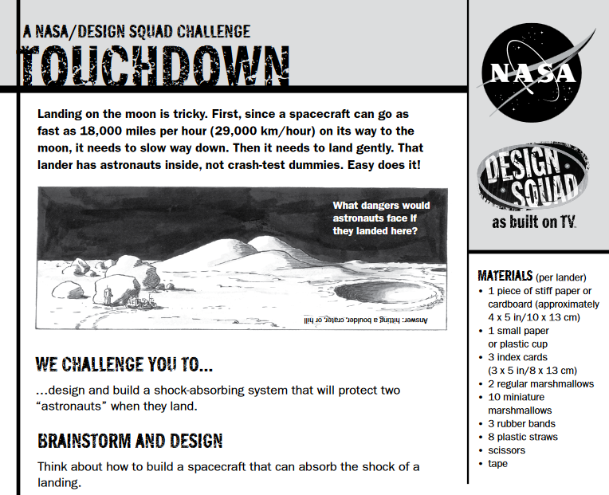

PBS Design Squad
http://pbskids.org/designsquad/

Slide 12
Education Resources
http://www.uastem.com/links/

Slide 13
Razorback STEM Day Friday – December 13, 2019 Arkansas Student Union
8:15 – UA STEM students arrive and help set up (Rooms 507-510)
8:45 – Holcomb 1st graders arrive on campus 8:50 – Welcome and Greeting (Rooms 507-510) 9:00-11:00 – Begin STEM station Rotations Rotate stations every 30 minutes STEM Station 1: Astronomy Clay Moon Design Challenge (503) STEM Station 2: Through the Mountain Keva Design Challenge (504) STEM Station 3: Crazy Fort Design Challenge (507-510) STEM Station 4: Paper Chain Design Challenge (513-514) 11:00 – Lunch and Recap (Rooms 507-510) 11:30 – Class Pictures with Razorbug (Union Fountain) Holcomb students dismiss to busses after class picture 11:45 – UA STEM students recap and discussion (Rooms 507-510), break down stations, load supplies

Slide 14
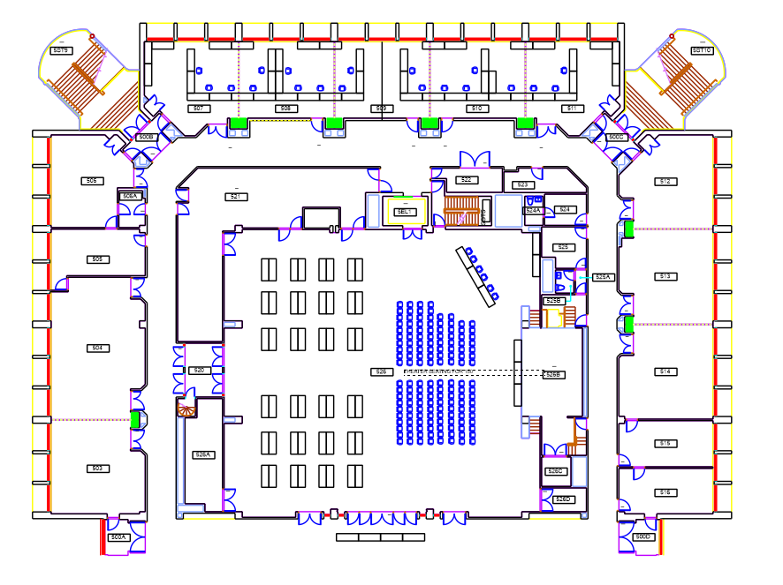

Slide 15
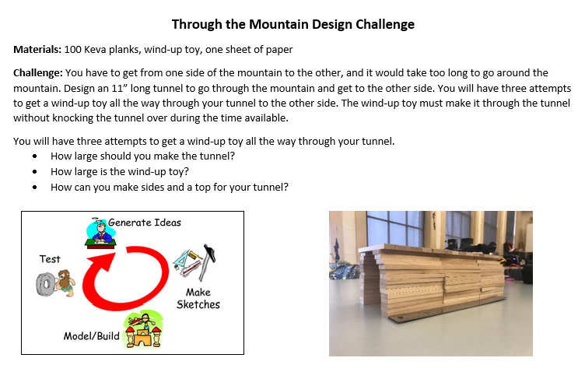
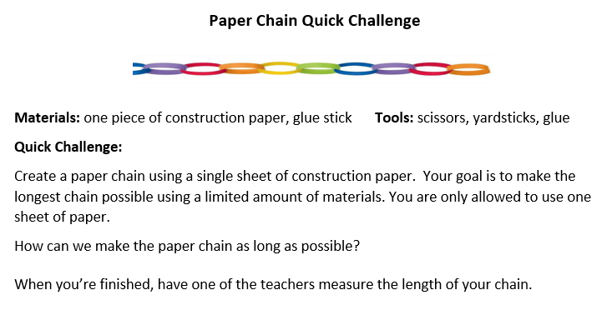
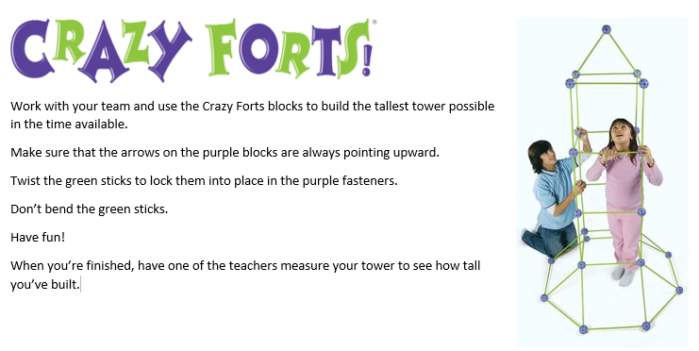

Slide 16
Champion!
Be a

