Slide 1
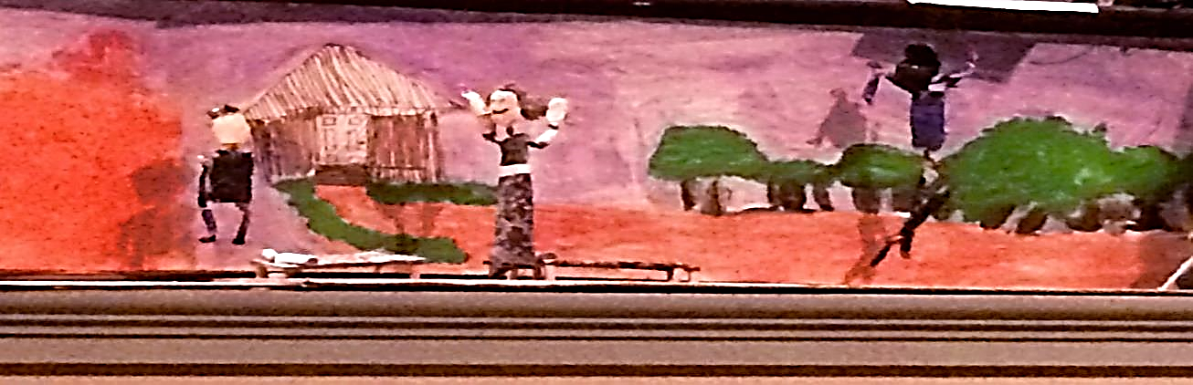
Engineering a Play

Slide 2
Rationale and Purpose
Social Studies and Engineering Design both receive limited classroom time in elementary school
Textbooks are often used and rarely engaging
SOLUTION?
Integrate more informational texts (literacy)
Create an engineering design challenge to engage students in the use of interactive strategies such as brainstorming, cooperative learning, and design thinking

Slide 3
Context
Third Grade Classroom
  Social Studies Unit on Arkansas History and Westward Expansion
  Examined the importance of people and events in early Arkansas history
  Must comprehend and be able to explain the historical significance of exploration, settlement, and statehood
Integrating Literacy, STEM, and Social Studies

Slide 4
Standards
Body of Standards | Specified Standards
CCSS English Language Arts | CCSS.ELA-Literacy.RI.3.3 – Describe the relationship between a series of historical events, scientific ideas or concepts, or steps in technical procedures in a text, using language that pertains to time, sequence, and cause/effect. CCSS.ELA-Literacy.RI.3.7 – Use information gained from illustrations (e.g., maps, photo- graphs) and the words in a text to demonstrate understanding of the text (e.g., where, when, why, and how key events occur). CCSS.ELA-Literacy.RI.3.8 – Describe logical connections between particular sentences and paragraphs in a text (e.g., comparison, cause/ effect, first/second/third in a sequence). CCSS. ELA-Literacy.SL.3.4 – Report on a top- ic or text, tell a story, or recount an experience with appropriate facts and relevant, descriptive details, speaking clearly at an understandable pace.
C3 Framework for Social Studies | D2.His.3.3-5. – Generate questions about individuals and groups who have shaped significant historical changes and continuities. D2.His.11.3-5. – Infer the intended audience and purpose of a historical source from information within the source itself.
STL Technological Literacy Standards | STL 9. – Students will develop an understanding of engineering design. STL 9. C. The engineering design process involves defining a problem, generating ideas, selecting a solution, testing the solution(s), making the item, evaluating it, and presenting results. STL 9.D. – When designing an object, it is important to be creative and consider all ideas. STL 9.E. – Models are used to communicate and test design ideas and processes.

Slide 5
Big Ideas and Essential Questions
BIG IDEAS
Using informational and fictional texts
Understanding key historical events, engineering design, puppetry, stories, simple tools and processes
Using presentation skills to tell a story through a dramatic performance
ESSENTIAL QUESTIONS
How does the past impact the present?
How can a script for a play be developed from
a book?
How can the set design support the characters (marionettes) as they engage the audience through animation of the script and narration of the story?

Slide 6
Deliverables
Written script
Puppet Pals© prototype
Set design
Marionettes
Production of the play
Completed design journal

Slide 7
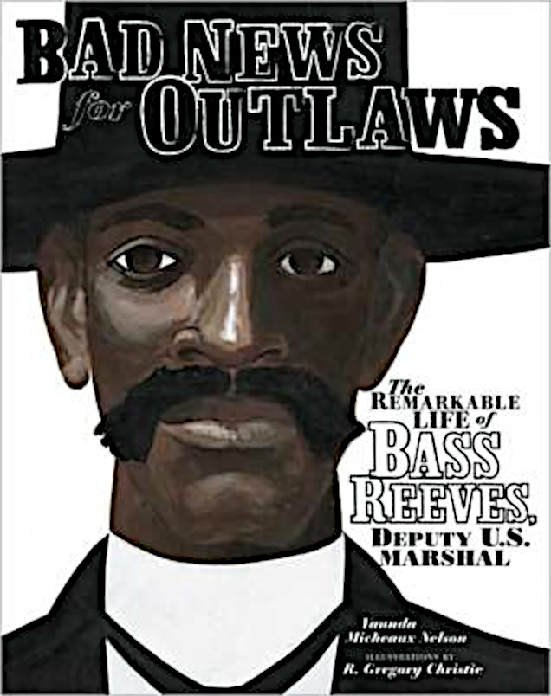
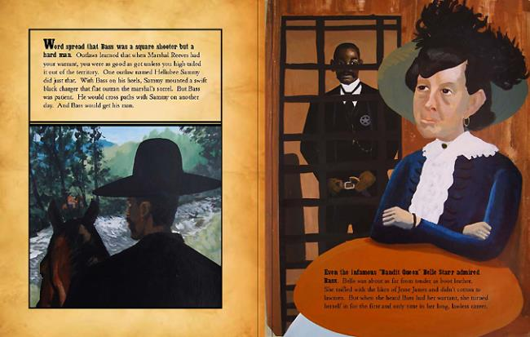
Text

Slide 8
Parameters
Identify an historical event to be used as the storyline for the marionette play.
Use the Puppet Pals© App to design a prototype that illustrates the first draft of the play.
Write a script for the marionette play.
Design and create the marionette characters using the materials provided.
Utilize recycled materials to design the set and create the marionette characters.
Include all team members in the marionette play (each team member must participate as a character that has a speaking part).
Use a design journal to conduct research and to gather information for the challenge.

Slide 9
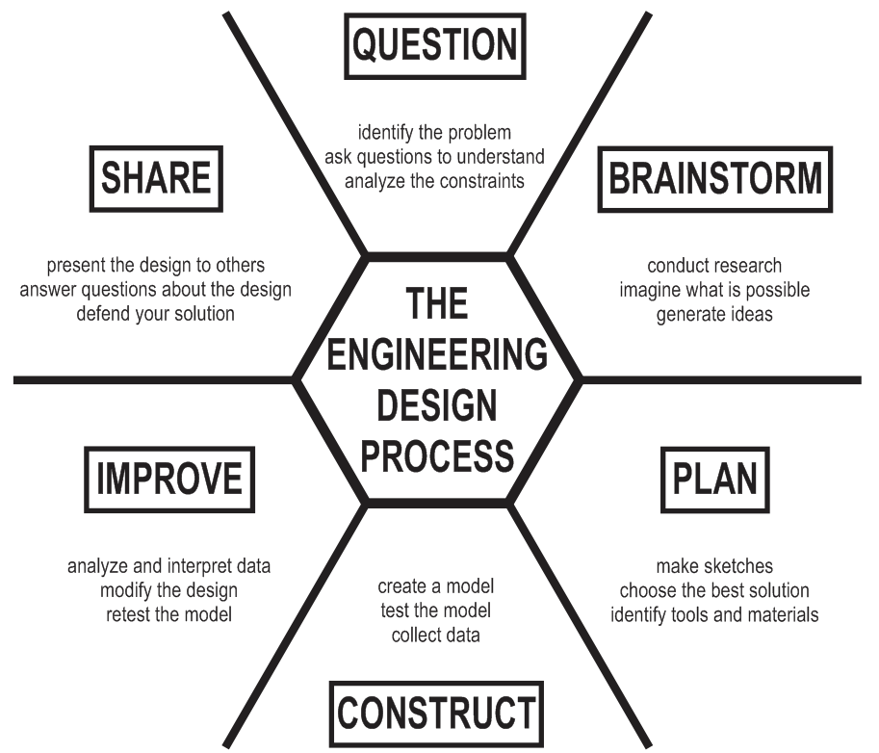
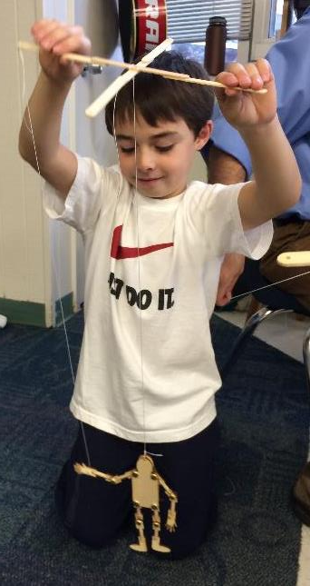

Slide 10
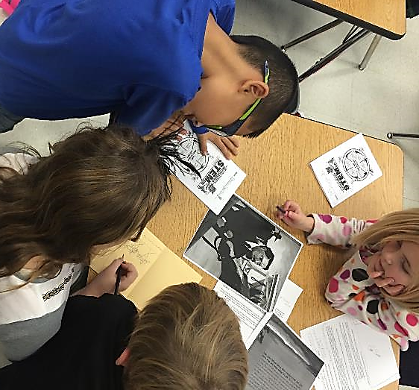
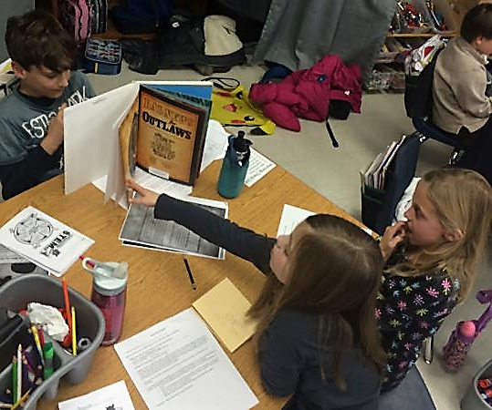
Classroom Implementation
Setting the stage
  Dividing the story
  Group-Work: Creating a plan and a story board

Slide 11
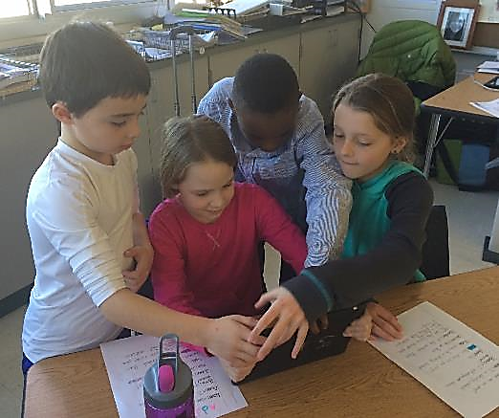
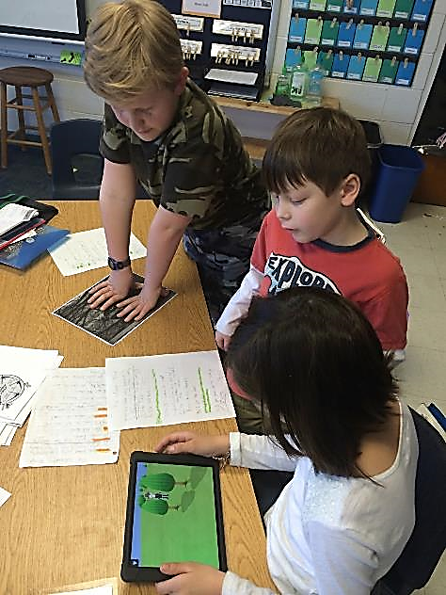
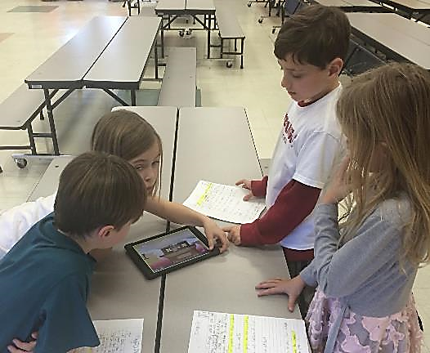
Implementation
3rd graders created a prototype of their play using the Puppet Pals© App

Slide 12
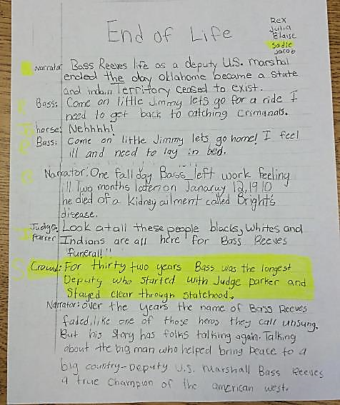
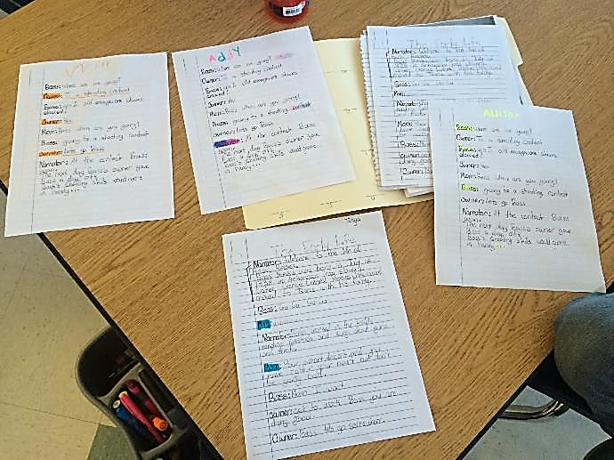
Implementation
Each 4-5 person team was assigned one section of the life of Bass Reeves
  Collaborated to turn the story into a script
  Requirement: Each group member must have a speaking part

Slide 13
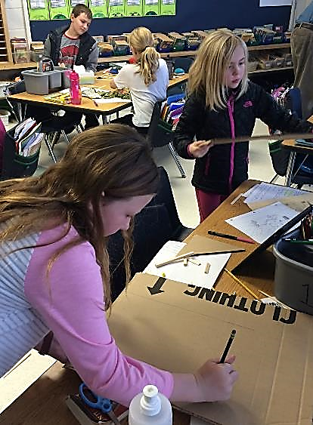
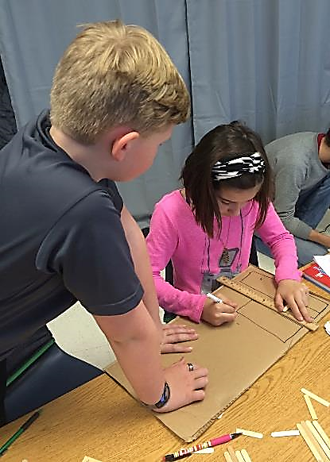
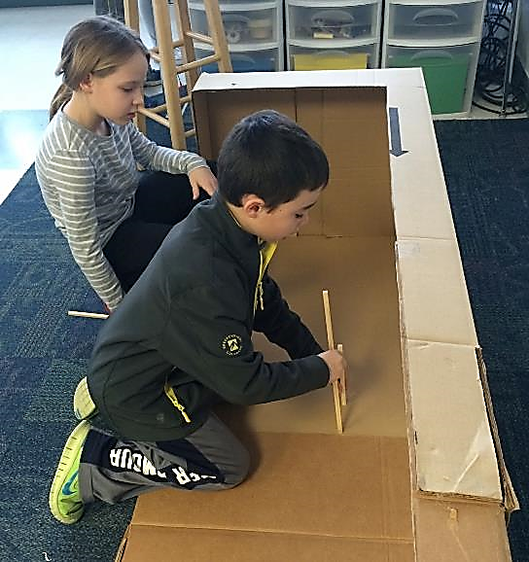
Implementation
Class stage was created
Each group produced a backdrop and necessary props for their scene

Slide 14
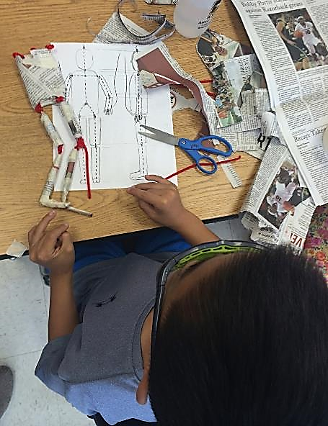
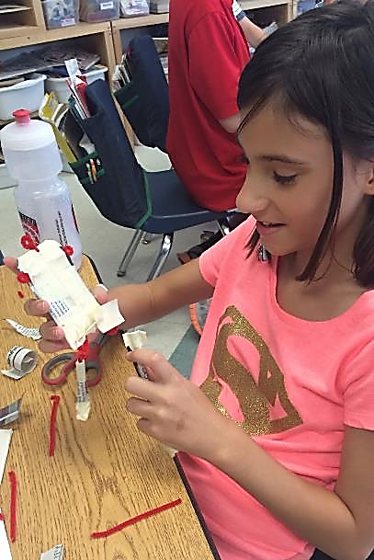
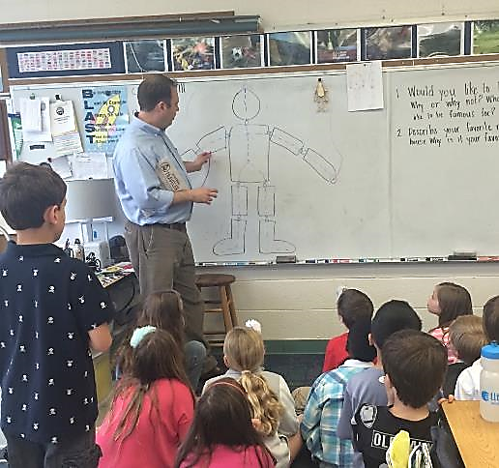
Implementation
Every student created a marionette for their character.
  Body proportions were discussed, as were joints and movement.

Slide 15
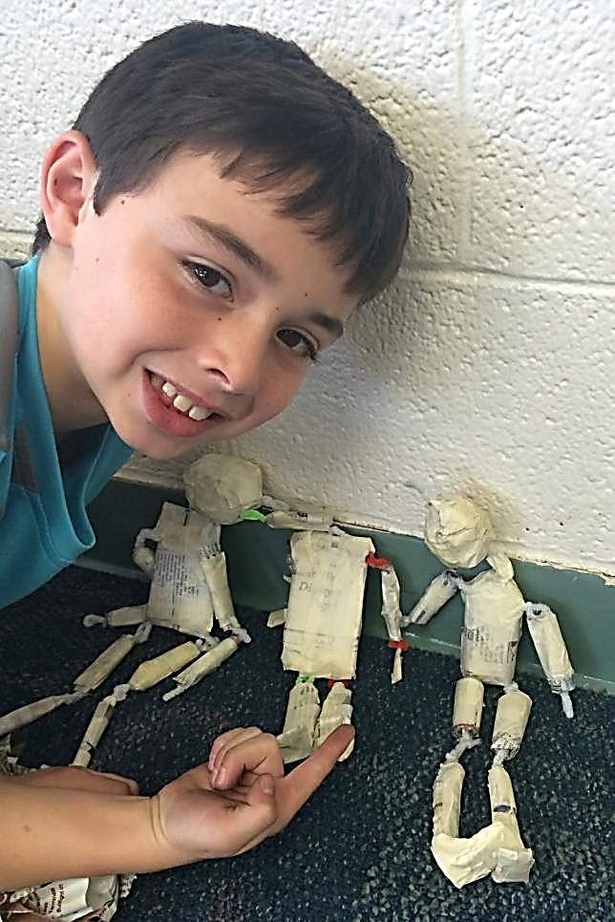
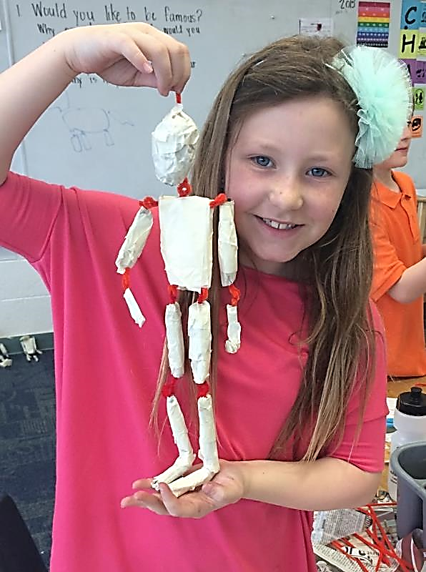
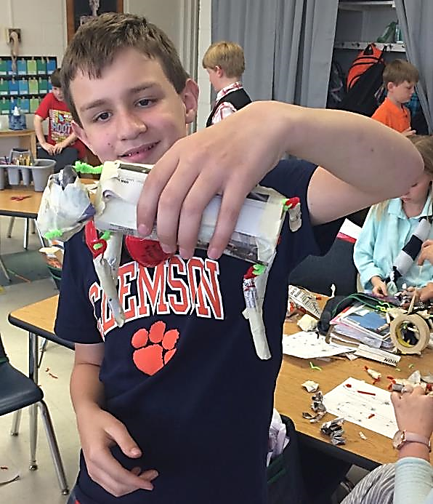
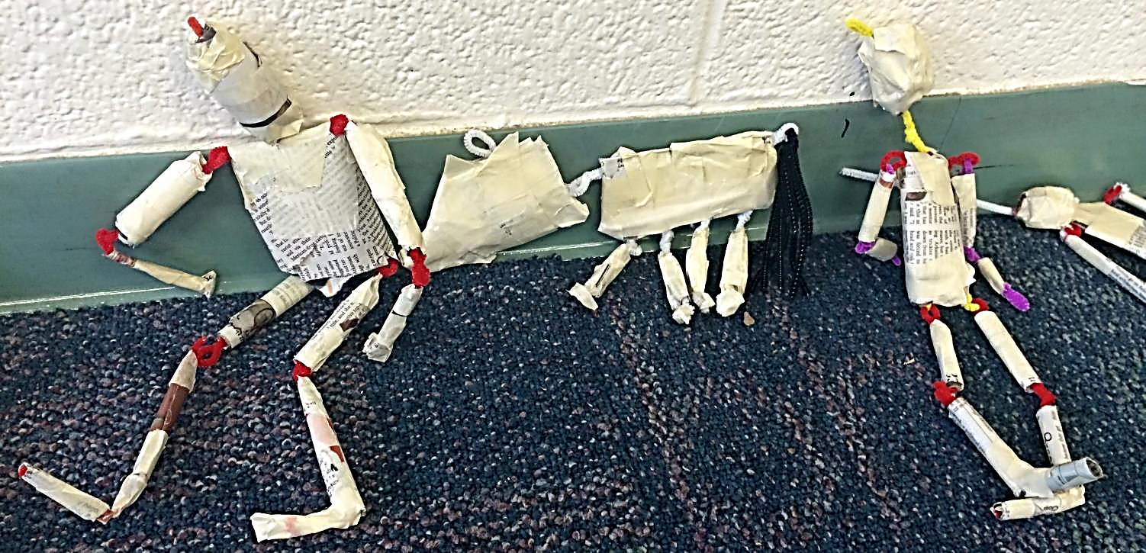

Slide 16
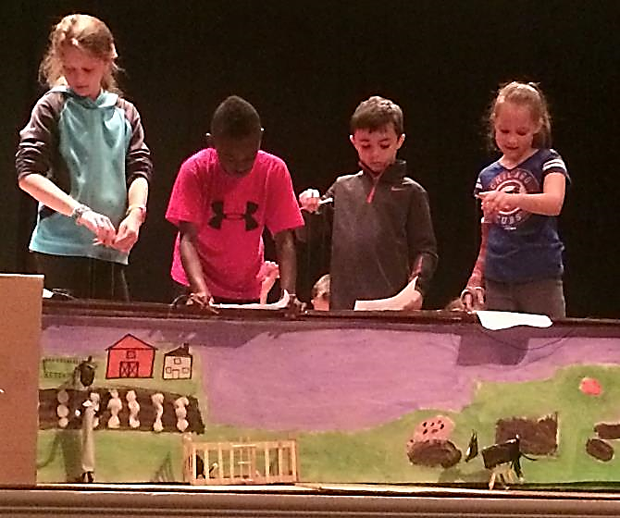
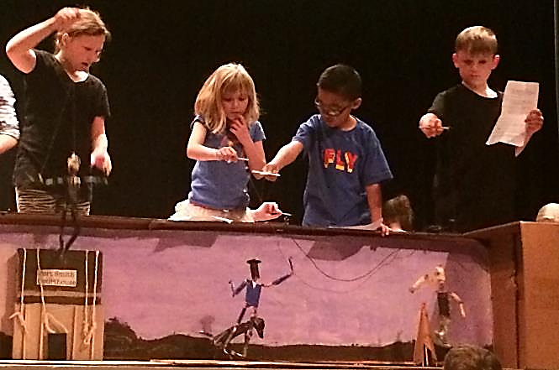
Performance
3rd grade class and families were invited to the University to perform their play on stage.
  The performance was filmed and each student received a copy.

Slide 17
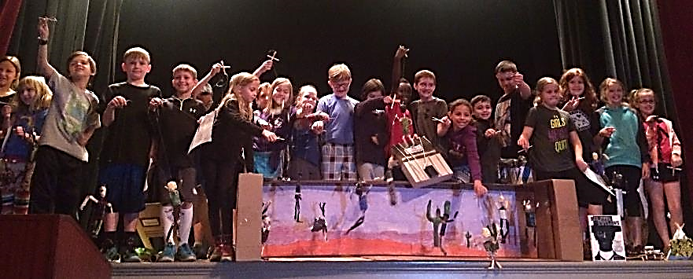
Student Learning
Deeper story comprehension
Deeper understanding of historical time period
Real-world challenges of
  team-work
  brainstorming
  problem-solving
  design
  organization
  production
  communication
    public speaking
Social and cultural awareness

Slide 18
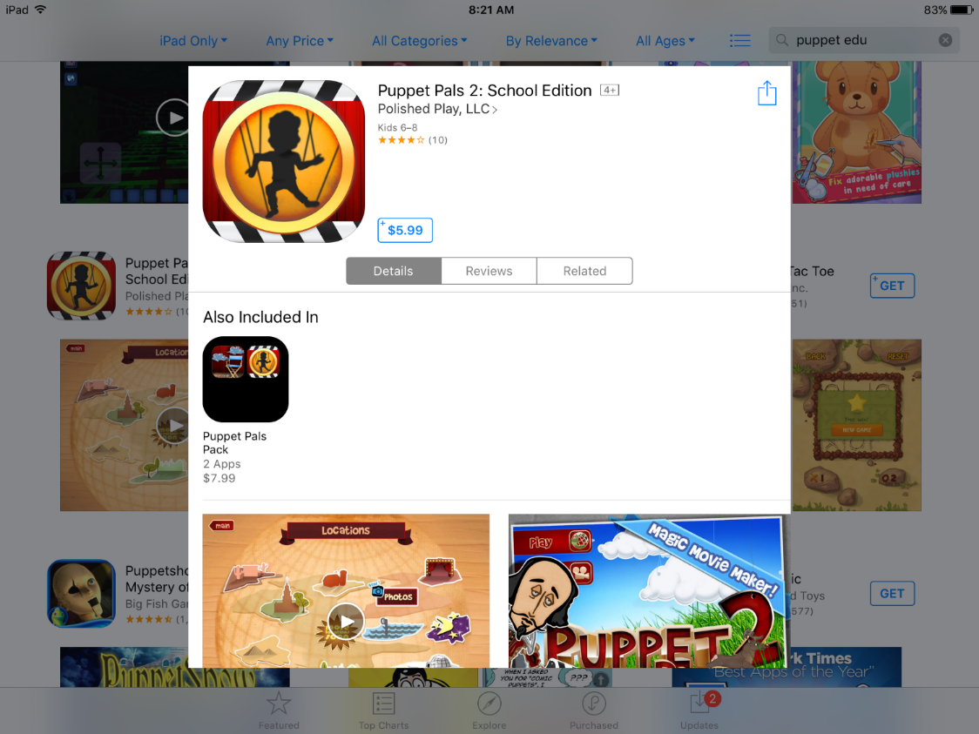

Slide 19
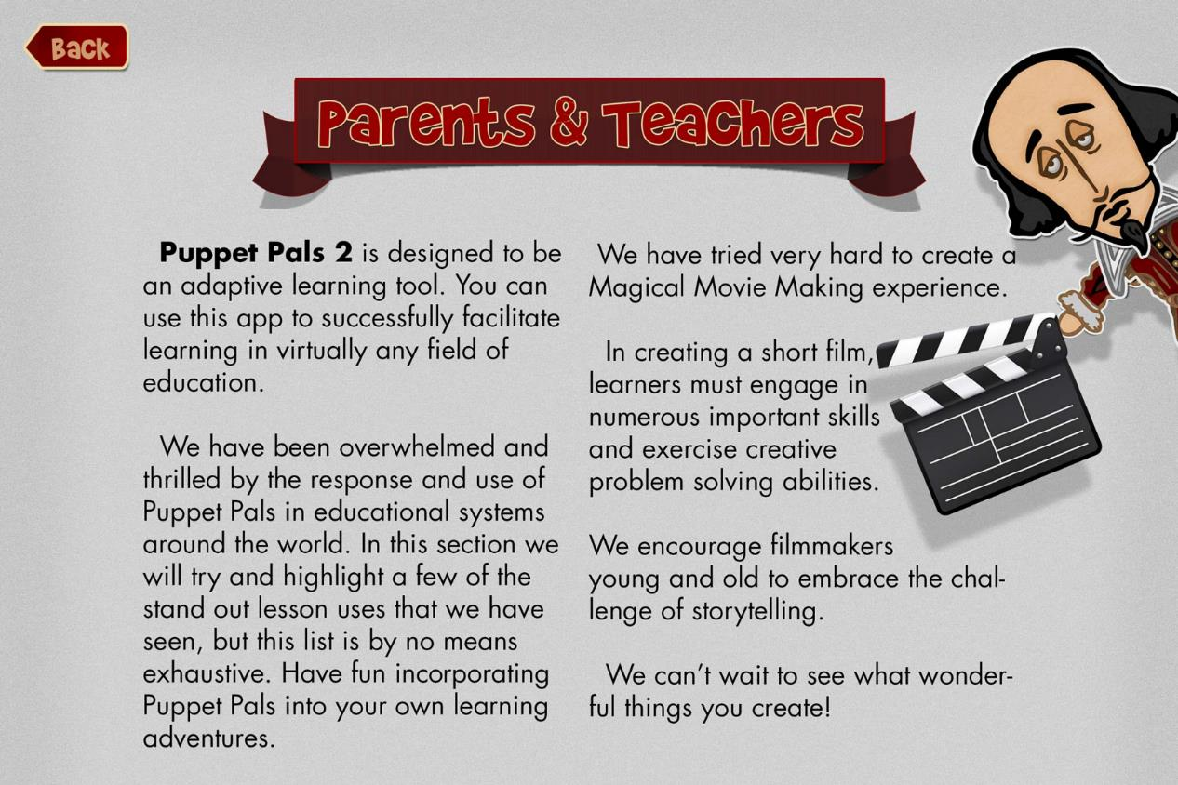

Slide 20
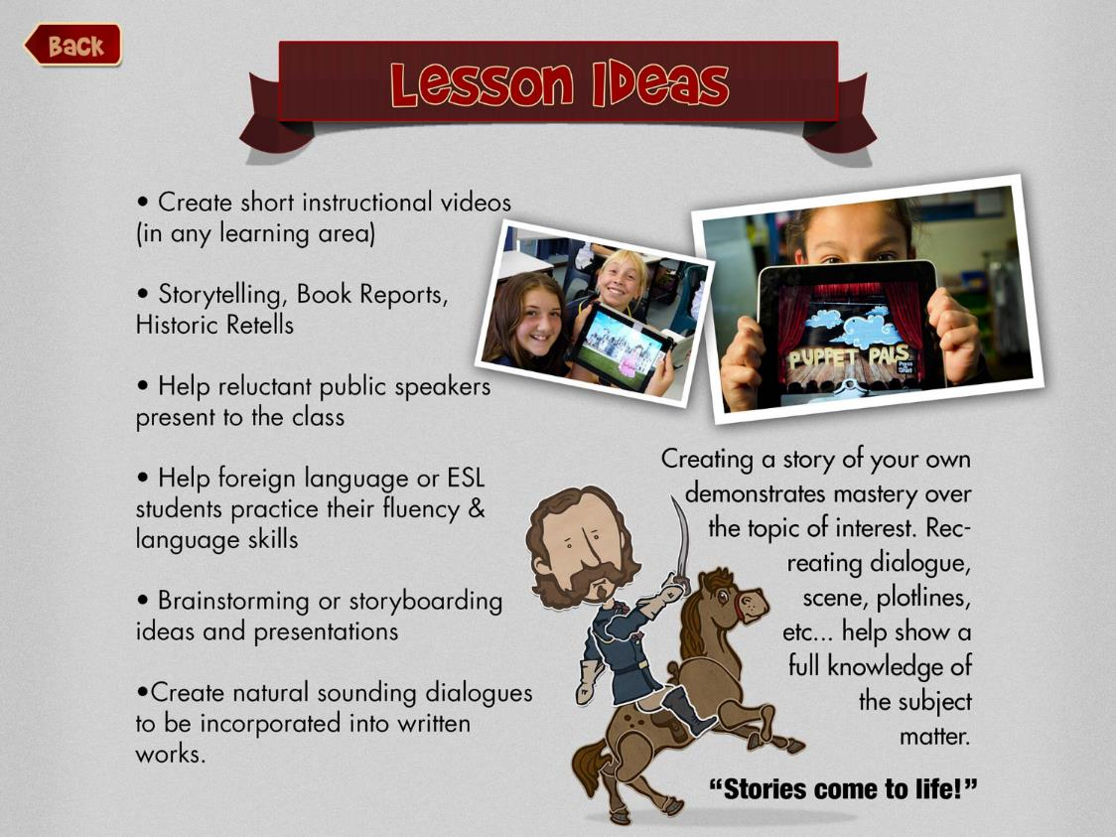

Slide 21
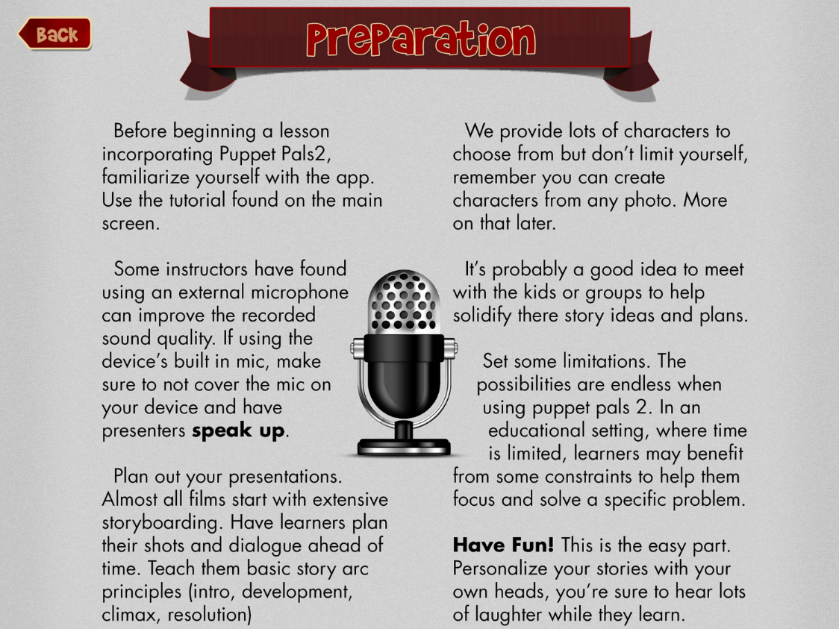

Slide 22
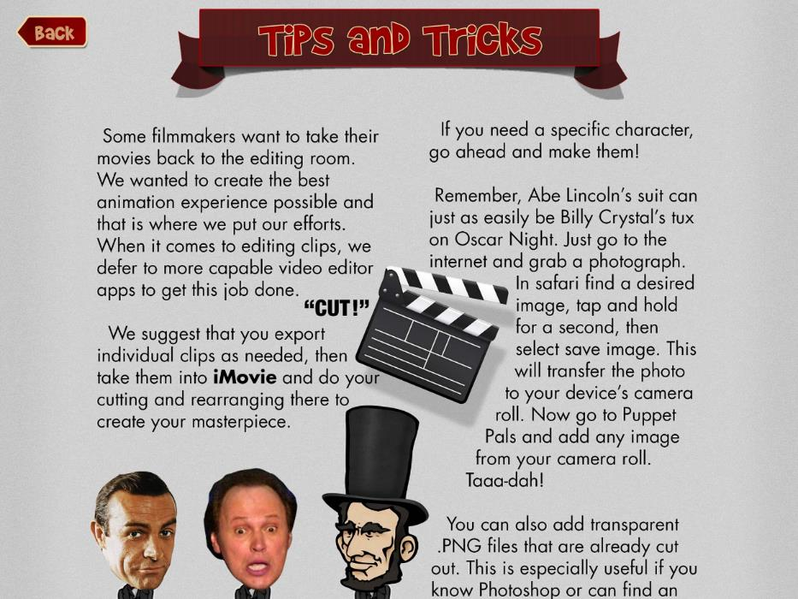
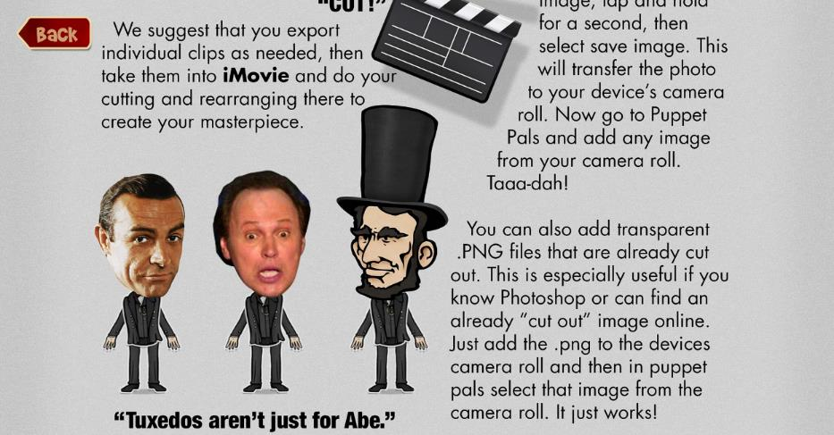

Slide 23
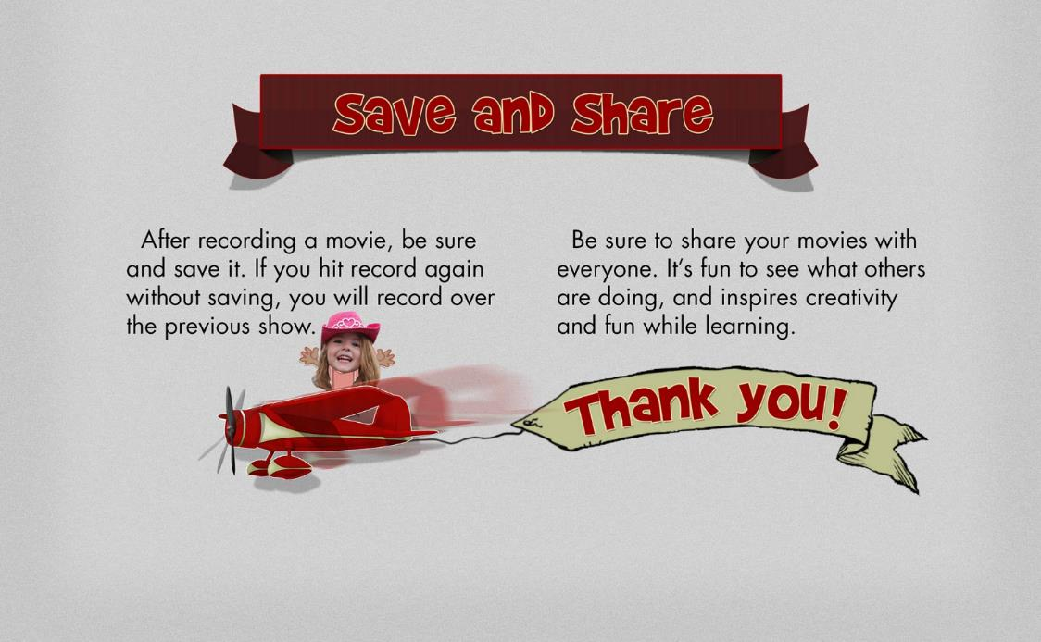

Slide 24
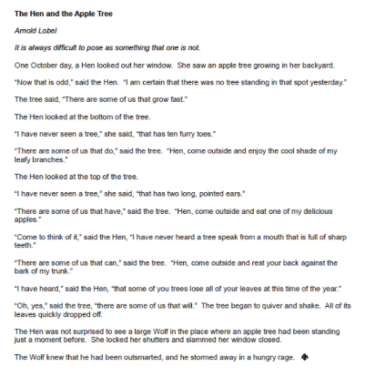
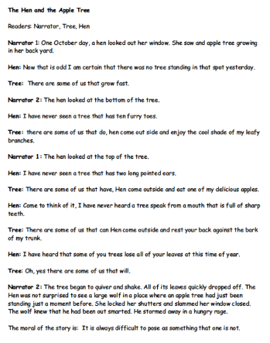

Slide 25
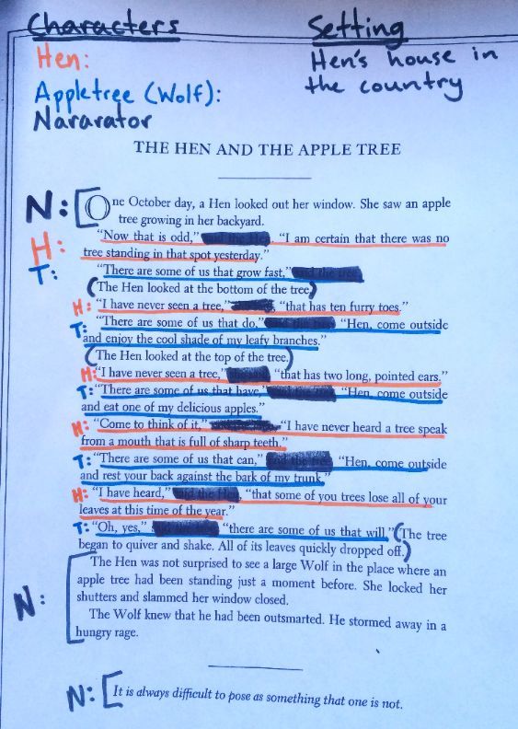


Slide 26
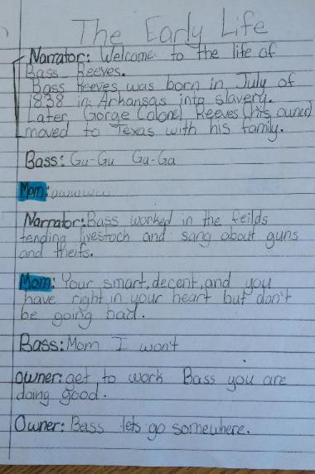
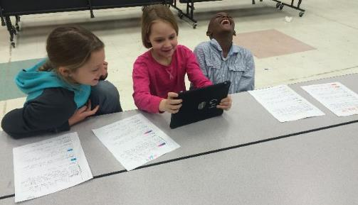
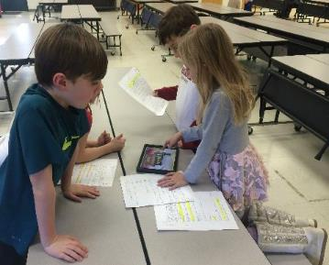
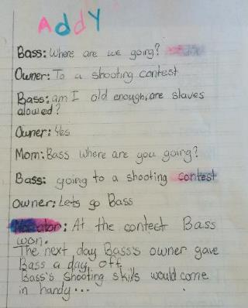
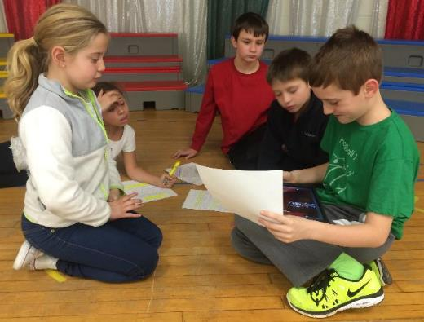
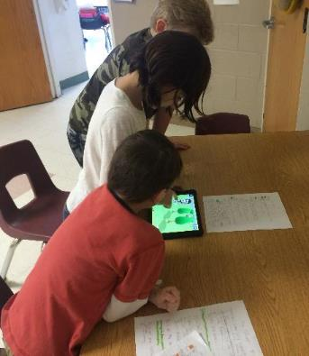

Slide 27
