Slide 1
Strategies for STEM Laboratory Development
In the Elementary Grades

Slide 2

WHAT DO STEM LABS OFFER?
Opportunities to…….
*Create *Design
*Construct *Expand

Slide 3
SKILLS DEVELOPED IN A STEM LAB
Generalizable Skills
Measuring
Safety
Tool usage
Troubleshooting
Reverse engineering
Choosing the right tool
Testing
Using instruments
Programming
Reading schematics
Sketching
Documentation
Following patterns
Research
Product assessment
Teamwork
Observation
How machines work
Presentation skills

Slide 4
If you can imagine it,
you can make it!
So, let’s make a STEM Lab

Slide 5
Rich Learning Environments
Serve as gathering points
Enabling a new generation of innovators
Providing the tools needed
Fabrication areas
Presentation areas

Slide 6
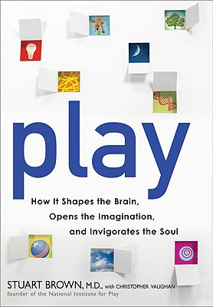
Play:
How it Shapes the Brain, Opens the Imagination and Invigorates the Soul
by Dr. Stuart Brown
Notes:
In his book “Play: How it Shapes the Brain, Opens the Imagination and Invigorates the Soul” Dr. Stuart Brown
tells the story about how the Jet Propulsion Laboratory realized that, although it was hiring the
best and brightest college graduates, they were the wrong kind of people. Something had changed in the
kind of people who came to work at JPL.
The JPL managers went back to look at their own retiring engineers and ... found that in their youth, their older, problem-solving employees had taken apart clocks to see how they worked, or made soapbox derby racers, or built hi-fi stereos, or fixed appliances. The young engineering school graduates who had also done these things, who had played with their hands, were adept at the kinds of problem solving that management sought. Those who hadn’t, generally were not. From that point on, JPL made questions about applicants’youthful projects and play a standard part of job interviews. Through research the JPL managers discovered that there is a kind of magic in play. We must try to bring the youthful magic of play into schools, hard as it may be. Formal education has become such a serious business, defining success with abstract thinking and high-stakes testing, that
there’s no time and no context for play. If play is what you do outside school, then that is where the real
learning will take place and that’s where innovation and creativity will be found

Slide 7
We Don’t Want Everyone to be an Engineer!
But we do want students to:
Cross disciplines
Develop new skills
Build mental contexts
Take risks, failing sometimes
Accept challenges/solve problems
Deeply understand difficult concepts
Nourish building traits like creativity, curiosity, open-mindedness, persistence, social responsibility, and teamwork

Slide 8
Choosing a Location
Repurposing an existing space
The computer lab: Take out some computer stations, buy a few tablets/laptops and invest the rest of the budget in fabrication tools
The library: This is already a shared school resource, just add a fabrication area
The stage: Use the space behind the stage as a STEM fabrication area
Outdoors: A STEM fabrication lab can be constructed near the school garden

Slide 9
A child in middle school today will be entering the prime of their careers in 2040
We have no idea what the world will look like then
Therefore, it is crucial that we impart these students with timeless skills like curiosity, creativity, and the ability to learn on one’s own
21st Century Learning

Slide 10
Financial Resources
Find an advocate with financial resources
Beg and borrow
Buy used or cheap: Craigslist, Harbor Freight, garage sales, etc.
Just-in-time purchasing
Start with the basics and add

Slide 11
The Workspace
Create a safe, comfortable & creative space
Room to move around
Easy to clean
Cutting area
Gluing area
Work tables with stools
Storage area for raw materials/projects
Tool storage area
First aid kit
Presentation area

Slide 12
Tools: Keeping it Simple
Most of us think about cutting, sawing, and drilling when we hear the word “Tool." But the word "tool" means much more, and children need to understand the broader meaning.
Tools are usually hand held or hand operated devices that help us do work. Tools allow us to do things that would not be possible or would be difficult without them. Tools extend human capabilities.
Tools extend human capabilities (Children’s Engineering, 2009).

Slide 13
Tools
General tools for:
Cutting
Fastening
Shaping
Marking
Measuring
Taking apart
Putting together
Safety
All power tools should be used after training and w/supervision
Hand operated tools are best
Wear safety glasses and lab apron when using any tool

Slide 14
Sample Tools
Hand Operated
Drill press/drill bits
Bolt cutters
Hammers
Mallets
Screwdriver assortment
Adjustable wrenches
Slip joint pliers
Utility knives
Cutters
Miter box and saw
Scissors
Pull saw
Coping saw
Files
Clothes pins
Square nose pliers
Needle nose pliers
Locking pliers (vise grips)
Hacksaw
Tape measure
Yardstick
Caliper set
C-clamps/quick-clamps
Spring clamps
Staple gun
Hot glue/gun
Paint brushes

Slide 15
Sample Tools
Power Tools
Electric drill
Rotary tool
Scroll saw
Shop vacuum
Electronics
Microcontrollers and robotics
Computers: Laptops, desktops, netbooks, tablets, WiFi
Digital camera
Printer
Laser cutter, 3D printer?

Slide 16
Materials
Materials can limit creative possibilities.
The wider the selection of materials available to a designer, the greater the range of possible solutions becomes.
Humans have used the natural materials found in their environment to solve problems for centuries.
When available materials didn't fit their needs, humans adapted: using old materials in new ways or inventing new materials (Children’s Engineering, 2009).

Slide 17
Properties of Materials
Teachers can tie discussions of properties of materials into what they are already doing in the classroom.
Example: if students are making something out of construction paper and they find out that the paper is not heavy enough for their needs, students might ask for poster board or card stock.
Instead of providing them with stiffer paper, a teacher might ask them how they can make the paper they are using stronger.

Slide 18
Properties of Materials
Teachers can tie discussions of properties of materials into what they are already doing in the classroom.
Example: if students are making something out of construction paper and they find out that the paper is not heavy enough for their needs, students might ask for poster board or card stock.
Instead of providing them with stiffer paper, a teacher might ask them how they can make the paper they are using stronger.

Slide 19
Consumables
Consumables/Replacements
Utility knife blades
Coping saw blades
Hack saw blades
Rotary tool bit set
Staples
Hot glue sticks
Wood/school glue/CA glue
Duct tape/electrical tape
Pens/pencils/markers
Sand paper assortment
Sponge sanding block
Materials/Parts
Recycled materials/storage bins
Wood, plywood, dowels, balsa, basswood, popsicle sticks, toothpicks
Paper: Construction/printer, cups
Metal: Washers, nuts, nails, thumbtacks, screws, hinges, wire, pins
Cardboard, paperboard, craft paper, foam board, polystyrene foam
String, rope, zip ties
Acrylic paint
Hand moldable plastic/clay
Rubberbands, thread, push pins

Slide 20
Role of the Teacher
The project manager
The principal investigator
The coach
The research librarian
Doesn’t have to be STEM Expert
Helping students gain independence, develop willingness to take risks and learn from one another.

Slide 21
Presentation Area
Students should present and defend their ideas
Multimedia is OK, but you don’t need anything fancy!
PowerPoint, Prezi, Animoto, Windows Movie Maker, Photo Story
Notes:
Sometimes students spend too much time on presentation—let the product tell the story

Slide 22
How are STEM Labs Integrated into the School?
Every class visits the STEM lab at least 1 day per week
STEM lab teacher moves all students through a series of carefully crafted design problems/lessons/units
STEM Lab teacher coordinates with classroom teachers
Classroom teachers have expanded STEM lessons in regular classes.
Some tools and materials from STEM labs are portable
STEM lab teachers works with classroom teachers to expand curricular offerings outside STEM lab

Slide 23
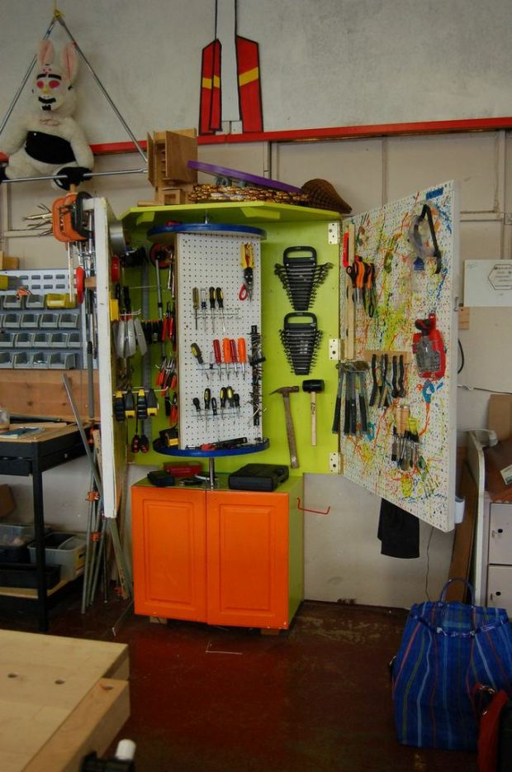
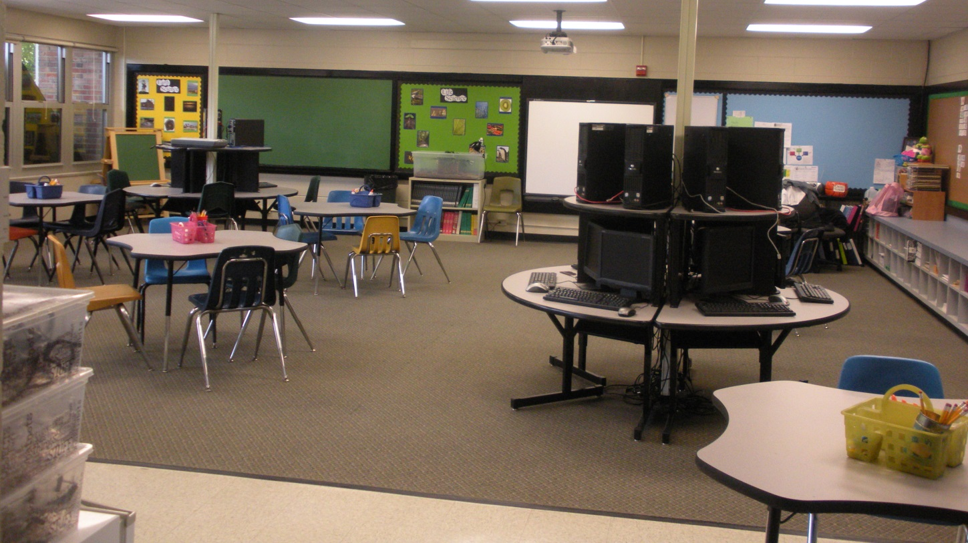
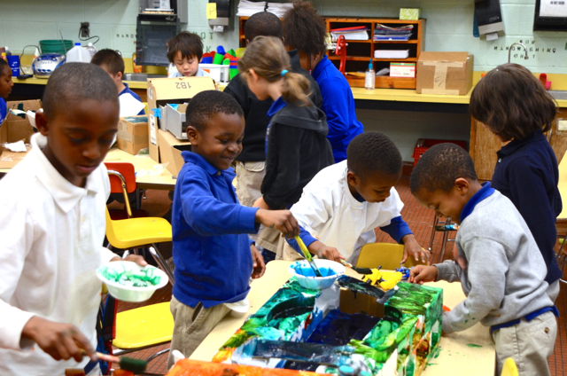
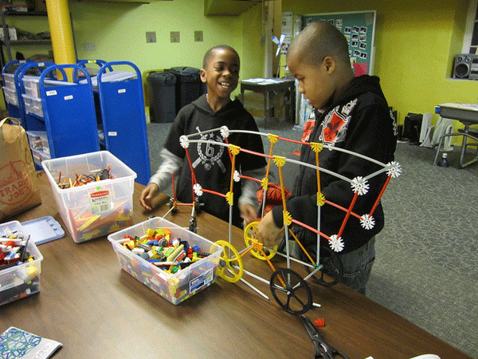

Slide 24
Common Fear/Barriers
I don’t have a background in engineering, how can I teach this?
What if the students ask a question that I can’t answer?
All of the students will be working on multiple problems simultaneously, how can I manage that?
I am afraid to let the students use the tools because of safety concerns!
I don’t have any space in my curriculum for one more thing!

Slide 25
Resources
Howtoons: mini-motor, Frankenmouse, nocturnal robot, turkey baster flute, speaker cup, cigar box guitar, marshmallows launcher, blimp, ornithopter, homemade strobe, light bending, tower, ice cream http://www.instructables.com/group/howtoons/
Make Magazine: http://makezine.com/
Exploratorium Tinkering Studio: http://tinkering.exploratorium.edu/
Children’s Engineering: http://www.childrensengineering.com
City Technology: http://www.citytechnology.org/

Slide 26
WHAT DO STEM LABS OFFER?
It is important to remember that the greatest learning often takes place from the ideas that might fall short of the stated goal.
Mistakes can provide great learning opportunities
Most Important: Teachers/students learn that there is no such thing as “one correct answer”

