Slide 1
Creativity
Creativity- the use of the imagination or original ideas, especially in the production of an artistic work… inventiveness, innovation, originality.
Can be nurtured
Can be measured

Slide 2
Torrance Test
We will take a test of creativity often given to children.
Once I hand out the assessment, you will have 3 minutes to draw as many pictures as you can. The goal is to draw as many, and as many creative pictures as you can in the time allotted. Pictures should also have a title or description.

Slide 3
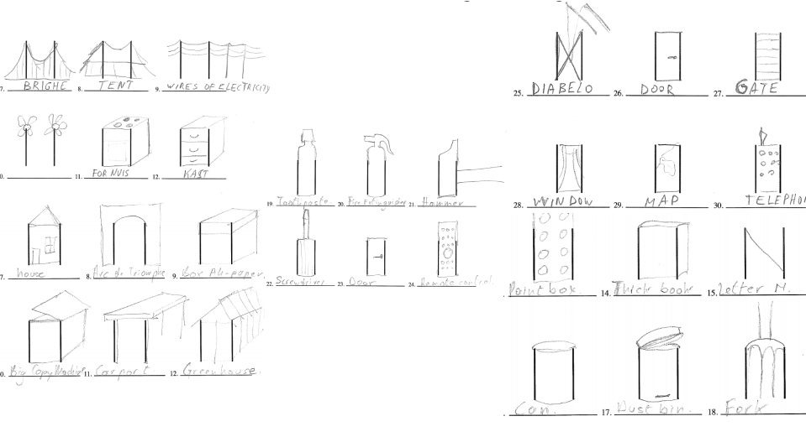

Slide 4
Creativity- Four Categories of Divergent Thinking
Fluency- how many ideas you can come up with in a short period of time
Originality- how uncommon your ideas are
Flexibility- how many areas your ideas cover
Elaboration- level of detail in responses

Slide 5
What does this have to do with STEM Education?
The ideas of Fluency and Flexibility = Brainstorming
These are skills that can be practiced
Tension between fluency and originality

Slide 6
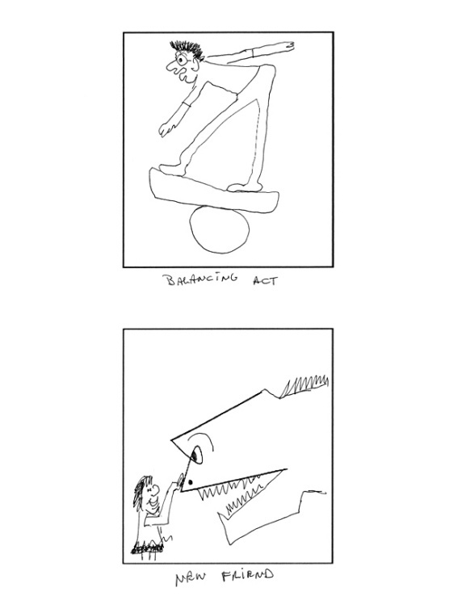
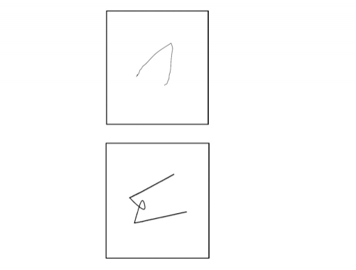
Other Fun Exercises
Guilford Alternative Uses Test- 2 min. to think of as many uses as possible for a paper clip
Incomplete Figures- these are on GT screens

Slide 7
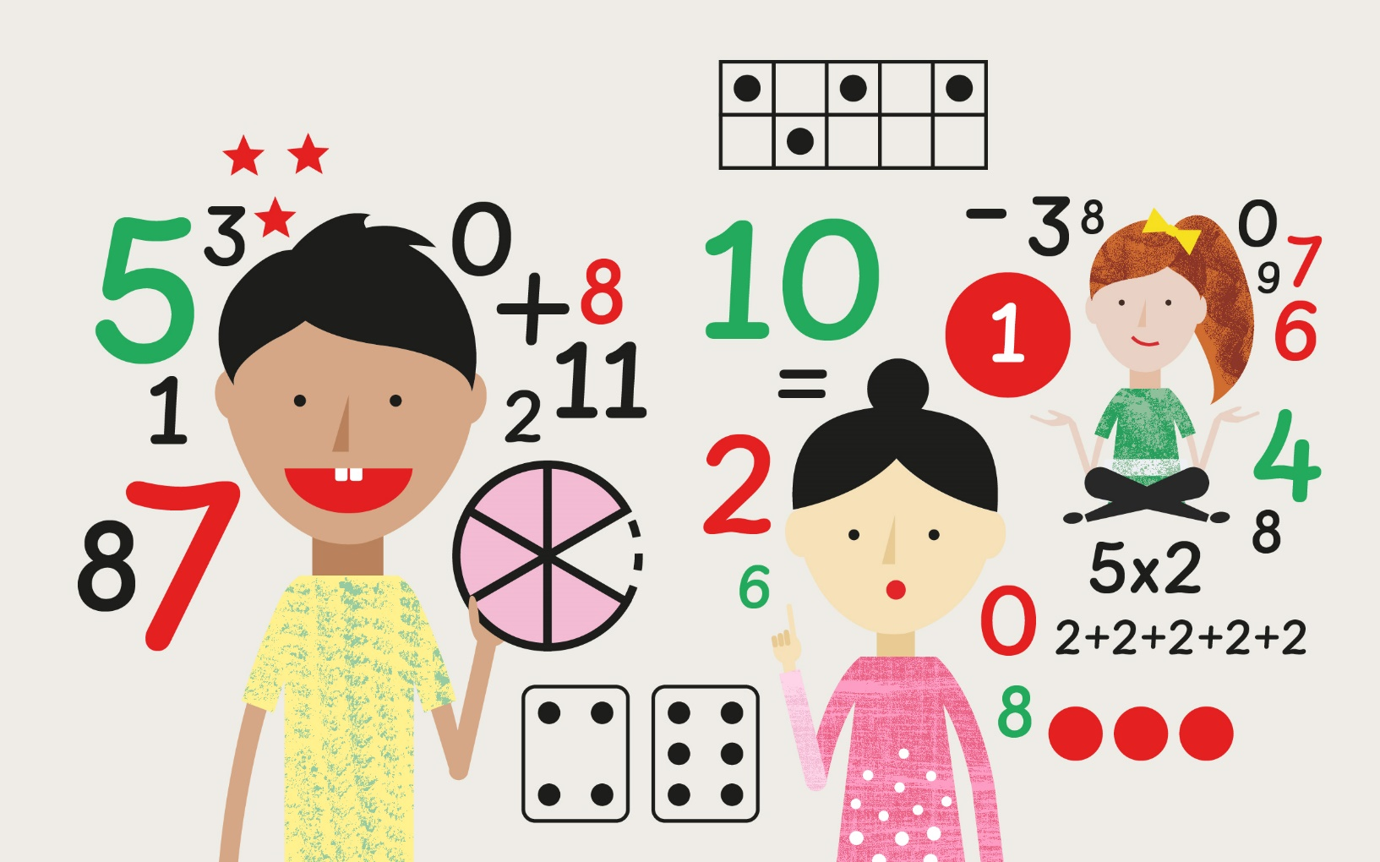
Number Sense and Creativity

Slide 8
16 = 9 + 7

Slide 9
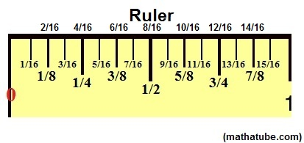
Measure Twice, Cut Once

Slide 10
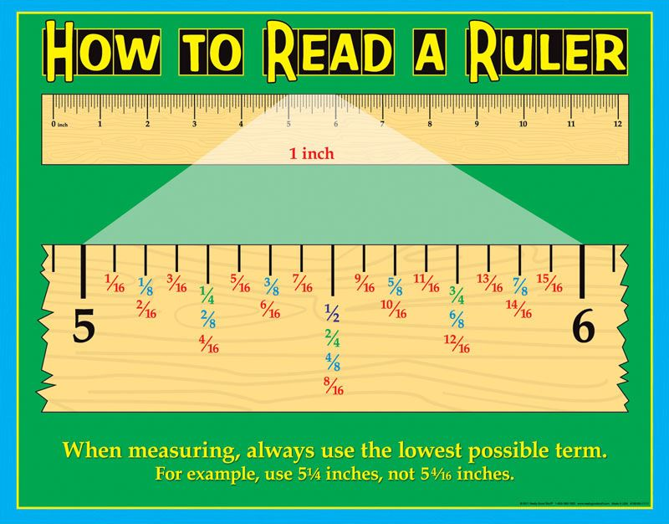

Slide 11
Three Simple Steps to Add Fractions
Step 1: Make sure the bottom numbers (the denominators) are the same.
Step 2: Add the top numbers (the numerators), put that answer over the denominator.
Step 3: Simplify the fraction (if needed)

Slide 12
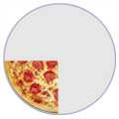
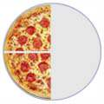
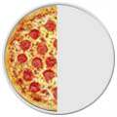
Adding Fractions
¼ | + | ¼ | = | 2/4 | = | ½

Slide 13
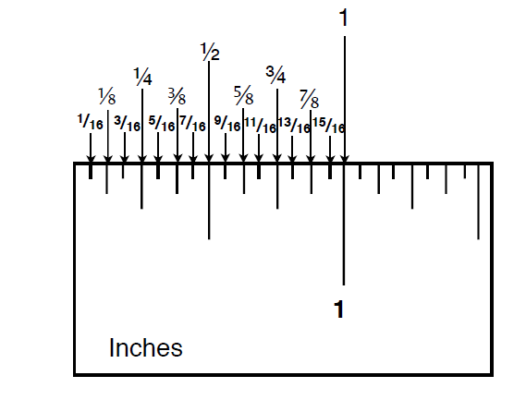

Slide 14
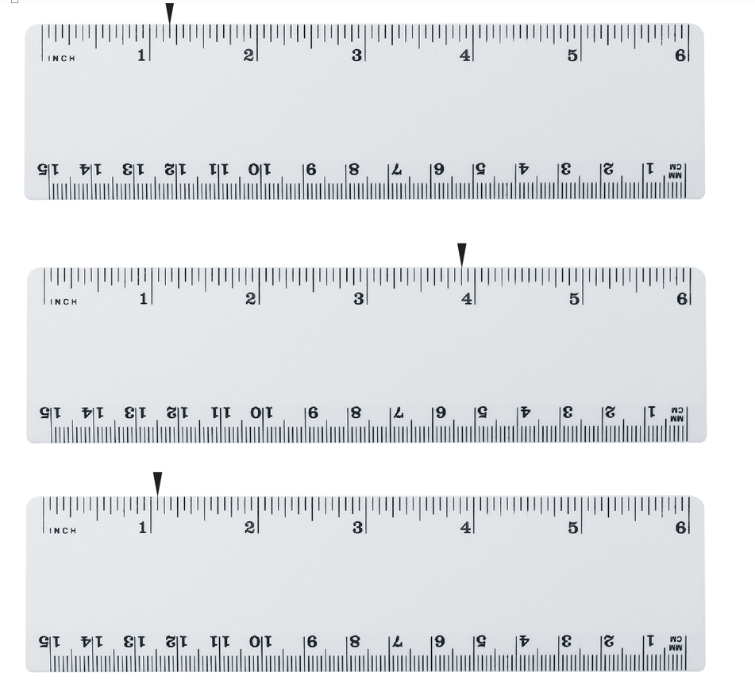

Slide 15
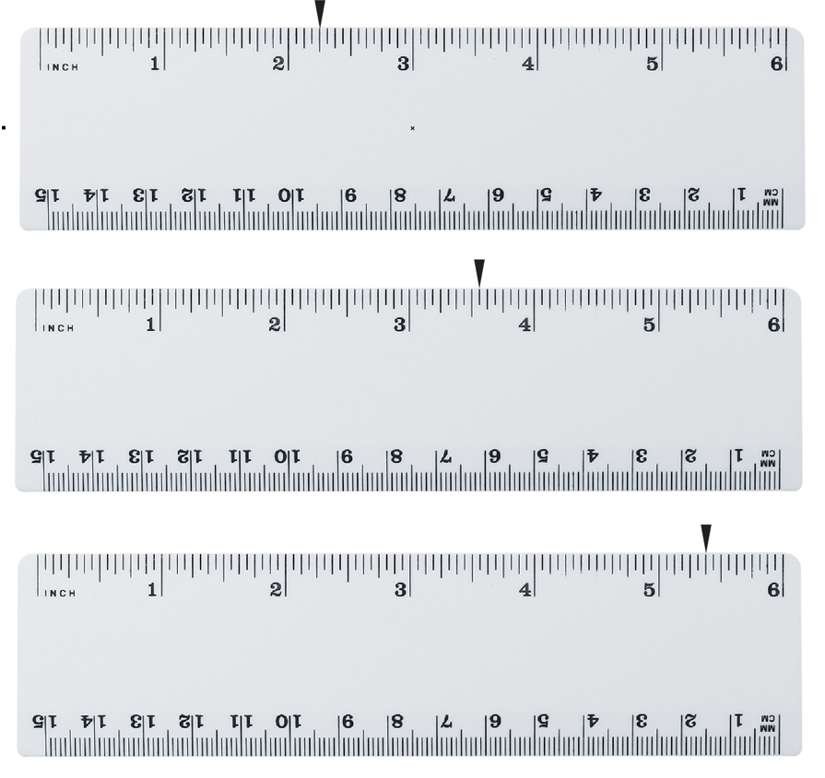

Slide 16
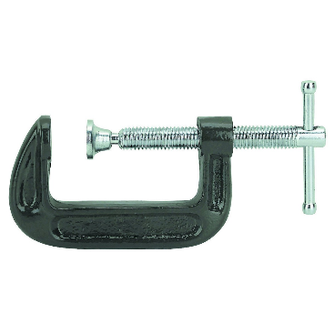
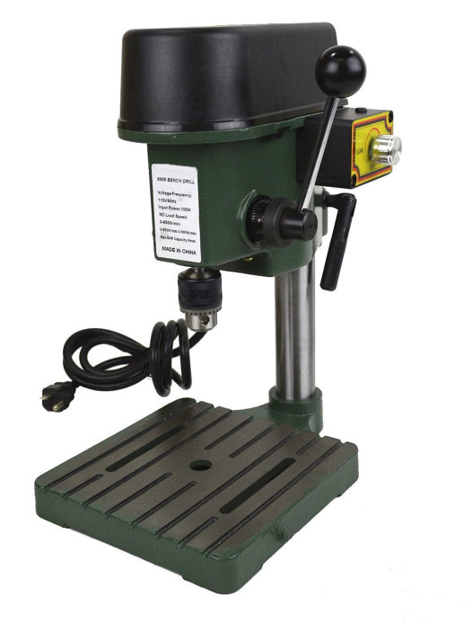
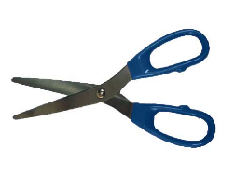
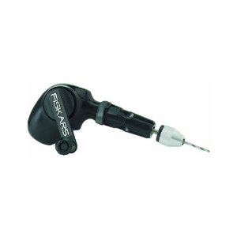
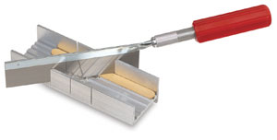
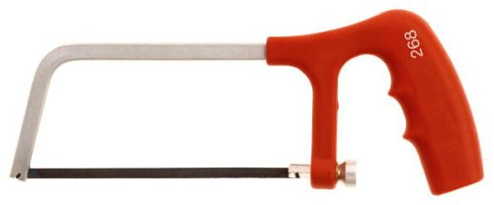
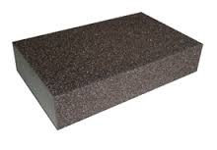
Tools
What other tools have we used?

Slide 17
Tools
Scissors
C-clamp
Razor Saw
Miter Box
Drill Press
Hack Saw
Hand Drill
What other tools have we used?
Sanding Sponge

Slide 18
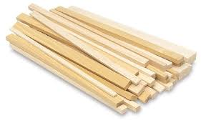
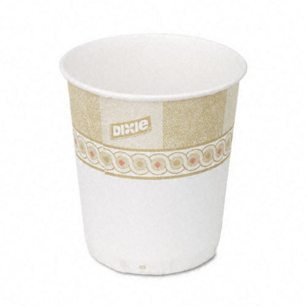
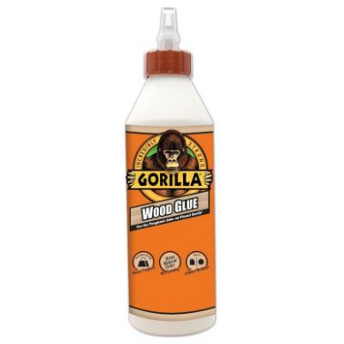
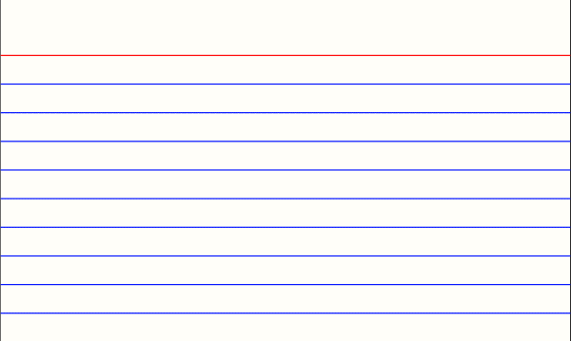
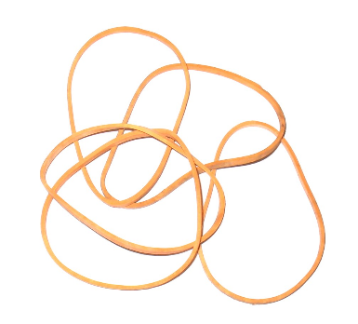
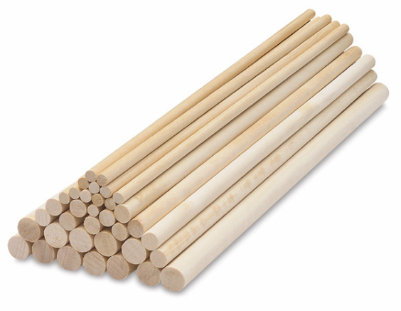
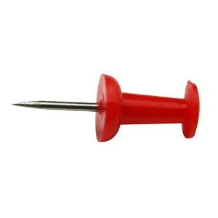
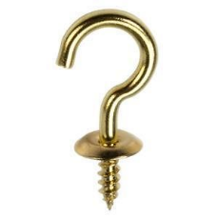
Materials

Slide 19
Materials
Wood (Dimensional Lumber)
Paper Cup
Wood Glue
Notecard/Cardstock
Rubber Bands
Cup Hook
Thumbtack
Dowel Rods

Slide 20
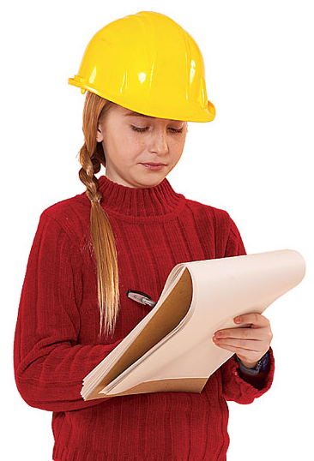
Processes
Gluing
Sanding
Measuring
Cutting
Drilling
Clamping

