Slide 1
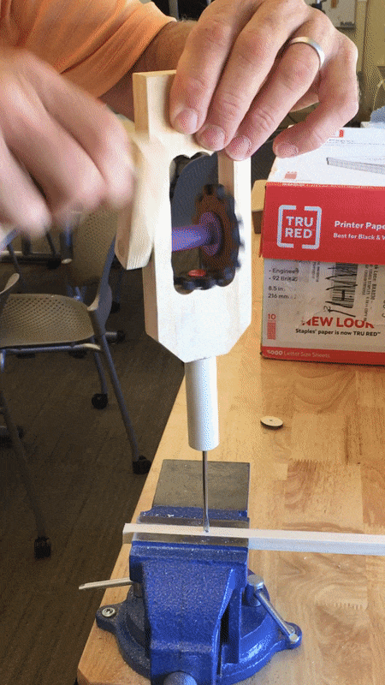
Assembling a Manual Hand Drill
A Technical/Procedural Project

Slide 2
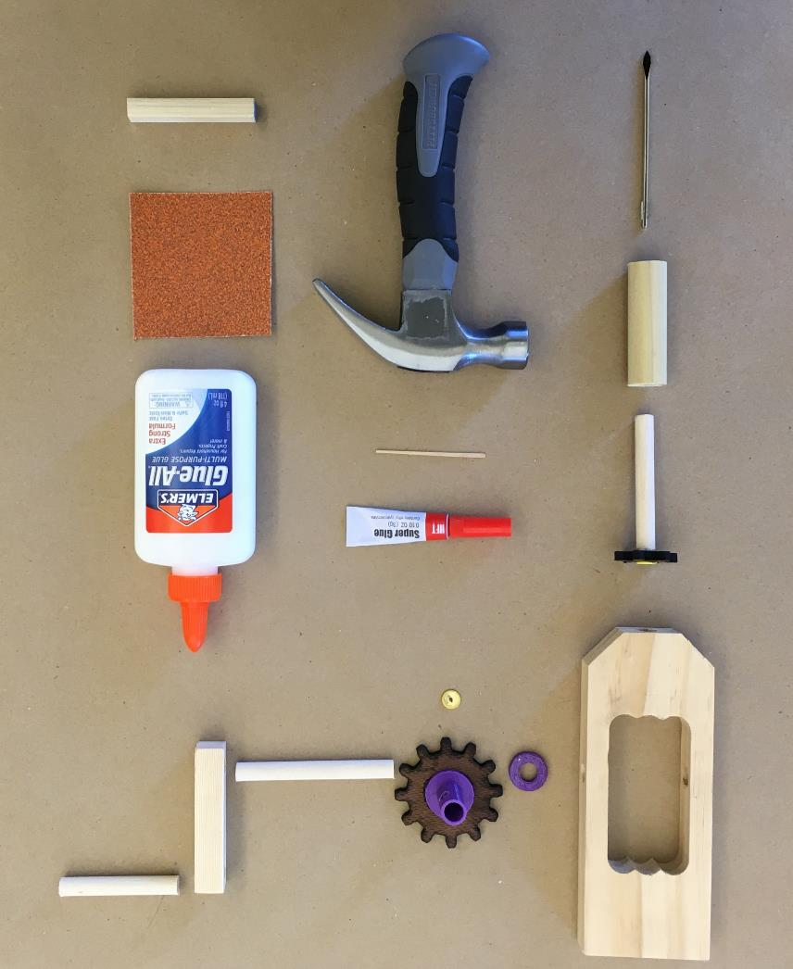
1
DRILL FRAME
15
SANDPAPER
3
PLASTIC SPACER
16
SCRAP WOODEN BLOCK*
2
2
7
3
LARGE GEAR AND PLASTIC COLLAR
1
5
4
2 - THUMBTACKS
6
5
LONG DOWEL
4
6
WOODEN HANDLE PIECE
13
7
SHORT DOWEL - HANDLE
8
12
14
8
SMALL GEAR AND DOWEL
9
LARGE DOWEL - CHUCK
9
10
DRILL BIT
15
11
STUBBY HAMMER*
11
12
TOOTHPICK
10
13
SUPER GLUE (CA GLUE)
16
14
WHITE GLUE*
*NOT PROVIDED IN KIT

Slide 3
Step 1 Identify the tools and materials needed to assemble your manual hand drill.
You will need to have white glue available to you and a scrap wooden block such as a piece of wood left over from your Space Frame Design Challenge.
You will also need a small hammer. If needed, you may borrow one from the STEM lab.

Slide 4
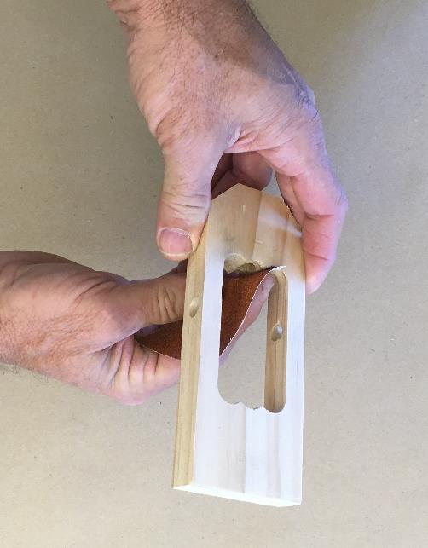
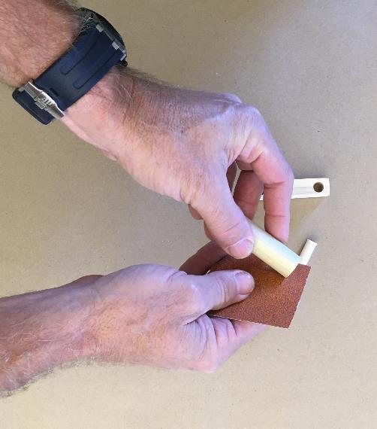
1
Step 2 Sand each of the wood components.
Pay particular attention to sanding down sharp edges at the bottom of the drill frame.
5
6
7
15

Slide 5
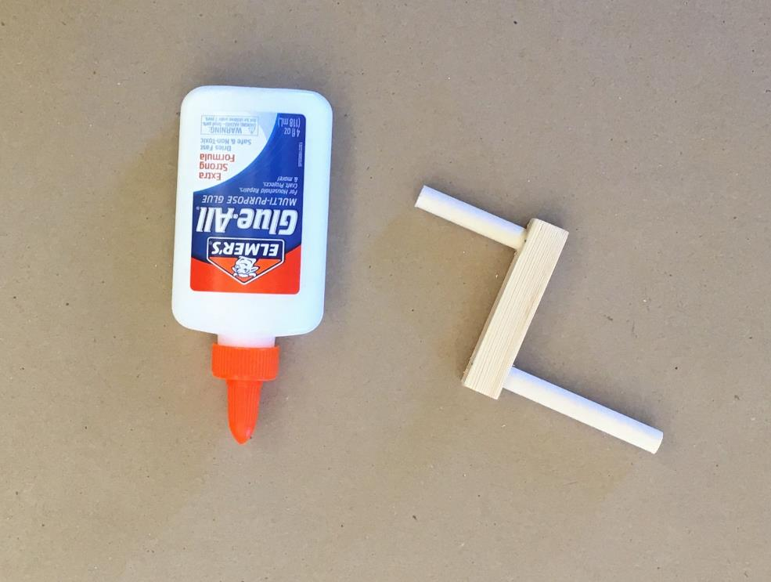
Step 3 Use white glue to affix each of the dowel rods for the drill handle.
*It is important that you let
the glue dry overnight.
5
6
7
14

Slide 6
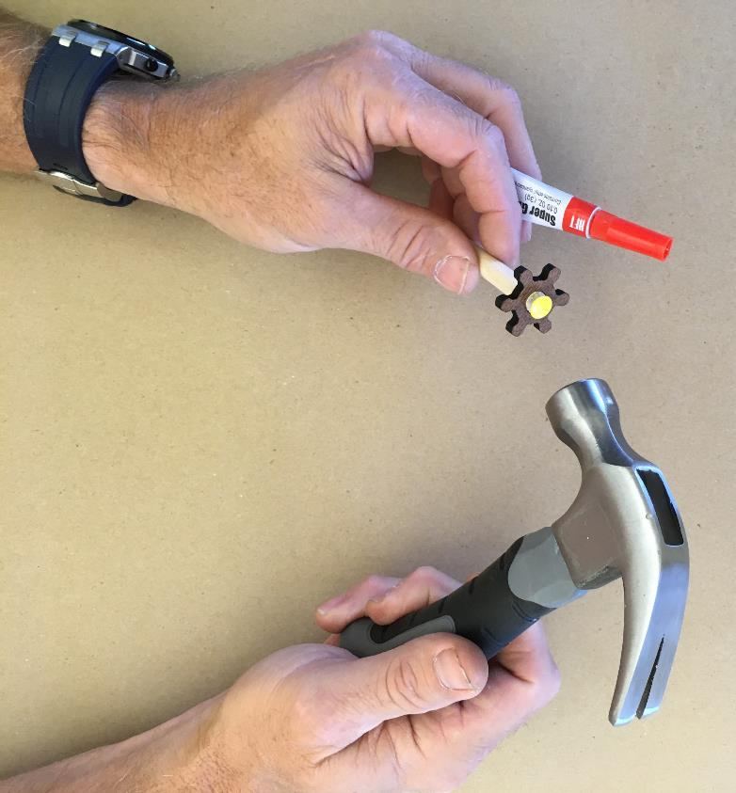
Step 4 Use the provided super glue and toothpick to completely coat the end of the dowel rod where it is connected to the smaller gear.
Carefully place a thumbtack into the center of the dowel rod and give it a few taps to ensure that it makes contact with the super glue.
11
12
4
8
13

Slide 7
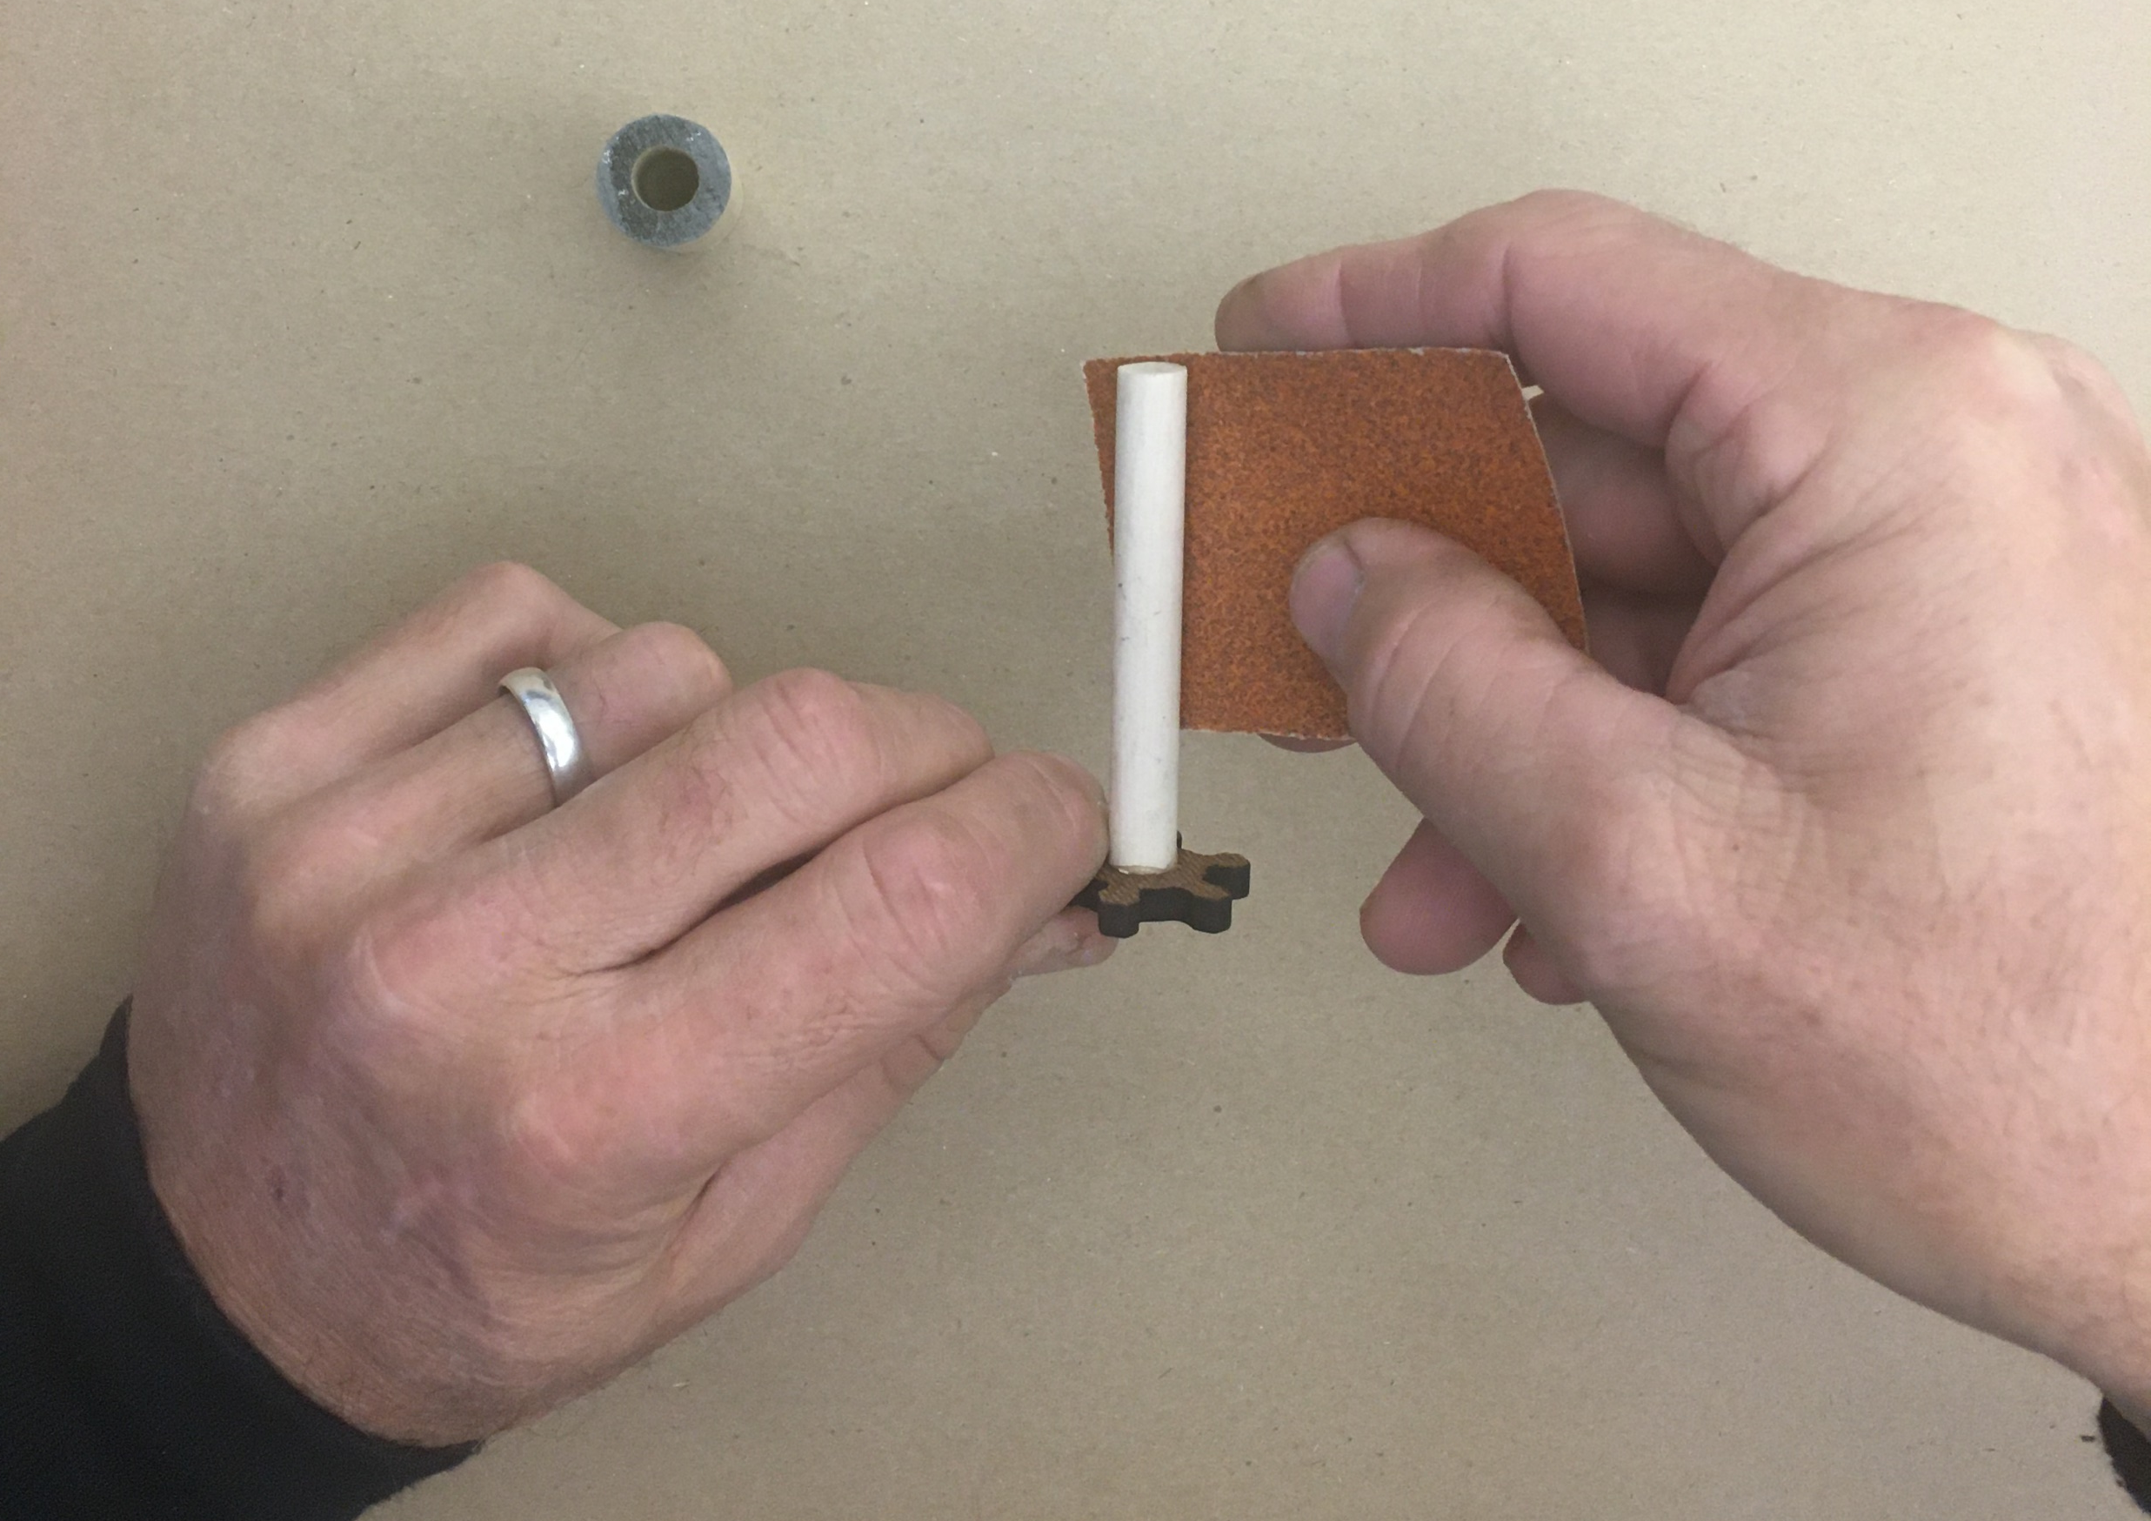
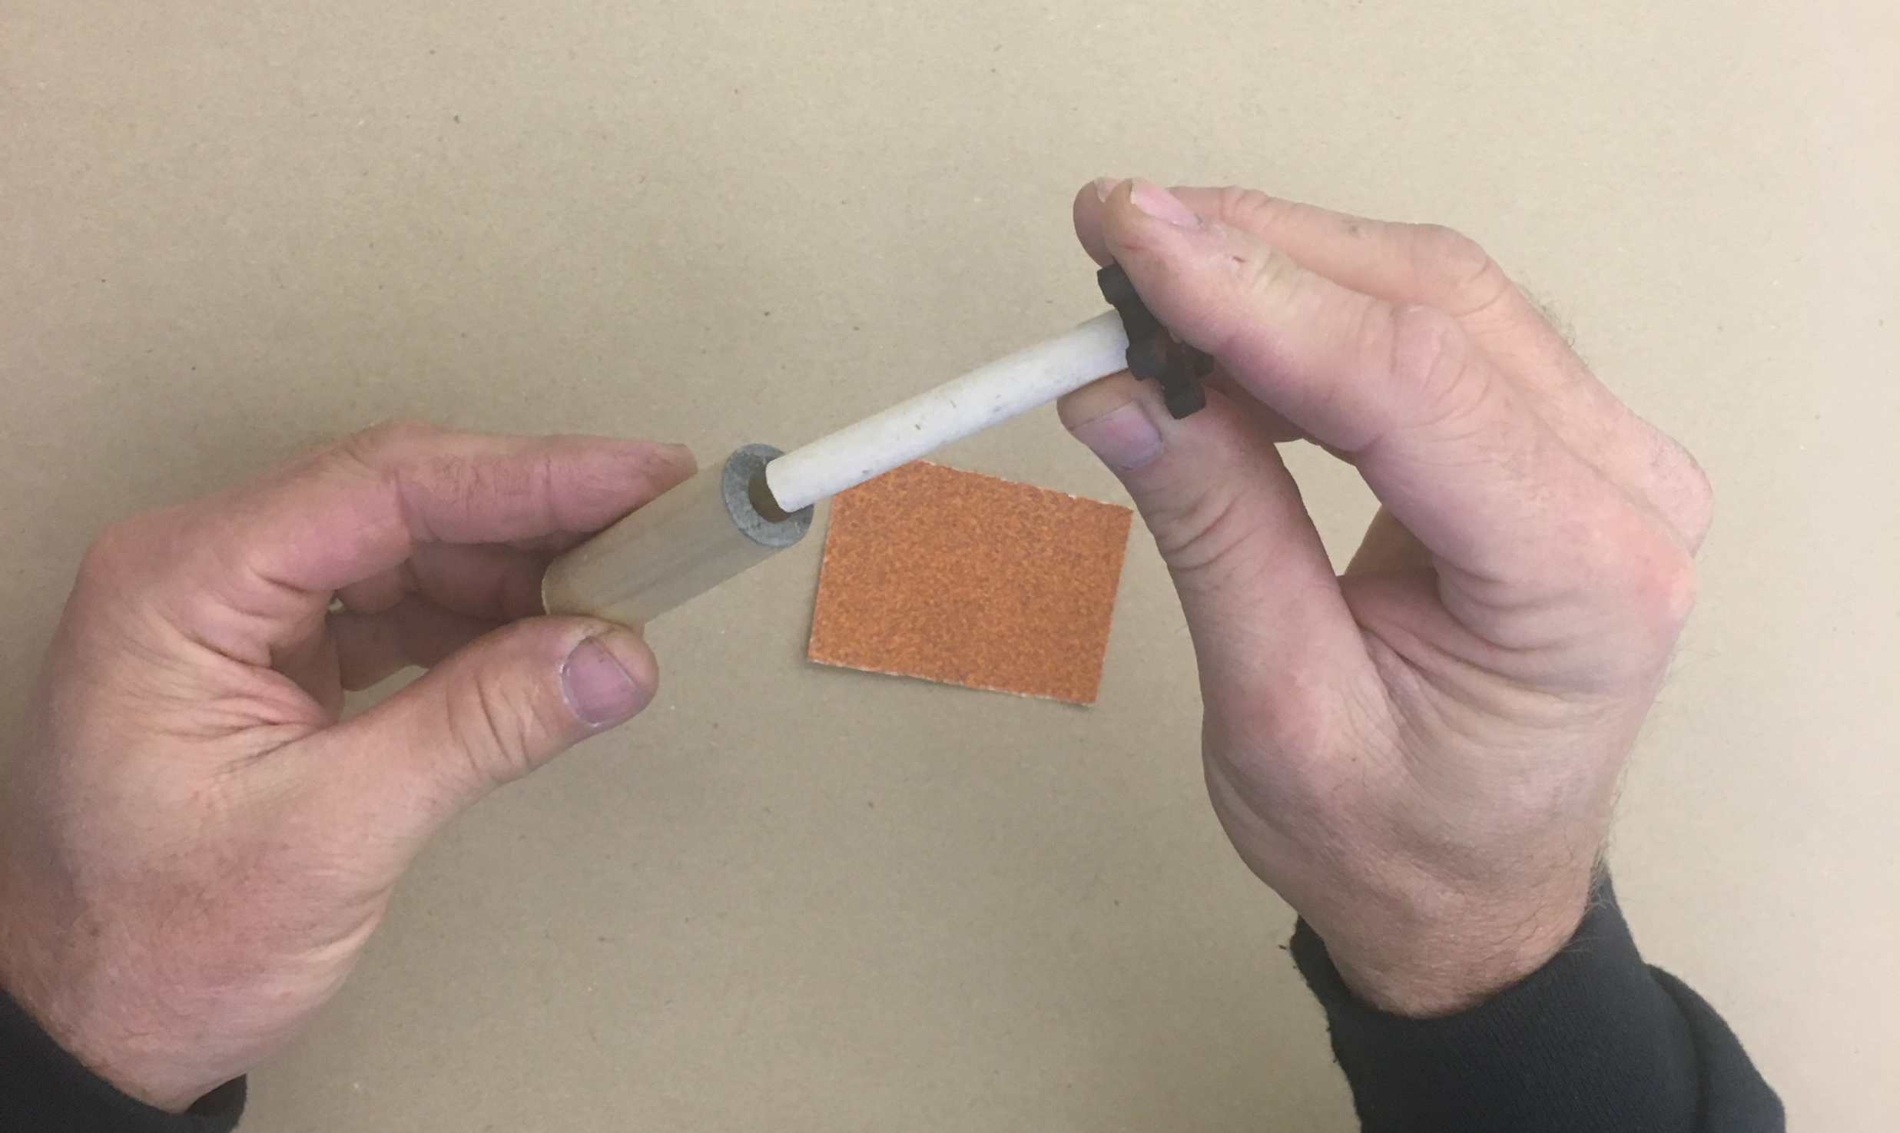
Before continuing to Step 5 Use the provided super sandpaper to sand down the dowel rod that is connected to the smaller gear. It should slip easily into the large dowel – chuck.
Set the large dowel – chuck aside and continue to Step 5.
8
9
15

Slide 8
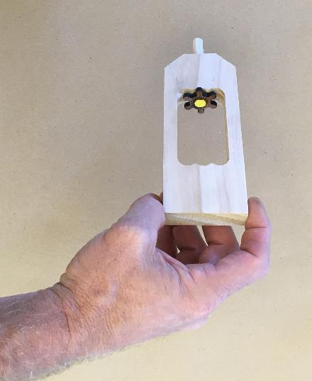
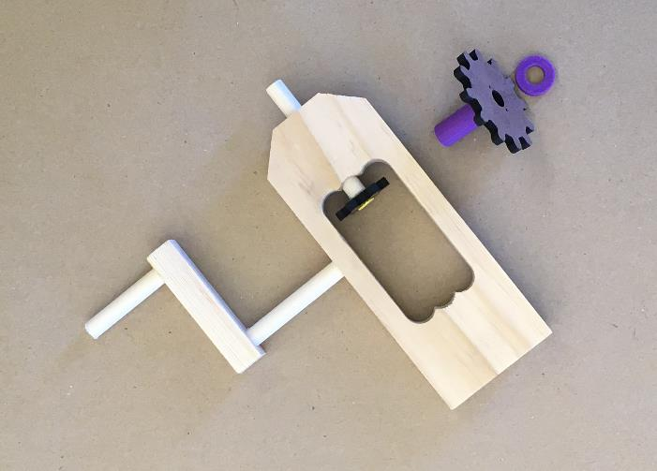
Step 5 Place the dowel rod through the drill frame to ensure that it spins freely.
Lay out each of the components that will be assembled next – the handle, the larger gear with the plastic collar and plastic spacer. Remember that the shorter dowel rod on the handle will go to the outside of the drill frame.
1
4
8
3
2

Slide 9
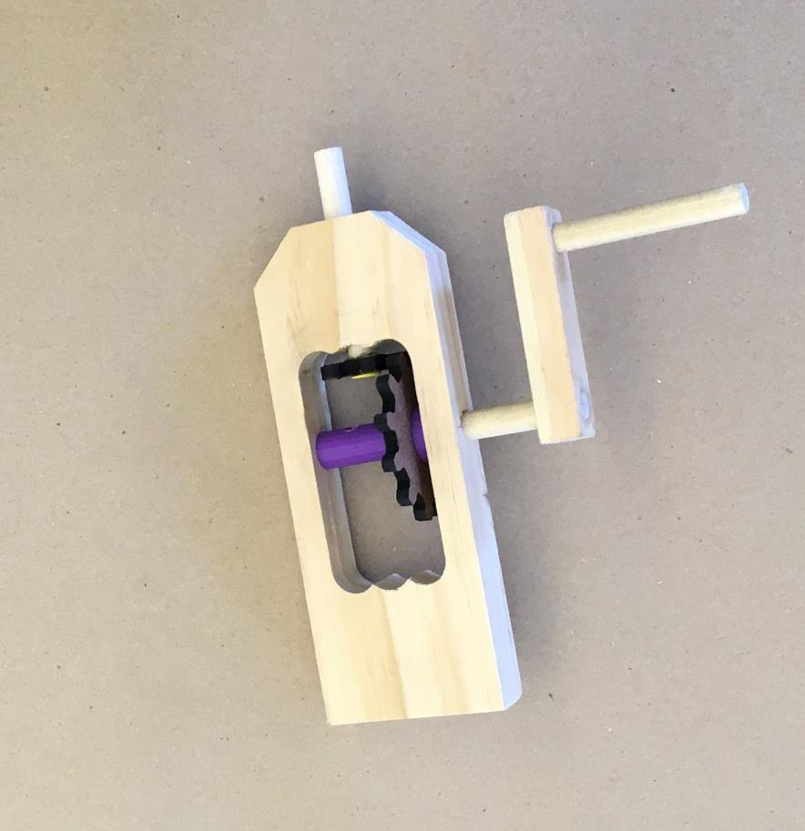
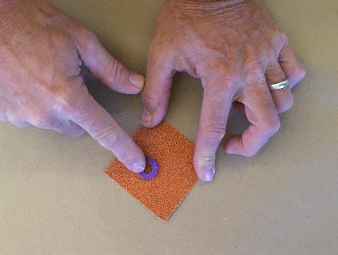
Step 6 Align each of the components and slip the dowel through the larger gear and collar and the spacer.
To ensure a perfect fit, you may need to sand down the spacer piece.
2
15

Slide 10
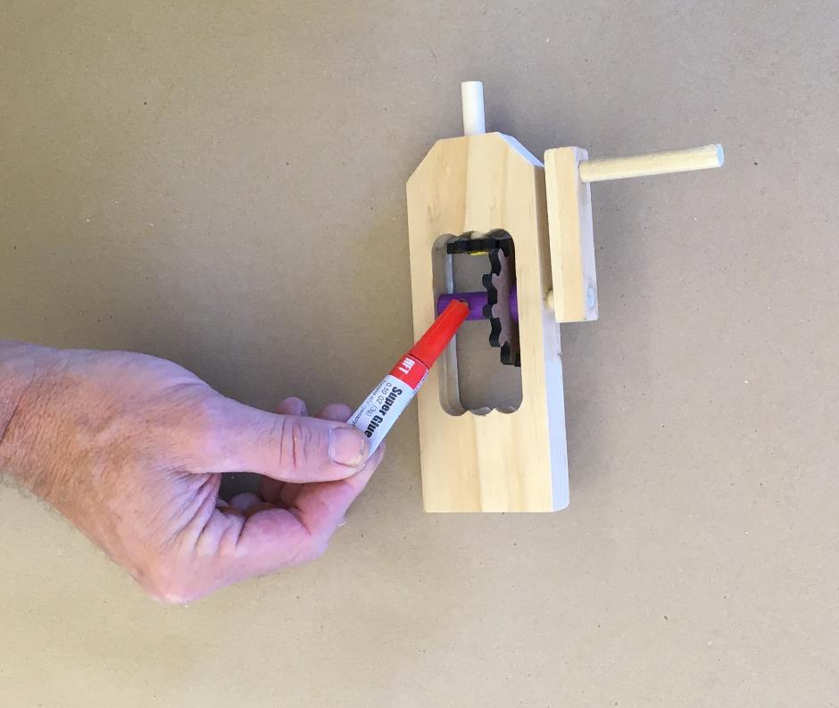
Step 7 Fill the hole on the plastic collar with super glue and then rotate the gear while holding the handle so that the glue is transferred between the two surfaces.
*Immediately proceed to
Step 8.
13

Slide 11
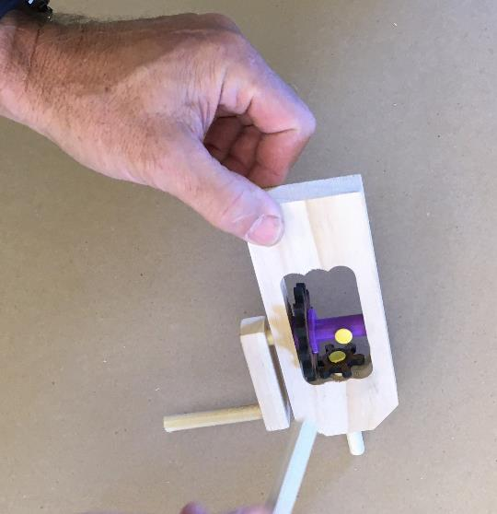
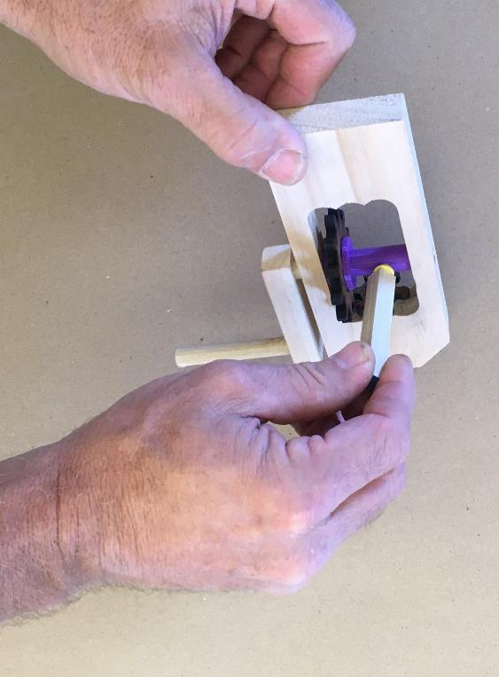
4
Step 8 Immediately after filling the hole on the collar and rotating it on the dowel, place a thumbtack over the hole and use the scrap of wood to seat the thumbtack flush to the collar.
16

Slide 12
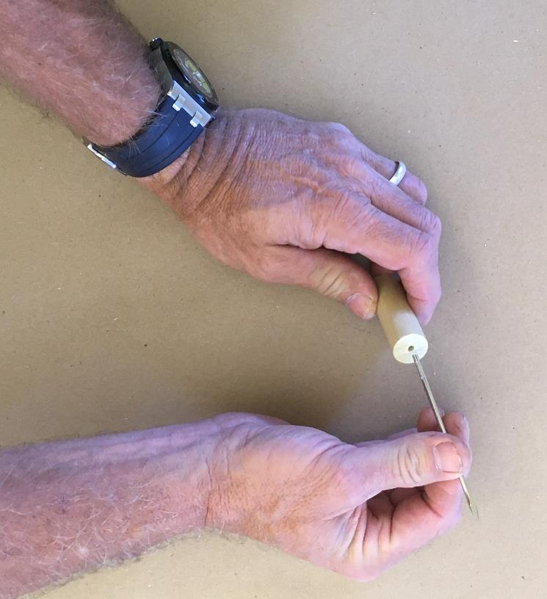
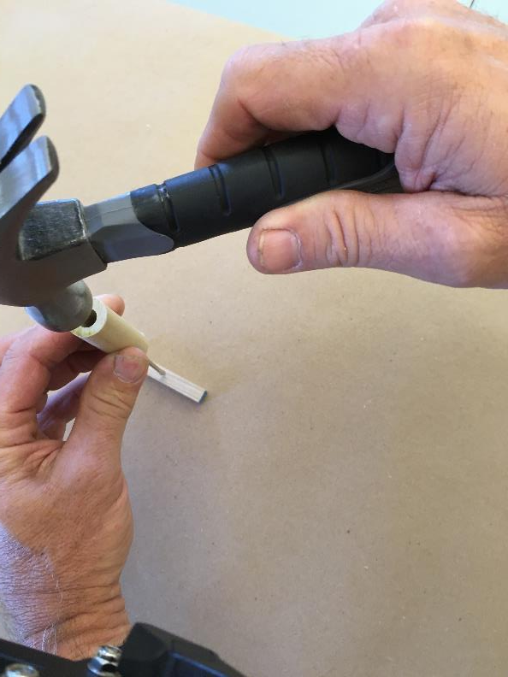
Step 9 Align the drill bit with the small hole on remaining dowel rod.
Place the drill tip on a piece of scrap wood and gently tap to seat the bit.
9
10
11
16

Slide 13
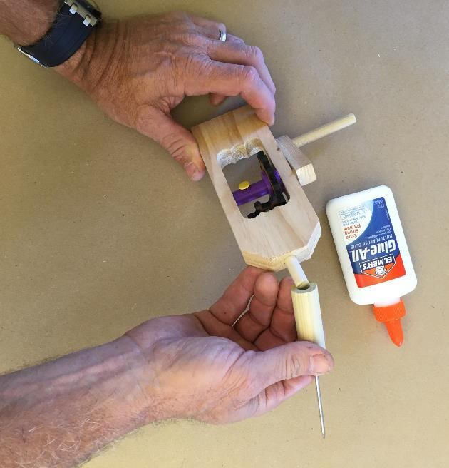
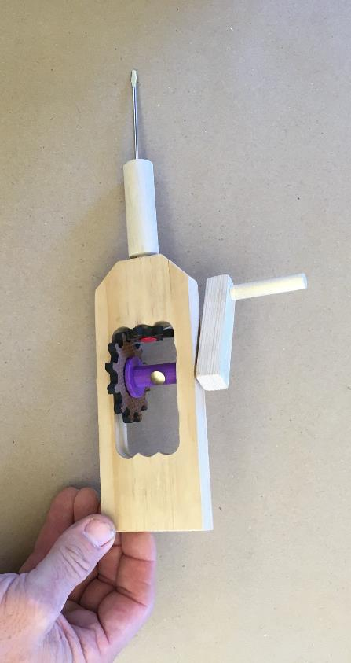
Step 10 Use white glue to adhere the large dowel with drill bit onto the dowel rod protruding through the bottom of the drill frame. It should be snug to the drill frame, but able to rotate freely.
Wipe off all excess glue between the dowel and the frame.
14
*Allow the glue to dry overnight before attempting to use your drill.

Slide 14
Congratulations! Your manual hand drill assembly is complete and you are ready to give it a try.
Create a video of you using your new drill to drill a hole in a piece of wood and submit the YouTube link to Blackboard

