Slide 1

Education Resources

Slide 2

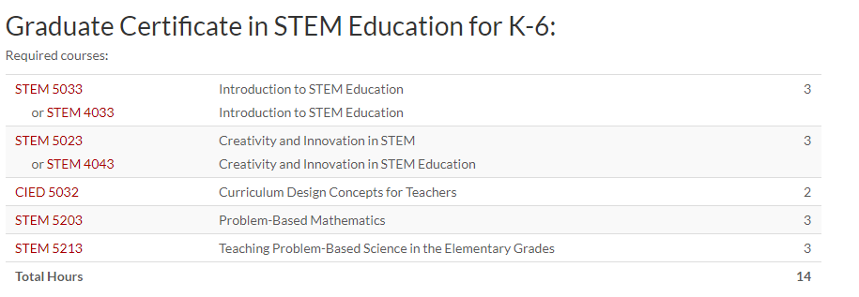

Slide 3


University of Arkansas STEM Education
http://www.uastem.com/downloads/

Slide 4
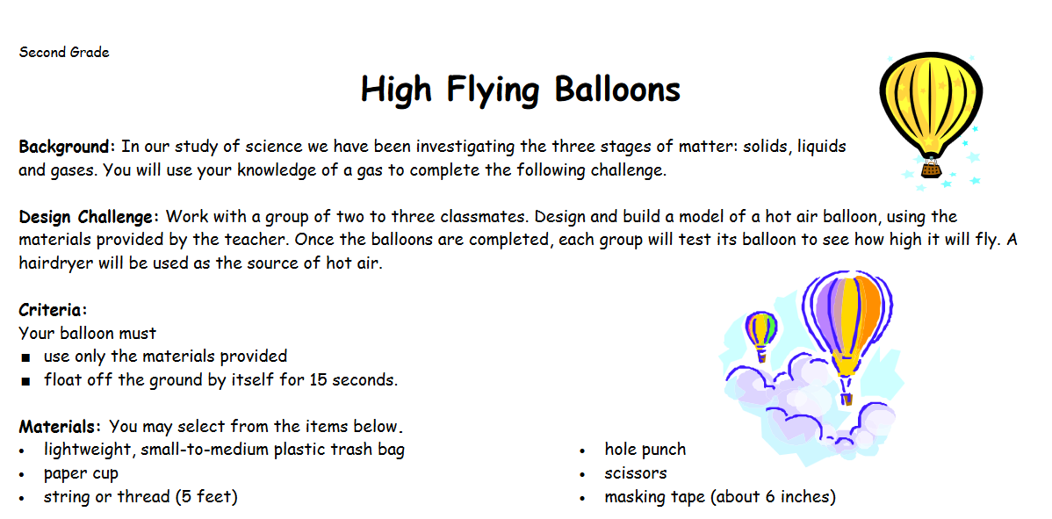

Virginia Children’s Engineering Council
http://www.childrensengineering.org/index.php

Slide 5
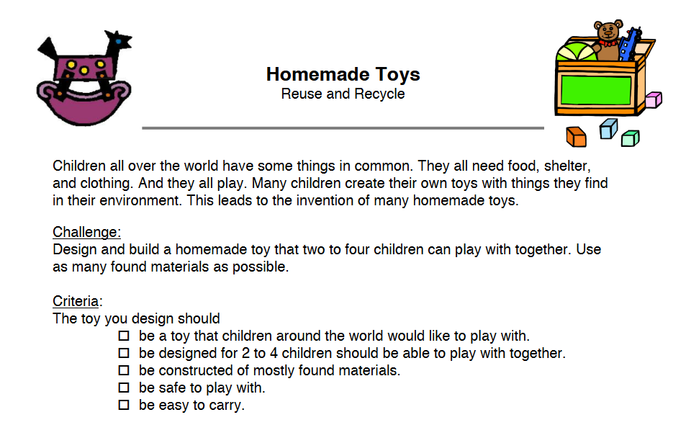

Children’s Engineering
http://www.childrensengineering.com/

Slide 6
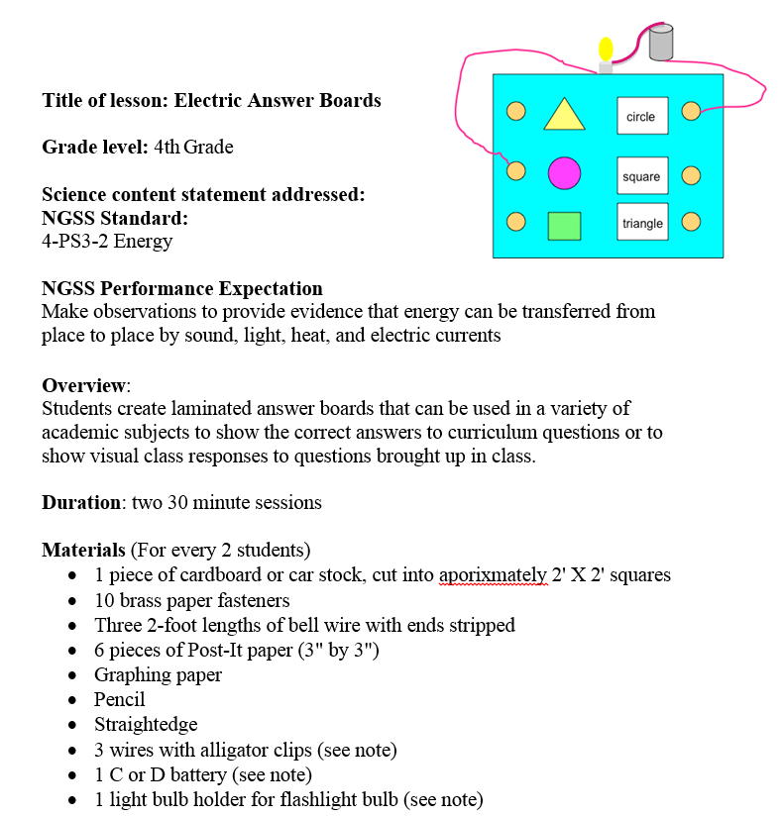

STEM is Elementary
http://www.stemiselementary.com/

Slide 7


NASA Education Resources
https://www.nasa.gov/education/resources

Slide 8


Engineering Go for it (eGFI)
http://teachers.egfi-k12.org/

Slide 9
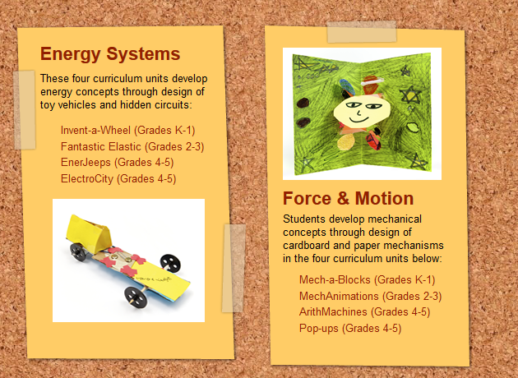

City Technology
http://www.citytechnology.org/
Fantastic Elastic

Slide 10
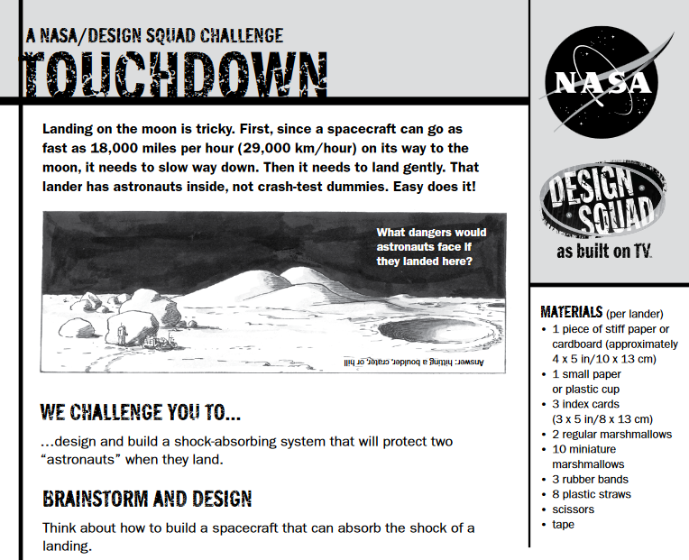

PBS Design Squad
http://pbskids.org/designsquad/

Slide 11

Teach Engineering
https://www.teachengineering.org/

Slide 12

Hour of Code – December
https://hourofcode.com/

Slide 13
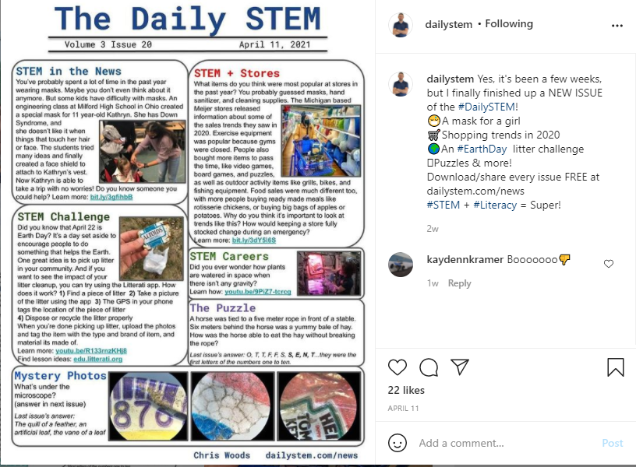

Slide 14


Slide 15
Champion!
Be a

