Slide 1
Technical/Procedural Problem Solving
Another Type of Problem Solving for STEM Learning

Slide 2
Problem Solving Categories
Design
Trouble-shooting
Invention/Innovation
Research and Development
Experimentation
Technical/Procedural

Slide 3
So Far, We’ve Focused on Design
While Design Problem Solving is the primary method used in STEM, in some cases you will need to use other methods.
Now we are going to focus on Technical/Procedural Problem Solving

Slide 4
Technical/Procedural Problem Solving
Form of problem solving that requires a student to follow a set of technical directions to accomplish a task. For example, students might be required to build an electronic device following precise directions of a technical nature and then, when the device is complete, the students must complete a series of experiments.
T/P Problem Solving is a lower level method of problem solving (Six Facets)

Slide 5
T/P Problem Solving & Six Facets
While Design Problem Solving is very effective in reaching the higher levels of the Six Facets (Applications, Perspective, Empathy, & Self-knowledge)
T/P Problem Solving can be a useful tool for reaching the first two levels of the Six Facets (Explanation & Interpretation)

Slide 6
Strategies for Solving T/P Problems
Typically don’t use the Design Process/Loop
T/P Problems require the student to:
  Seek relationships and work out solutions
  Follow step-by-step technical directions
  Read a schematic drawing
  Write technical directions
  Understanding the systemic order of technical devices
  T/P Problems requires that the learner have some prior background in the subject matter

Slide 7
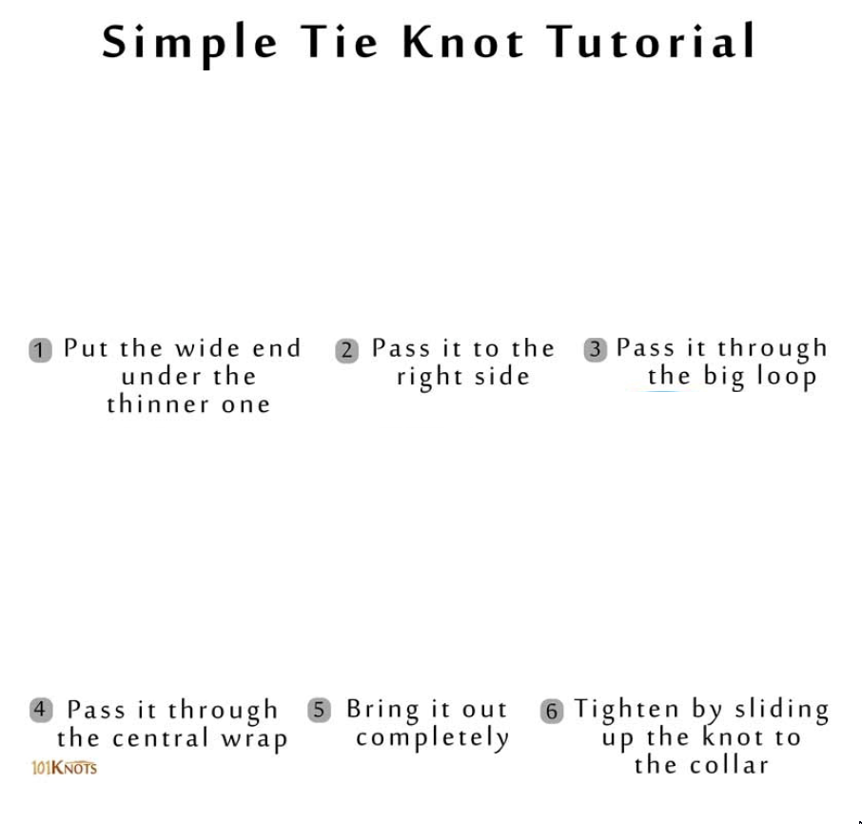

Slide 8
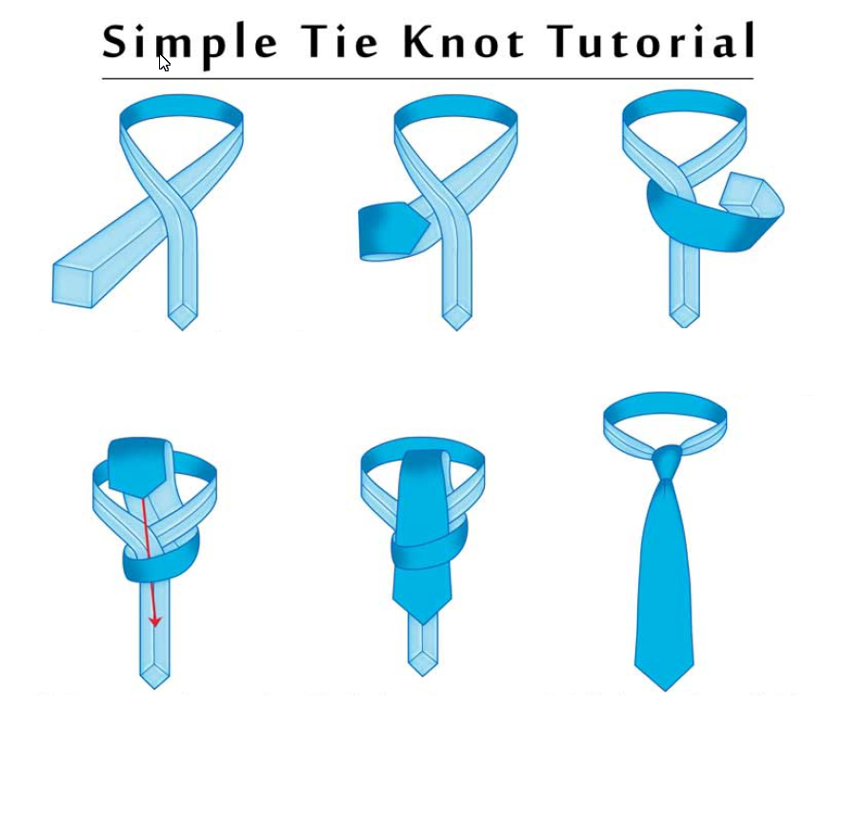

Slide 9
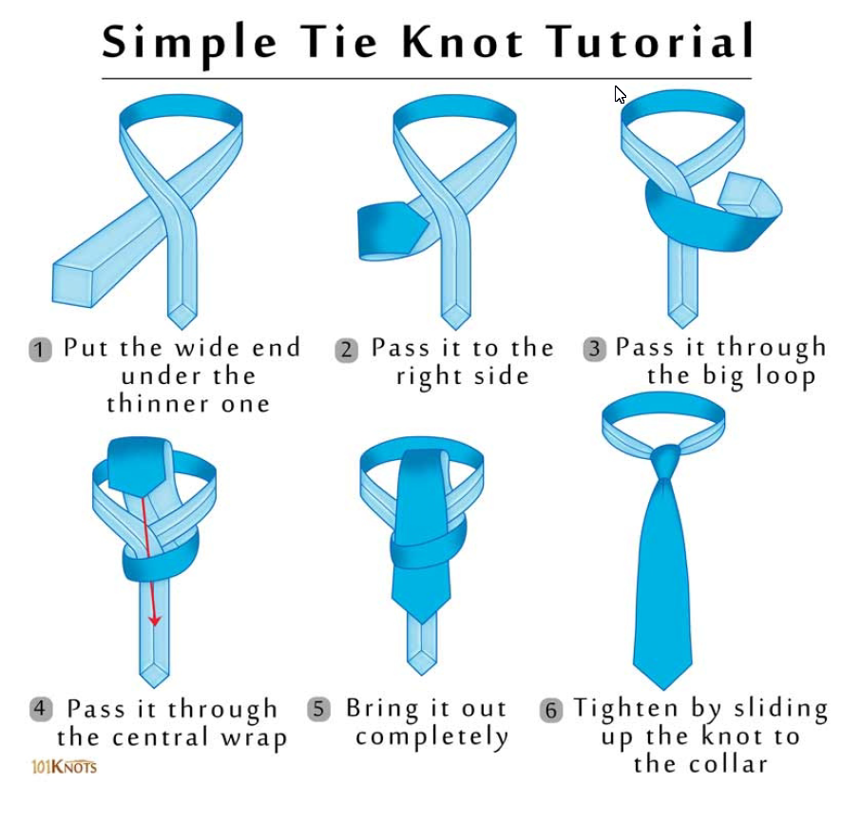

Slide 10
Writing a Technical/Procedural STEM Problem
-Good pictures and written directions to develop the technical product
-Detailed instructions on what the students will do after creating the product
  – test – experiments – modifications - data collection
  – this is where the content learning will occur.

Slide 11
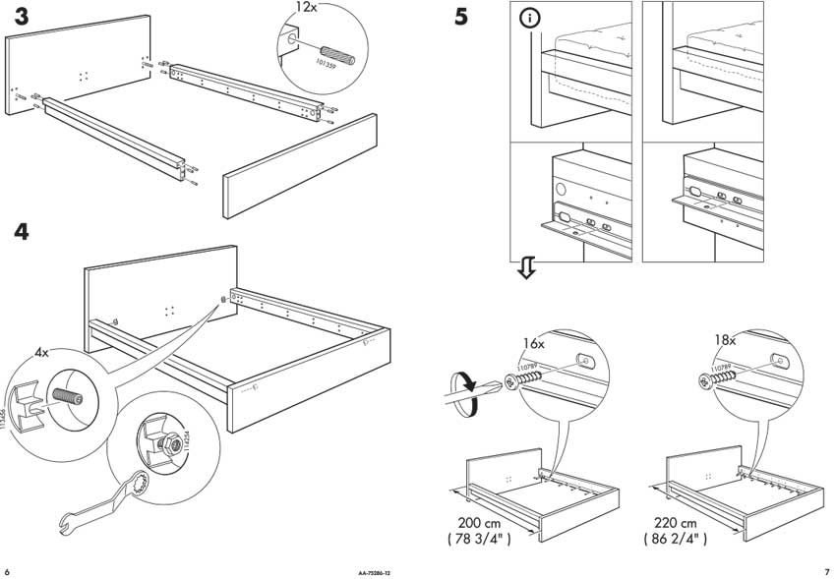

Slide 12
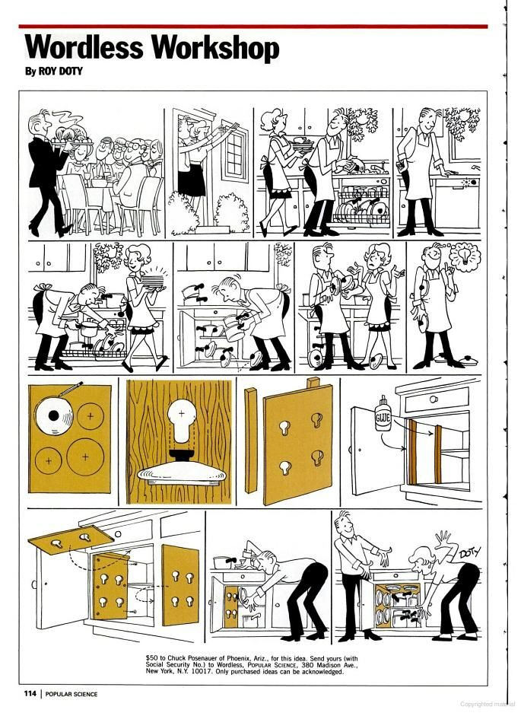

Slide 13
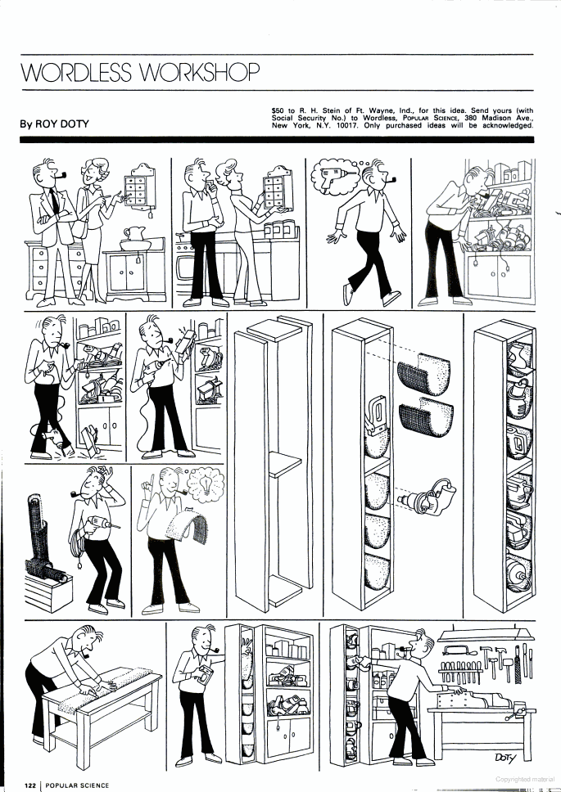

Slide 14
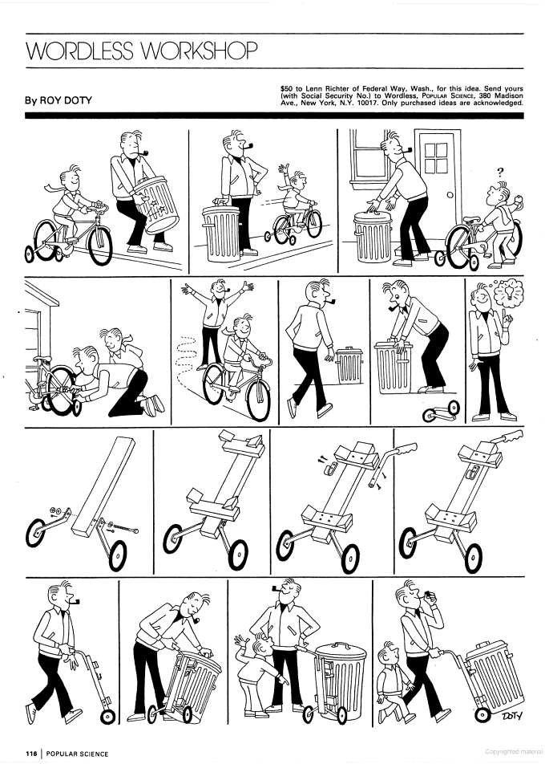

Slide 15


Slide 16
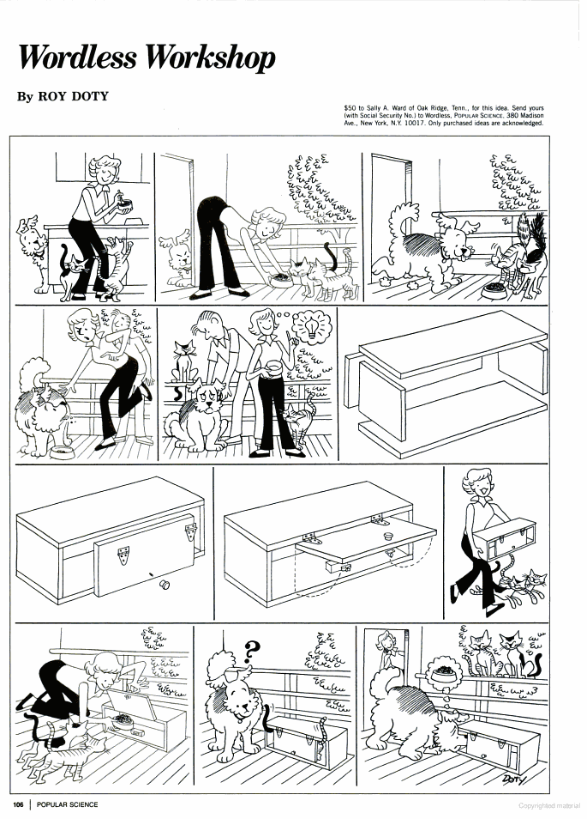

Slide 17
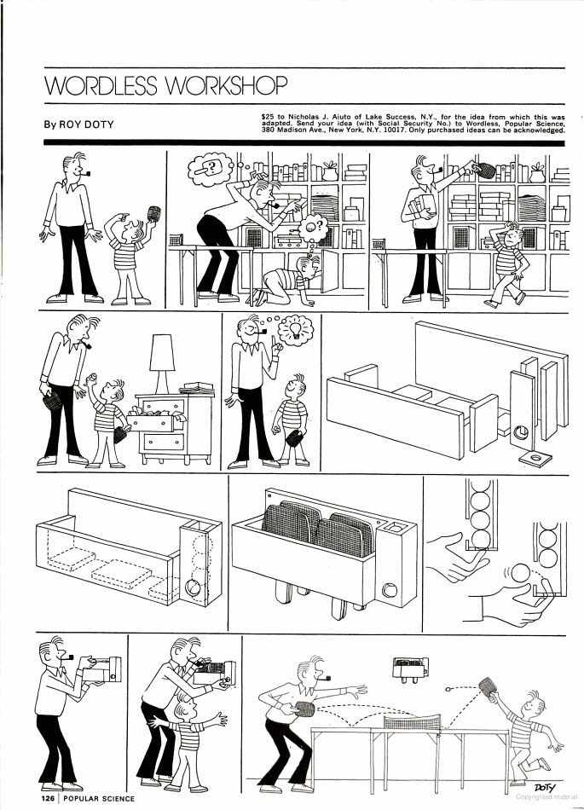

Slide 18
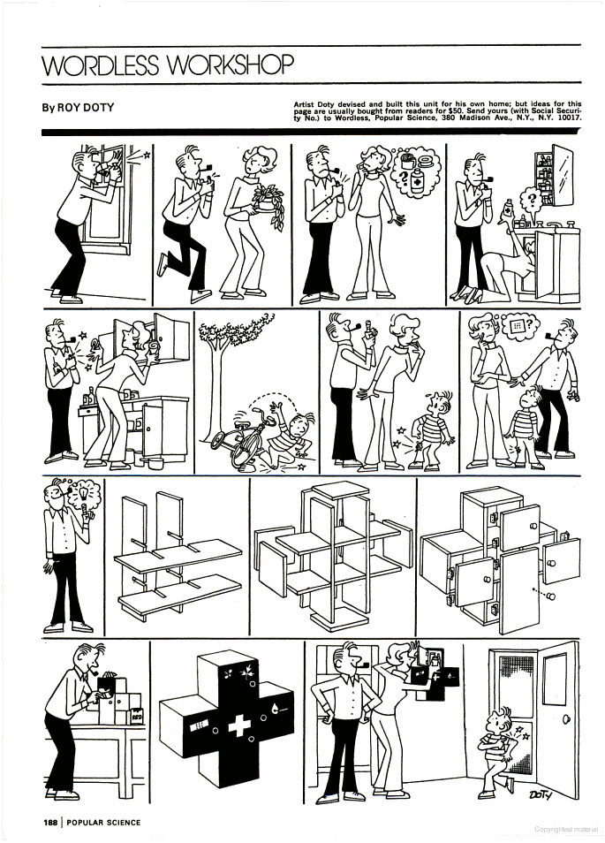

Slide 19
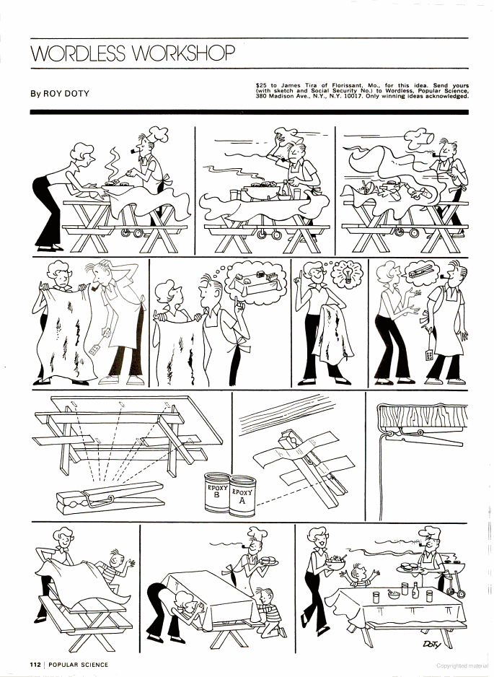

Slide 20
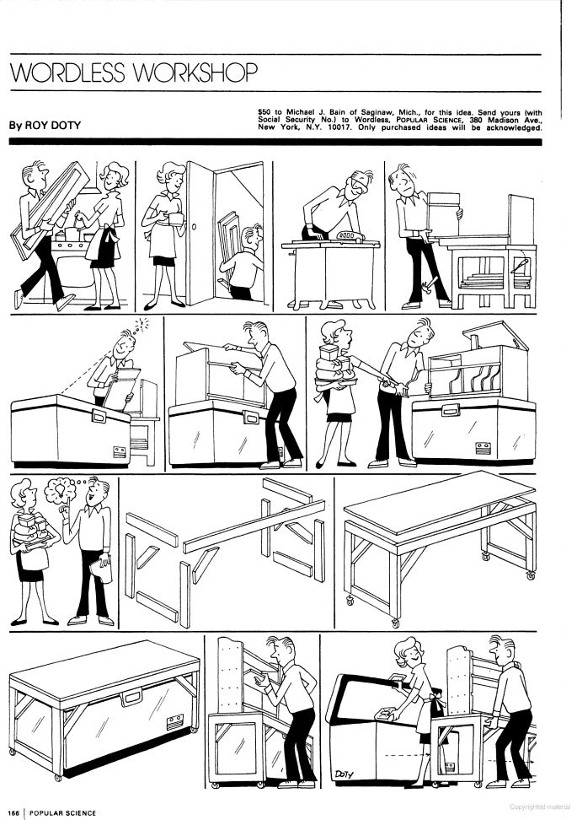

Slide 21
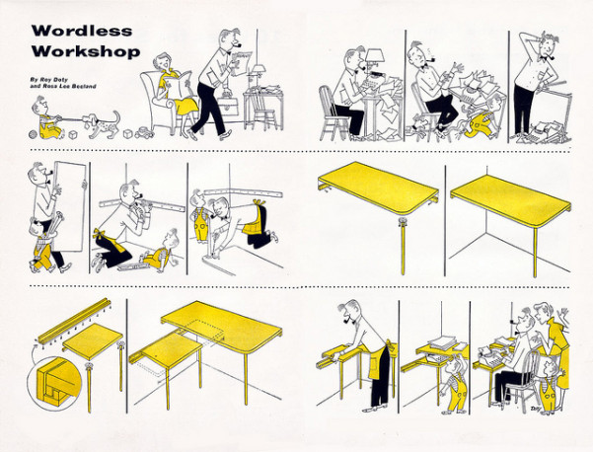

Slide 22
Sample: T/P Problem
Rudolph the NO LIGHT Reindeer
Building Simple Circuits with a switch to demonstrate the transfer of energy in an electric circuit.

Slide 23
Rudolph the NO LIGHT Reindeer
Building Simple Circuits with a switch.

Slide 24
Electricity
What is in your home or classroom that uses electricity?

Slide 25
What is electricity?
A type of energy
Electricity can travel (be transferred) through wires in currents
What is electrical current?
The path that moves from one point to another

Slide 26
Where does electricity get its energy?
Power Source
  Power Plant
  Electrical lines
  Battery
Electricity has to have energy (power) to work
Notes:
Reference:
http://www.corestandards.org

Slide 27
Power of a battery
We use batteries to get electricity into objects that are not connected to a wall plug.
What are some things that we use batteries for?

Slide 28
The Circuit
In order for electricity to travel to where we need it, there must be a complete circuit of electricity. A complete circuit is like a circle.
A circuit is a closed path so electricity can follow.
Electricity starts at a particular place, travels around the circuit, and returns to the same place.
No circuit will work if it has a break in it.
Notes:
Reference:
http://www.corestandards.org

Slide 29
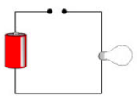
Closed Circuit or Open Circuit
Notes:
Reference:
http://www.corestandards.org

Slide 30
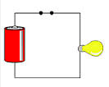
Closed Circuit or Open Circuit
Notes:
Reference:
http://www.corestandards.org

Slide 31

Positive and Negative
In order to make a circuit complete we also need positive and negative terminals
Positive
Negative
Notes:
Reference:
http://www.corestandards.org

Slide 32


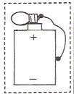
What do you think?
Will the bulb light?
NO
NO
YES
Notes:
Reference:
http://www.corestandards.org

Slide 33

A Complete and Happy Circuit
No breaks in Circuit
Negative Flow
Positive Flow
Notes:
Reference:
http://www.corestandards.org

Slide 34
You are almost ready to light Rudolph’s Nose!
In order to complete your next STEM challenge you will need to use math, technology, and engineering knowledge.
You can do it!!
Notes:
Reference:
http://www.corestandards.org

Slide 35

Math
You have one plate, but we need to divide it to make Rudolph’s body.
How do we do that?
Notes:
Reference:
http://www.corestandards.org

Slide 36
Cut it in half.
2 halves equal a whole ½ + ½ = 1
½
- - - - - - - - - - - - - - - - - - - - - - - - - - - - - - - - - - - - - -
½
Notes:
Reference:
http://www.corestandards.org

Slide 37

Lets do it again!
You have ½ plate, but we need to divide it to make Rudolph’s head.
How do we do that?
Notes:
Reference:
http://www.corestandards.org

Slide 38
½
½
- - - - - - - - - - - - - - - - - - - - - - - - - - - - -
Notes:
Reference:
http://www.corestandards.org

Slide 39
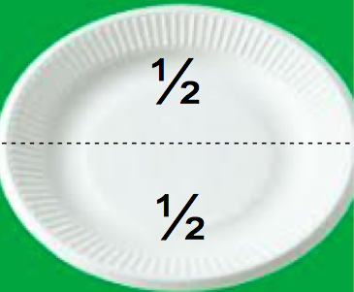
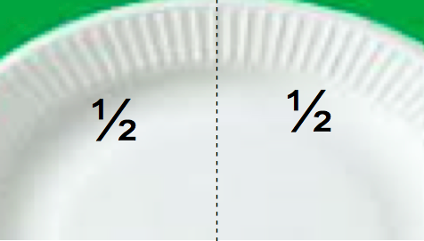
Look at what we did with fractions!
Notes:
Reference:
http://www.corestandards.org

Slide 40
Rudolph needs legs too!
You have one square of paper, and Rudolph needs how many legs?
4
Notes:
Reference:
http://www.corestandards.org

Slide 41
How can you make 4 rectangle legs out of a square?
¼
¼
¼
¼
- - - - - - - - - - - - - - - - - - - - - - - - -
- - - - - - - - - - - - - - - - - - - - - - - - -
- - - - - - - - - - - - - - - - - - - - - - - - -
What fraction did we make?
¼ + ¼ + ¼ + ¼ = 1 whole
Notes:
Reference:
http://www.corestandards.org

Slide 42
Let’s Assemble,
Color your paper plate body and head brown
Trace your right hand and left hand on the brown paper and cut out to make the antlers
Tape the wiggly eyes on the head
Attach the head
Notes:
Reference:
http://www.corestandards.org

Slide 43
Let’s assemble the circuit
Carefully put the light through the nose and paper plate.
Attach the resister to the negative end of the light (shorter prong) and then attach to paperclip to form a switch
Attach the red wire to the positive end of the light (longer prong)
Attach paperclip to the negative (black) wire from battery to make a the switch for your circuit
Notes:
Reference:
http://www.corestandards.org

Slide 44
Let’s assemble the circuit
Tape down the battery and wires
Attach the antlers and legs to the body
YAY! You did it, now Rudolph can guide the sleigh on Christmas Eve!
Notes:
Reference:
http://www.corestandards.org

Slide 45
