Slide 1
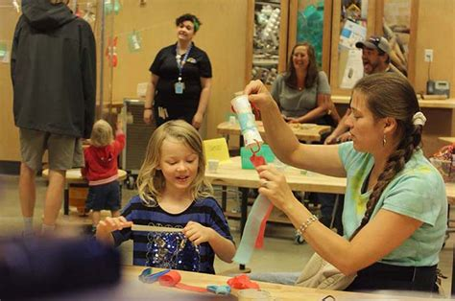

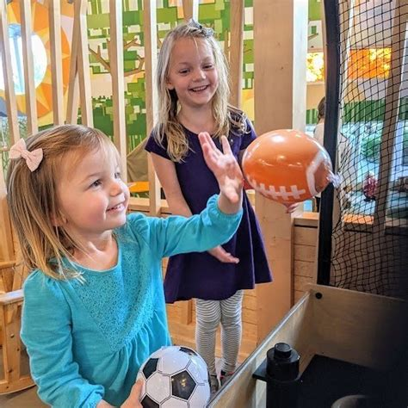
March 3 – 9am-12pm

Slide 2
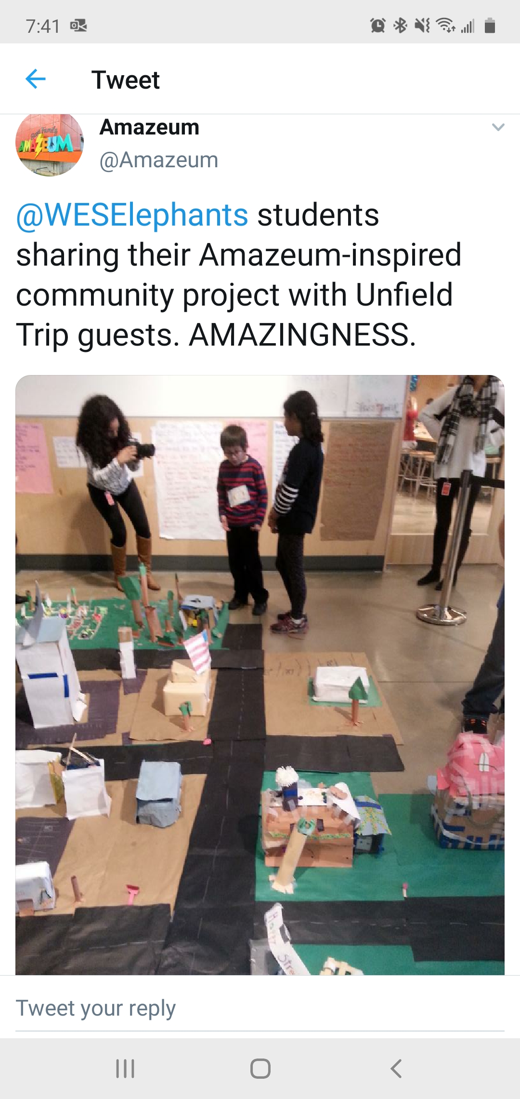
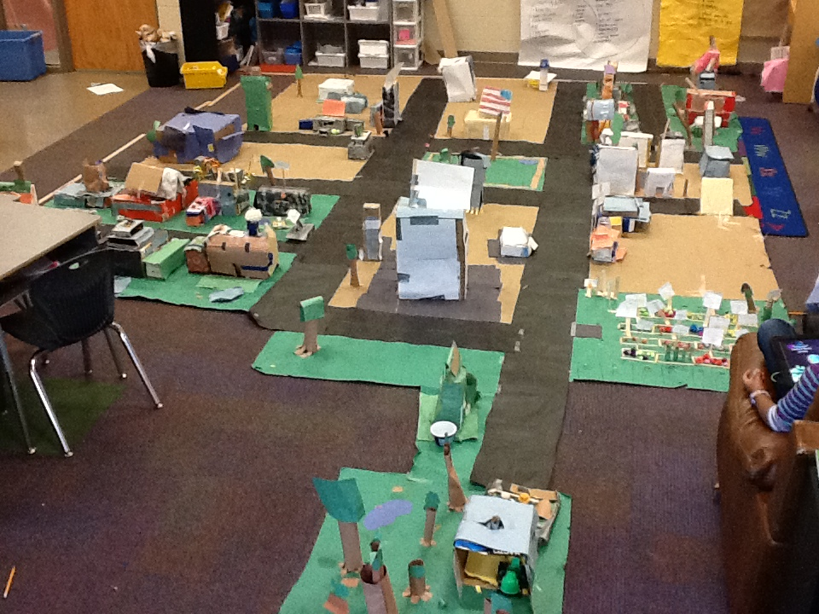
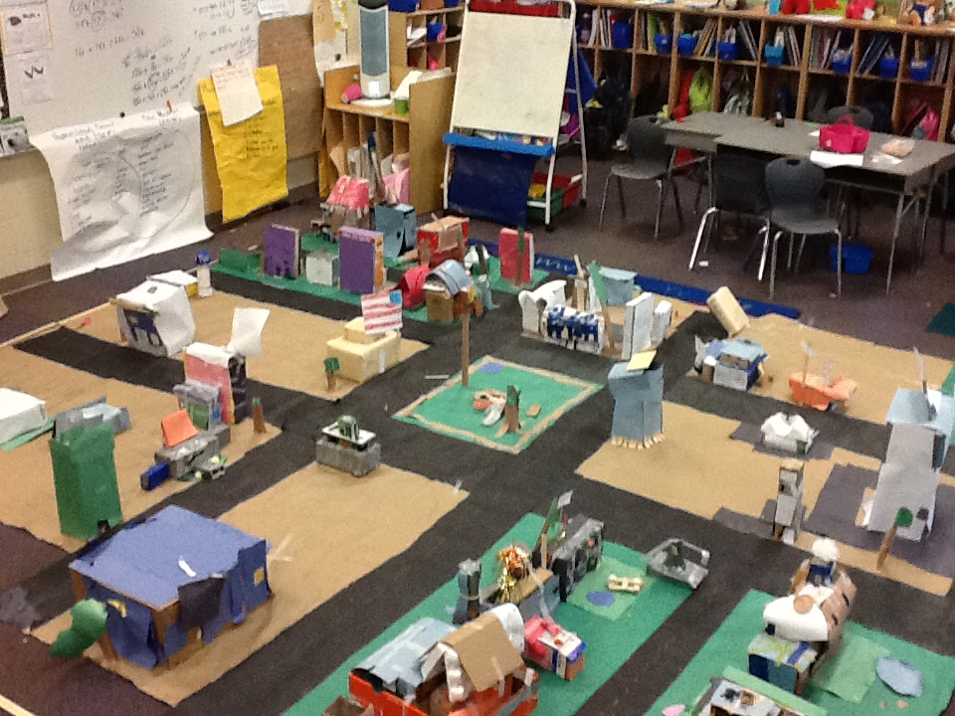
Passion Moves Kids Into Action
https://www.amazeum.org/educators/

Slide 3
How does low tech making support student skill building?
https://www.solutiontree.com/free-resources/literacy/rl#
*these materials on your flash drive
vocabulary acquisition
descriptive and procedural writing
remaking twists – pg. 92
empathy development
creating with cardboard
What to Do with a Box
destructing and constructing with cardboard
corrugation and grain
tinkering with textiles
tinkering is discovering something on your own terms – genius hour
learning is messy
paper engineering
Chapter 4 – Low Tech Making
Iggy Peck Example
Ada Twist, Scientist
Sofia Valdez, Future Prez
Rosie Revere, Engineer

Slide 4
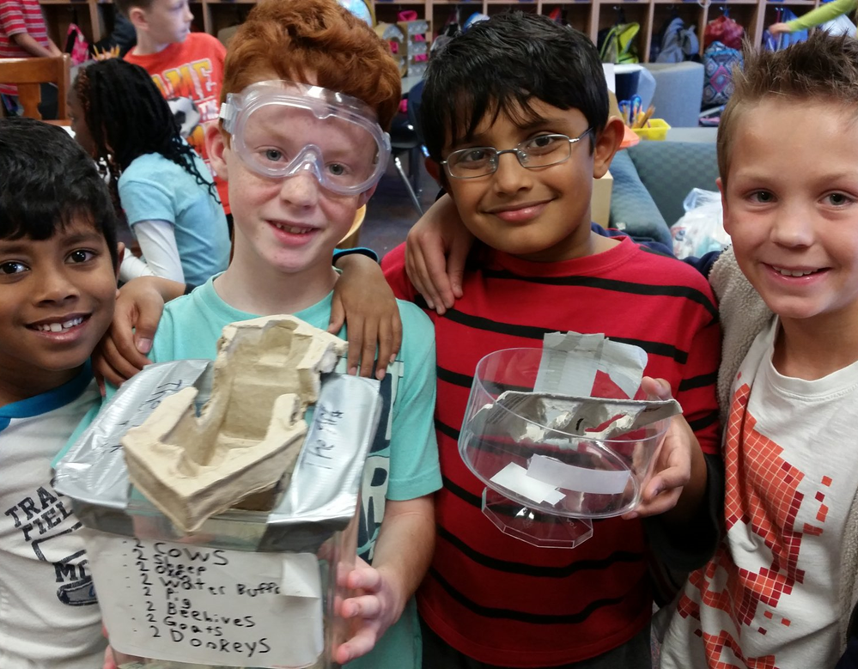
Tinkering
Playful
Experimental
Iterative
Engaging
Explorative
New possibilities
(Resnick & Rosenbaum, 2013)

Slide 5
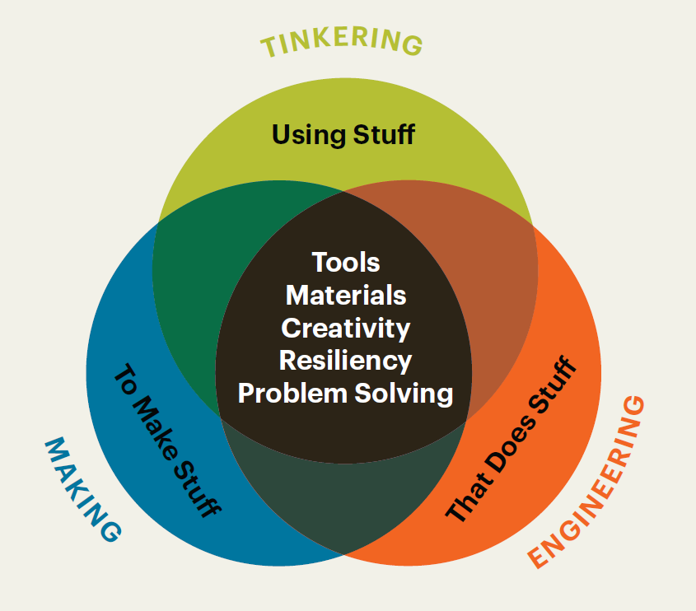
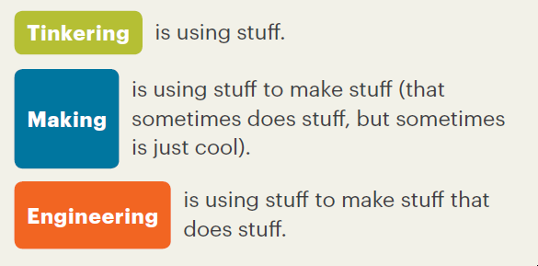
What You Need to Know About Tinkering, Making, and Engineering, NAEYC, Adapted from the Boston Children’s Museum, Tinker Kit: Educators’ Guide (Boston: Boston Children’s Museum, 2016), 4.

Slide 6

https://www.tinkercad.com/

Slide 7
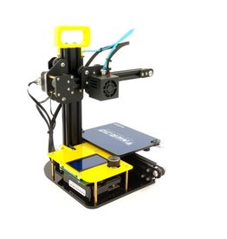
3D
Printing

Slide 8
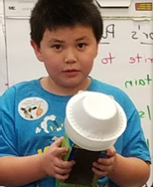
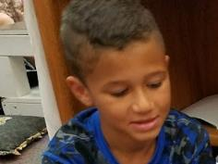

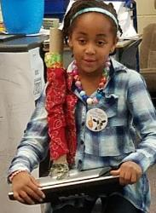
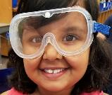
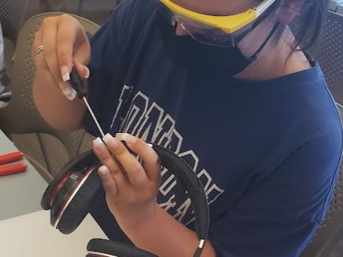
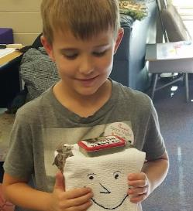
Page Title 7
”Teachers are the gatekeepers to fostering the gifts and talents of future STEM innovators.”
(Cotabish, et. al, 2013)

