Slide 1
The Literature-based STEM Curriculum
Using Literature to Introduce STEM lessons

Slide 2
Introducing Literature-based STEM
The narrative-centered learning environment
Consider curriculum as a story
Stories rarely lay out all the facts and ideas in a step- by- step fashion
Sometimes illogical & incomplete, stories are likely to engage
Storytellers are great teachers
Instead of presenting a straightforward sequence of events, the storyteller deliberately raises questions and delays answering them
Things learned in the form of a story are easier to remember
Project-based learning thrusts students into problem situations immediately, much like a reader is thrust into the middle of a story

Slide 3
The Literature-based Curriculum
3 Questions answered in all Literature-based Curricula
  What do we know? --What do we need to know? --How can we find out?
Key Features of Literature-based Curriculum
The presence of a mystery, dilemma, or oddity is essential
  The most basic feature of all compelling stories (or problems)
  We are placed into an environment that has to be figured out
  Designed to provide drama, to offer surprises, twists, and turns
  What drives a story? What makes it worth telling? (TROUBLE)
    Misfit between characters, their actions, the goals of the story, the setting, and the means
  A good story centers on what is essential (A big idea)

Slide 4
Literature-based Curriculum
5 Essential Elements of a Literature-based Curriculum
Identifying importance: What is most important about this topic? Why should it matter to students?
Finding binary opposites: What opposites best capture the importance of the topic?
Organizing content into story form: What content most dramatically embodies the opposites
Conclusion: What is the best way of resolving the conflicts between the opposites/solve the conflict
Evaluation: How will we determine whether they have learned?

Slide 5
Creating STEM Lessons
7 Elements of a Good STEM Lesson/Project
Purpose and Relevance: Is it personally relevant to the students? Does it provide a certain level of intrigue? Does it cause the student to want to invest time and effort?
Time: Projects can last one class period or an entire term, but time must be provided to research, plan, build, test, debug, retest, and communicate.
Complexity: The best STEM projects include content from all disciplines in STEM and the connections between these content areas.
Intensity: Tap into that natural intensity that children exhibit when mastering a video game, reading a new book from a series, etc.

Slide 6
Creating STEM Lessons (continued)
7 Elements of a Good STEM Lesson/Project
Connection: Great projects or prompts force students to connect with other students, people, and ideas (think Internet) with whom they might not naturally connect.
Communication: The big idea of PBL is the concept that the final solution must be shared and defended. This provides a great deal of motivation and a sense of satisfaction.
Novelty: Perhaps the most important consideration in STEM. Few project ideas are so profound that they can be used year after year with the same level of success. If the teacher is bored with the idea, students will be bored with the idea.

Slide 7
Creating STEM Lessons
Essential Features for Literature-based Problems:
  Have a clear purpose that ties directly back to the text.
  Focus be on process, product, or usually both
  Focus on ill-structured problems - No simple right or wrong answers; solutions must be assessed along some sort of continuum.
  Focus on degrees (e.g., quality, proficiency, understanding, etc.).
  Share performance-based scoring information with students early—as a guide

Slide 8
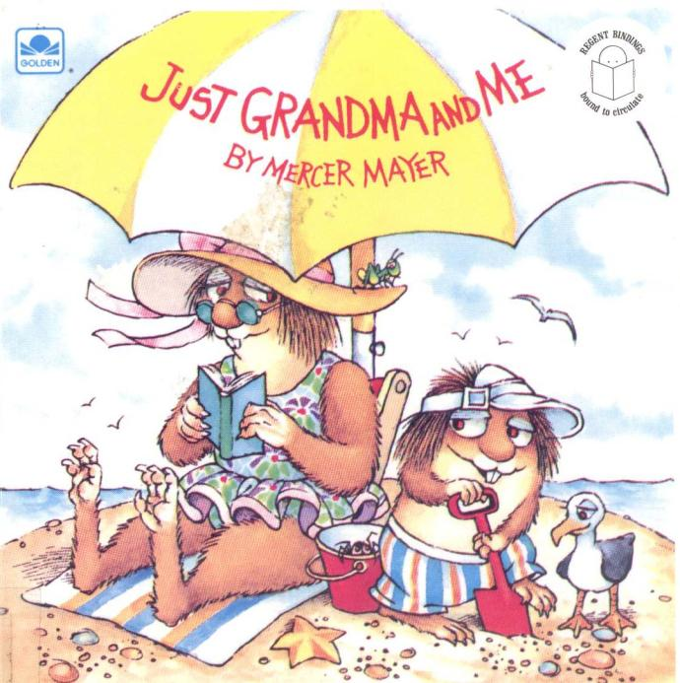

Slide 9
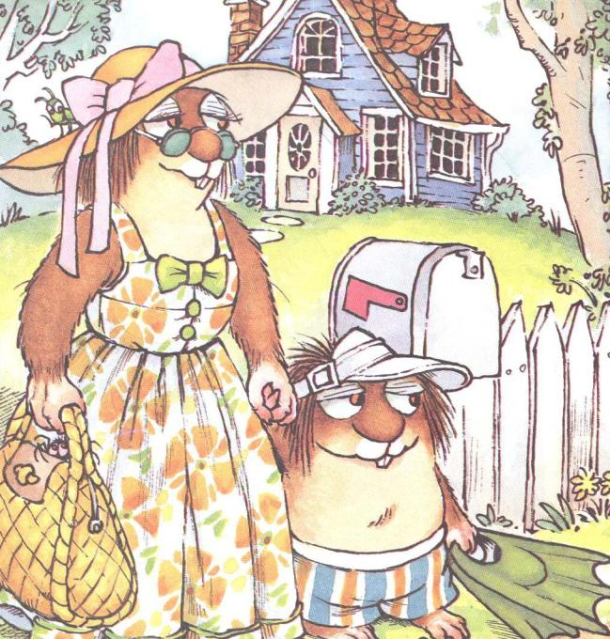

Slide 10
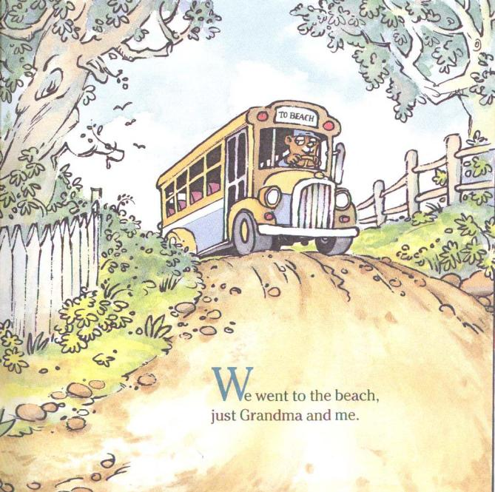

Slide 11
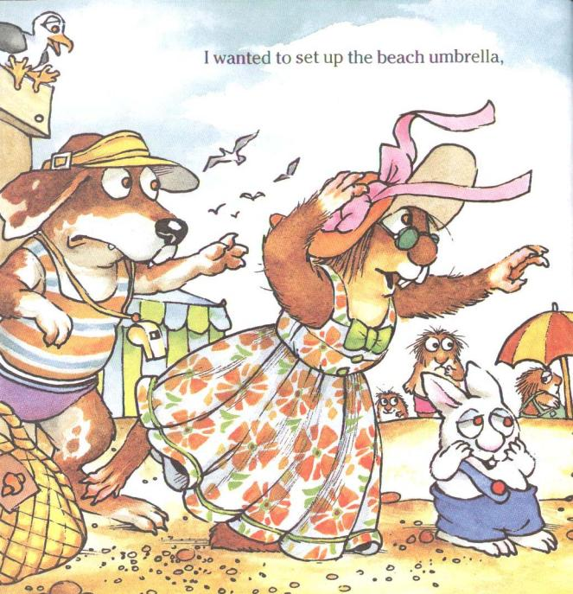

Slide 12


Slide 13
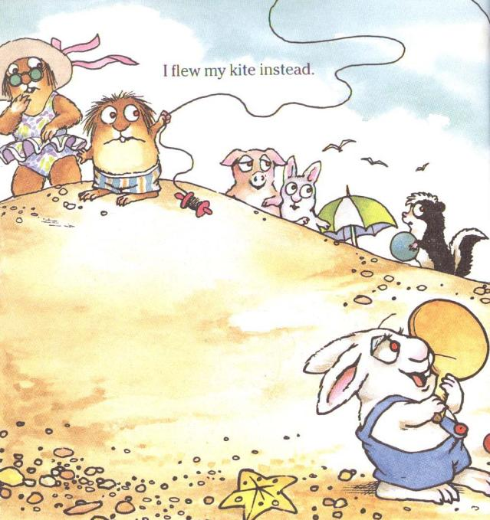

Slide 14
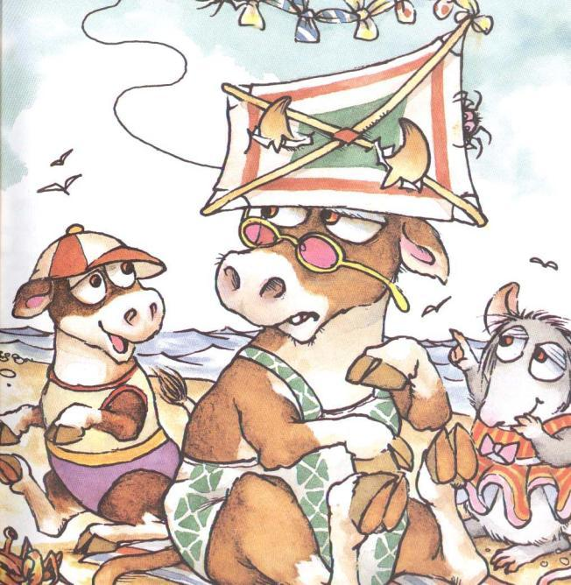

Slide 15
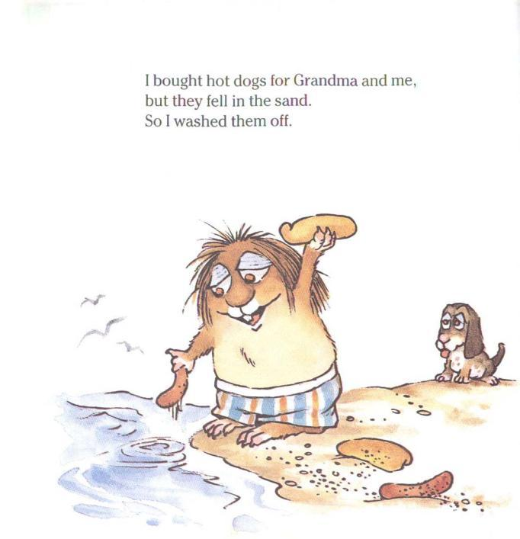

Slide 16
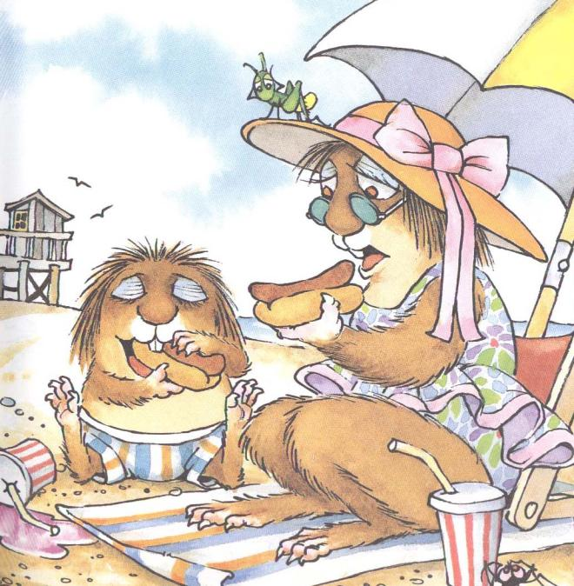

Slide 17
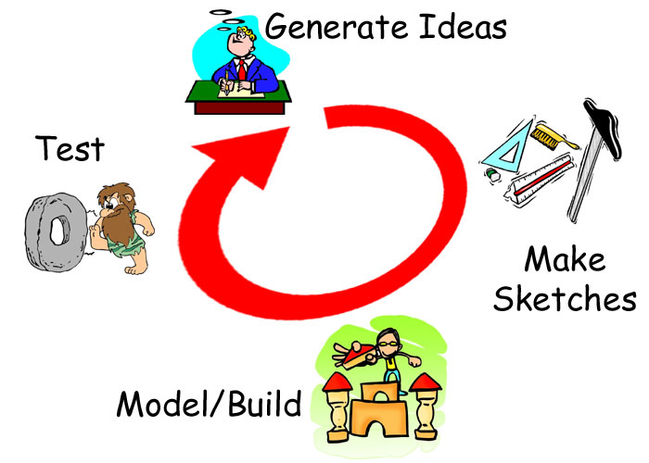
What is the problem here?

Slide 18


The Hot Dog Carrier
2nd Grade
Scenario
Little Critter and his grandmother
go to the beach. (Book: Just Grandma
and Me by Mercer Mayer) While at the beach, Little Critter and Grandma get hungry. Little Critter goes to get lunch but drops the hotdogs and rolls in the beach sand on his way back to the beach blanket where his Grandma is sitting.

Slide 19
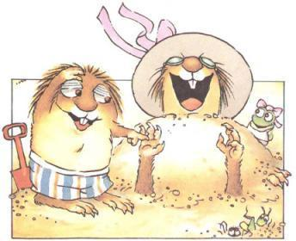
Challenge
Little Critter and Grandma do not
like to eat gritty sand covered hotdogs. Design and create a hotdog carrier that will keep the hot dogs and buns both warm and sand free when Little Critter carries them back to the beach blanket. Little critter is small so the carrier should be as small and light weight as possible. You will have a budget of $2.00 to create your carrier.

Slide 20

Curriculum Standards
Science – Structure and Properties of Matter
2-PS1-1 Plan and conduct an investigation to describe and classify different kinds of materials by their observable properties (color, texture, hardness, and flexibility)
2-PS1-2 Analyze data obtained from testing different materials to determine which materials have the properties that are best suited for an intended purpose
2-PS1-4 Construct an argument with evidence that some changes caused by heating or cooling can be reversed and some cannot.

Slide 21
Curriculum Standards (cont.):
Social Studies - Geography
Interaction of People and the Environment - Students shall develop an understanding of the interactions between people and their environment.
Technology and Engineering Education
Standard 2: Core Concepts of Technology and Engineering
Safely use tools to complete tasks.
  Explain that materials are selected for use because they possess desirable properties and characteristics.
  Develop a plan in order to complete a task.
  Collaborate effectively as a member of a team.

Slide 22
Curriculum Standards (cont.):
Math
Measurement and Data
AR.Math.Content.2.MD.A.1 - Measure the length of an object by selecting and using appropriate tools such as rulers, yardsticks, meter sticks, and measuring tapes
Work with time and money
AR.Math.Content.2.MD.C.7 - Tell and write time from analog and digital clocks to the nearest five minutes, using a.m. and p.m.
AR. Math.Content.2.MD.C.8 - Solve word problems involving dollar bills, quarters, dimes, nickels, and pennies, using $ and ¢ symbols appropriately

Slide 23
Curriculum Standards (cont.):
English Language Arts
Oral and Visual Communications
Speaking - Students shall demonstrate effective oral communication skills to express ideas and to present information.
Inquiring/Researching
Research/Inquiry Process - Students shall engage in inquiry and research to address questions, to make judgments about credibility, and to communicate ideas in ways that suit the purpose and audience.

Slide 24
Big Ideas
Materials – structure and properties
    Describing – understanding intended purpose - strength, flexibility, hardness, texture, and absorbency
    *heating and cooling
Measuring
Counting
  Creating a simple budget
  Using credits or money
Working as a team
Designing and making your thinking visible to others

Slide 25
Big Ideas
Understanding the properties of materials can help up create better design for an intended purpose
Measuring is important in our daily lives
Keeping a budget can help us save money
It is important to be able to work as a team
Designing and making can help us make our thinking visible to others

Slide 26
Essential Questions
How can I use my understanding of the properties of materials to build a hot dog carrier for Little Critter?
How did I use my understanding of counting money and measurement to create my design?
How was I able to collaborate effectively as a member of my engineering design team?

Slide 27

Evaluation:
Test your hot dog carrier and refine your design.
Evaluate and record your solution in your Design Journal.
    -understanding of properties of materials
    -measuring/counting
    -working as a team
Present and demonstrate your solution to the class.

Slide 28

Assessment Rubric
5 = Excellent - 1 = Needs Improvement
Documentation - Process - Design Journal
Design sketch 5 4 3 2 1
Documentation of problem solving 5 4 3 2 1
Self-evaluation 5 4 3 2 1
Product - Hot Dog Carrier
Investigation and analysis of materials 5 4 3 2 1
Size and weight of carrier 5 4 3 2 1
Cost of the carrier 5 4 3 2 1
Heat Maintenance 5 4 3 2 1
Function 5 4 3 2 1
Collaboration – Process - Teamwork
Organization 5 4 3 2 1
Cooperation 5 4 3 2 1
Presentation 5 4 3 2 1
Team evaluation 5 4 3 2 1

Slide 29

Limitations (requirements parameters or constraints) :
Work with a partner or group to develop a plan and create a hot dog carrier that
  keeps the hot dogs warm
  keeps the hot dogs from falling on the ground
  is no larger than 12"x12"x12“
  weighs less than 1 pound
Complete a Design Journal to document your thinking and your team’s development of the solution.
Presentation to the class

Slide 30

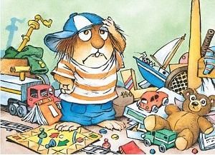
Materials:
Styrofoam trays – 50¢
Egg cartons - 50¢
Cardboard tubes - 25¢
12” yarn - 10¢
12” string - 10¢
Plastic margarine tubs – $1.00
1 pipe cleaners - 10¢
12” X 12” cardboard - 50¢
Paper fasteners - 25¢
Plastic knives/spoons - 50¢
12” X 12” aluminum foil - 25¢
Craft sticks - 50¢
Tape/glue – as needed
Tools: Rulers, scissors, Canary Cutters,
Crop-a-Diles – other tools as appropriate

Slide 31
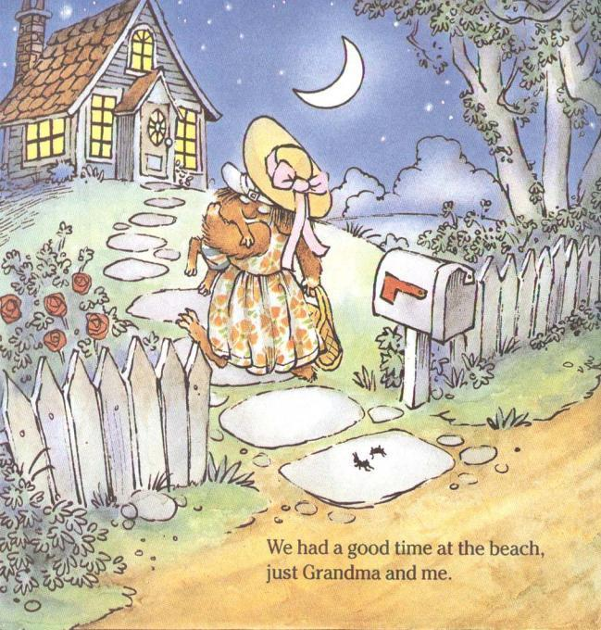

Slide 32
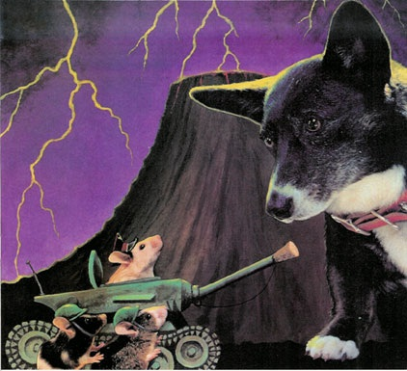
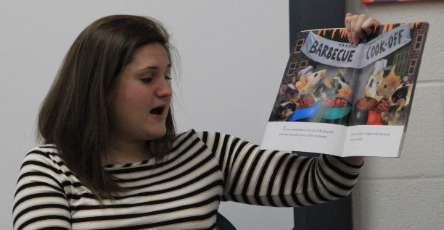
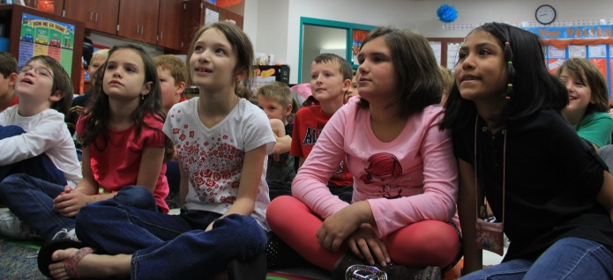
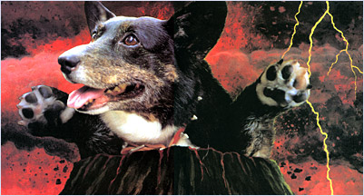
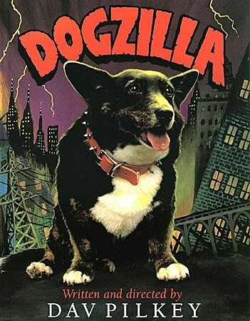
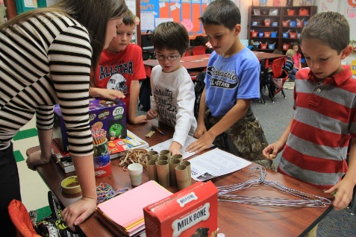
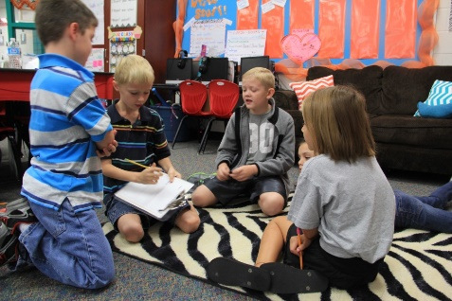
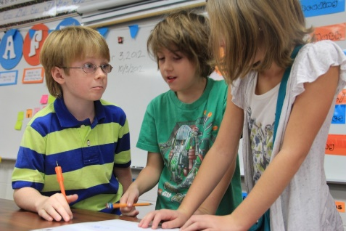
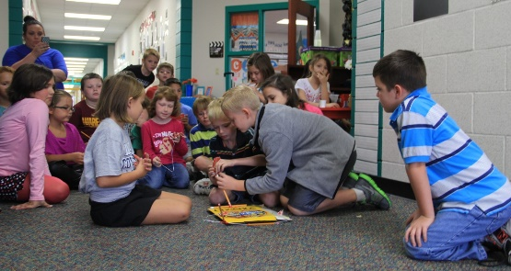
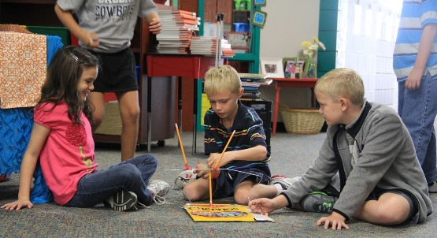
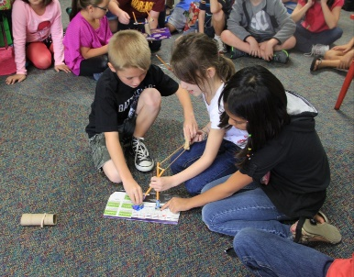
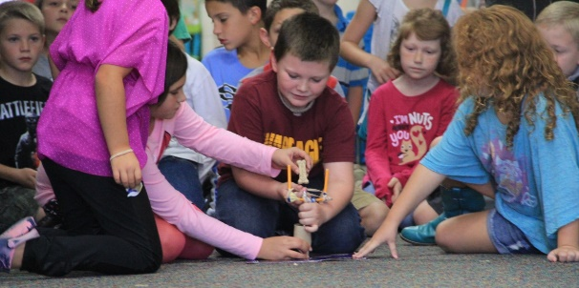
Dog Treat Slinger
Design Challenge

