Slide 1
Creativity
Creativity- the use of the imagination or original ideas, especially in the production of an artistic work… inventiveness, innovation, originality.
Can be nurtured
Can be measured

Slide 2
Anytime we are faced with a problem or dilemma with no learned or practiced solution, some creativity is required (Torrance, 1962; 1988; 1995)
Creativity is a vital ingredient in meeting the challenges of a continuous life cycle, a cycle in which growth and change are the norm from conception throughout life. A life filled with growth and change requires a conscious effort to think creatively. To develop creativeness, the mind needs to be exercised as well as filled with materials out of which ideas can be formed. The richest fuel for ideation is firsthand experience (Osborn, 1963).
Creativity is the ability to see a situation in many ways and to continue to question until satisfaction is reached (Goff, 1998).

Slide 3
Torrance Test
We will take a test of creativity often given to children.
Once I hand out the assessment, you will have 3 minutes to draw as many pictures as you can. The goal is to draw as many, and as many creative pictures as you can in the time allotted. Pictures should also have a title or description.

Slide 4
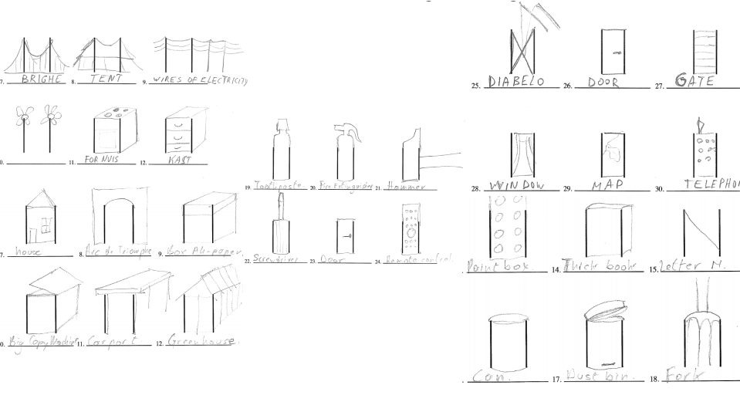

Slide 5
Creativity- Four Categories of Divergent Thinking
Fluency- how many ideas you can come up with in a short period of time
Originality- how uncommon your ideas are
Flexibility- how many areas your ideas cover
Elaboration- level of detail in responses

Slide 6
What does this have to do with STEM Education?
The ideas of Fluency and Flexibility = Brainstorming
These are skills that can be practiced
Tension between fluency and originality

Slide 7
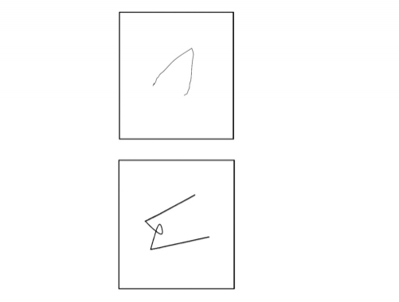
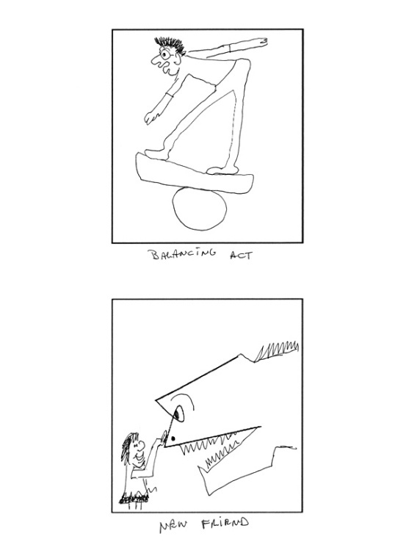
Other Fun Exercises
Guilford Alternative Uses Test- 2 min. to think of as many uses as possible for a paper clip
Incomplete Figures- these are on GT screens

Slide 8
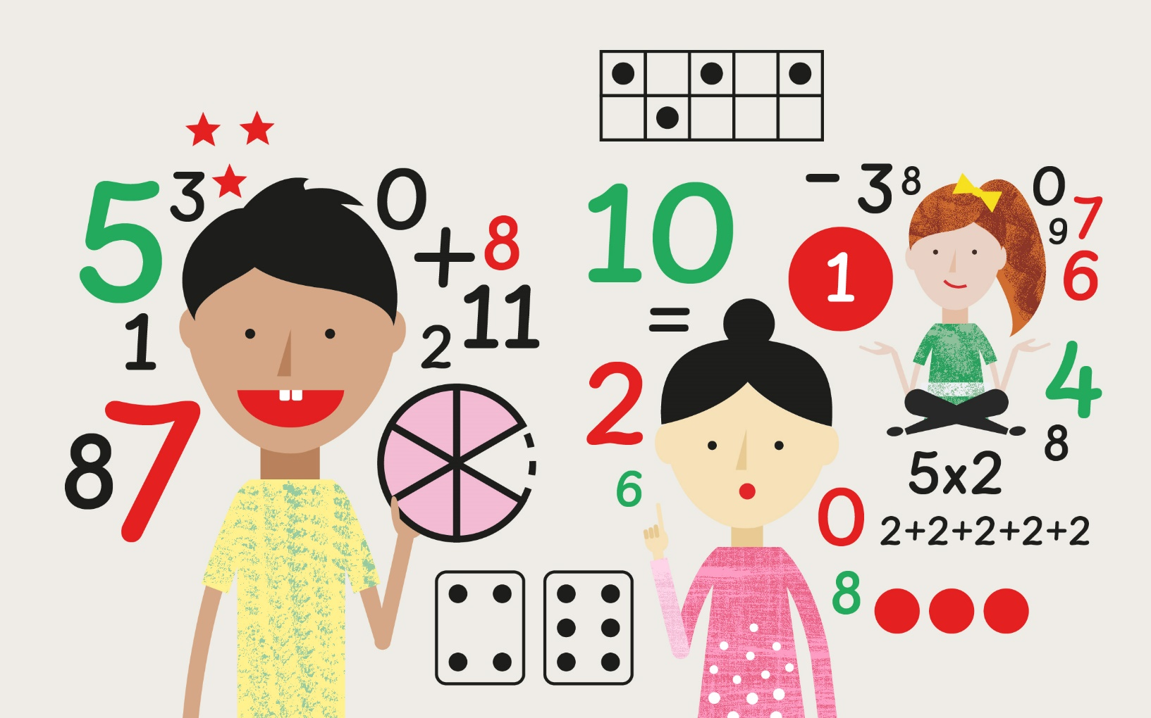
Number Sense and Creativity

Slide 9
16 = 9 + 7

Slide 10
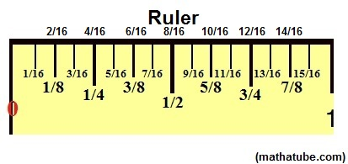
Measure Twice, Cut Once

Slide 11
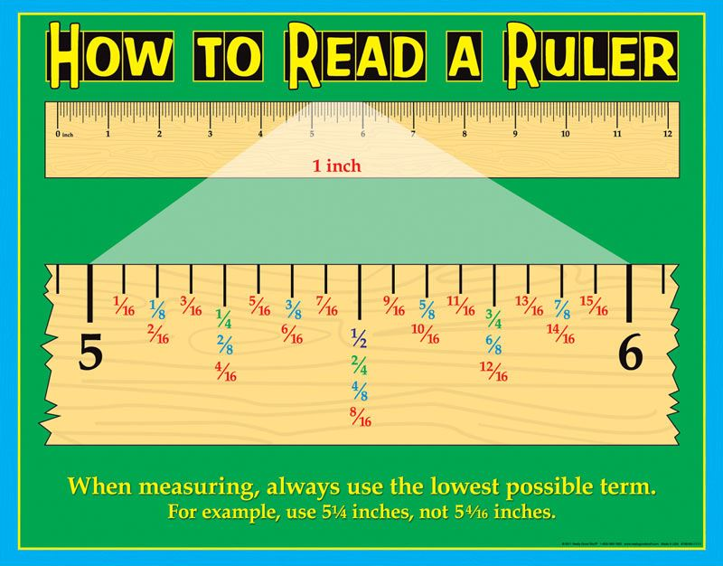

Slide 12
Three Simple Steps to Add Fractions
Step 1: Make sure the bottom numbers (the denominators) are the same.
Step 2: Add the top numbers (the numerators), put that answer over the denominator.
Step 3: Simplify the fraction (if needed)

Slide 13
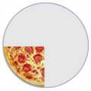
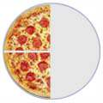
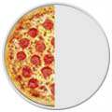
Adding Fractions
¼ | + | ¼ | = | 2/4 | = | ½

Slide 14
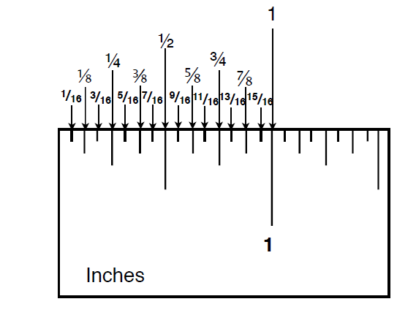

Slide 15
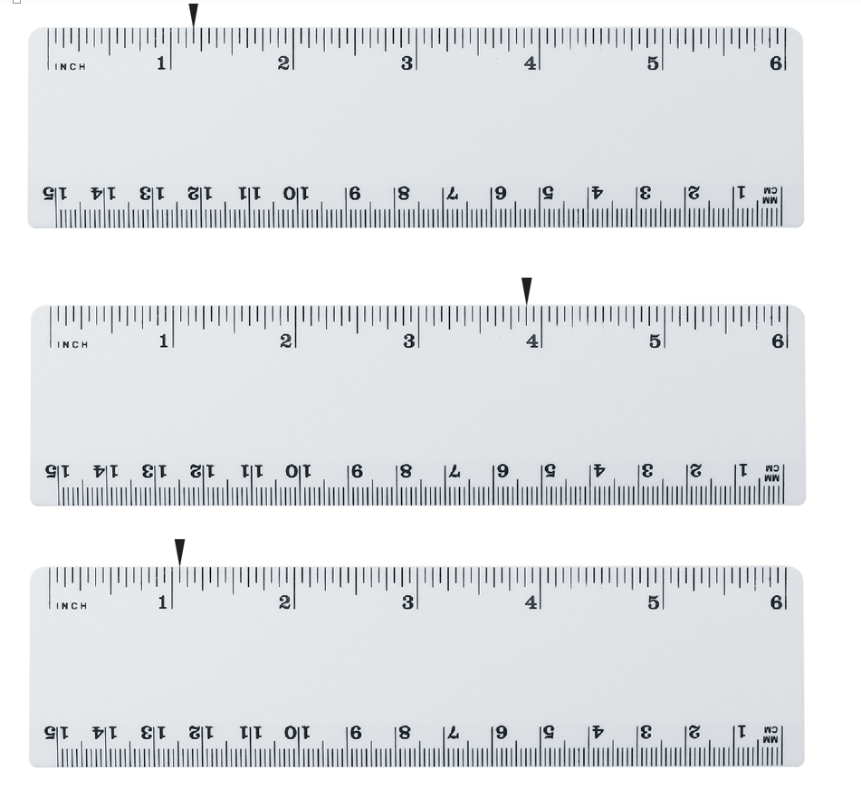

Slide 16
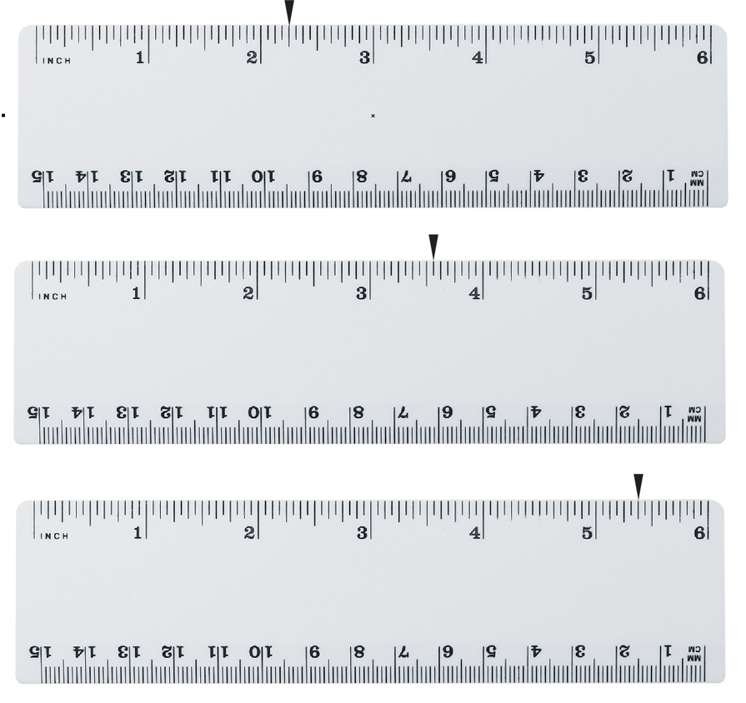

Slide 17
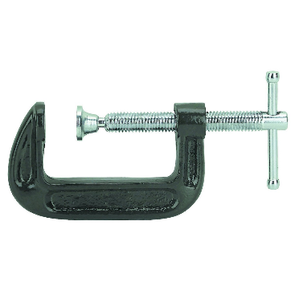
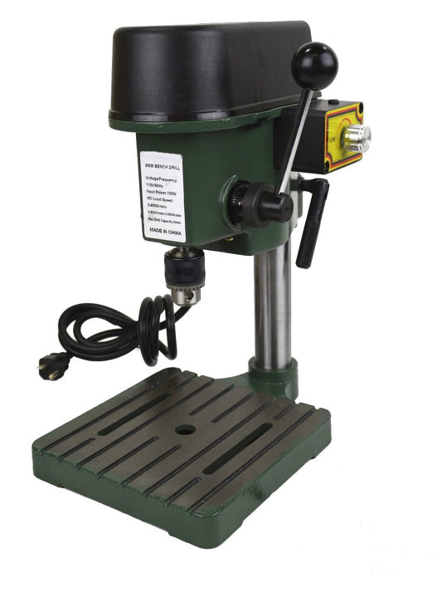
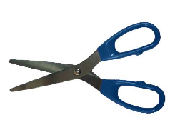
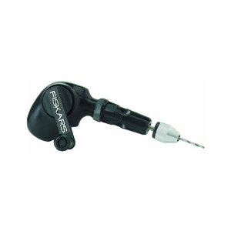
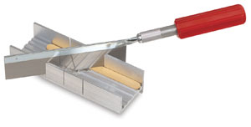
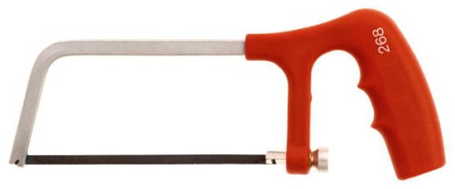
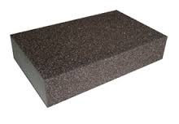
Tools
What other tools have we used?

Slide 18
Tools
Scissors
C-clamp
Razor Saw
Miter Box
Drill Press
Hack Saw
Hand Drill
What other tools have we used?
Sanding Sponge

Slide 19
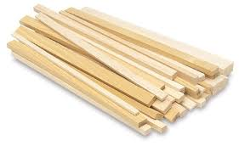
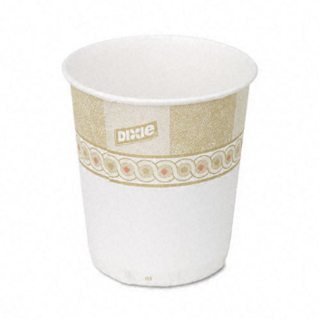
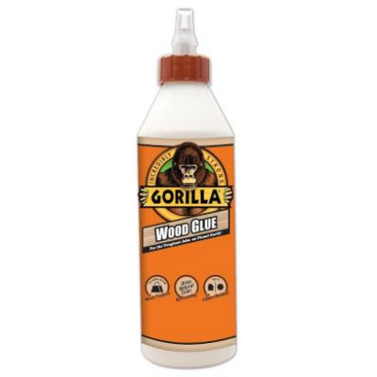

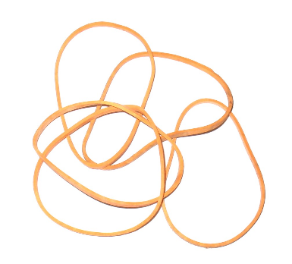
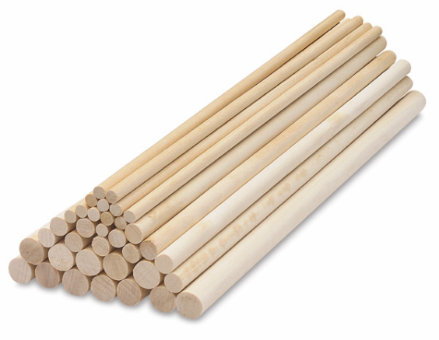
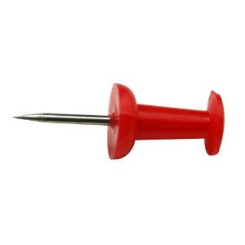
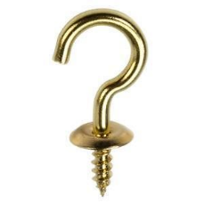
Materials

Slide 20
Materials
Wood (Dimensional Lumber)
Paper Cup
Wood Glue
Notecard/Cardstock
Rubber Bands
Cup Hook
Thumbtack
Dowel Rods

Slide 21
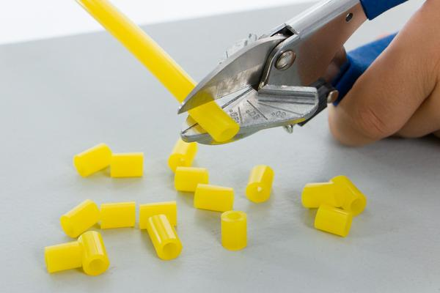
Vinyl Tubing -
Slide Stop from Teacher Geek

Slide 22

Processes
Gluing
Sanding
Measuring
Cutting
Drilling
Clamping

