Slide 1
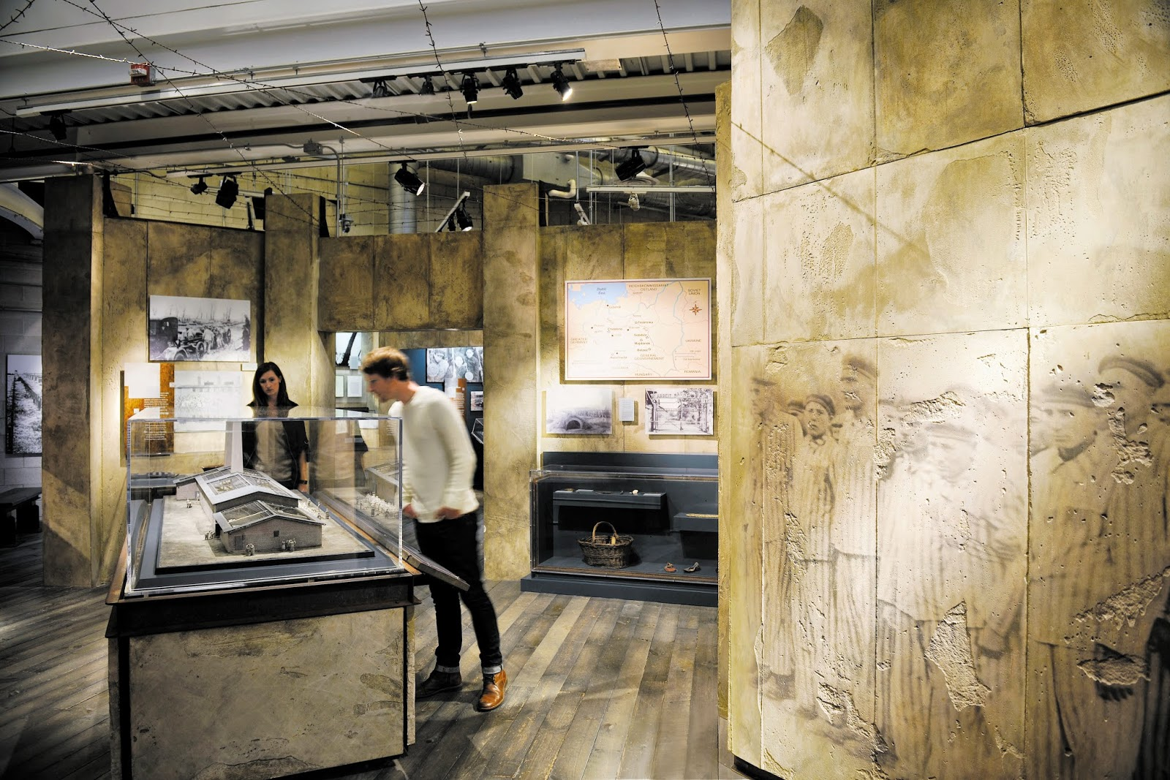

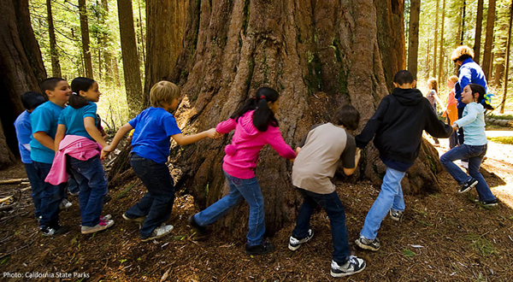

The Many Faces of Informal Learning

Slide 2
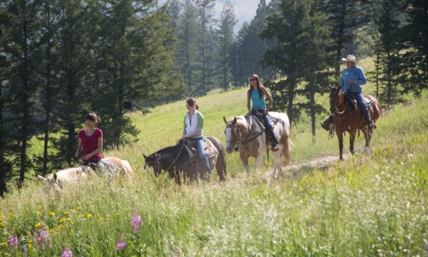
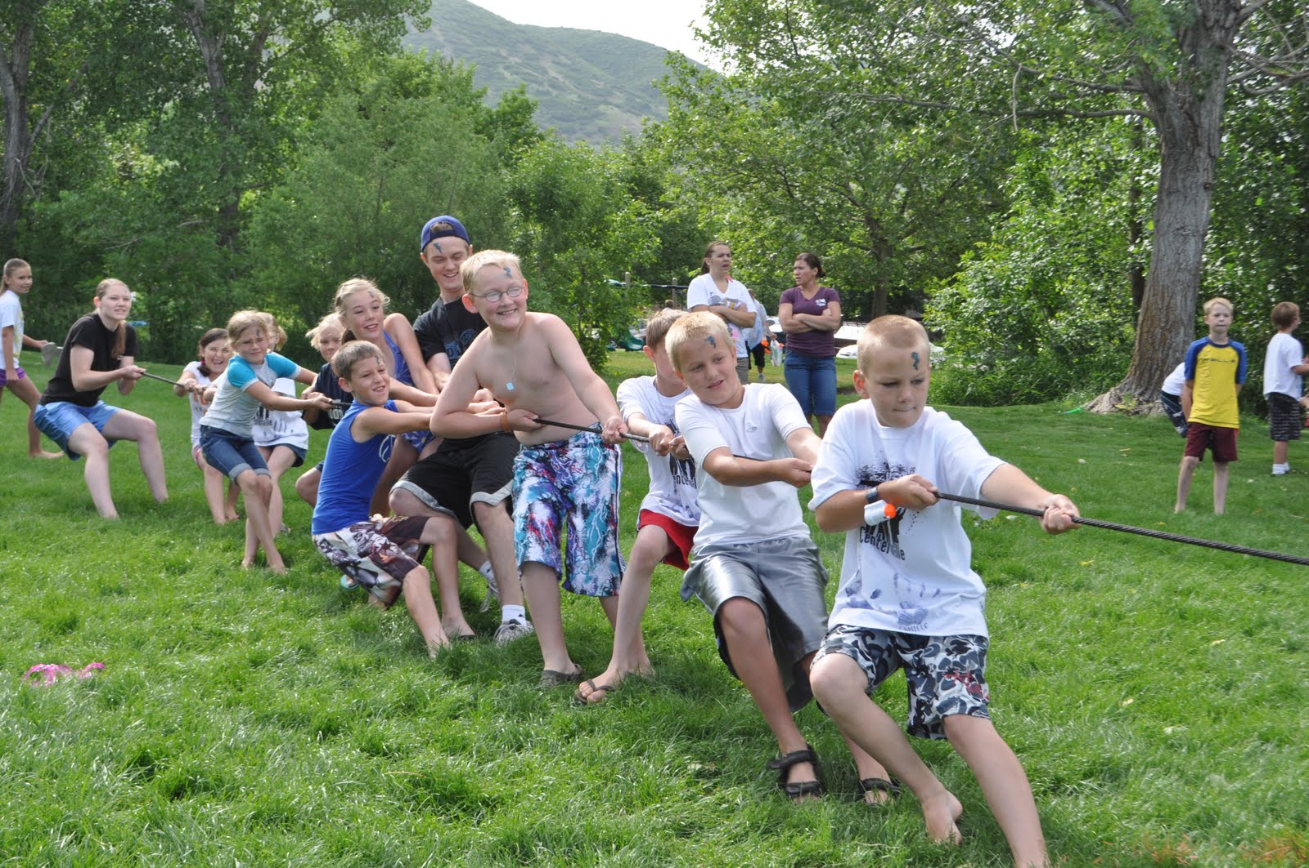
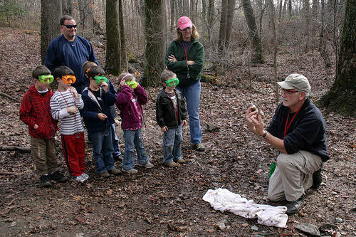
Informal learning can take many forms, but are related
Community service learning
Discovery learning
Environmental education
Experiential learning
Outdoor learning
Place-based learning

Slide 3
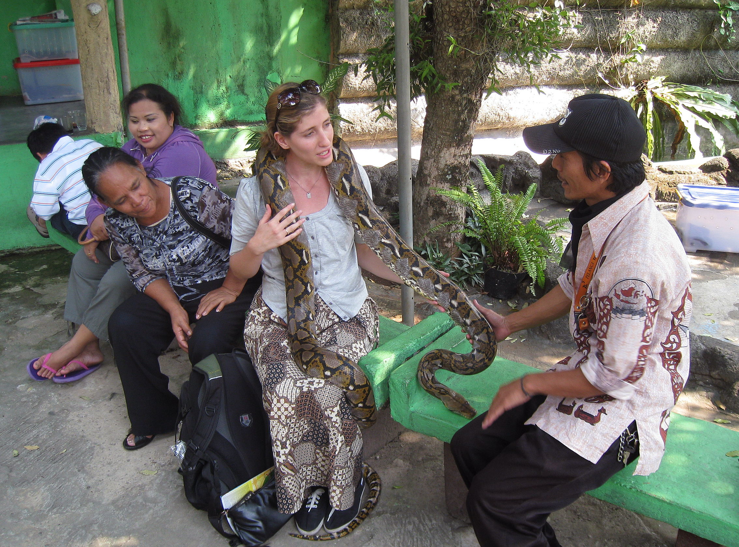
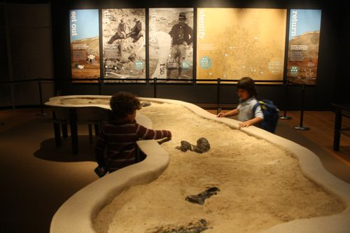
Informal (Free Choice) Learning
Learning that occurs in environments [usually] outside the school. May occur with many sorts of self-selected activities such as visiting a museum, science center, zoo, the internet, watching television, reading, etc.

Slide 4
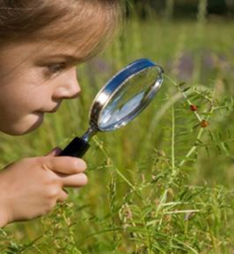
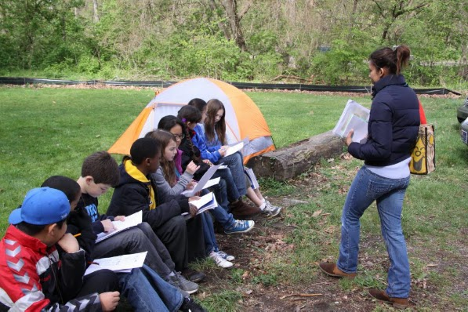
Outdoor Education
Learning activities that occur outside the traditional classroom in camps, on the school grounds, or within the community
These activities may be related to school content or may be recreational in nature

Slide 5
Locations for Informal & Outdoor Learning
Schoolyards/outdoor classrooms
Local neighborhood
Museums/science centers/zoos & aquaria
Historic sites
Businesses & factories
Parks
Churches
Youth camps
Libraries

Slide 6
Other Types of Informal/Outdoor Learning Categories
Environmental education
Experiential learning/Experience-based learning
Formal learning in an informal setting
Hands-on learning
Inquiry learning
Place-based/Community-based learning
Problem-based learning
Project-based learning
Recreational learning
Situated learning

Slide 7
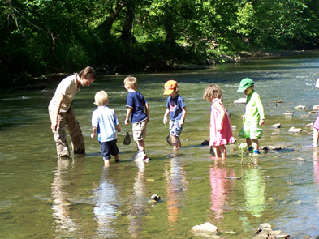
Environmental Education
An instructional approach designed to develop citizens who are environmentally literate and have knowledge and understanding of the biophysical environment and its associated problems, are aware of how to help solve the problems, and are motivated to work toward solutions.

Slide 8
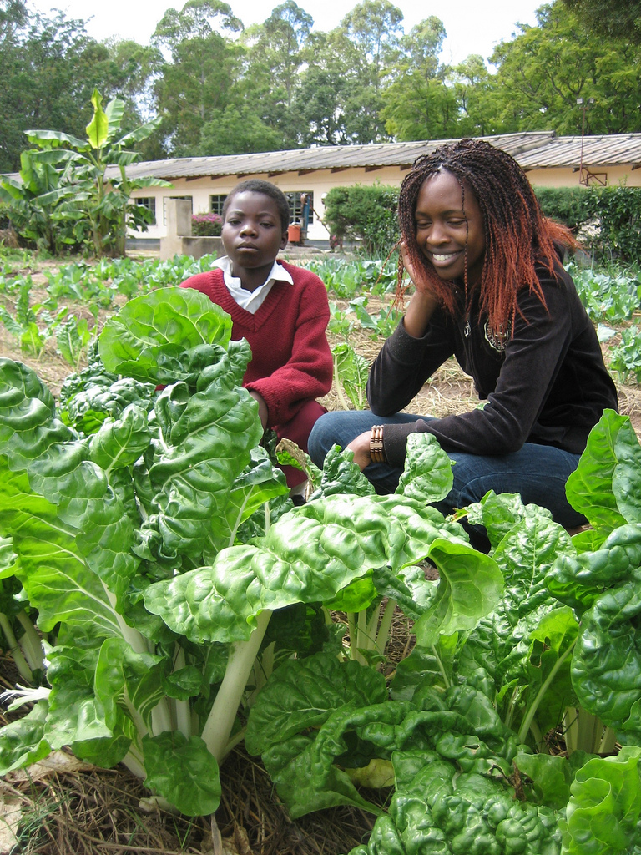
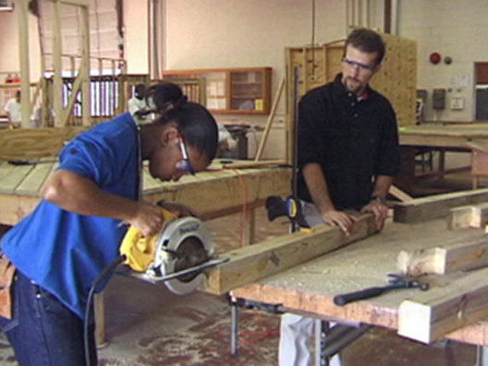
Experiential/Experience-based Learning
An instructional approach in which students learn through direct experience and reflection. These experiences can be either spontaneous or designed and orchestrated by the teacher for specific instructional purposes.

Slide 9
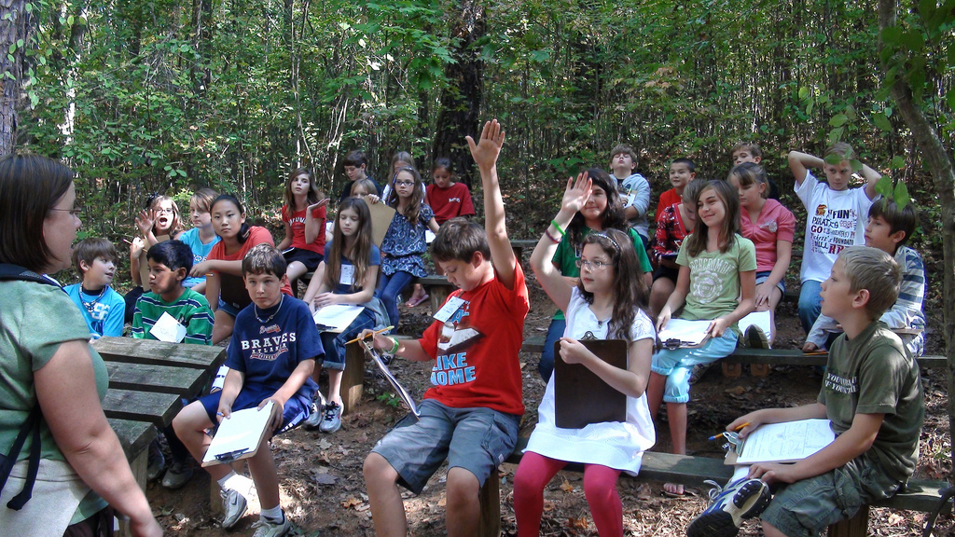
Formal Learning in an Informal Setting
Structured lessons delivered outside the traditional classroom setting

Slide 10
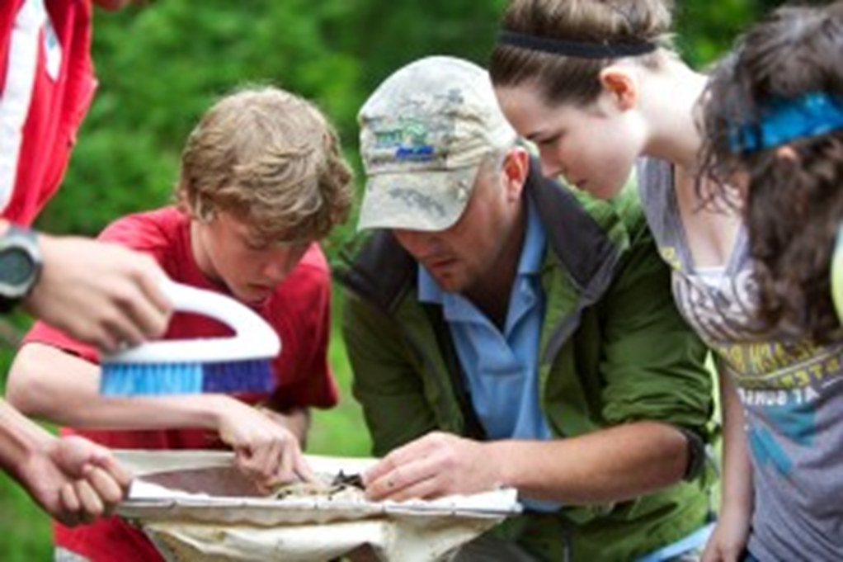
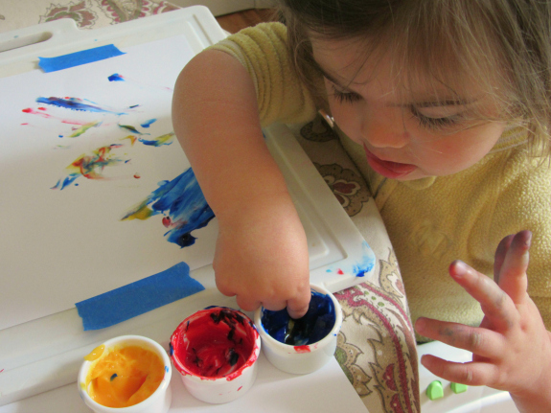
Hands-On Learning
Instructional activities that give students the opportunity to directly explore, investigate, observe, probe, or manipulate objects related to a phenomena, event, or question

Slide 11
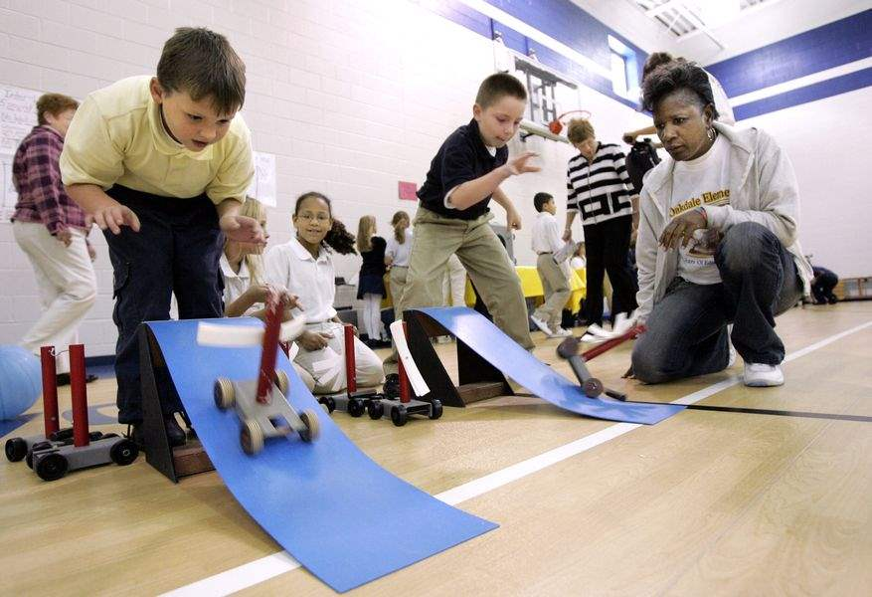
Inquiry Learning
A general label for any instructional technique in which students are engaged in an investigation or scientifically oriented questions. Students seek evidence to address questions, develop explanations to the questions posed, evaluate these explanations, and communicate their results.

Slide 12
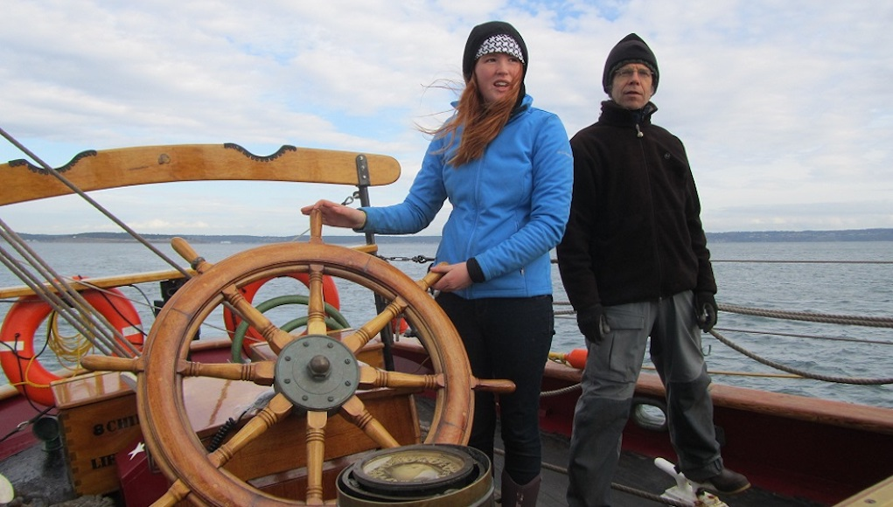
Place-based/Community-based Learning
An instructional approach that promotes learning rooted in a specific locale and involves students in solving community problems or is tied to experiences that are connected to a specific location

Slide 13

Problem-based Learning
An inquiry teaching strategy related to project-based instruction in which students are given real-world situations or scenarios (problems) and asked to offer insights regarding the situations

Slide 14
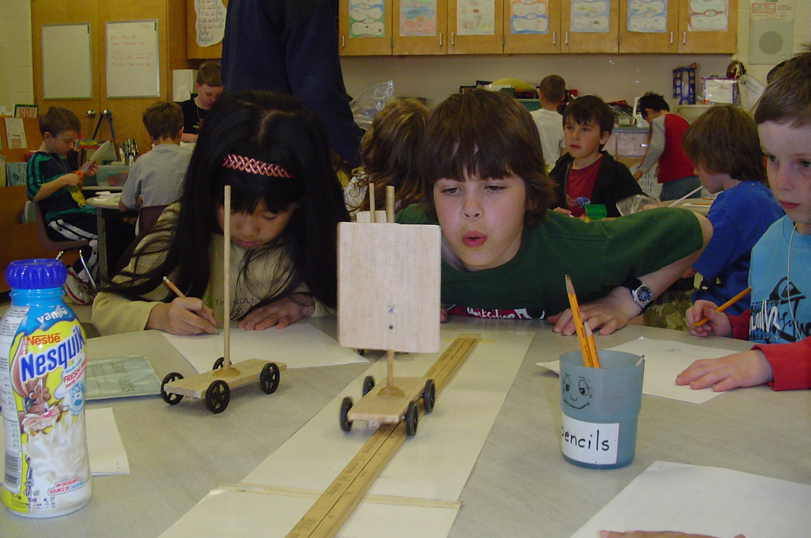
Project-based Learning
A type of inquiry teaching related to problem-based instruction in which students are given real-world challenges, situations or scenarios and asked to address these challenges and, generally, produce a product as a solution, not just offer a solution

Slide 15
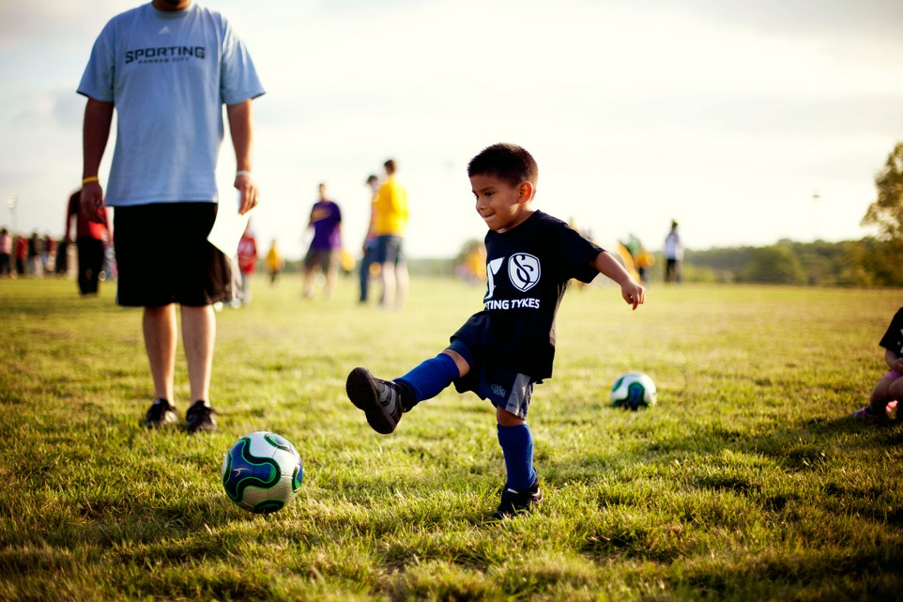
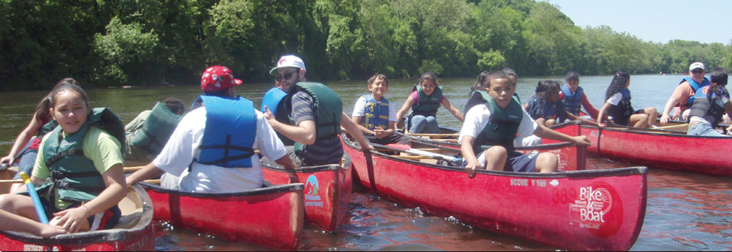
Recreational Learning
An instructional approach in which preplanned, directed and fun activities are performed for purposes of play, amusement or relaxation. It includes education offered for the purpose of teaching fundamentals, skills or techniques of sports, games, or other leisure-time pursuits.

Slide 16
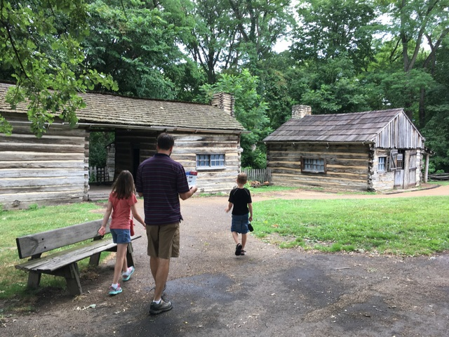
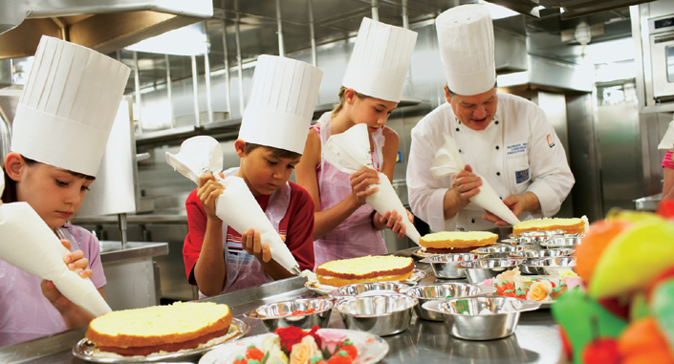
Situated Learning
Occurs when a learner is immersed and heavily involved in an experience that may provide opportunities for them to gain new knowledge and/or skills. This form of learning combines understanding from past experiences and current observations in the field.

Slide 17
How do these learning approaches all relate to each other?
Activity:
In groups of 2-3, develop a model showing the groupings and relationships of these 12 instructional approaches. Be prepared to explain your model.

