Slide 1
Historical and Global Perspectives on Informal and Outdoor Learning

Slide 2
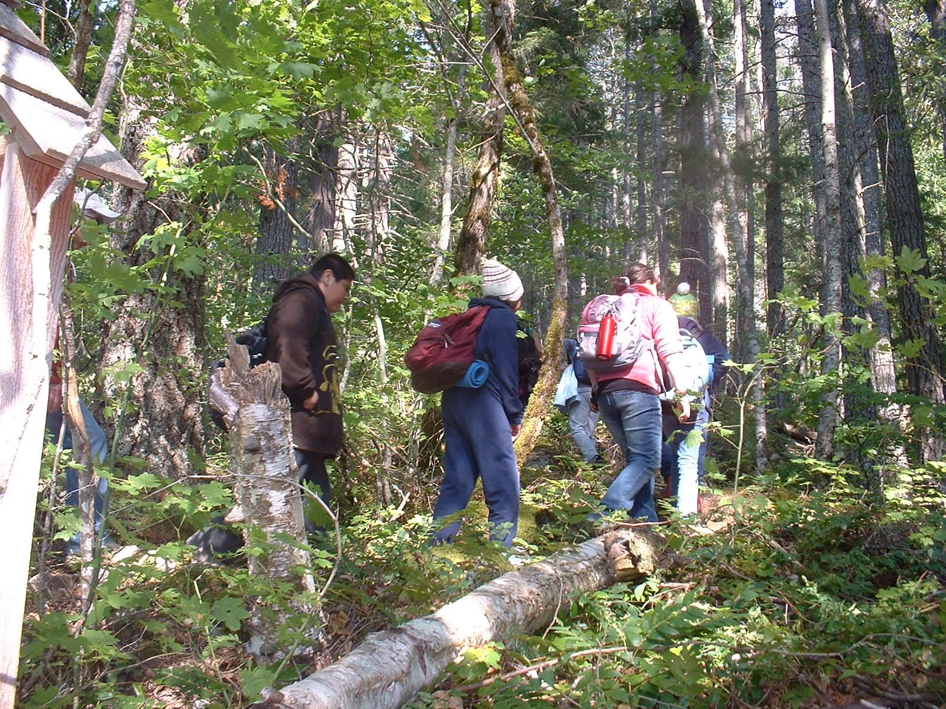
Conception of “outdoor learning”, rationales, and educational benefits
Discuss: Why do you think children need to spend time outdoors?

Slide 3
Early rationales for outdoor learning in the United States (1700 to 1900)
Skill acquisition geared toward agricultural careers and lifestyles
  Practical skills (farm skills, lumbering, surveying, survival skills, etc.)
  Leisure was not considered important
  Children learned skills outdoors alongside other family and community members

Slide 4
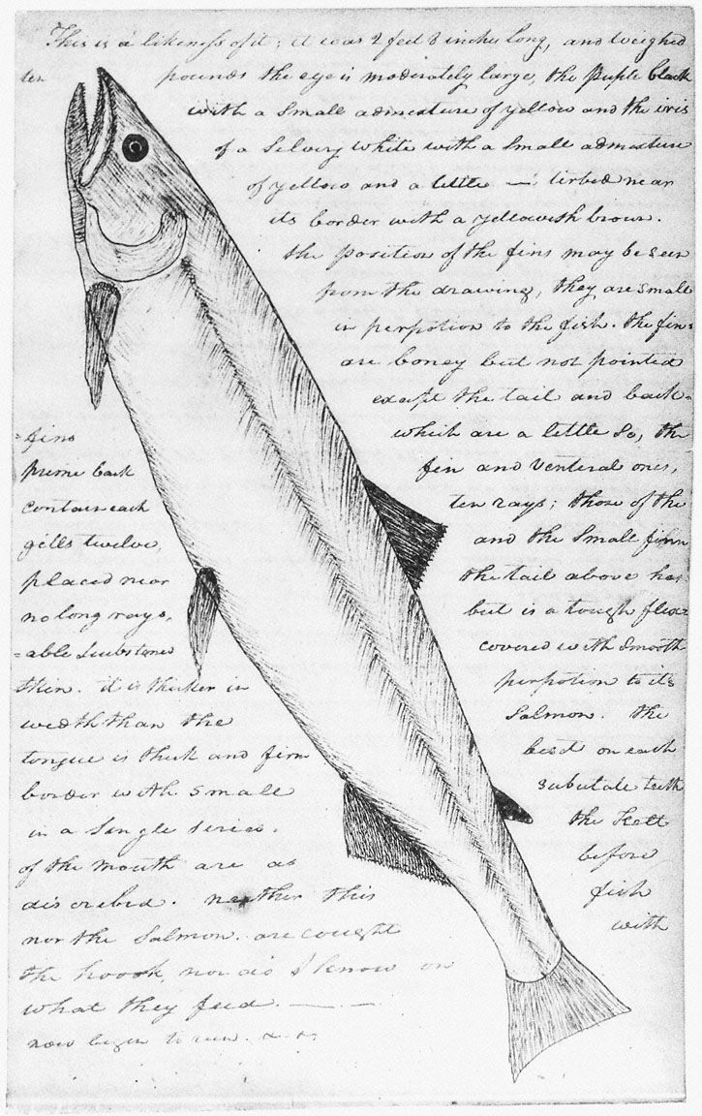

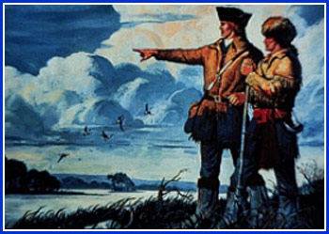
Naturalists often set the outdoor/informal learning standard
Lewis and Clark and the “Corp of Discovery”
Two and a half year journey (1804-1806)
Kept journals of their findings
Utilized outdoor survival skills
Learned additional skills and languages from native tribes

Slide 5
Rationales for outdoor learning
(Early to mid-20th century)
Personal growth and development
  Character building
  Preparation for war
Environmental education
  Began as nature study
Skill acquisition/Adventure learning
  Practical skills (starting fires, building shelters, etc.)
  Recreational skills (canoeing, rock climbing, fishing, etc.)

Slide 6
Modern rationales for learning outside the traditional classroom (Mid-20th century to today)
Making the curricula come alive
  Some topics are better studied outdoors (astronomy, ecology, living history, etc.)
  Makes topics relevant
  Children learn better and retain more in a relaxed atmosphere
Understanding the environment and sustainability issues
Encouraging physical activity, well being, & risk management
Combating “Nature-deficit disorder” (Louv, 2008)

Slide 7
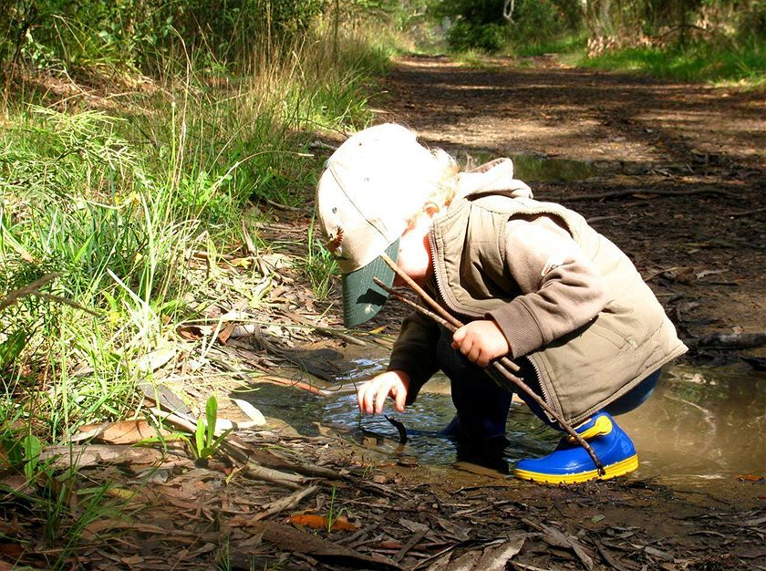
Basic psychological needs that motivate learning (Dettweiler, et al., 2017)
Competence (able to actually do things well)*
Autonomy (feeling of mastery over their own ideas and decision making)
Relatedness (or connection)
Also…reduced stress, as measured by lower cortisol levels

Slide 8
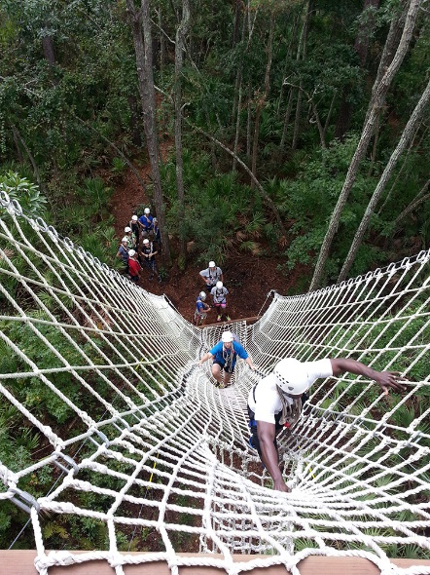
Outdoor education during the past 50 years or so…
Focused on adventure learning in highly controlled environments (e.g. ropes courses)
Facilitated by instructors trained to do activities using specialized equipment
Often occur far from the school setting
Little connection to the school curriculum

Slide 9
Benefits of learning in the outdoors
Intellectual/Educational
Socio-emotional/Health
Provides a meaningful relevant context for learning and developing new skills (results in higher academic achievement)
Increases intrinsic motivation to learn & feelings of competency
Increased attention span
Promotes opportunities for hands-on learning
Enhanced personal and social communication skills & encourages group cooperation
Increases physical health & enhances mental and spiritual health
Enhanced spiritual, sensory, and aesthetic awareness
The ability to assert personal control and increased sensitivity to one's own well-being
Reduces near-sightedness

Slide 10
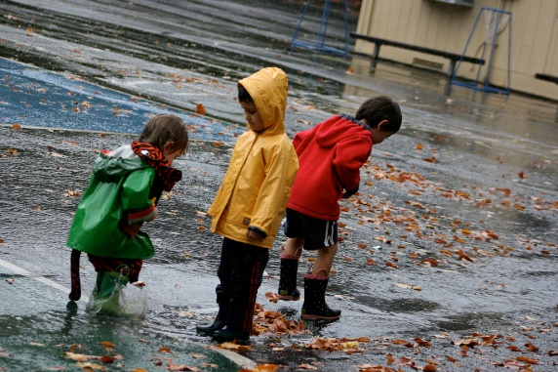
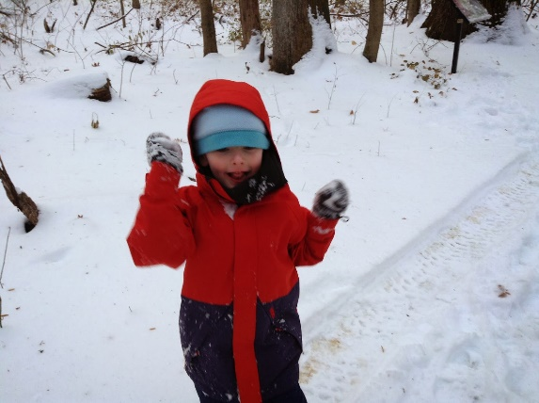
Disadvantages of learning in the outdoors
Health & Safety
Additional paper work
Following curriculum requirements
Weather (and the need for appropriate clothing)
Supervision
Natural Hazards

Slide 11
School grounds and local areas become extensions of the traditional classroom
Residential outdoor education centers
Using school grounds and local landscapes
Occur some distance away from school
Expensive
Require a specialist
Experienced infrequently by students
Takes time out of the regular curriculum
Rarely connect to the curriculum
Increased paperwork for teachers
Capacity to link with most curriculum areas
School grounds and cultural settings extend the classroom
Allows for frequent visits

Slide 12

Four broad contexts for outdoor learning
School Grounds
Local Neighborhood
Day excursions (field trips)
Overnight stays, residential camps, and expeditions
The more remote the location, the more logistical challenges
1. School grounds
2. Local Neighborhood
3. Day excursions
4. Overnight stays &
expeditions

Slide 13
Challenges to outdoor learning
Many teachers are not sure where/how to begin incorporating outdoor experiences in a meaningful way
Many lessons are content-specific (e.g. science) or stand alone activities and not incorporated throughout a coherent curriculum
Lack of resources to support learning outdoors
Outdoor lessons are predominantly used in the early years (PK-5), fewer opportunities for upper elementary or secondary students outside of field studies in science (HS timetables often get in the way)
Some educational and political contexts are not supportive of outdoor learning

Slide 14

Many countries incorporate outdoor learning
Sweden
Finland
United Kingdom
Australia
Switzerland
New Zealand
Netherlands
Denmark
Germany
Scotland and New Zealand enjoy government support for learning outside the classroom

Slide 15
In the United States…
OE is focused on disparate activities, not an integral part of a coherent curriculum area
  In other words, an activity or lesson here and there, not a real curriculum
Primarily occurs in the early years (PK to 6th grade)
School timetables get in the way
There is a distinct focus on the “what” of students’ learning, not the “why” or “how”

Slide 16
Real barriers to outdoor learning… well, maybe
Administrators, and some teachers, do not recognize the value of learning outside the traditional classroom
No Child Left Behind (NCLB) and high stakes testing
  Discourages cross-curricular activities and cooperation among teachers
  Pressure to meet standards
  Competition between teachers, schools, and districts for good test results
  For school districts, dollars are at stake
NCLB discourages teachers from deviating from the curriculum
  Discourages innovation and risk taking
  “If it isn’t tested – it’s not part of this classroom!”
Classroom climate that often discourages students from asking questions
  Questions take time away from test preparation
  Students have no actual stake in the test outcomes

Slide 17
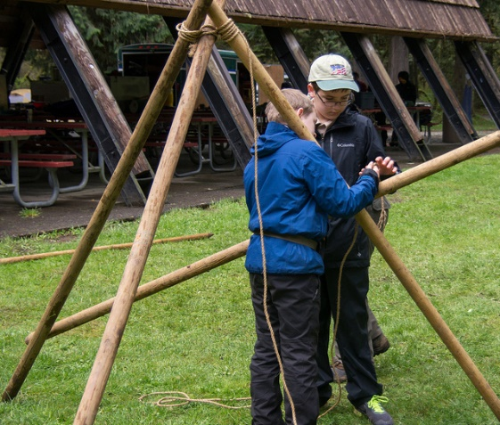
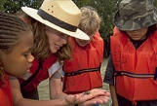
Who should incorporate outdoor education?
Classroom teachers
Environmental education centers and programs
Park naturalists, rangers, and interpreters
Community and social agencies
Volunteer organizations
Youth groups

Slide 18
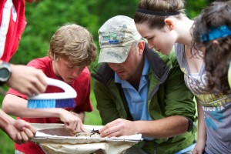
Guidelines for meaningful and effective outdoor learning
Learning across the curriculum
Education for sustainable development
Learning through local landscapes
Harnessing student curiosity
Enabling students to take responsibility
Building community partnerships
Administration and risk management
Supervising people outdoors

Slide 19
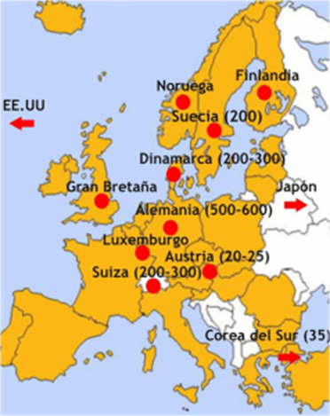
The rise of “Nature Preschools” and “Forest Kindergartens”
Began in Europe and is spreading worldwide
Children spend a large part (if not all) of each day learning outside, regardless of the weather
Content (nature, weather, geology, physical science, etc.) is connected to the natural world
The movement is gaining ground in the US

Slide 20
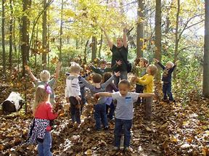
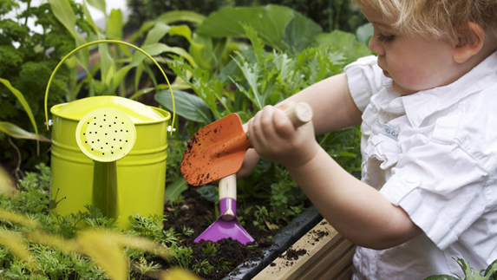
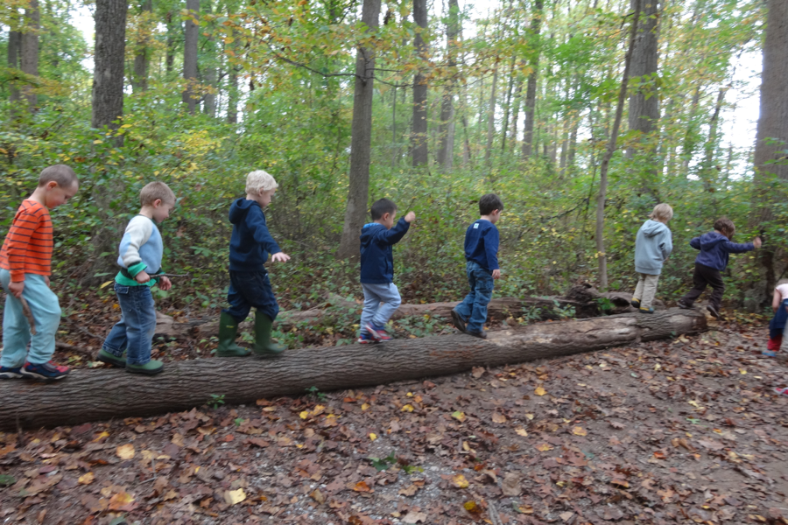
Nature preschools
A nature preschool is a growing trend in education
It is a fully-licensed child care operation that uses a natural area as a regular focus of its student activities. Typically, nature preschool classes go outside every day to enjoy loosely-structured explorations and play in natural settings

Slide 21
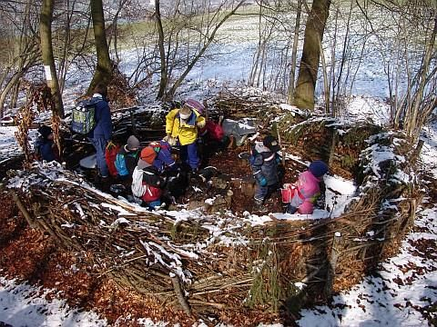
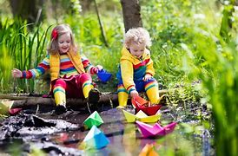
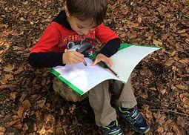
Forest kindergartens
A forest kindergarten is a type of preschool education for children between the ages of three and six that is held almost exclusively outdoors. Whatever the weather, children are encouraged to play, explore and learn in a forest or natural environment.

Slide 22
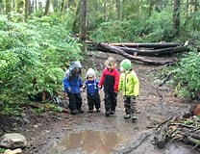
Nature Preschools & Forest Kindergartens Around the United States
First nature preschool in the US was 1967 at the new Canaan Nature Center (Connecticut)
The idea began to take hold in the 1990s and early 2000s
Dozens of schools (and growing) currently found in 38 states, plus the District of Columbia, in urban, suburban, and rural areas https://mamookids.com/blogs/journal/the-ultimate-guide-to-forest-nature-schools-in-the-us
- Some examples:
  Blue Ridge Forest School (Virginia) https://www.blueridgeforestschool.com/
  Cedarsong Nature School (Vashon Island, Washington State) https://cedarsongway.org/
  Ferncliff Nature Preschool (near LR, Arkansas) https://ferncliff.org/nature-school/nature-preschool/
  Free Forest School (Found in numerous metro/urban areas) https://www.freeforestschool.org/
  Tiny Trees Preschool (Seattle, Washington) https://tinytrees.org/

Slide 23
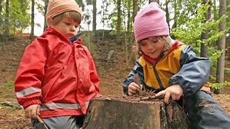
Nature Preschools & Forest Kindergartens Around the World
Germany
  Forest kindergartens are modeled after the waldkindergartens in Europe where children spend 80-90% of their time outdoors in natural areas.
Finland
  “Forest Schools” developed from Scandinavian forest communities in response to urbanization
  1950s schools introduced the “morning walk” into their daily curriculum and grew into it’s own program in the 1970s
  Engaged learning, boost in children’s health, improved academic performance, good for social skills, helps low-income families, engages teachers & lowers stress levels
Canada
  2012 Canada established the forest school network similar to the UK approach
  Currently lists over a dozen programs on their website
Australia
Hong Kong
New Zealand
Norway
Thailand
Turkey
UK British Forest Schools https://www.forestschools.com/

Slide 24
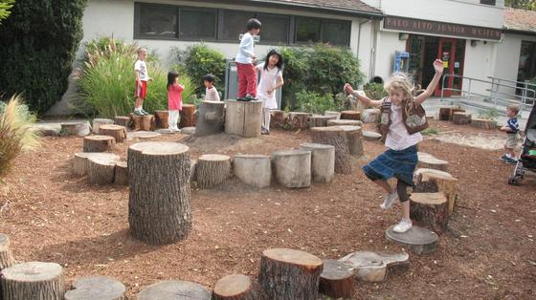
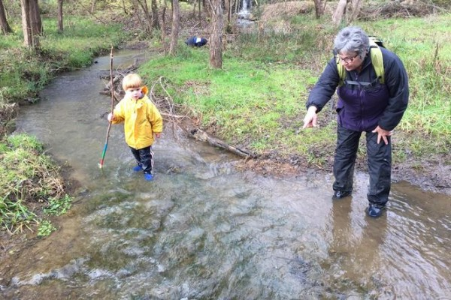
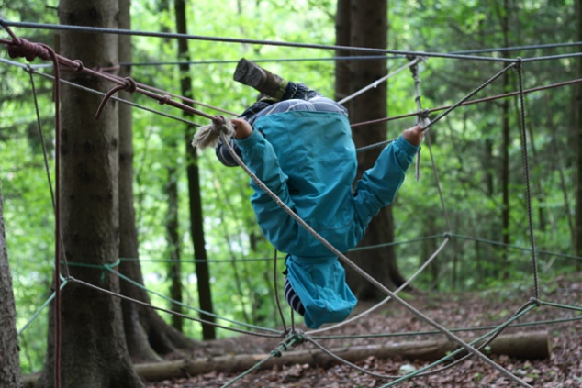
What does informal learning look like in a NP/FK?
Video: Kids Gone Wild: Denmark’s Forest Kindergartens https://www.youtube.com/watch?v=Jkiij9dJfcw
Video: Changing the Nature of Preschool (Cedarsong Nature School) https://www.youtube.com/watch?v=1jNAImEvcAs

Slide 25
What do you think about teaching young children in the outdoors?
Concerns for children
Benefits to children
Cold
Wet
Injuries
No fences/running away
Natural dangers (e.g. water)
When do children learn to “go to school”?
Won’t be ready for primary grades
Learn to manage risk & be careful (e.g. climbing trees)
Learn to use tools
Encourages imagination & attention span
Encourages activity
Build balance
Learn to handle hardship (e.g. cold, wet, hot)
Builds trust and confidence
Engage in natural vs. virtual world
Builds interest in learning
Less stressed

Slide 26
Resources
American Forest Kindergarten Association https://www.forestkindergartenassociation.org/
Natural Start Alliance https://naturalstart.org/
Nature Explore https://natureexplore.org/
Nature-Based Early Learning Conference
Eastern Region Association of Forest and Nature Schools http://www.erafans.org/

Slide 27
Other similar schools in NWA –
Northwest Arkansas Forest School Homeschool Co-op – Fayetteville-based
Clover Community School (K-8) - Bentonville - Project-based and Nature-inspired
Informal Education – Snails and Turkey Tails: NWA Forest Meet-Up Groups for Families

Slide 28
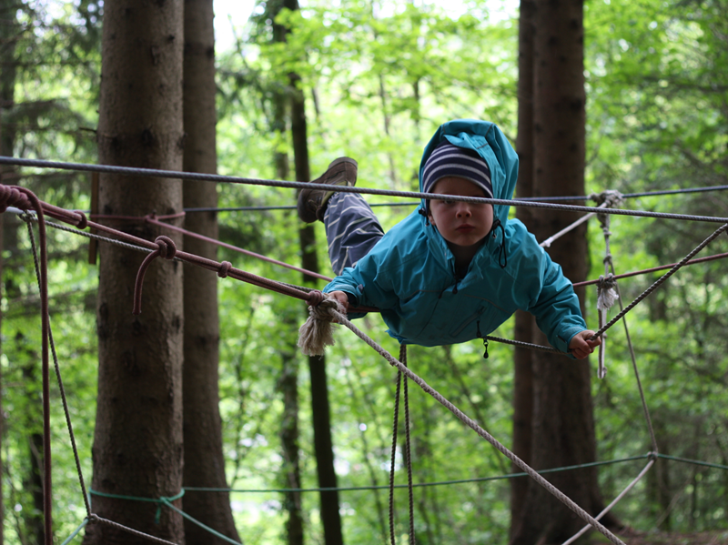
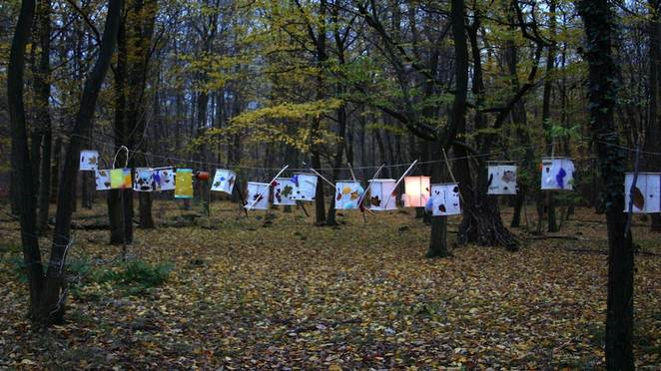
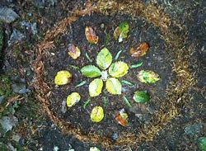

Slide 29
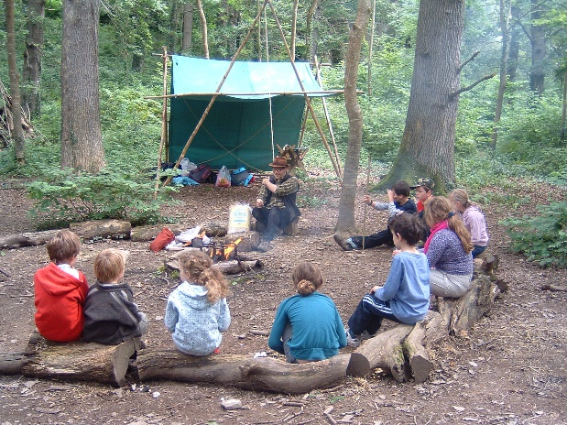
Activity: Plan Your Ideal Nature Preschool/Forest Kindergarten
Working in a group, plan and design your “ideal” nature preschool/forest kindergarten. Consider the following:
Physical space
  How many children will be served? How large is your space? What will you do there?
  Shade and/or weather structures
  Seating & working areas
  Storage
  Stand-alone or connected to another facility
Curriculum
  The intended curriculum
  The hidden curriculum
  Meeting state standards
Support Facilities/Activities
  Lunches
  Bathrooms
  Nap time
  Medical

