Slide 1
Writing a Grant Proposal
How to write proposals that actually get funded

Slide 2
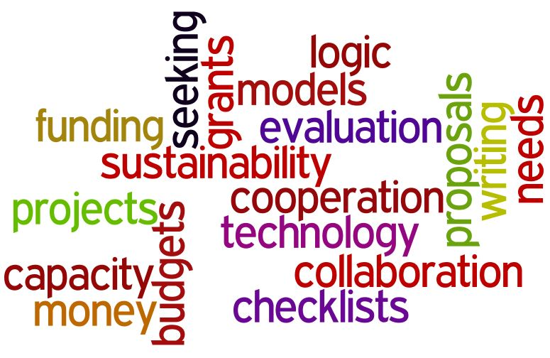
In 2016, over 25,600 private foundations in the U.S. Gave away $6.3 billion. At $11,000 per second, that’s a LOT of money!!!
Donors give money to meet their needs and advance their causes, not yours.
When seeking funding, the name of the game is to find a good match between your needs and the funder’s goals. You will need to research things such as the funder’s:
  Area of interest,
  Patterns of giving,
  Geographical restrictions, among others.

Slide 3

Four Top Reasons that Proposals do not get funded
Funding source does not believe you understand the problem
Funding source does not believe in your solution
Funding source does not believe in your qualifications
Funding source does not believe or trust your budget

Slide 4
RFP’s (Request for Proposals)
Foundations and state and national government agencies issue RFP's (requests for proposals).
What is a proposal?
  A PROPOSAL is a representation of your program. - “You never get a second chance to make a first impression.” No misspelled words, no white out. Accurate, crisp, clean.
  A PROPOSAL is a request. - Don't forget to ask for the money. Don't beg. Don't be arrogant.
  A PROPOSAL is persuasion.
  A PROPOSAL is a promise. - Don't promise what you cannot deliver. Deliver more than you promised.
  A PROPOSAL is a plan.

Slide 5
Have a planned approach to writing a proposal
Before making a formal request for money, an organization must have a clear idea of its project. Writing a proposal for the project helps staff organize ideas and concepts and develop them into an effective program. A well written proposal should describe the importance of and need for the project as well as outline the organization's specific plans for implementing it.
DO set up a personal appointment before you write the proposal, especially if seeking money from a corporation.
DO follow directions exactly! Leave no space blank, put N/A. If they say “Write a 300 word description,” write a 300 word description.
You DON'T have to be the low bidder to get funding. Ask for what you need to complete the project.

Slide 6

The funding process
Fundraising is an important part of the process of planning your program. Obviously, sufficient funds to operate a project are essential to its success. However, requesting money from a foundation is not the first step.
Foundations receive many requests for money from a variety of organizations for a range of project ideas. You need to make your project stand out.
  Provide detailed and organized information about your project
  Describe your need
  Matched to the special area of interest of the foundation
  It is a poor use of time to prepare a proposal for the wrong funding agency

Slide 7
Where do you find funders?
Libraries are a good source of information about foundations
Local, state, regional and national planning associations
Government agencies and departments (Dept. of Education; Department of Interior; EPA; Arkansas Game and Fish, etc.)
Private foundations (Walton Family; Gates Foundation; Rockefeller, etc.)
Special interest groups (Arkansas Environmental Education Association; National Wildlife Association; National Audubon Society; Children and Nature Network, etc.)
Local school districts and universities
Businesses (Lowes; Home Depot; McDonalds, etc.)

Slide 8

Components of a proposal
Each RFP has its own requirements, but usually includes some or all of the following:
Summary
Introduction
Problem or needs statement
Program objectives
Methods
Evaluation (if requested)
Other funding sources and future funding
Budget
Appendices
Cover letter

Slide 9
Summary
Appears at the beginning of the proposal; is interesting; clearly, concisely, and briefly summarizes request.
  Identifies the grant applicant
  Includes at least one sentence on your organization's qualifications
  Includes at least one sentence on the problem
  Includes at least one sentence on objectives
  Includes at least one sentence on methods
  Includes total cost, funds already obtained and amount requested in the proposal.

Slide 10
Introduction
Describes the applicant/agency and its qualifications for funding; is brief, interesting, and free of excessive jargon; leads logically to the problem statement.
  Clearly establishes who is applying for funds
  Describes applicant agency purposes and goals, programs and activities, and clients or constituents
  Provides evidence of the applicant's accomplishments (with statistics, if possible)
  Possibly offers quotes/endorsements in support of accomplishments
  Supports qualifications in area of activity in which funds are sought (e.g., research, training)

Slide 11
Problem statement or needs assessment
Relates to purposes and goals of applicant agency; is of reasonable dimensions, makes a compelling case; makes no unsupported assumptions; is brief, interesting, and free of jargon.
  Is supported by statistical evidence and/or statements from authorities
  Is stated in terms of clients' needs and problems, not the applicant's.

Slide 12
Program objectives
Describes program outcomes in measurable terms; are outcomes, not methods.
  At least one objective for each problem or need committed to in problem statement.
  Describes the population that will benefit
  States the time by which objectives will be accomplished

Slide 13
Methods
Describes activities to be conducted to achieve the desired objectives; presents a reasonable scope of activities that can be conducted within the time and resources of the program.
  Flows naturally from problems and objectives
  Clearly describes program activities and reasons for the selection of activities
  Describes sequence of activities or a timeline (this includes both planning and the activity itself)
  Describes staffing of program
  Describes clients and client selection

Slide 14
Evaluation
Presents a plan for determining the degree to which objectives are met and methods are followed.
  Presents a plan for evaluating accomplishments of objectives
  Presents a plan for evaluating and modifying methods over the course of the program
  Tells who will be doing the evaluation and how they were chosen
  Clearly states criteria of success
  Explains how data will be gathered and any test instruments or questionnaires to be used
  Describes the process of data analysis
  Describes any evaluation reports to be produced

Slide 15
Other funding sources and/or future funding
Describes a plan for continuation beyond the grant and/or the availability of other resources necessary to implement the grant.
  List other sources of funding committed to project
  Presents a specific plan to obtain other needed and future funding if program is to be continued
  Is accompanied by letters of commitment, if necessary

Slide 16
budget
Clearly delineates costs to be met by the funding source and those provided by other parties; is detailed in all aspects.
  Tells the same story as the proposal narrative
  Contains no unexplained amounts for miscellaneous or contingency
  Includes all items asked of the funding source
  Includes all items paid for by the other sources
  Is sufficient to perform task described in the narrative
  Round up slightly, in case of price changes between when you write the proposal and when you actually purchase materials and supplies

Slide 17
Budget
Item | Source | Price each | Number required | Total
Yardsmith 8-in children’s rake | Lowes | 4.98 | 10 | 49.80
Yardsmith 27.165-in steel short-handle children’s shovel | Lowes | 4.98 | 10 | 49.80
Yardsmith 8.58-in carbon steel garden trowel | Lowes | 3.98 | 20 | 79.60
Vegetable seeds (assorted varieties) | Lowes |  |  | 50.00
Seed starting potting soil (12 dry quart) | Lowes | 5.49 | 4 | 21.96
Ferry Morse 72-cell tray | Lowes | 5.50 | 10 | 55.00
Garden hose (5/8-in x100-ft | Lowes | 51.98 | 1 | 51.98
Watering wand | Lowes | 12.98 | 1 | 12.98
Subtotal |  |  |  | 366.12
Tax (local) @ 11.5% |  |  |  | 42.11
Total |  |  |  | 408.23

Slide 18
Budget justification
You need to justify the items in your budget – explain why you need the items and numbers you are asking for
Based on 20 children participating:
  10 child rakes and 10 child shovels will be needed for all children to participate in garden preparation
  20 trowels will be needed for all children to participate in planting seeds and seedlings
  1 hose and watering wand to water the garden
  Vegetable seeds for starting indoors and planting directly in the garden
  Cell trays and seed starting mix for starting seedlings indoors

Slide 19
Final tips…
Write as simply and clearly as possible. Avoid using slang or phrases that are not commonly understood or that could be easily misunderstood.
Keep the proposal as short as possible while still maintaining the substance. Remember to try to match your interests with those of foundation.
Avoid broad or sweeping statements. Issues, problems and needs should be stated as accurately and factually as possible.
Test the proposal on others not familiar with it before submission.
Be prepared to rethink and rewrite the proposal.

