Slide 1
Fostering Curiosity and Understanding through Take-Apart Tinkering

Slide 2
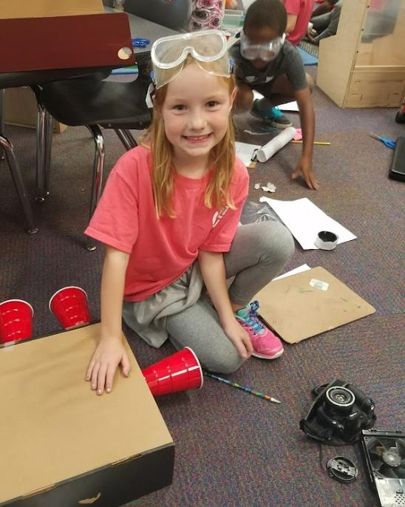
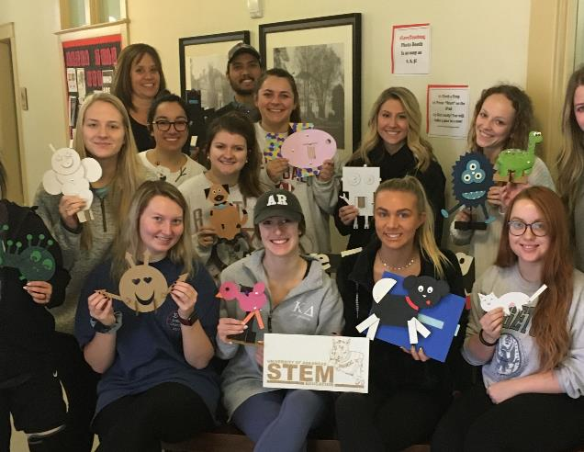
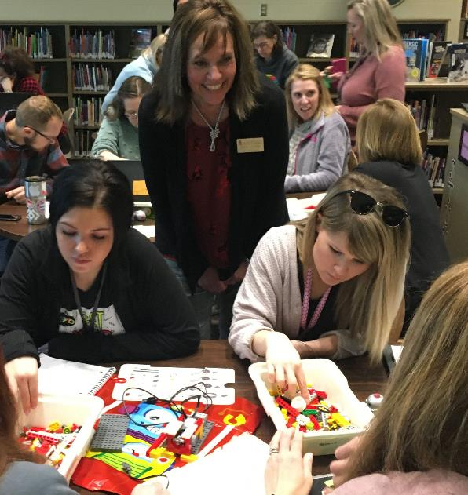


Slide 3

Slide 5
Meet Tori
After
Before
I color in
the lines.
I think
inside the box.
I am good at tests!
Tell me what to think and I’ll think it.

Slide 4
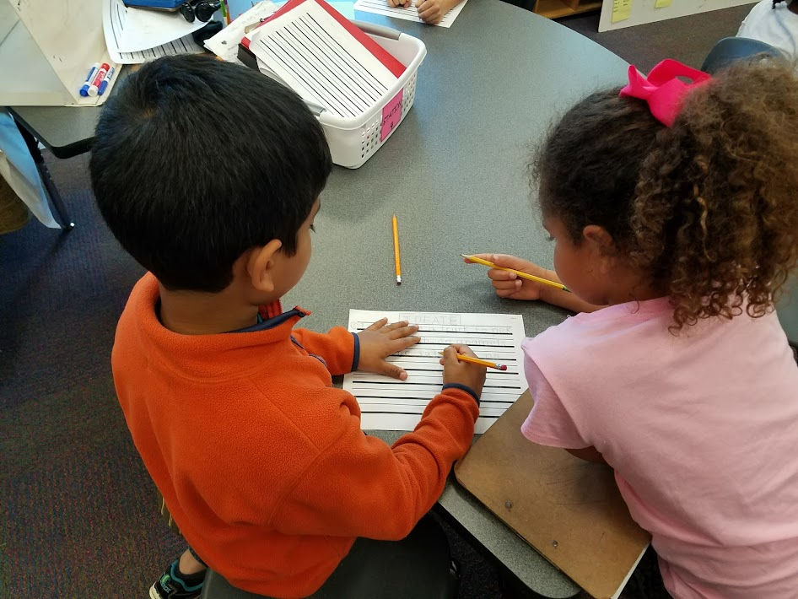
Literature Exploration
Prediction of future workforce shortages in STEM (U.S. Bureau of Labor Statistics, 2021)
Despite 20+ year effort, fewer American students entering STEM fields (National Science Foundation, 2018)

Slide 5
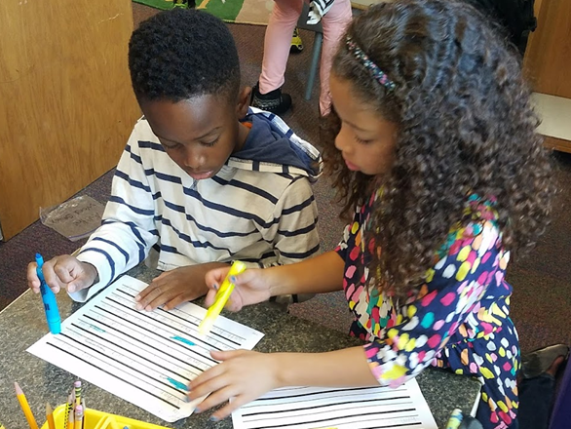
“A weak emphasis on innovation and design in education, especially at the primary level, has contributed to challenges in meeting the STEM-related job demands.” (Swift, Strimel, & Bartholomew, 2018, p. 7)

Slide 6
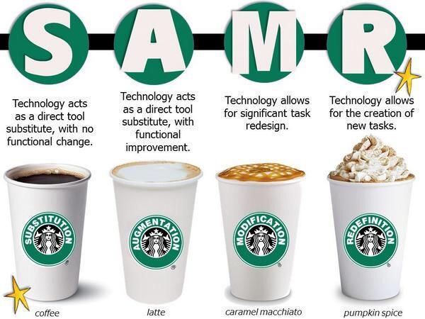

Slide 7
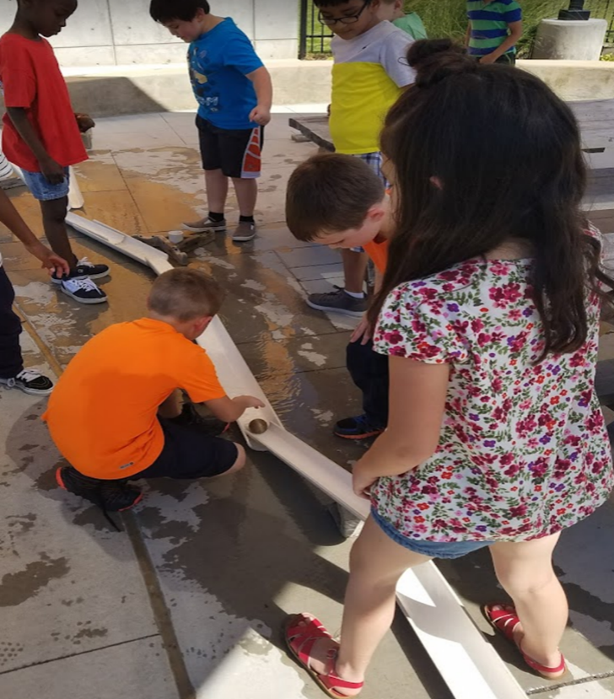
-4th grade 30% lost interest in science
-8th grade 50% deemed science is irrelevant to their future
-Equates to millions of students lacking confidence to enter STEM fields (Daugherty & Carter, 2018)

Slide 8
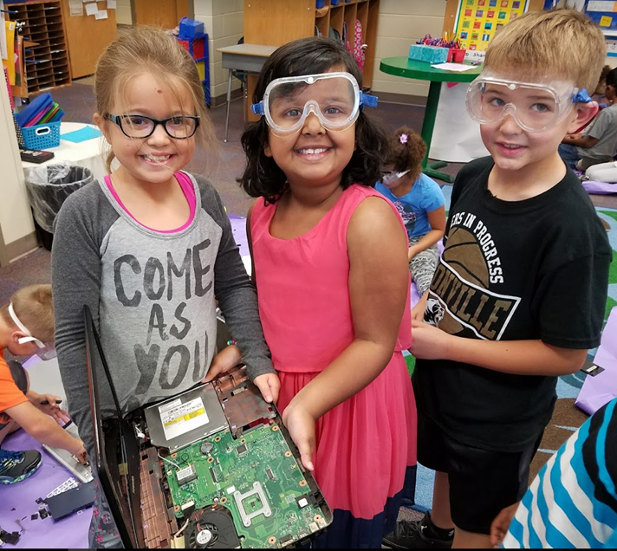
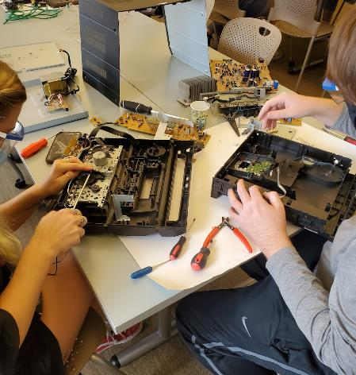
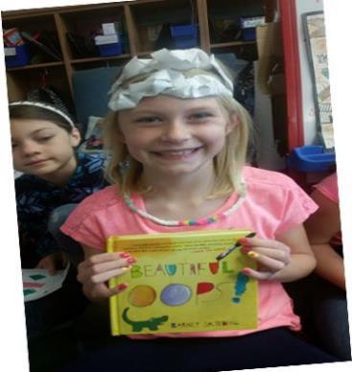
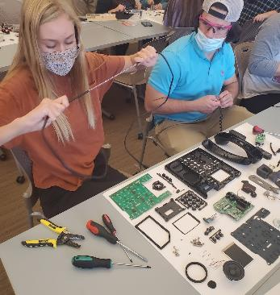
Tinkering &Take-Apart in in the Elementary Classroom

Slide 9
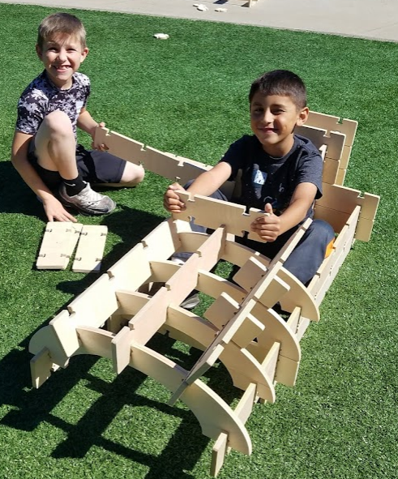
We learn about the world and advance through science, technology, engineering, and mathematics practices and experiences(Kelley & Knowles, 2016).

Slide 10
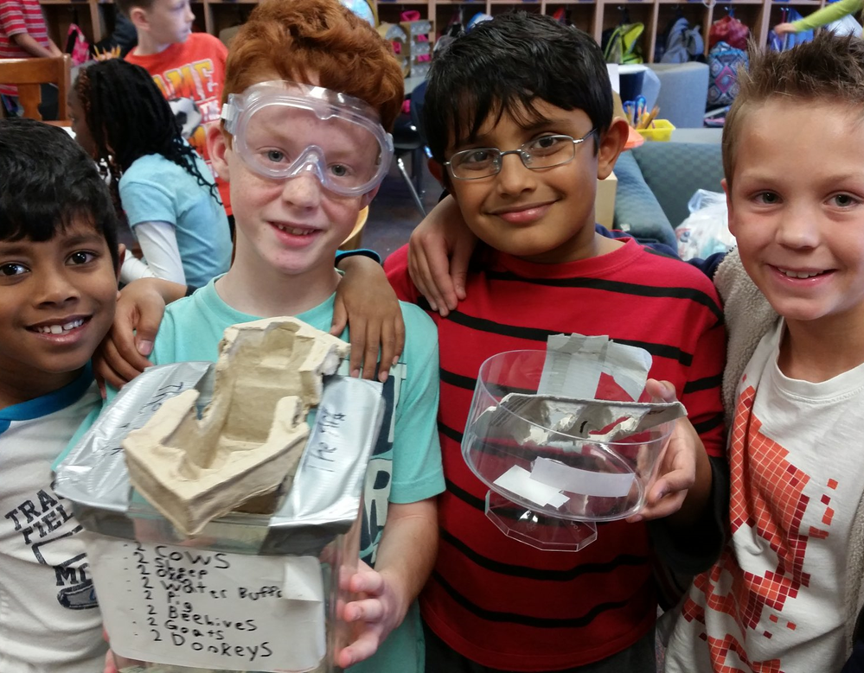
Tinkering
Playful
Experimental
Iterative
Engaging
Explorative
New possibilities
(Resnick & Rosenbaum, 2013)

Slide 11
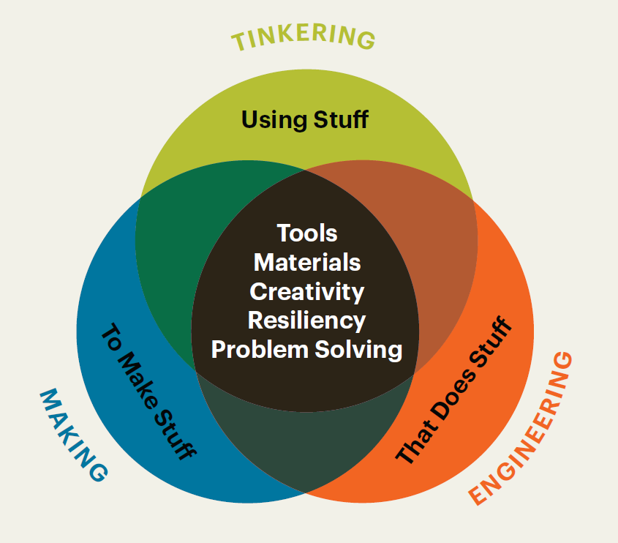
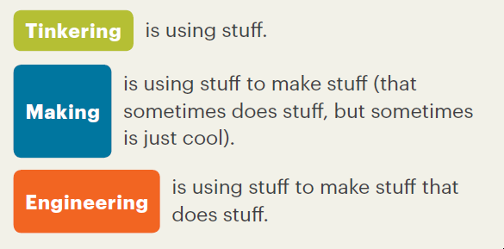
What You Need to Know About Tinkering, Making, and Engineering, NAEYC, Adapted from the Boston Children’s Museum, Tinker Kit: Educators’ Guide (Boston: Boston Children’s Museum, 2016), 4.

Slide 12
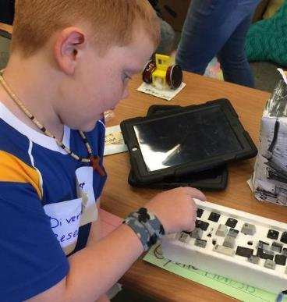
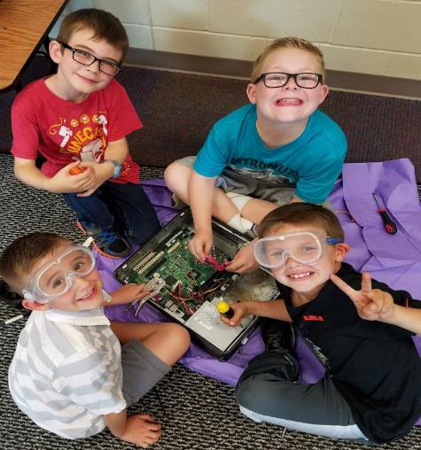
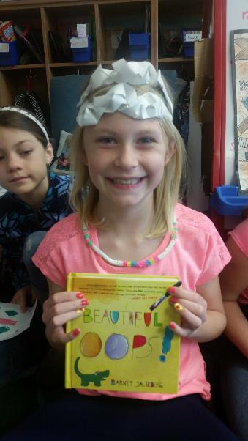
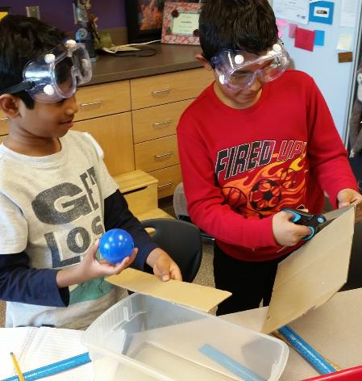
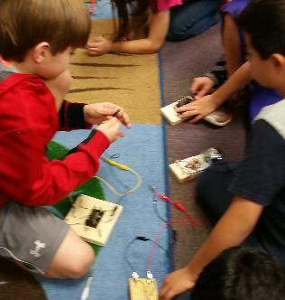
Slide 2

Slide 13
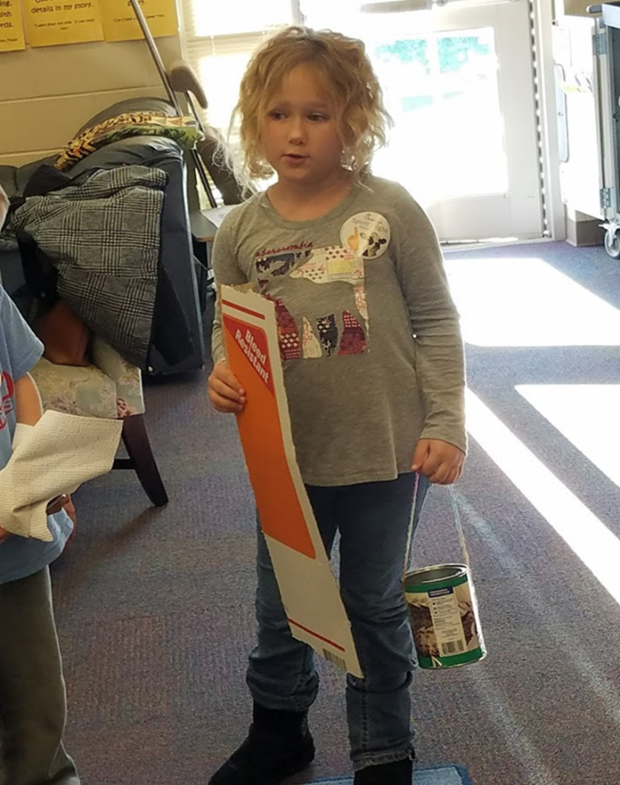
Tinkering
“Tinkering is undervalued (and even discouraged) in many educational settings today, but it is well aligned with…the goals of the progressive-constructionist tradition.”
(Resnick & Rosenbaum, 2013, p. 164)

Slide 14
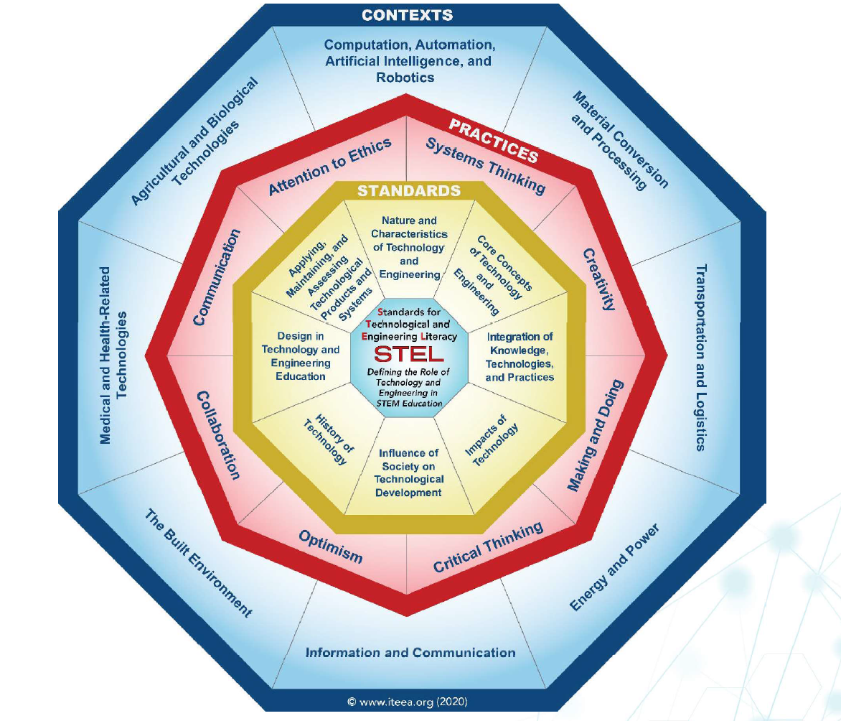
Structure of Standards for Technological and Engineering Literacy (ITEEA, 2020)
Practices
Systems Thinking
Creativity
Making and Doing
Critical Thinking
Optimism
Collaboration
Communication
Attention to Ethics

Slide 15
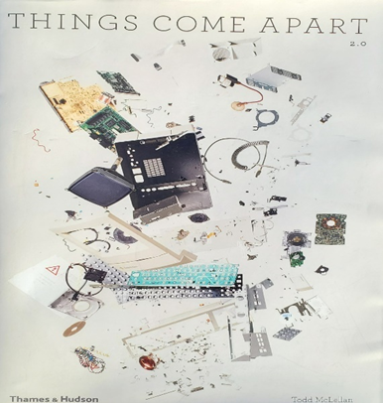
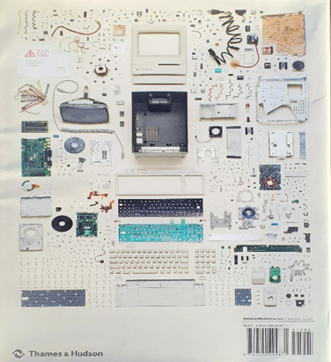
Things Come Apart: A Teardown Manual for Modern Living (McLellan, 2013)

Slide 16
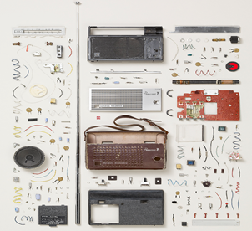

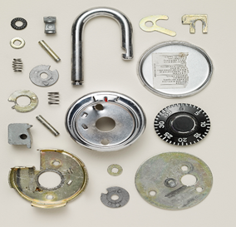
Slide 6
transistor radio
mechanical pencil
combination lock

Slide 17
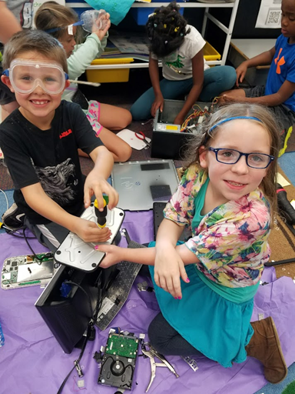
Take-apart
Process of Deconstruction
Real tools
Discover how things work
How are things made?
(Heroman, 2017)

Slide 18
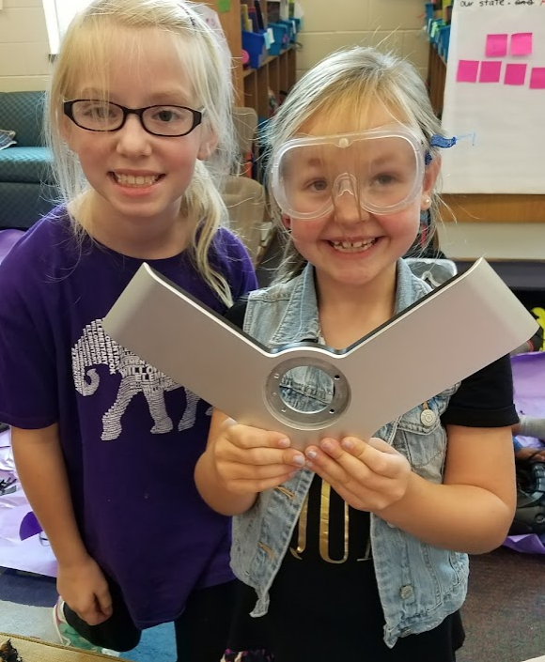
“The integration of engineering practices in the science classroom as early as grade one shows potential in fostering and sustaining student interest, participation, and self-concept in engineering and science” (Capobianco, Yu, & French, 2014).

Slide 19
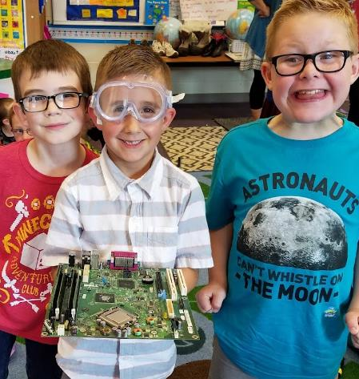
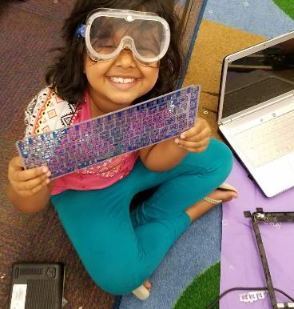
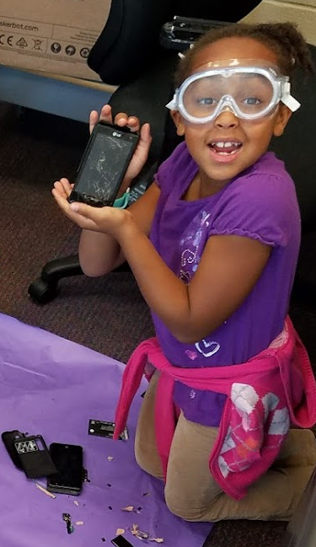
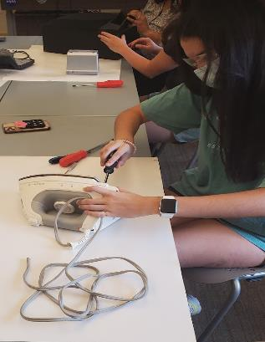
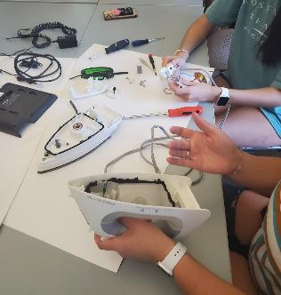
Slide 2

Slide 20
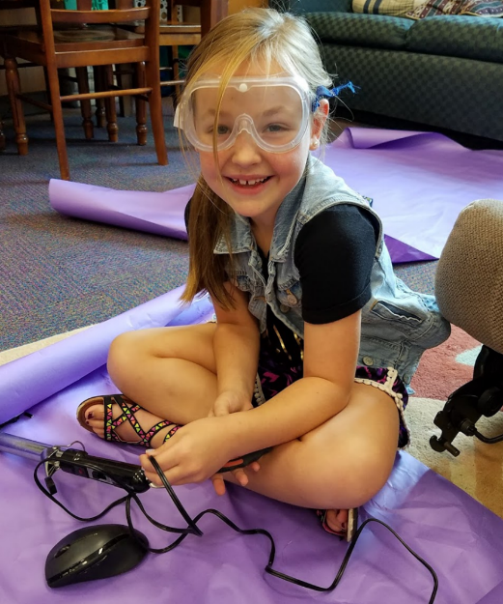
Tinkering and Take-apart Self-Efficacy
“Conviction that one can successfully execute the behavior required to produce outcomes…
Procedures, whatever their form, serve as means of creating and strengthening expectations of personal efficacy”
(Bandura, 1977, p. 193).
Preparing students to become technologically and engineering literate should not be left to chance (Move, 2019).

Slide 21
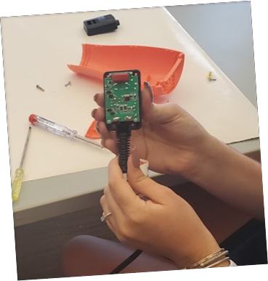
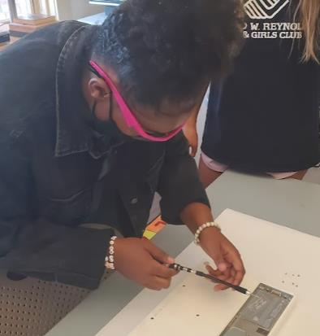
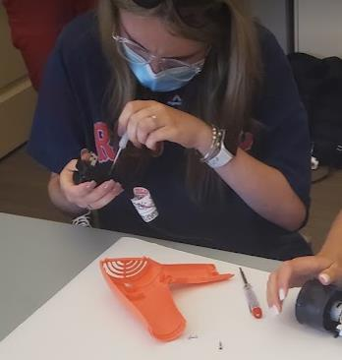
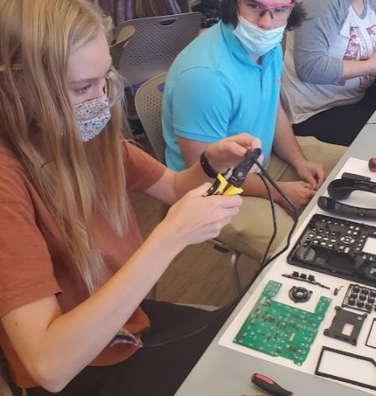
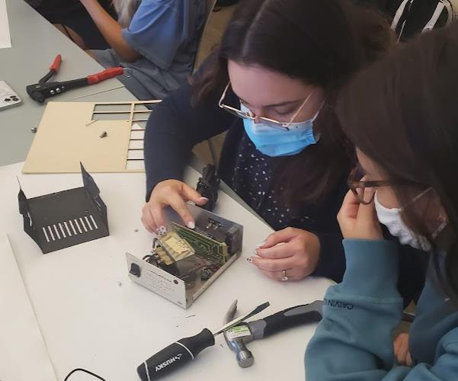
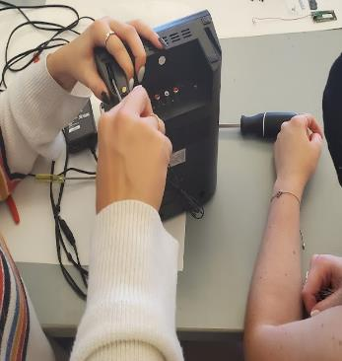

Slide 2

Slide 22

Tinkering and take-apart Preparing students to become technologically and engineering literate should not be left to chance (Move, 2019).

Slide 23
Slide 5
Meet Tori 2.0
After
Before
I color outside
the lines.
I am good at taking tests, but I can also think critically and I am not afraid to take on a new challenge!
I think
outside the box.
Just get me started and I can solve the problem!

Slide 24
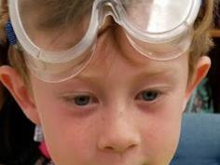


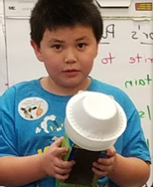

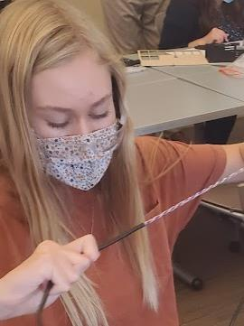
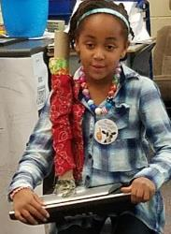
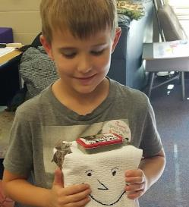
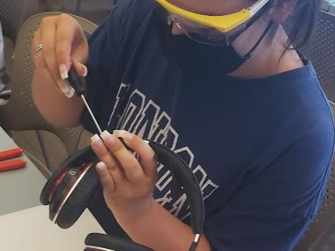
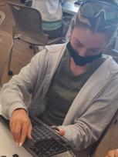
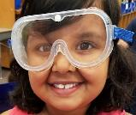
Page Title 7
”Elementary teachers are the gatekeepers to fostering the gifts and talents of future STEM innovators.”
(Cotabish, et. al, 2013)

Slide 25
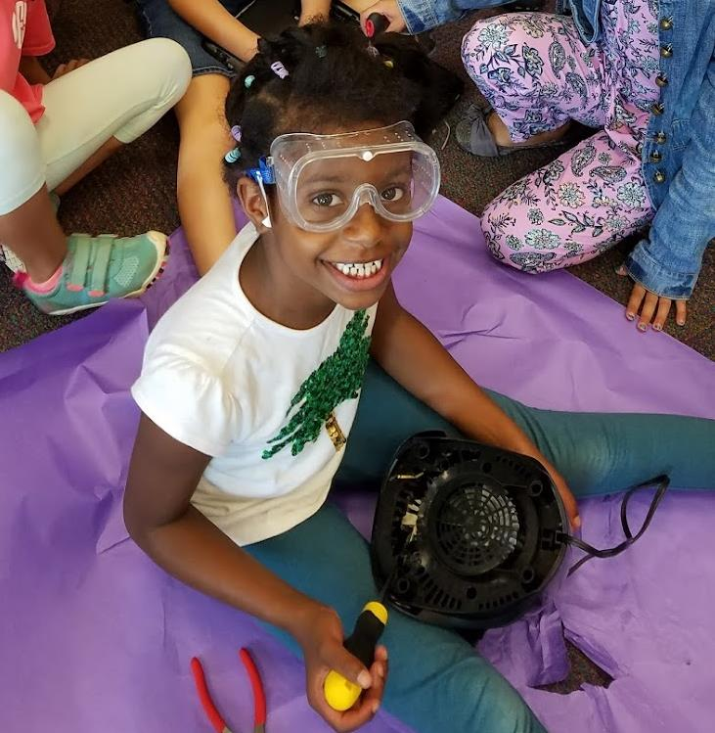
Comprehending how something works and applying that knowledge in a novel way depends on opportunities to tinker, take-apart, explore and create; things that define the foundation of learning engineering (Brophy, et. al, 2008).

Slide 26
Curiosity and Understanding through Take-Apart Tinkering
Your turn…

