Slide 1
Harnessing Curiosity for Learning Outdoors
…and managing the inherent risks of informal learning

Slide 2

Nature vs. Nurture
Nature
  Behavioral traits that people are born with
Nurture
  The role of personal experience in the learning process

Slide 3
Learning Theories
Piaget (1977) ~ children’s learning is developmental and linked to their maturity and their capacity to learn increases with age
  Sensorimotor stage (birth to 24 months)
  Pre-operational stage (2 to 7 years)
  Concrete operational stage (7 to 11 years)
  Formal operational stage (11 to 15/20 years)
Vygotsky (1978) ~ “social learning theory” explains that people learn better through social interactions, and social environments influence the learning process
  Zone of proximal development – “children’s optimal performance is achieved when working with a more knowledgeable person”
Rogers (1983) ~ learner-centered approach focuses on individual creativity and problem-solving abilities. The individual is responsible for their own learning, with the teacher acting as a facilitator.
Bee (1989) ~ “active voluntary exploration” depends on the willingness of the learner to engage in the process

Slide 4
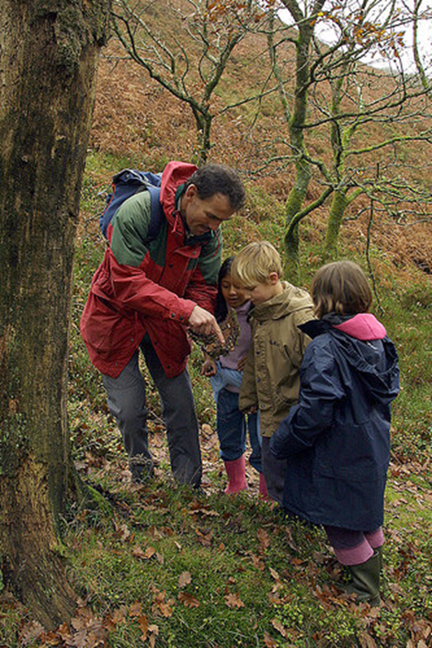
Development of Curiosity
Children go through a natural progression of maturity
While people can certainly learn alone, social contexts increase the rate of learning
Teachers, parents, and other “experts” can facilitate this learning
People must be willing to engage in the learning process. There must be a conscious effort on the part of the learner.

Slide 5
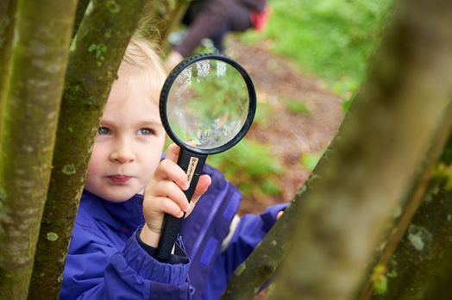
Incorporating Curiosity into Lesson Planning
Learning is motivated by a need to know
Characteristics of curiosity and learning are to “wonder why” and to argue
Curiosity is contextualized by the physical space
  Indoors vs. outdoors
  Concrete vs. green areas
Importance of independence and ownership to an individual’s learning
Natural settings are crucial because they stimulate all the senses and integrate informal play with formal learning (Louv, 2008)

Slide 6
Taking Curiosity Outdoors
Many children have little experience with the outdoors
Power of curiosity + coupled with the equally powerful stimuli found outdoors = joy of learning
Teachers (or others) need to harness children’s innate power of curiosity and direct it towards learning about the world
Re-engage learners in the world as they actually experience it
Leads to “experiential” or “authentic” learning

Slide 7
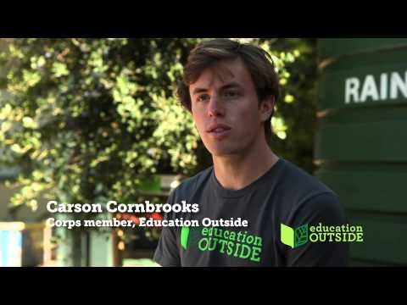
Open the Classroom Door https://www.youtube.com/watch?v=6pG4DqIEFfQ
Look for evidence of how students’ curiosity is encouraged.
  What is the teacher doing?
  What are the children doing?
How is this learning “authentic”?
How do the students respond to this approach to instruction?

Slide 8
Getting Started….
Provide or develop a physical space outdoors where curiosity can be nurtured
Use curiosity-stimulating teaching approaches, such as
  Incongruity
  Uncertainty
  Conflict
Foster an environment where inquiry, investigating, and questioning is the norm
Empower students to direct their own learning (at least in part)

Slide 9
Fostering Responsibility for Learning
Teacher’s responsibility vs. students’ responsibility
  “What am I going to teach?” vs. “What do the students want to learn?”
Teacher’s role
  Establish a collaborative learning community in which students can learn from others (other students or adults)
  Have long-term learning goals
  Able to differentiate for greater learning
  Allow students to accept risks and responsibility (and consequences) for their actions
  Construct situations where students need to make decisions
Student’s role
  Accept responsibility for learning, comfort, and safety
  Contribute to the experience

Slide 10
Scenario 1
Ms. G recently modified a lesson to include an outdoor learning component and received permission from the administrator to take her middle school class to a nearby park for the lesson. In the park, students were working in groups of 3 to complete the learning activity. She noticed that one student, Jamie, was sitting on a bench while his partners worked through the activity. After asking if something was wrong, Jamie replied that he did not like to be outside, citing that he thought the lesson was a waste of time and wanted to go back to the classroom.

Slide 11
Scenario 2
An instructor in an outdoor education/recreation program for young adults spends more time talking with some participants because he/she feels more comfortable with those participants or those participants seem more engaged, while others seem disinterested.
Should the instructor spend energy where it will do “the most good”, in other words, on participants who are interested and will take the instruction seriously?
Is this an ethical approach to teaching?
How can the instructor engage those who seem disinterested?
Be prepared to defend your position.

Slide 12
Scenario 3
You work as an interpreter at a museum (or science center, zoo, national park, etc.) and routinely lead guided tours for school groups. Sometimes the teachers take an active role in instruction and sometimes, not so much, expecting you to fill that role. One day you are leading a tour around your site and the teacher continually provides comments and information to her students that you know is incorrect. What would you do?

Slide 13
Our Mixed Messages to Children
The Paranoia of Parenthood
  Free range parenting vs. helicopter parenting
The publicity of tragedy
  Universal photography and video
  The quest for shock value
The litigious nature of our society
  The courts as lottery
    Verdicts are free money
  The commercialization of victimology
    Don’t be a “silent victim”/You may be entitled to “substantial compensation”
  Removal of other alternatives for settling disputes
  Zero tolerance policies ~ No fighting!

Slide 14
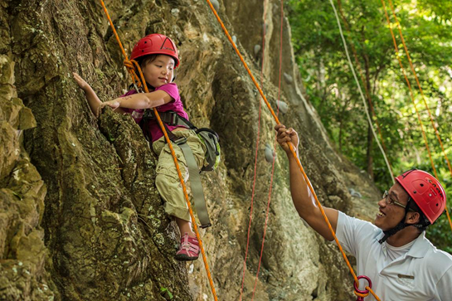
Managing Risk
Plan for unplanned events
Important to expose students to a manageable level of risk
Risk vs. negligence
Address and reduce risks, but don’t eliminate all of them
Managing risk involves…
  Be sure equipment is safe and in good repair
  Be sure everyone understands procedures
  Teacher is prepared to handle emergency situations (Emergency Action Plan)
  Always have a “Plan B”
Parental consent/medical release forms

Slide 15
Prepare Students for Risk
Allow time for contemplations and reflection
Asking “Think about…” questions without demanding answers
Be encouraging when confronted with speculation and imagination (not just tolerant), especially when dealing with children’s fears in the outdoors
Say “Try it and see”
Allow children to follow where their curiosity, love, and wonder lead them
Ultra-structured curriculum is not always the best route
  Locks every child into the same mode of learning
  Turns diversification into the educator’s burden
If every child does not learn the same thing, it’s OK
  It’s not only OK, but enriches the learning experience for the entire class

Slide 16
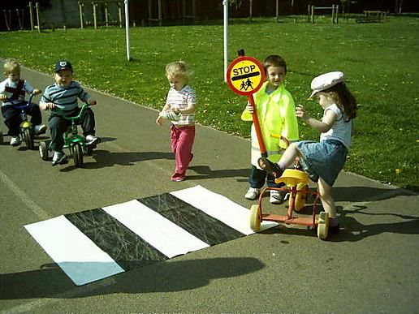
Risk Management Plan
Hazard
Control Measures
Road traffic
Exposure to the elements
Students wear visibility vests
Students walk on sidewalks
Students cross the street with the light and with a buddy
Wear appropriate clothing and footwear
Carry extra water (in warm conditions)
Sunscreen
Bring extra clothing

Slide 17

Classroom Management for the Outdoors
Video: Class Management Outdoors
https://www.youtube.com/watch?v=4yfaPnKjNhk

Slide 18
Managing Students/Groups Outdoors
Rules and procedures are there for a reason
  Lower risk of injury
  Allow students to monitor their own behavior
  Be consistent
Set Expectations
Establish Rules
Strategies

Slide 19
Setting Expectations
  Establish the tone for the activity or lesson
  Establish boundaries
    Space
    Acceptable behaviors
  Be consistent

Slide 20
Establish Rules
  3-5 rules work well
  Talk about rules ahead of time
  The point of rules are to avoid injury or tragic outcomes
  Take indoor rules and use outdoors
  Categories for rules:
    Respect
    Follow instructions
    Be safe and have fun

Slide 21
Six Strategies for Managing Students Outdoors
  Be preventative
    Talk about issues ahead of time and review it outdoors
  “Three strikes” method – Allows for flexibility
    Make the punishment fit the crime
    Strike1 = Warning (reframe/summarize the rule and allow student to correct their behavior)
    Strike 2 = Minor consequence (e.g: Sit out for a while)
    Strike 3 = Major consequence (e.g: Sit out entire activity)
  “Take a break”
    Remove student from their audience and go over expectations/consequences)

Slide 22
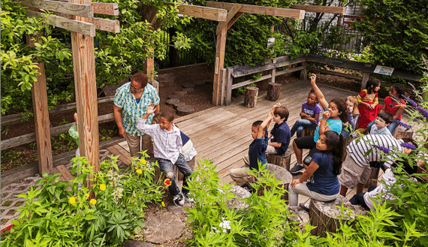
Other Management Strategies
4. Pick your battles
  Annoying
  Disruptive to class
  Potentially dangerous
5. Incorporate distractions into the class (sticks, rocks)
6. Attention grabbers
  Animal calls
  Countdown
  Walk like an animal
  Magnetic elbows
  Dance party
  Caterpillar and butterfly

Slide 23
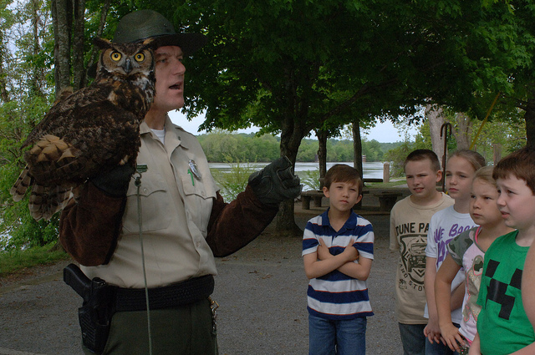
What NOT to Do When Teaching Outdoors
Nagging at kids
Threatening without follow through
Ignoring dangerous behavior, hoping it will end on its own

