Slide 1
Place-Based Education
Learning through Local Landscapes

Slide 2
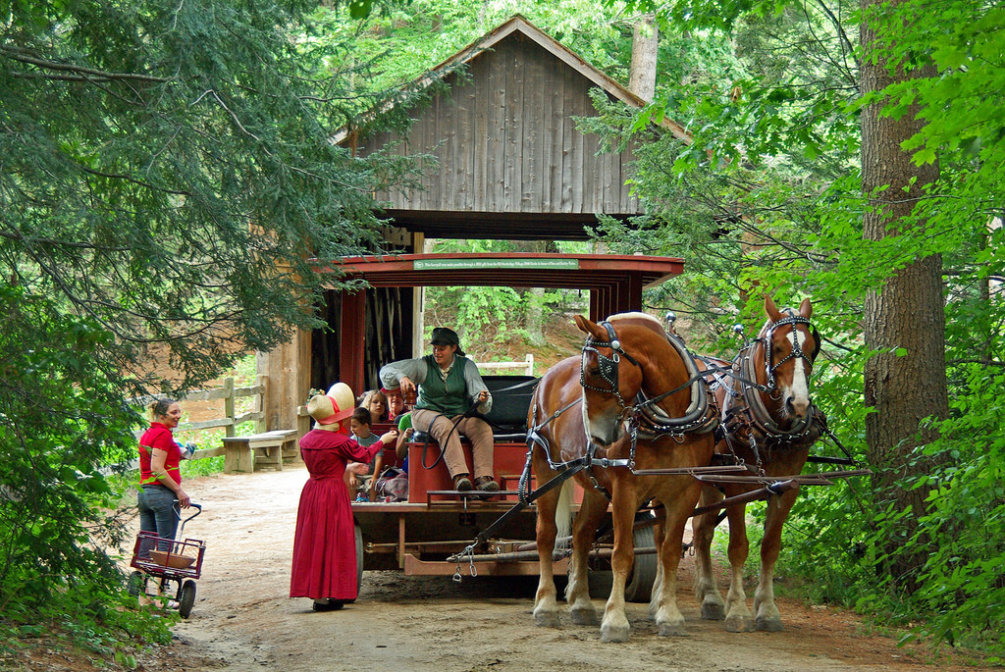
It’s All About Where You Are
“Knowledge can not be separated from place and time” (Suzanne Stewart, University of Toronto)
Learning more about a place and coming to understand our personal connections to it
All landscapes tell a story (socio-cultural, ecological)
Instruction rooted in local phenomena, history, and/or culture
Uses the local ecosystem as the core of instruction
Value of learning about local vs. exotic landscapes
Understand your own personal connections to that place

Slide 3
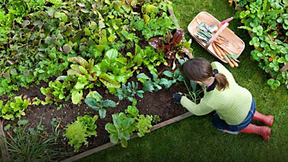
Links to community-based education & service learning
Helps students to learn and understand their place in the world
Particularly beneficial for a variety of indigenous/native students to preserve traditional ways of knowing and living
Holistic approach to understanding the world
Brings math, art, language arts, science, and/or social studies instruction outside
The idea of “Place” presents a unifying approach for learning outdoors
Encourages authentic science and historical studies

Slide 4
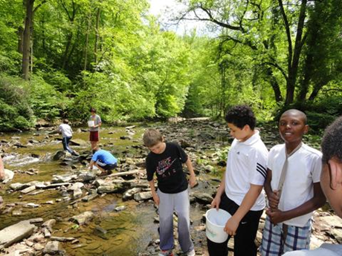
Place-based Learning Sites
Schoolyards
Local creeks, rivers, & lakes
Beaches
Parks
Vacant lots
Fencerows
Prairies
Forests
Farms & gardens
Habitat restoration projects
Biodiversity sites
Historic sites
Archeological sites

Slide 5
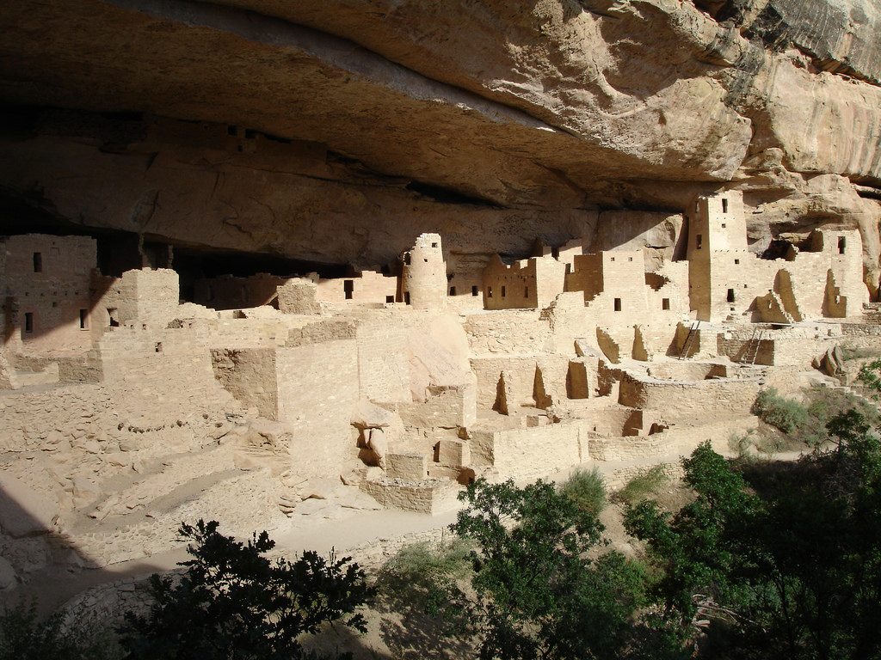
Landscapes Have a Story to Tell
Socio-cultural stories
Archeological sites
Early settlements
Military sites
Historic landmarks & monuments
Ecological stories
Learning the story of a place is a unifying approach

Slide 6
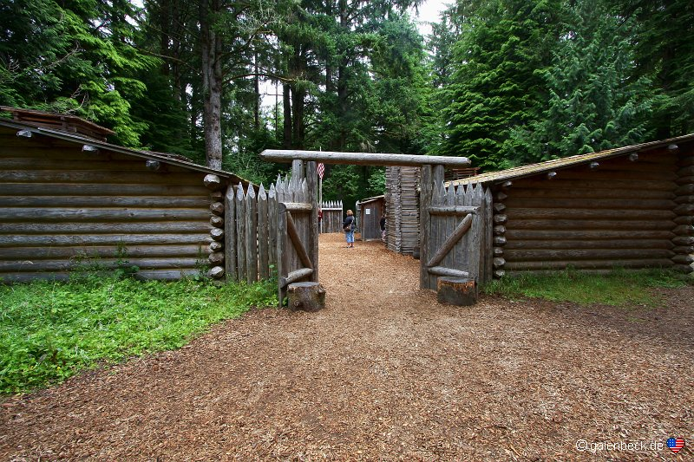
Local Landscapes Involve Students in Their Own Learning
Students become involved in learning that can span a wide amount of time
Prehistoric
Dinosaur fossils
Historic
Historic sites
Historic events
Modern
Sites of recent historic or ecological significance

Slide 7
Experiencing Local Landscapes and the Outdoors
Effects of a disconnect from natural environments
Children’s behavior in informal and outdoor spaces
Video: Nature Deficit Disorder: What Is It?
https://www.youtube.com/watch?v=UngTgxz-P8o

Slide 8
Benefits of Place-Based Education or Learning (PBE)
Children are happier, healthier and smarter when they have extended experiences in nature
PBE enhances self-efficacy, critical thinking, enthusiasm for learning & appreciation of nature
Participating in outdoor learning has a significant positive effect on students’ motivation to learn
Lower stress levels
Decline in discipline referrals
Schools with PBE programs score higher on standardized tests in reading, mathematics, and listening
Allows students to develop connections and deeper understanding of their local community
Can help to preserve local communities and traditional knowledge/culture
Can provide powerful, life-changing experiences for learners

Slide 9
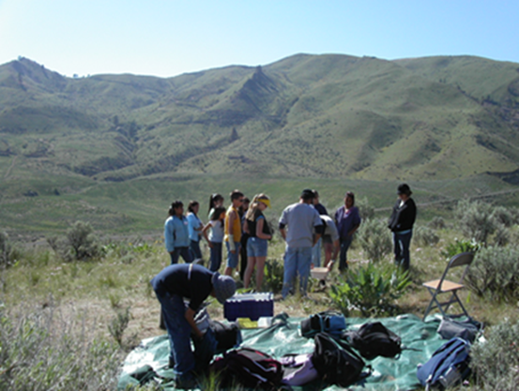
Some Examples of Place-based Learning
Kwadacha & Tsay Keh Dene Schools (Northern BC, Canada)
https://www.youtube.com/watch?v=AMnwc-R-wp0
Crellin Elementary School (Oakland, MD)
https://www.youtube.com/watch?v=Q3ij_dFpZgw
Hood River Middle School (Hood River, Oregon)
https://www.youtube.com/watch?v=MQi2UWzba3g

Slide 10
Community-based Learning Partnerships
Includes internships and other business partnerships
Can be custom-tailored to the needs of individual students
Community-based Learning: Connecting Students with Their World
(Montpelier High School, VT)
https://www.youtube.com/watch?v=TA1e2kz_adc

Slide 11
Place-based Schools and Residential Programs
Schools can be located within museums, nature centers, national forests, etc.
Allows for total immersion in the place-based experience
Residential experiences allow for 24/7 immersion
Inside a Place-based School: Public Museum School https://www.youtube.com/watch?v=hzOmtAPqpWc
Tremont School Program
https://www.youtube.com/watch?v=1t61ZdRR34s

Slide 12
Start By Looking Around Your Own “Backyard”
What are your students’ interests?
Recognize that all local landscapes have a story to tell
Who were the players?
What was their story?
What makes your area unique?
Map out the area for points of interest
Environmental
Cultural & historical
Identify experts on the area, or become one yourself

Slide 13
Planning for Place-based Instruction
Understanding local landscapes can involve students in learning about events that took place millions of years ago or help them to care and become involved in current land use or socio-cultural issues
Connecting students to a place builds connections to a community and relationships with the people who live there ~ building a sense of self
Focus on inter- and intra-personal growth helps students prepare to take an active role in their communities
Educators should take advantage of unique locales and avoid lessons that are “universal” (could be taught in any outdoor setting)

Slide 14
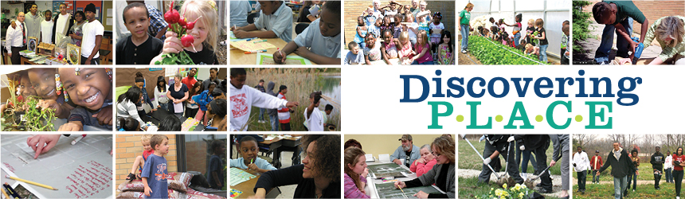
Place-based Lesson Planning
Plan your lessons to take advantage of the area
Plan to integrate multiple subject areas for deeper learning
Science
Social studies
Language arts
Fine arts
Other

