Slide 1
Managing Risk in the Outdoors

Slide 2
What is “risk management”?
Risk management is assessing and, where appropriate, taking action to reduce risks that arise from activities.
  Reducing the likelihood and severity of adverse outcomes
  Removing hazards entirely
Removing all possible hazards can create a sterile learning environment that reduces opportunities to learn.

Slide 3
Hazards vs. Risks
Hazard – anything with the potential to cause harm
Risk – the likelihood and severity of being harmed by a hazard
Risk assessment is the process of weighing the possible outcomes of hazards vs. risks. It is impossible to foresee every outcome that could cause harm.

Slide 4
Teachers have a duty to provide a standard of care that is commensurate with what other reasonable and prudent professionals would do in a similar situation.
What does “reasonable” mean?
  Perform a risk assessment
  Prepare to alter plans if the circumstances change

Slide 5
Negligence
Negligence – a wrong committed by one person against another
Four elements of “wrongs”
  Duty: the legal responsibility to act as a reasonable professional
  Breach of that duty: failing to meet the standard of care
  Injury: harm must have been caused
  Causation: there must be a causal relation between breach of duty and the injury
Claims of negligence can only succeed in courts if all four elements are present.

Slide 6
Example – Is this negligence?
A teacher takes her fourth grade class to a state park to hike the nature trail. On the hike the teacher is distracted by one her students asking a question and she forgets to remind the class about the upcoming rocky section of the trail. One of her students trips over a rock while walking the trail, spraining his ankle.
Is this an example of negligence?

Slide 7
Example – Is this negligence?
A kindergarten class is taking part in a classroom activity on the school grounds. While outside, it begins to rain so the teacher has her class line up to go inside. While climbing the steps to the school entrance, a child slips in the wet steps and hurts herself.
Is this negligence?

Slide 8
Example – Is this negligence?
A middle school teacher takes his class on a field trip to an outdoor ropes course. The trail to the course is still under construction, but there is no sign to indicate this. No one is hurt while approaching the course.
Is this negligence?

Slide 9
Why being exposed to appropriate levels of risk is important
“A mindset that is solely focused on safety does children and young people no favors. Far from keeping them safe from harm, it can deny them the very experiences that help them to learn how to handle the challenges that life may throw at them. There is an emerging consensus that our society has become too focus on reducing or eliminating risk in childhood.” (Gill, 2010, p.1)

Slide 10

Benefits of Learning to Handle Risk
Risk adverse vs. risk naïve (avoiding risk vs. not knowing what the risks might be)
There is risk in not exposing young people to risk
Imagined risk and real levels of risk
Video: The Benefits of Risk in Children’s Play https://www.youtube.com/watch?v=Lbev391A3nE

Slide 11
Tolerable risks
Low level of severity (scraped knees, scratches, getting wet, etc.)
Low likelihood of happening (being struck by lightning, etc.)
If education aims at developing the “whole person”, then it must include developing children’s abilities to take appropriate risks…AND teachers who will support this growth.

Slide 12
Desirable risks
Encounters with risks help children learn how to manage risks they will face throughout life (e.g. crossing traffic)
Children have a natural appetite for risk that needs to be fed. If not addressed, this could lead to greater levels of risk-taking that may not be acceptable.
Children gain health and developmental benefits from being physically active.
Children develop resilience through facing adverse circumstances.

Slide 13

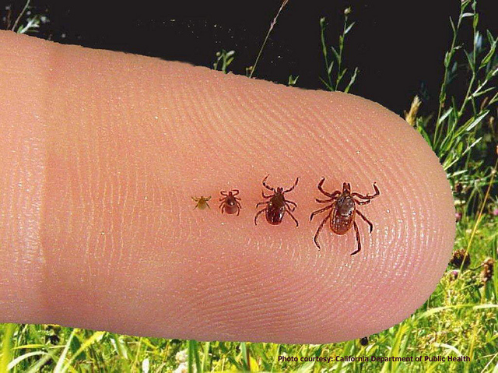

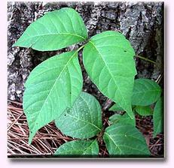
Perceived barriers to outdoor learning
Injury/risk
Distance
Cost
Weather
Time
Rigid curriculum

Slide 14
Teachers’ Risk Management Plan
Risk assessments
Emergency action plans
Consent forms
Off-site checklists
Incident reporting

Slide 15
Risk Assessments
Often a legal requirement (laws, local authorities, other bodies), specifically designed for the activities, location and people involved
Three general types of risk:
  Generic – covers hazards one can expect to encounter outside the classroom
    Exposure (wind, precipitation, sun, cold, etc.)
    Vehicular traffic (when crossing or walking beside roads or parking areas)
    Terrain (conditions under foot, steep slopes, water features, etc.)
    Environmental (snake bites, bug bites, poison ivy, etc.)
    External (e.g. students becoming separated from the group)
  Specific – used in a certain location, activity, or group (e.g. building fires, using saws)
  Dynamic – ongoing and usually not written down (e.g teacher constantly being alert and aware of surroundings, aware of unwanted visitors, teachers’ judgement)

Slide 16
Emergency Action Plan
A brief, readily accessible flowchart that serves as a guide in times of stress
Life threatening vs. Non-life threatening
Establish roles among adults before starting out
  Who administers first aid?
  Who contacts authorities and/or the school?
  Who manages the rest of the group?
  How do you ensure others in the group are not harmed?
  Another consideration is to collect cell phones.
  Keep a written account of the incident.

Slide 17
Consent Forms
Required for off-campus outings and non-routine activities
“Blanket” consent forms cover a variety of low-risk activities and reduce bureaucracy and allow for more spontaneous outings.
Both specific and blanket permission forms should include:
  Nature of the activity
  Benefits of the activity
  Times, dates, locations, etc.
  What to bring (clothes, food, drinks, etc.)
  Acknowledgement that students will be exposed to certain risks that differ from the regular classroom
  Assurance that a risk assessment has been conducted
  School personnel who will be present
  Space for parents to add medical instructions/special considerations for their child
  Space for parent/guardian signatures

Slide 18
Off-Site Checklist
A list of things that must be considered for each outing:
  First aid kit & student medications
  Risk management document
  Weather forecast
  Maps & directions
  A “tucker bag” (paper plates, cups, napkins, hand sanitizer, etc.)
  Notification for school personnel/administrators
  Ensure students use bathroom before leaving school
  Ensure students know their assigned adult and/or buddies for the outing

Slide 19
Incident Reporting and Monitoring
Includes written accounts of all accidents, illnesses, injuries, near misses and behavioral incidents that occur on the outing
Create a culture of cooperation
Allows other teachers to learn from the event
Allows for identifying trends in incidents, leading to better risk management plans

Slide 20
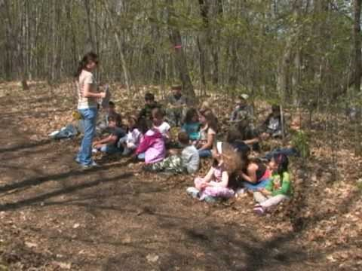
https://www.youtube.com/watch?v=Lbev391A3nE

