Slide 1
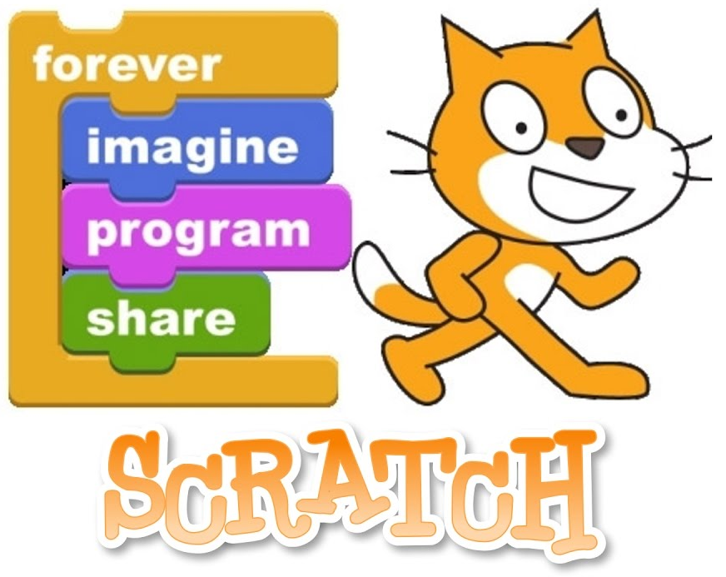

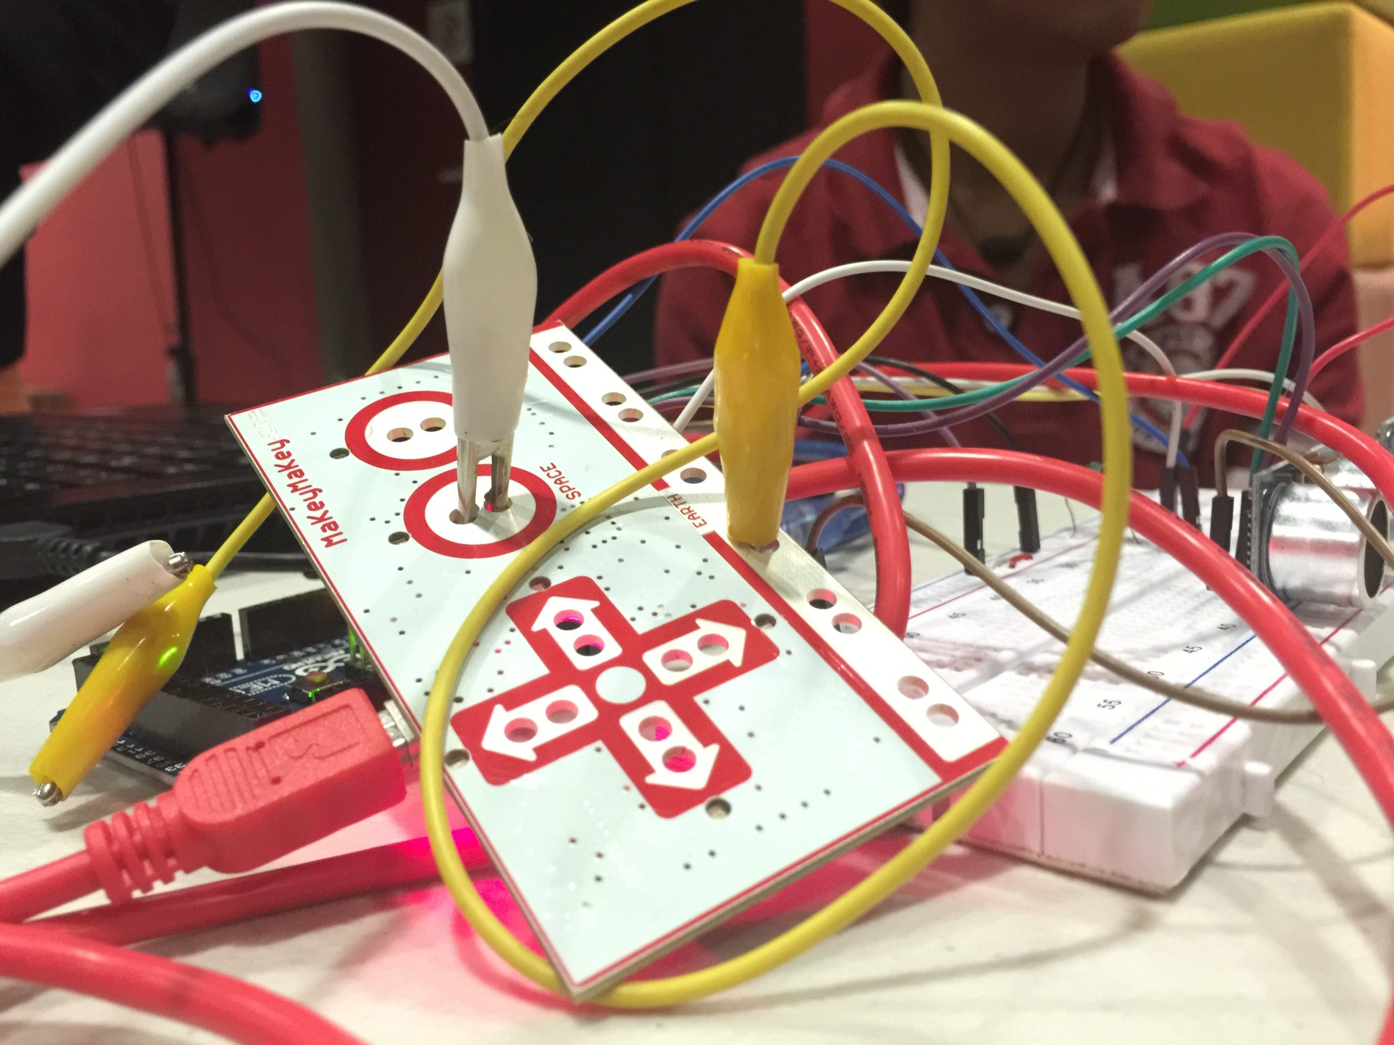

Slide 2
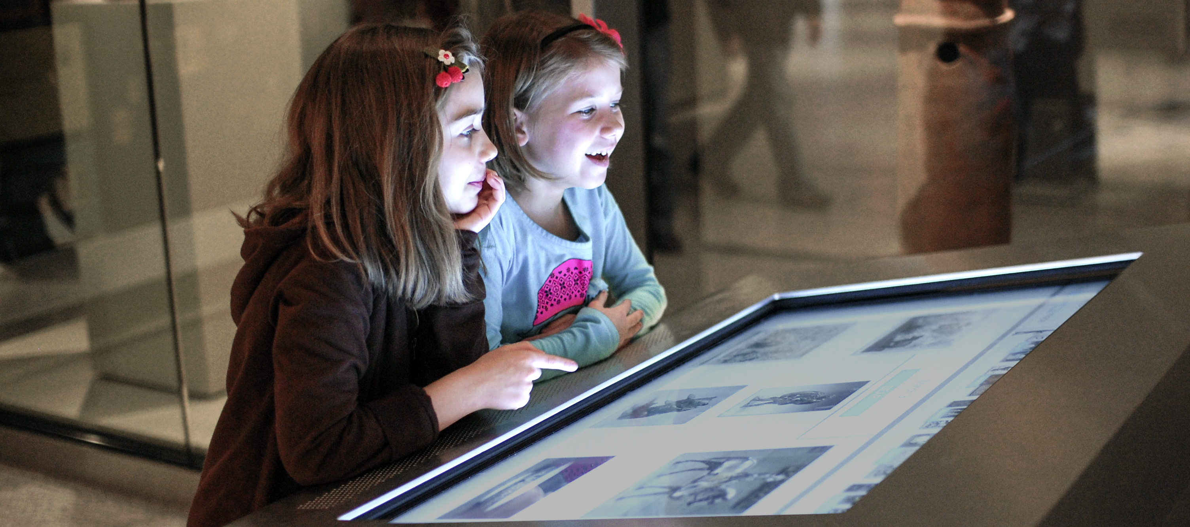

Slide 3
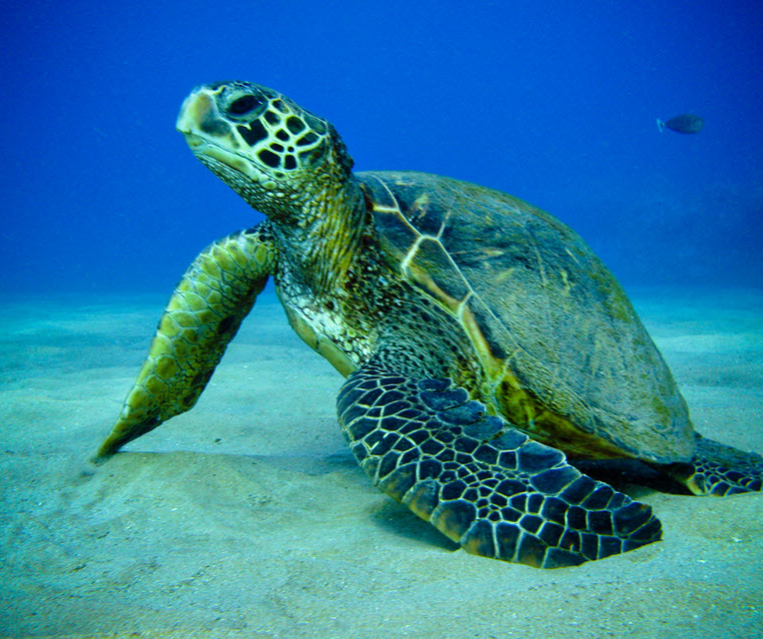

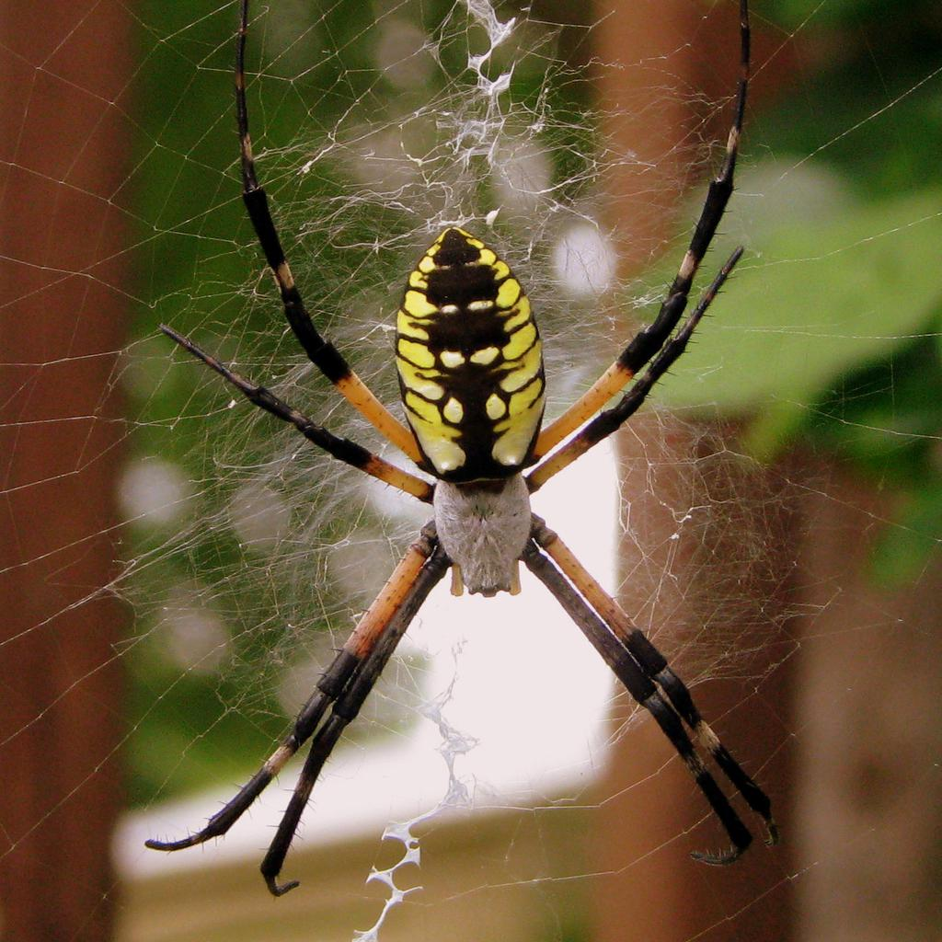
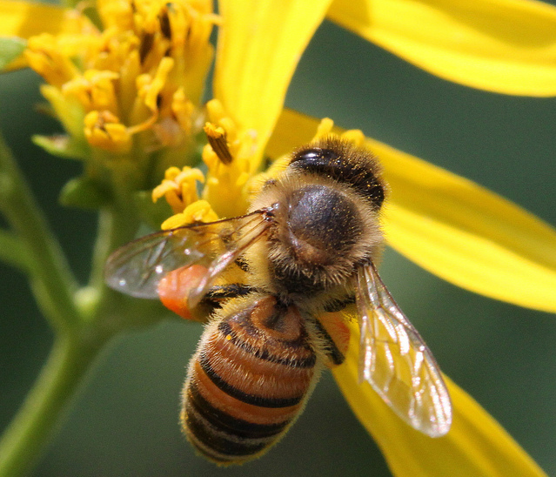
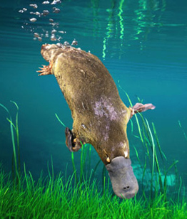
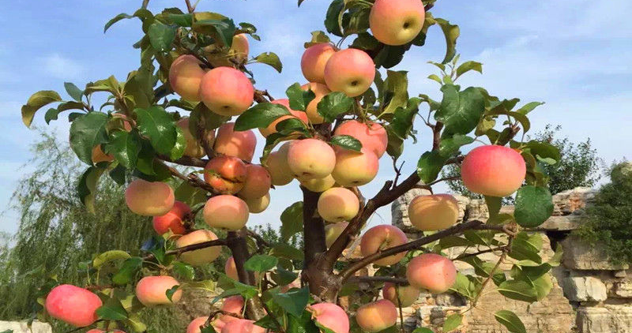
A Day at the Museum Challenge:
Your challenge is to create a table-top museum display that will inform your peers about your organism’s life cycle using Makey Makey, Scratch, and a lap-top computer.
Research the lifecycle of your organisms using different available informational texts and then create an interactive museum display that provides information regarding their organism’s life cycle. Students will use MakeyMakey and Scratch to make their display interactive. The students will code on Scratch and use MakeyMakey to follow the commands of the code.
Each stage of the life cycle should have an audio and video feature that adds to the overall experience of the display.

