Slide 1
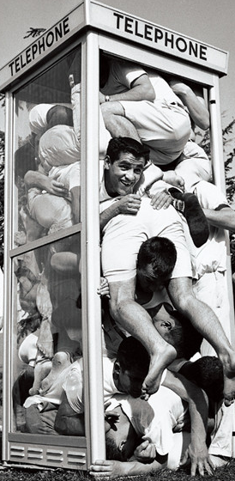
Team Fort Enclosure: A Collaborative Learning and Problem-based Learning Design Brief
Colleges and universities have long been recognized as institutions that launch crazy fads. I the 1950’s and 1960’s, stuffing as many people as possible into a phone booth was very popular on college campuses. While it was an absurd trend, it did require a great deal of creativity, collaboration, and problem-solving ability.
Standards (Grade 3):
Standards for Technological and Engineering Literacy
Standard 7: Design in Technology and Engineering Education
Apply the technology and engineering design process.
Arkansas Mathematics
AR.Math.3.MD.C.7: Relate area to the operations of multiplication and addition
Find the area of a rectangle with whole-number side lengths by tiling it and show that the area is the same as would be found by multiplying the side lengths
Multiply side lengths to find areas of rectangles with whole-number side lengths in the context of solving real world and mathematical problems, and represent whole-number products as rectangular areas in mathematical reasoning
Recognize area as additive. Find areas of rectilinear figures by decomposing them into non-overlapping rectangles and adding the areas of the non-overlapping parts, applying this technique to solve real world problems

Slide 2
Scenario:
In the spirit of phone booth stuffing—and, to test your levels of creativity, cooperative spirit, understanding of area, and problem-solving ability, use the Crazy Fort® building materials to build a fort that will enclose your entire problem-solving team.
Challenge:
Work as a member of a design team to build a fort that will enclose your entire team. Then calculate the area of the fort. Use your creative abilities to make the largest fort possible.
Big Ideas:
The area of a space can be determined by multiplying the side lengths of a volume.
Area models can represent the inner size of an object
The perimeter of an object can be calculated by adding the length of the sides
Essential Question: How can we determine the area of a space enclosed in a scale model structure?

Slide 3
Limitations:
The completed fort must have walls and a roof.
The connector ball arrows must always point upwards
Materials must not be cut or bend
Twist the green sticks to insert and remove from the connector balls
The structure must enclose your entire problem-solving team
If you can fit more than your team, and you have volunteers; build the biggest fort in class!

Slide 4

Questions: Answer on back of page
What type of structure did you create?
Did you find any loopholes that you could exploit? (thinking outside the box)
What strategies and techniques did you use to design your structure?
Did your initial design solve the problem, or did you have to move on to Plan B?
How did your team define the term “enclose?”
How can you calculate the perimeter of your team’s fort?
Calculate the area of your fort. Is it larger or smaller than the other teams in your class?
How could you find the volume of your fort?

Slide 5
Teacher’s Guide:
Team Fort Enclosure challenge is designed to introduce your students to the concept of area and provide them with a chance to build a scale model, of their own design, and then calculate area. Assign the students to small teams and ask them to create an enclosure that will encapsulate their entire team. Encourage them to make the largest enclosure in class—they can get volunteers from other teams if their enclosure will accommodate more people than they have on their team. After the enclosures are complete, spend some time illustrating the procedures used to calculate area. After all teams have calculated area, ask each team to present their fort enclosure and then test all enclosures to determine whether the team fort can contain all members of the team. Encourage them to keep testing by adding additional students until no more can fit inside the enclosure. Discuss the relationship between area and the number of students who can fit inside the enclosure. Discuss large and small rooms in the school in the context of area. You may wish to reward the team that designs the fort that encloses the most students, our use this activity as an introduction to a larger unit on area.

