Slide 1
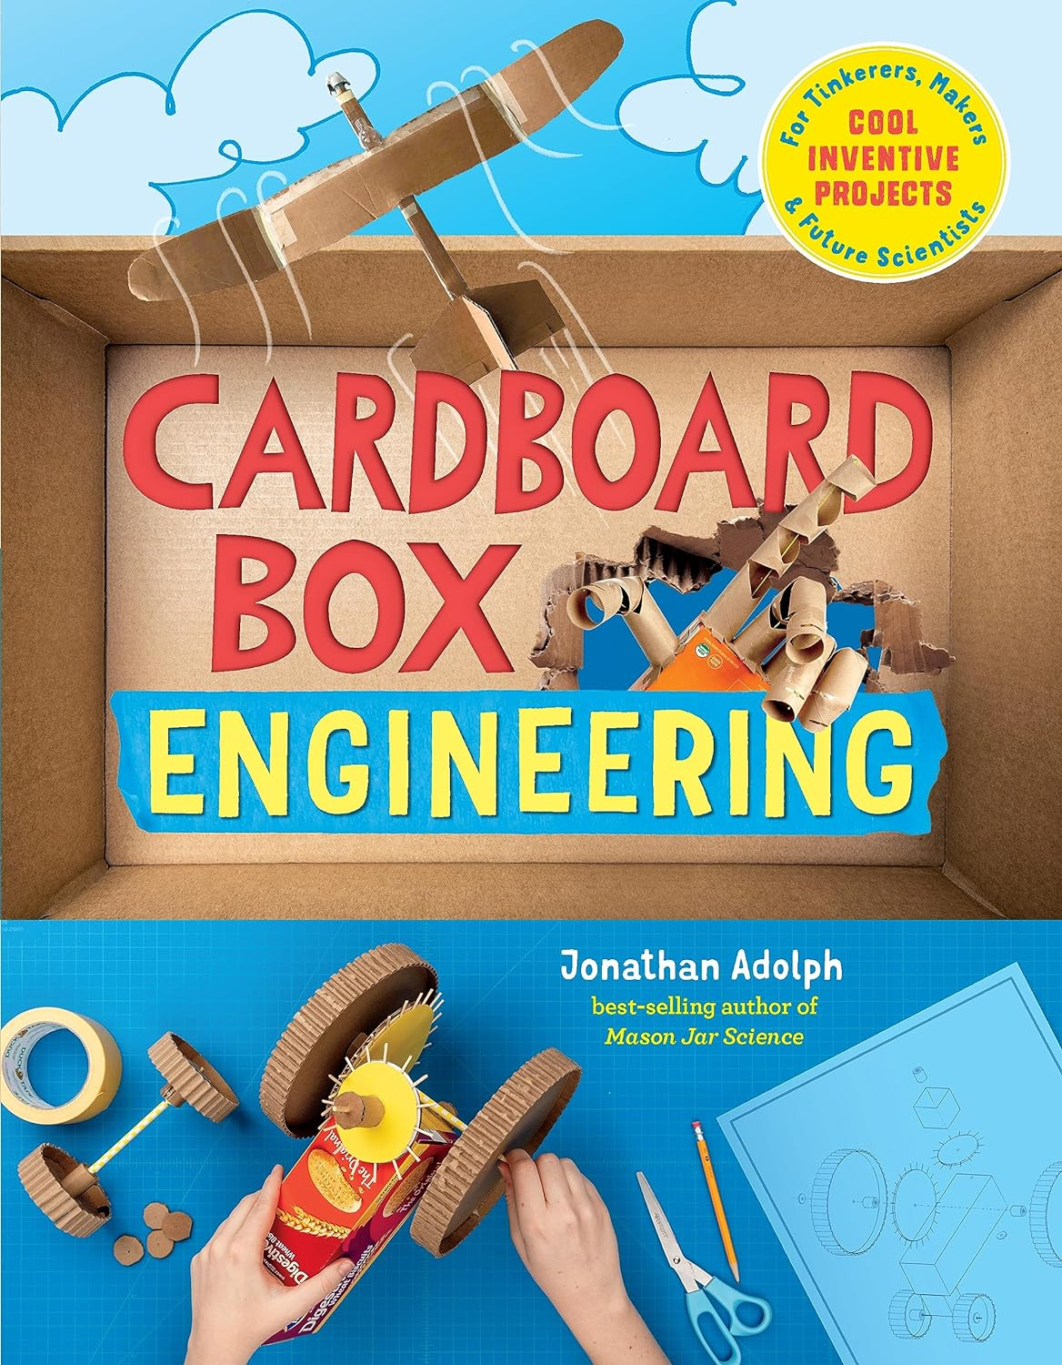
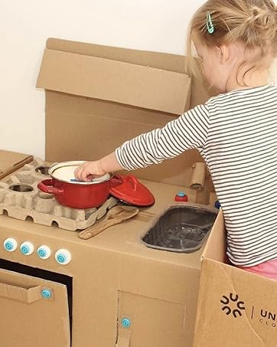
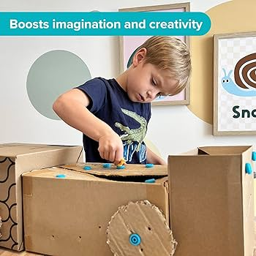
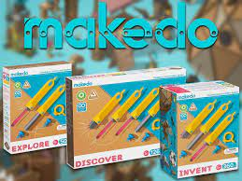

Slide 2
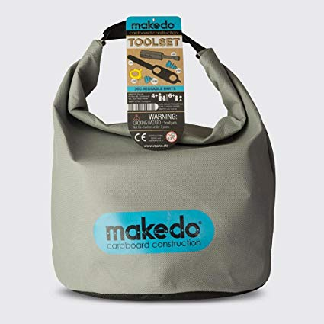
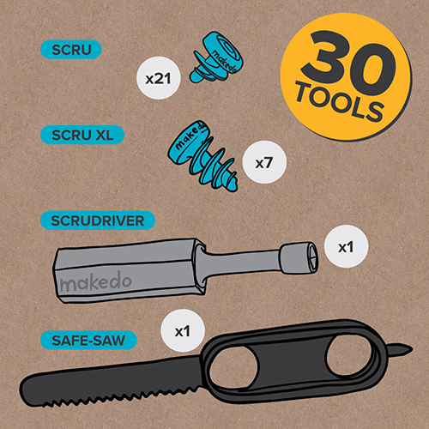
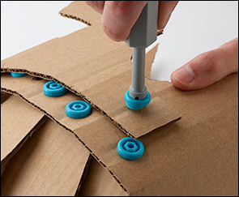
https://know.make.do/

Slide 3
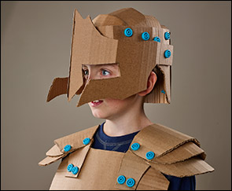
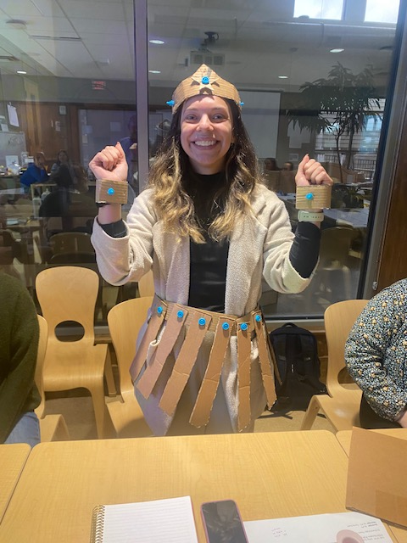
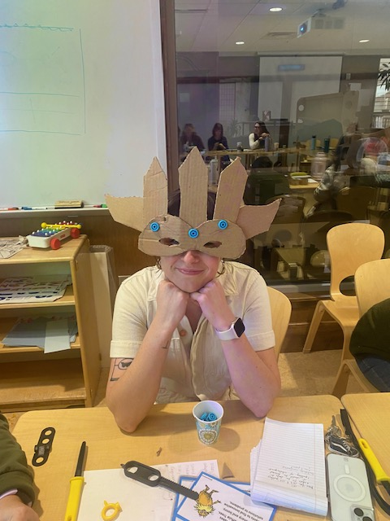
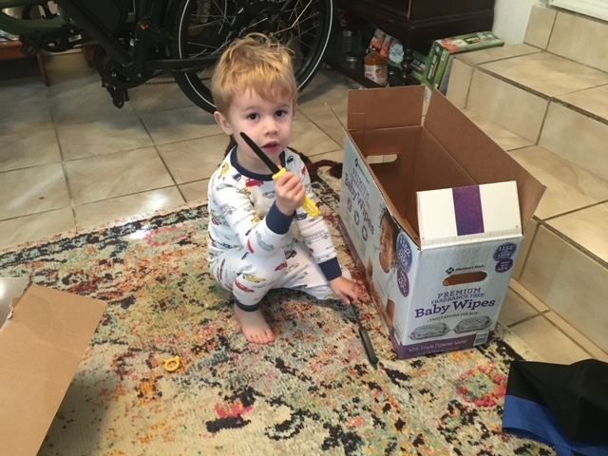

Slide 4
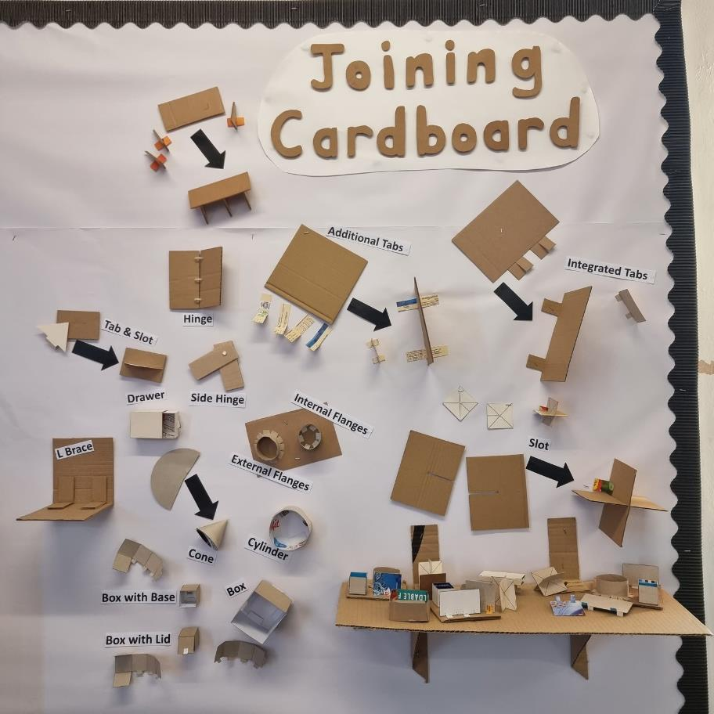
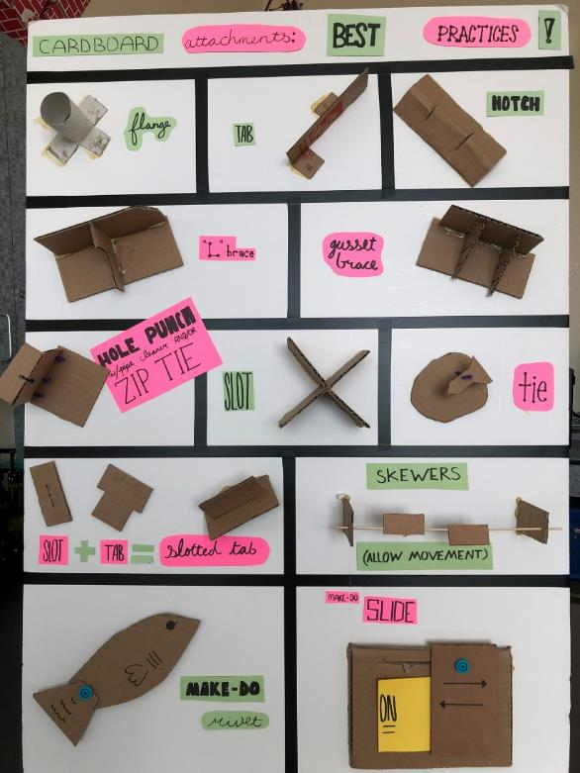

Slide 5
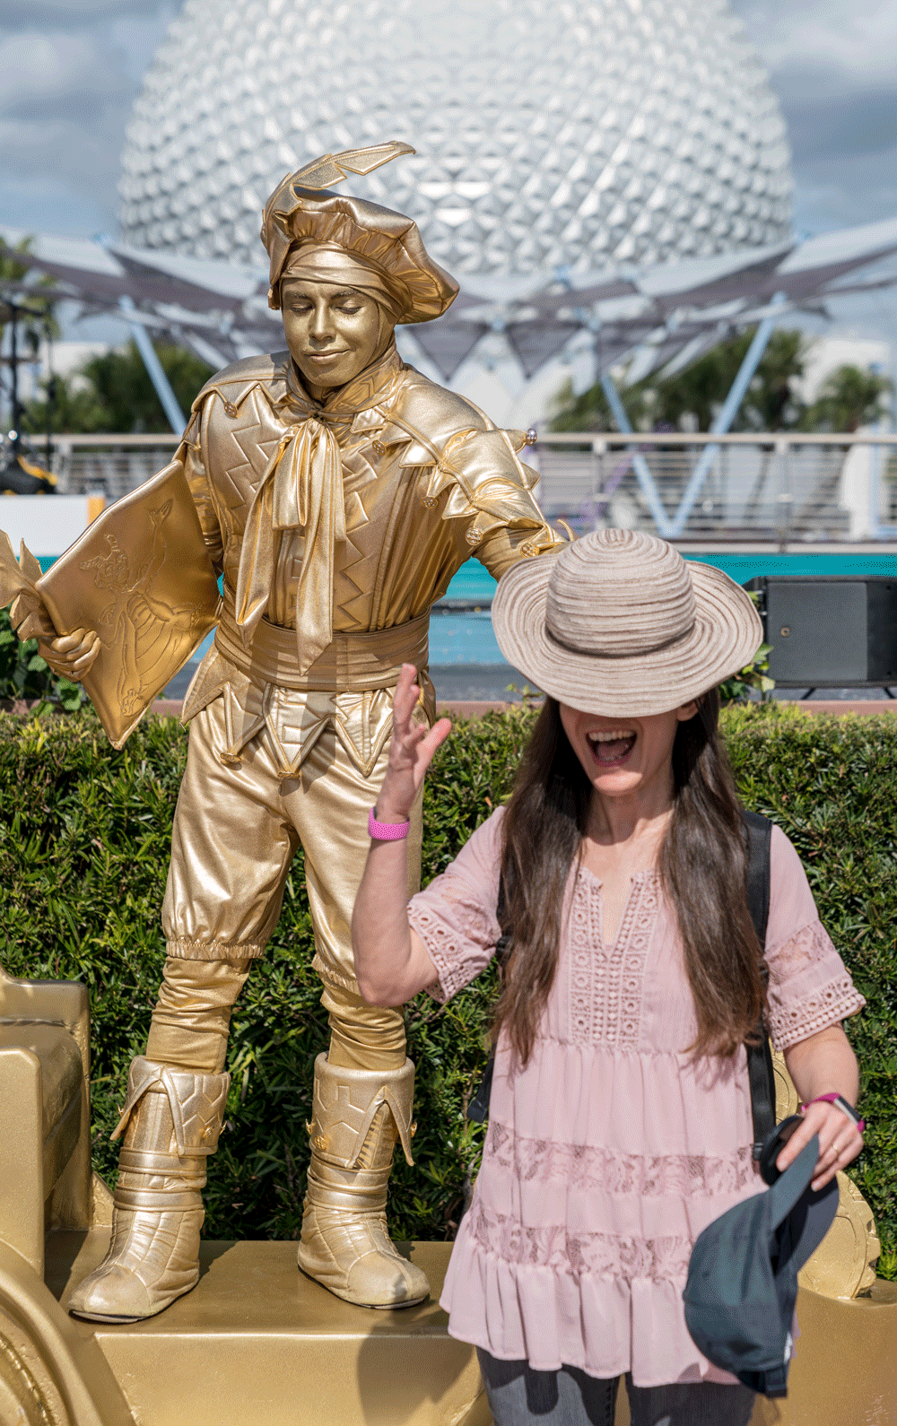
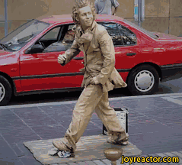
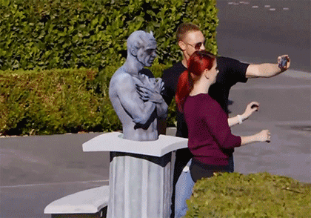
Scenario
Your community is trying to revive main street. Your class, known for creativity and innovation, has been asked to design multiple ‘living statue’ art pieces to be considered for the grand opening.
Challenge
Working with a small team and using the Makedo® tools, Canary cutters, and cardboard, design a ‘living statue’ of a famous person. One of the members of your team will need to be transformed into the ‘living statue’ when you present to the class.
Limitations
Must use a minimum of 15 Makedo Screws
Use only cardboard (although you may use markers for decoration)
Must be able to remain on your partner as you move to the performance site.
Time is limited, you will have 30 minutes to complete the design before we present to the mayor.

