Slide 1
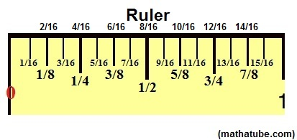
Measure Twice, Cut Once

Slide 2
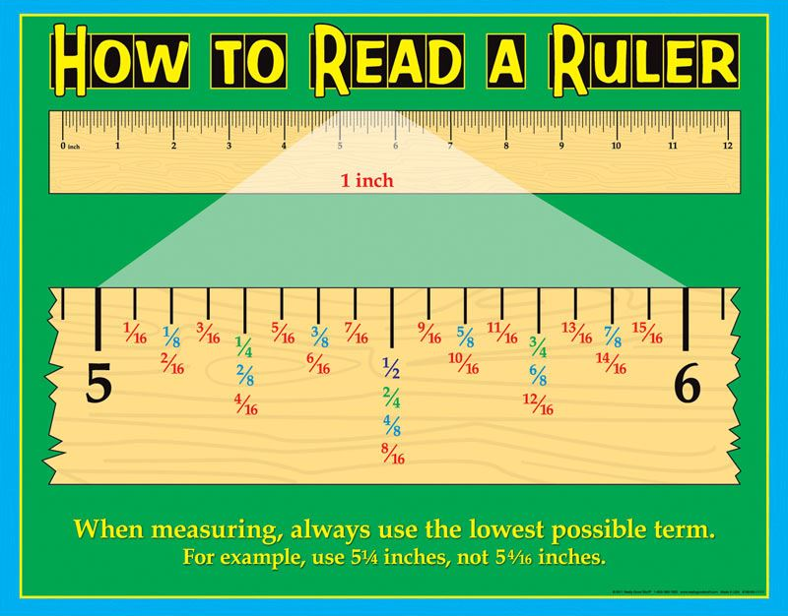

Slide 3
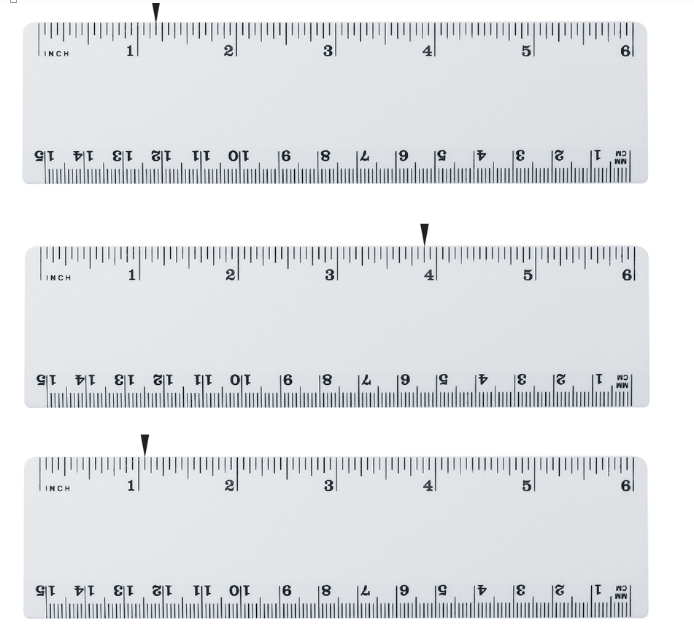

Slide 4
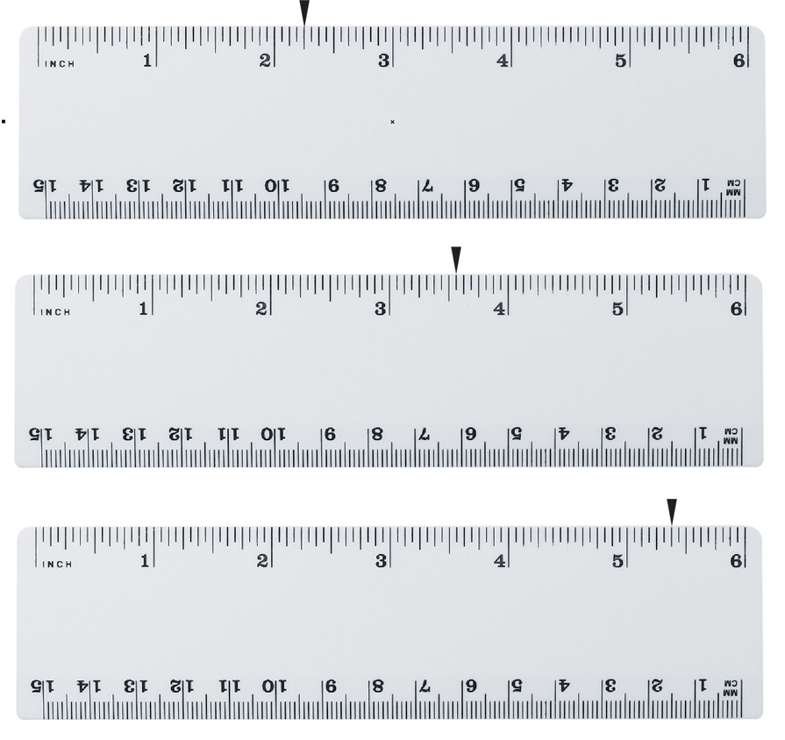

Slide 5
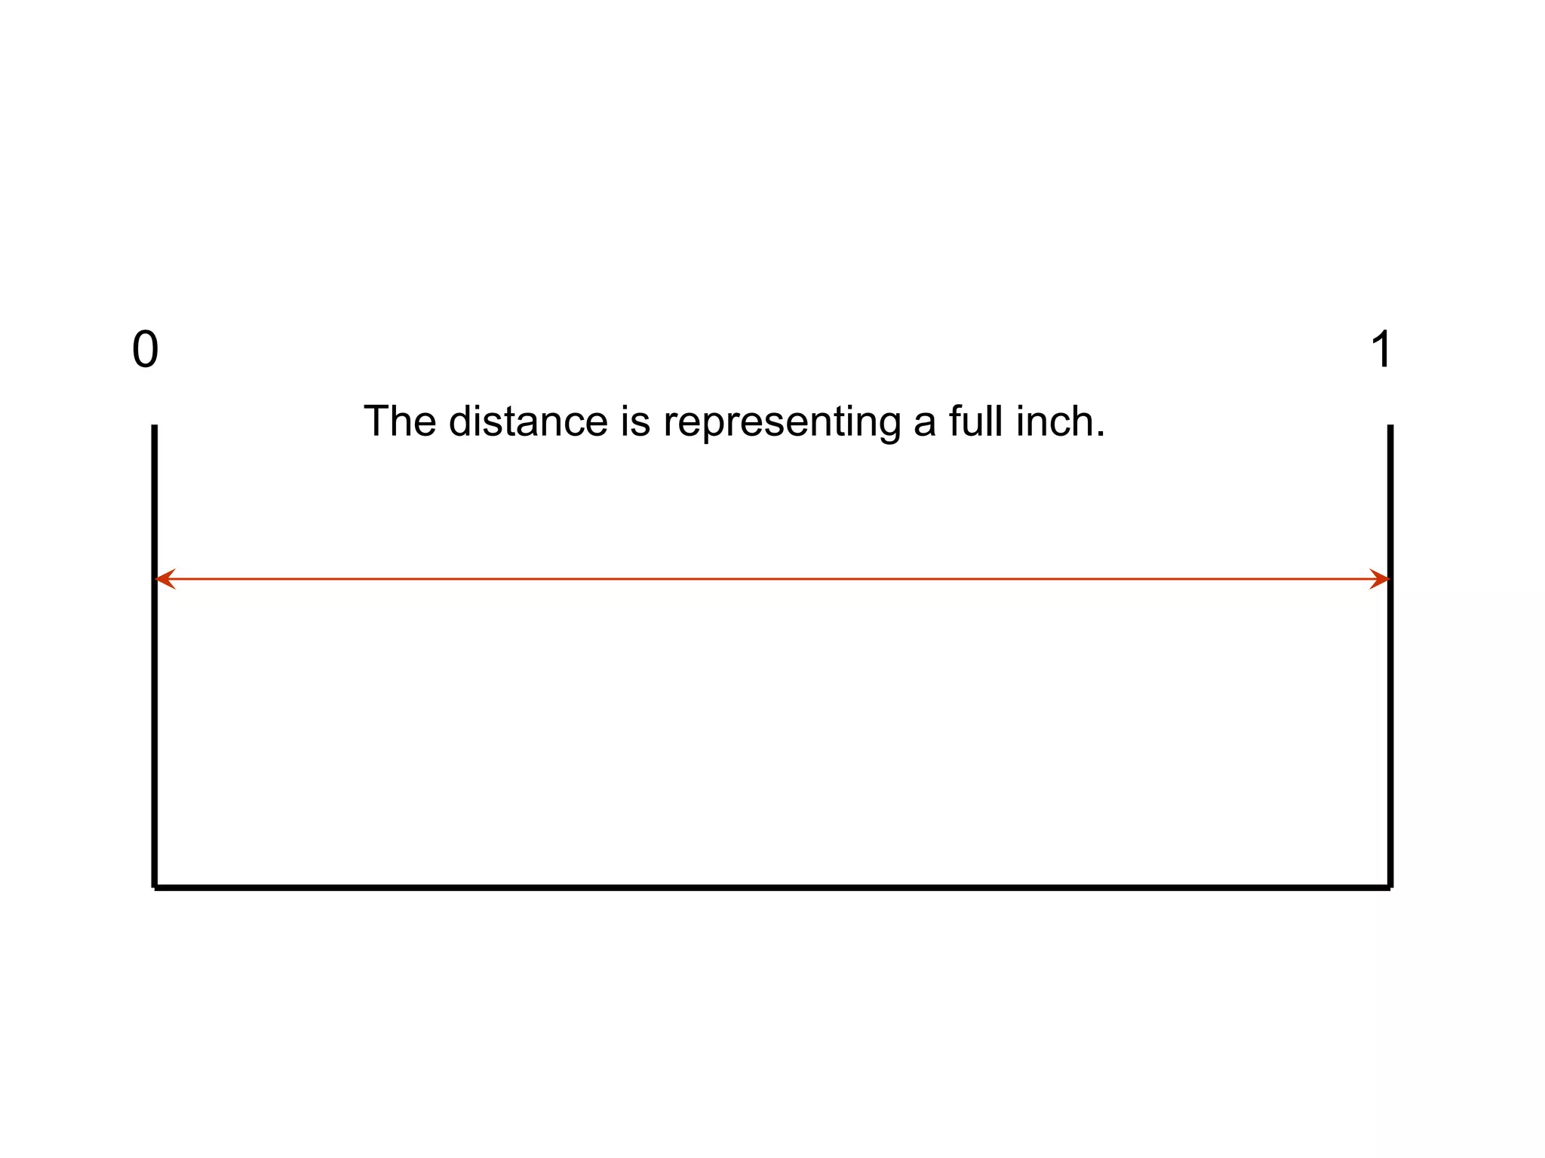

Slide 6
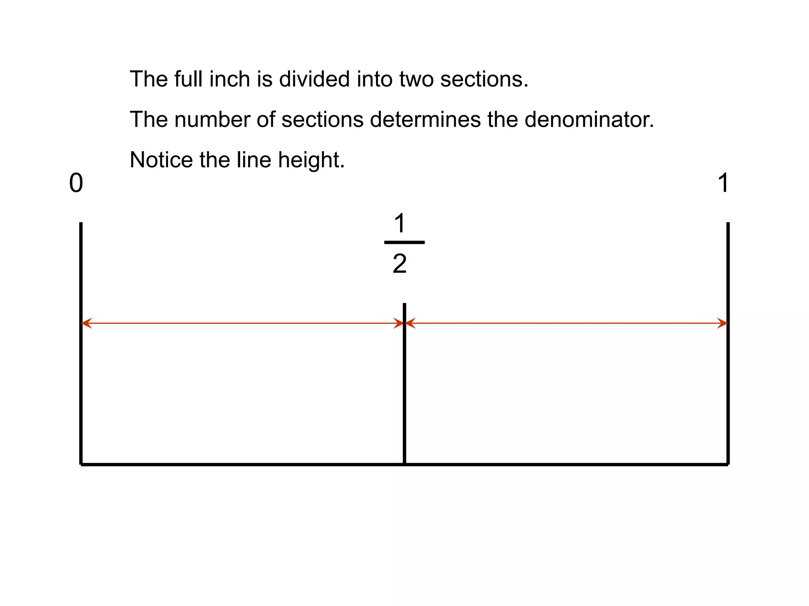

Slide 7
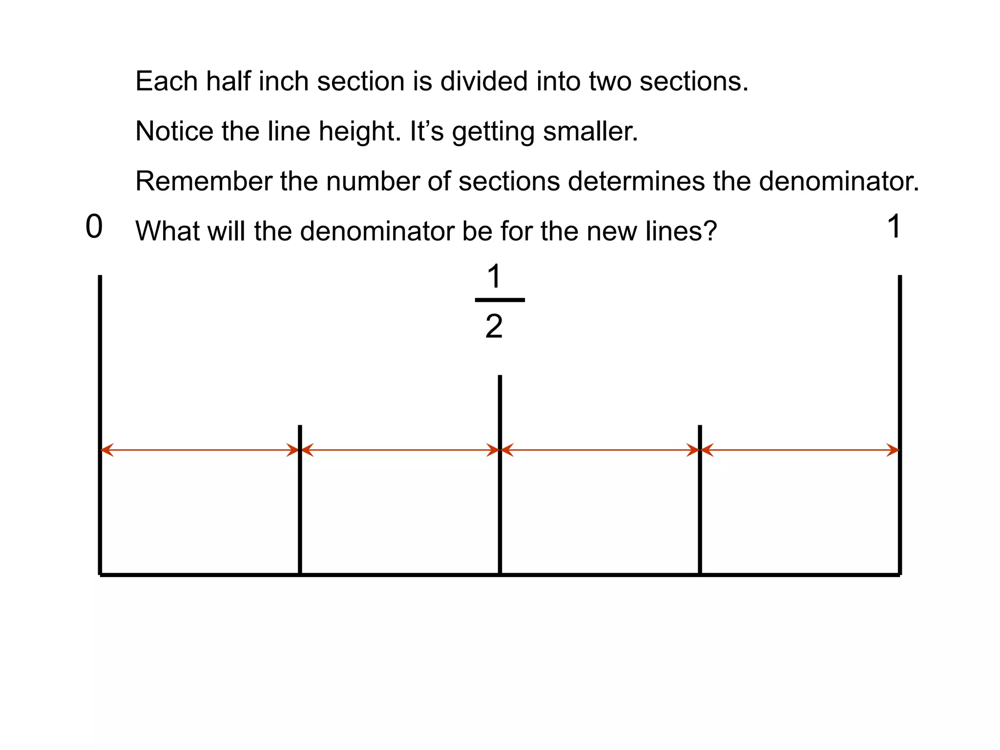

Slide 8
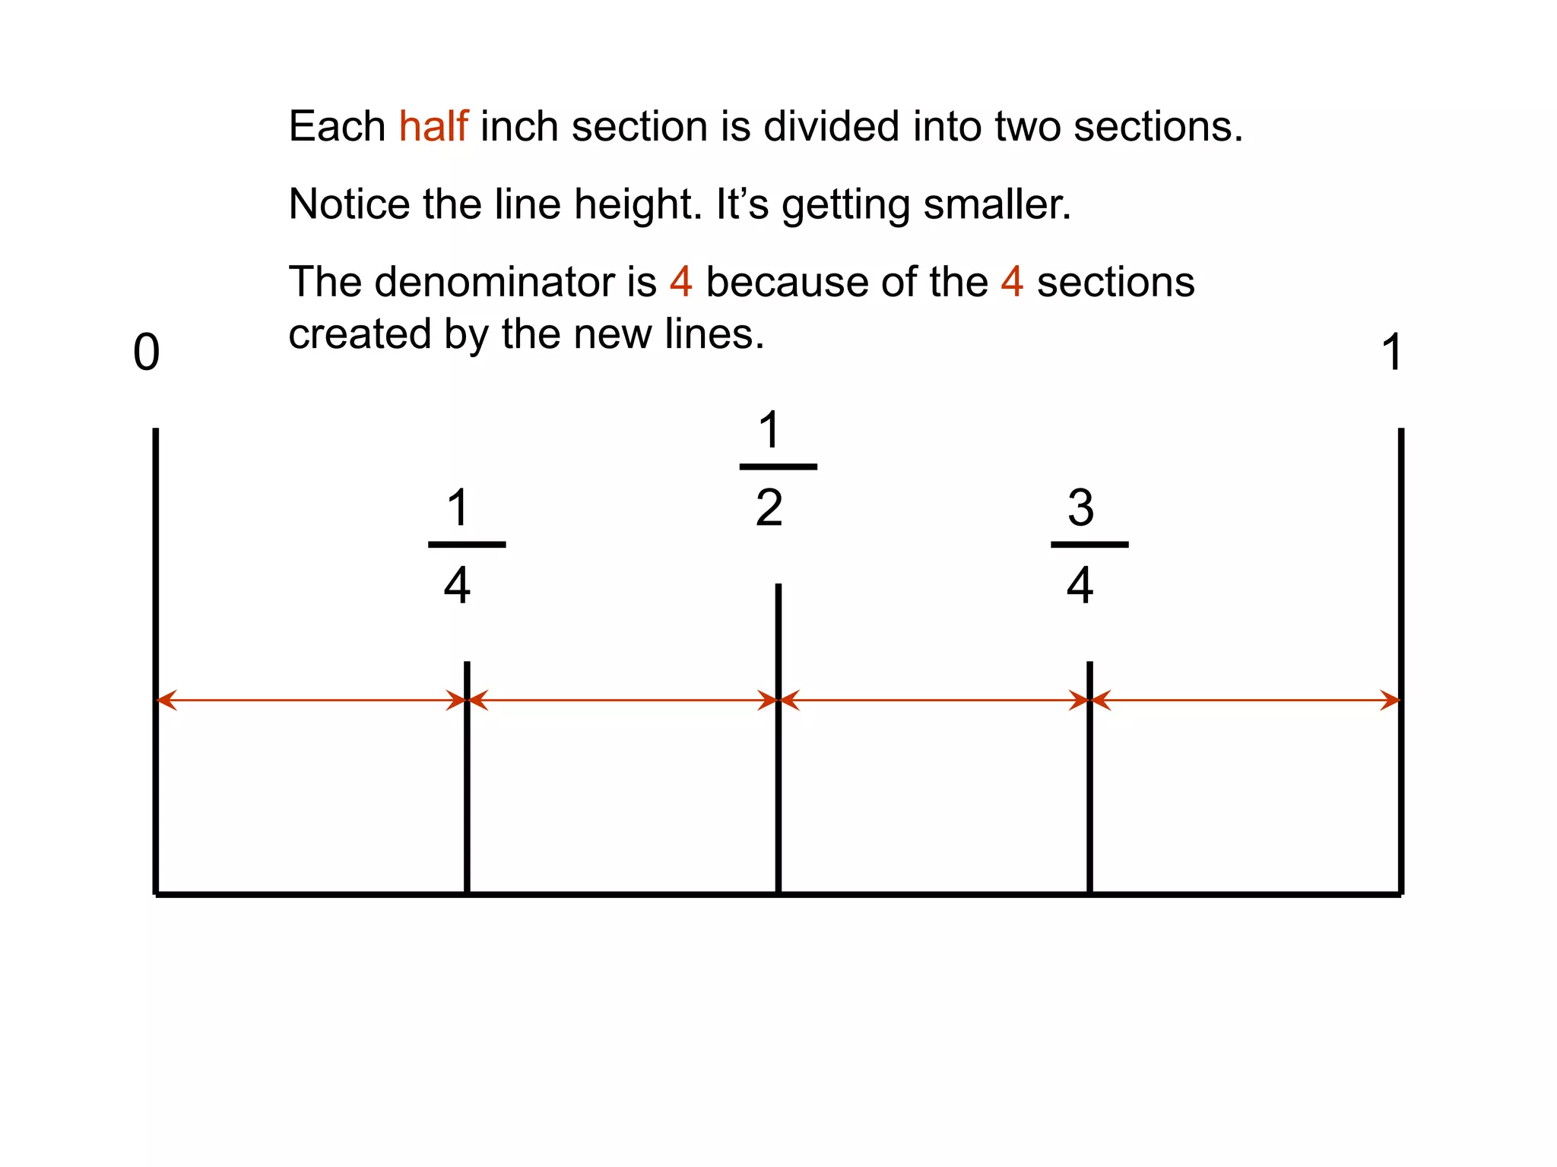

Slide 9
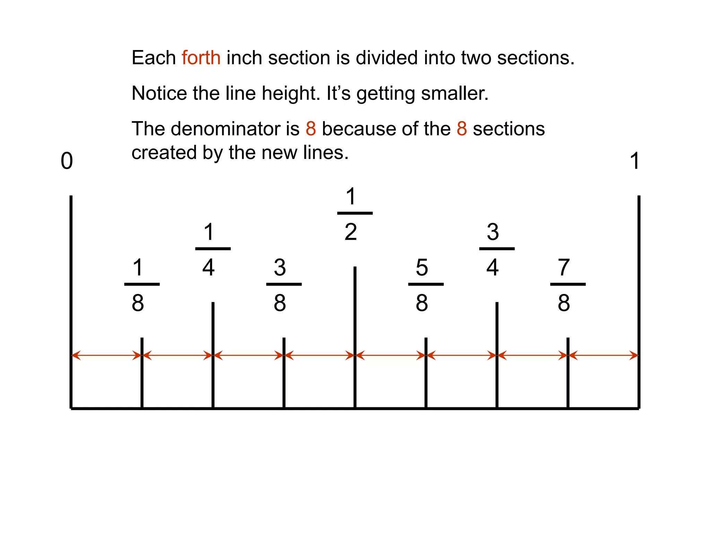

Slide 10
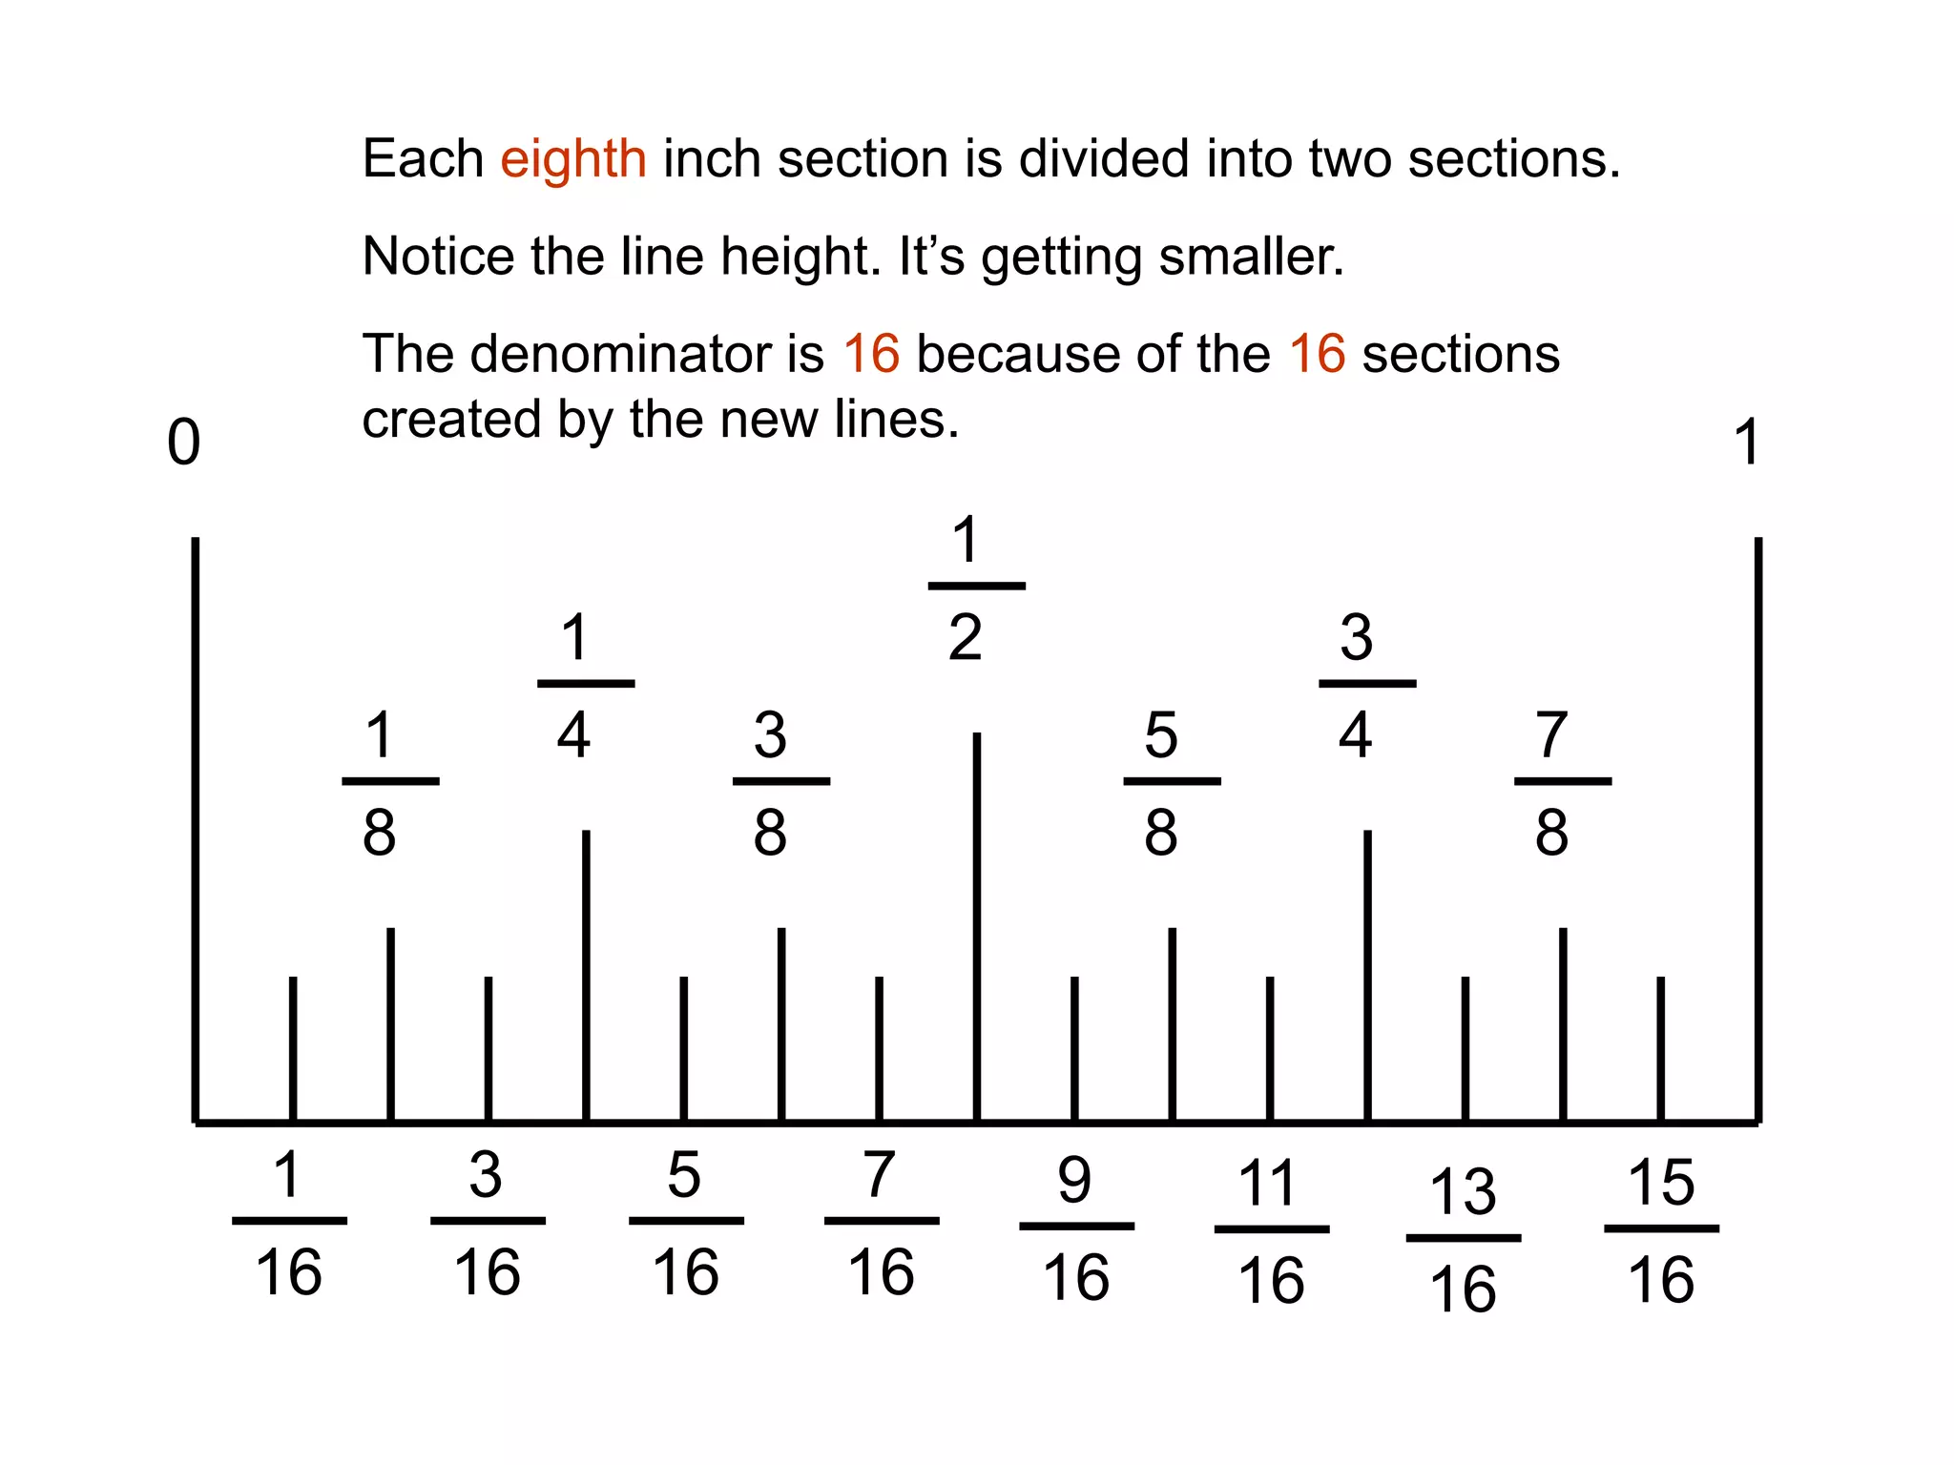

Slide 11
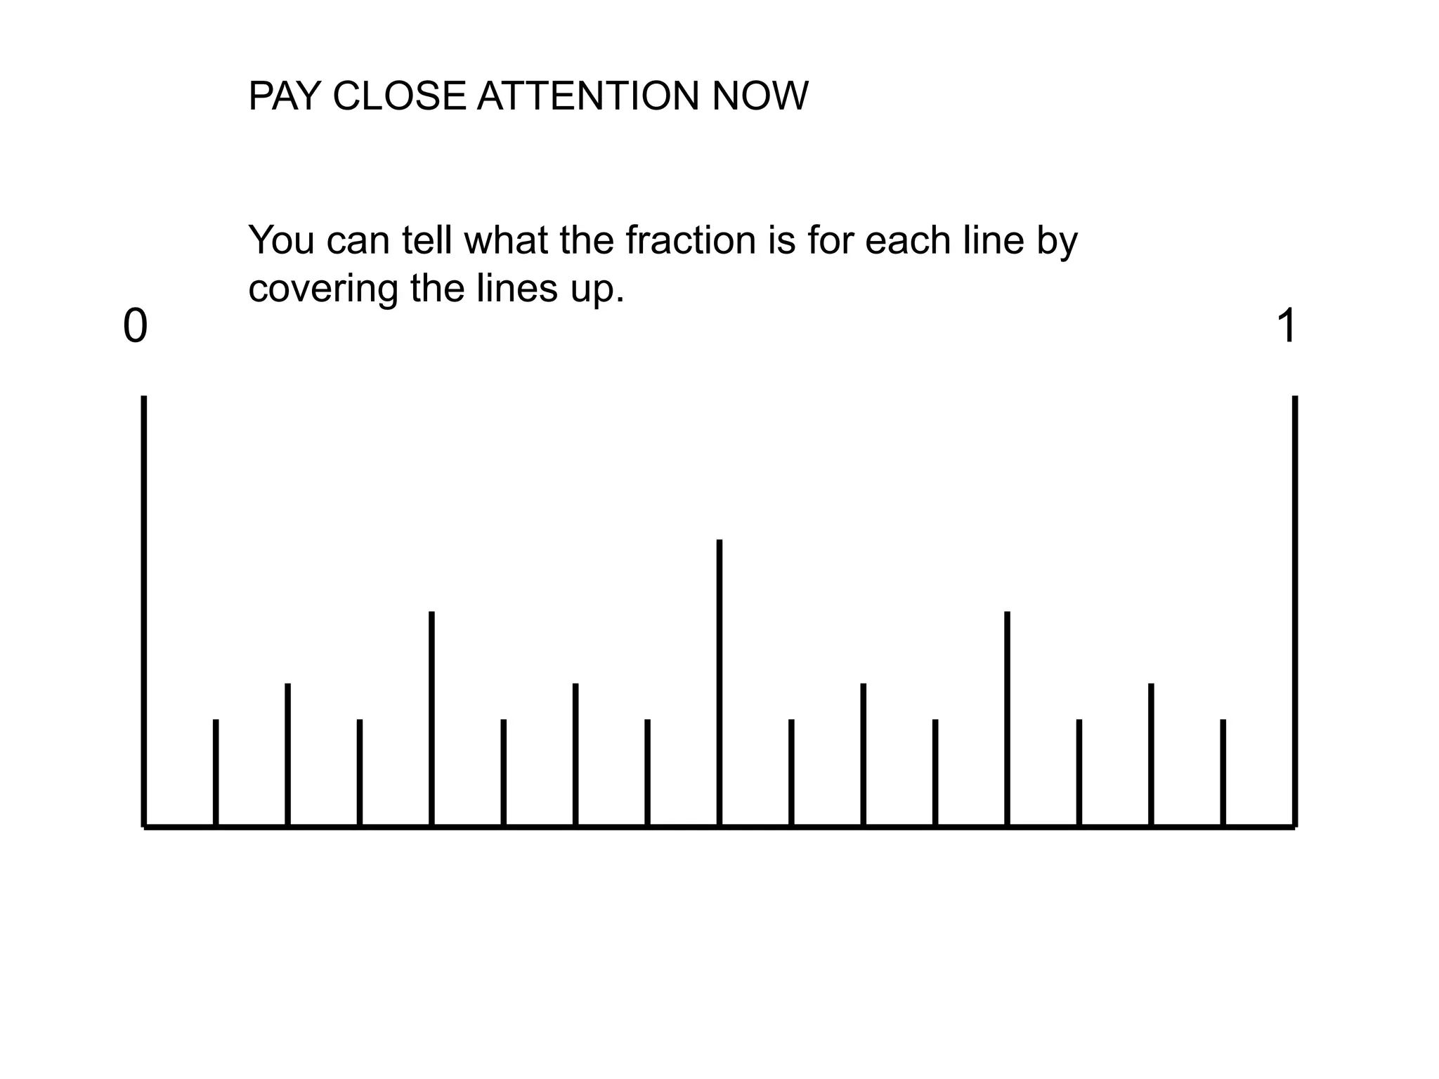

Slide 12
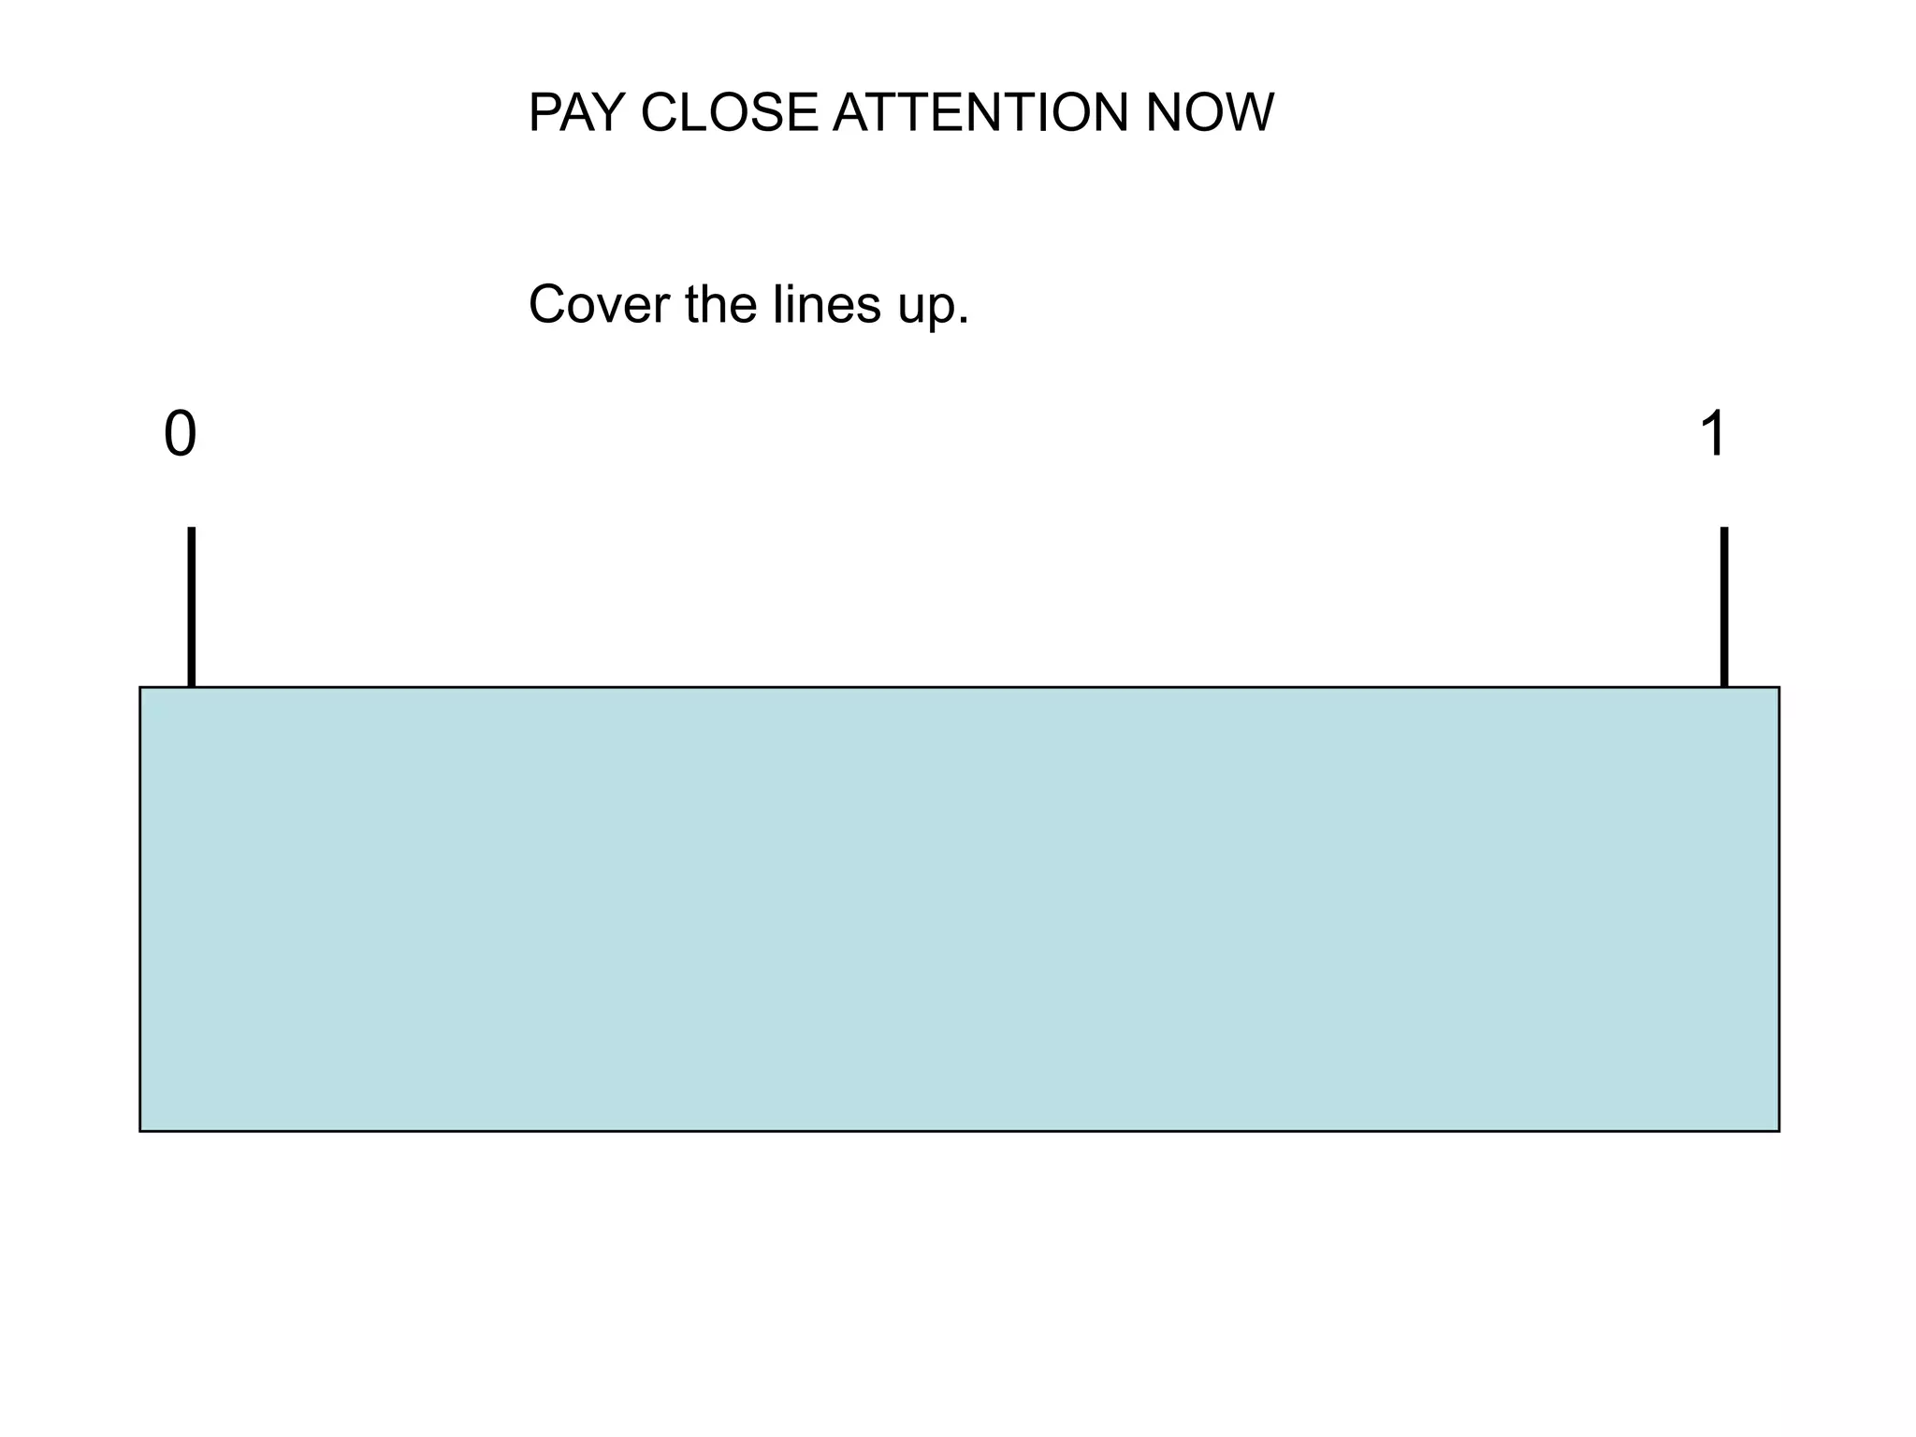

Slide 13
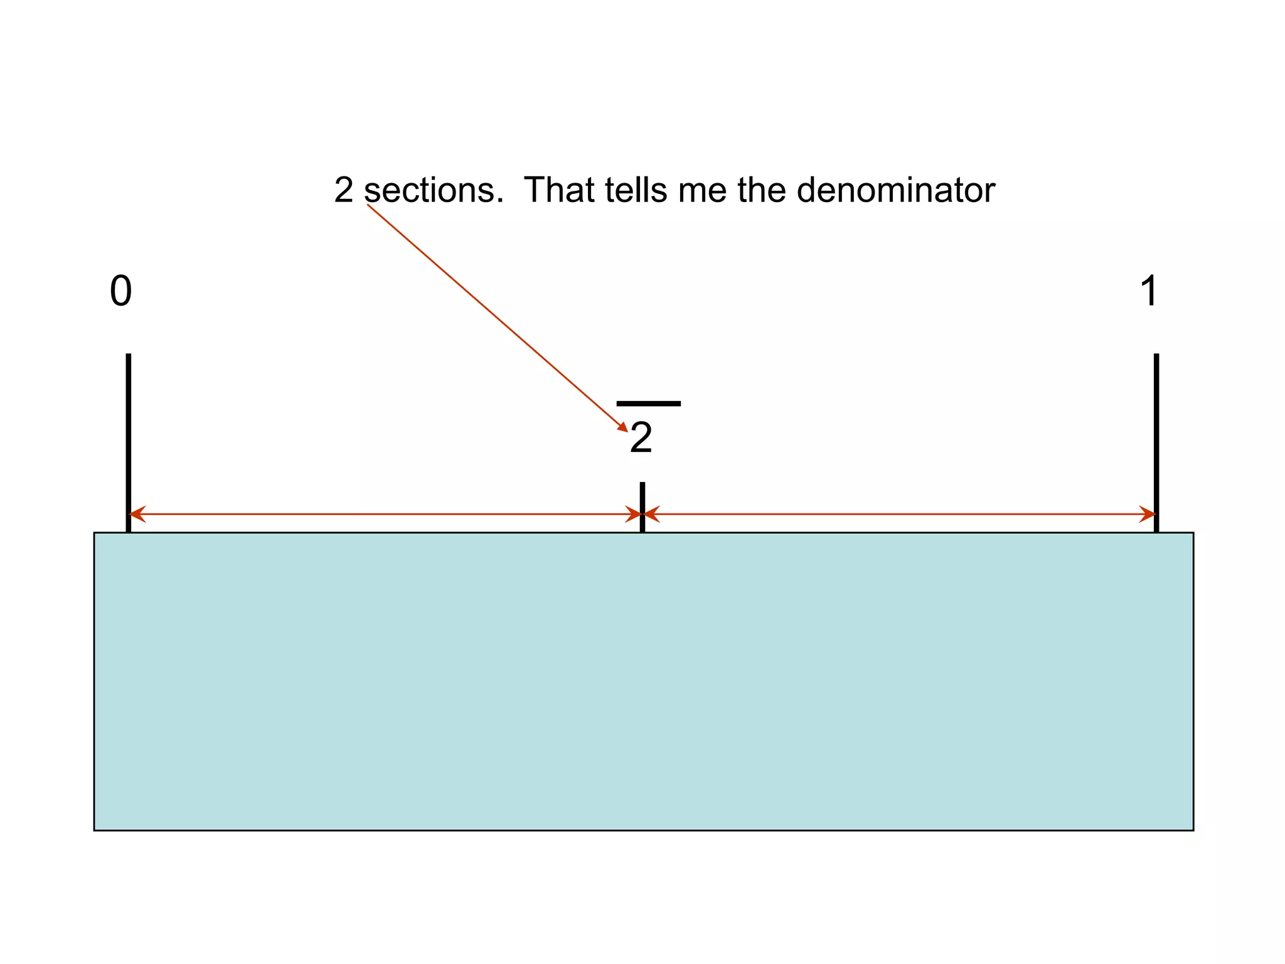

Slide 14
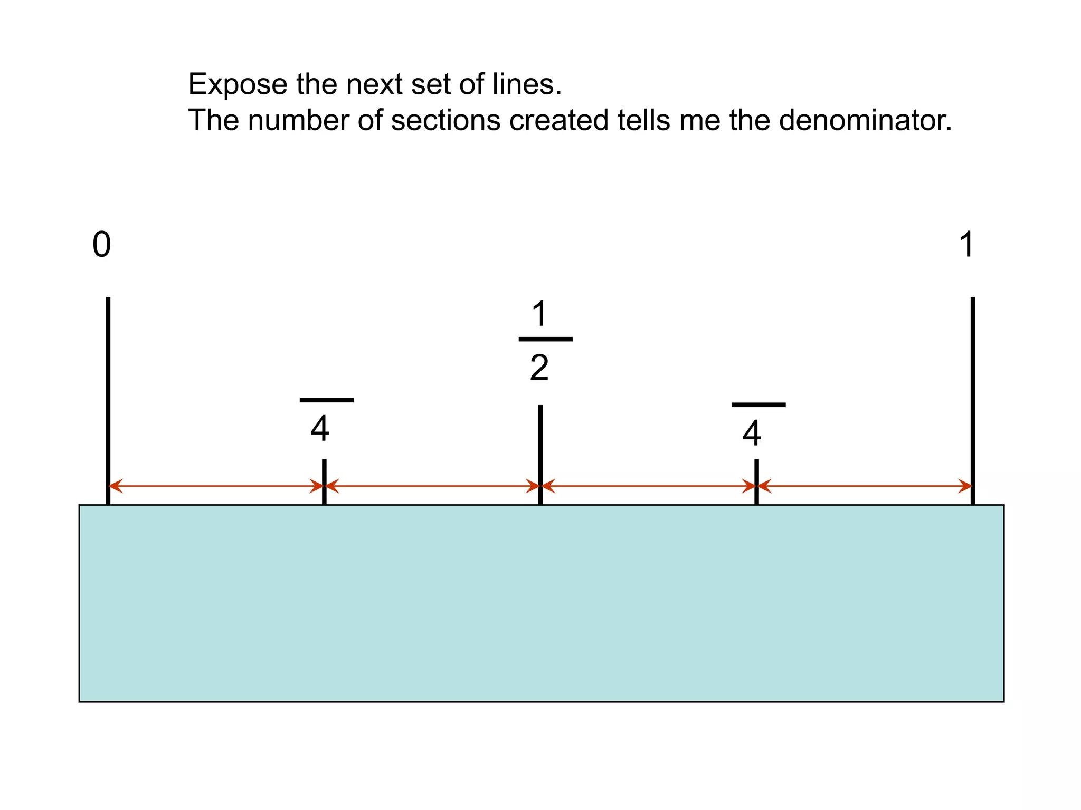

Slide 15
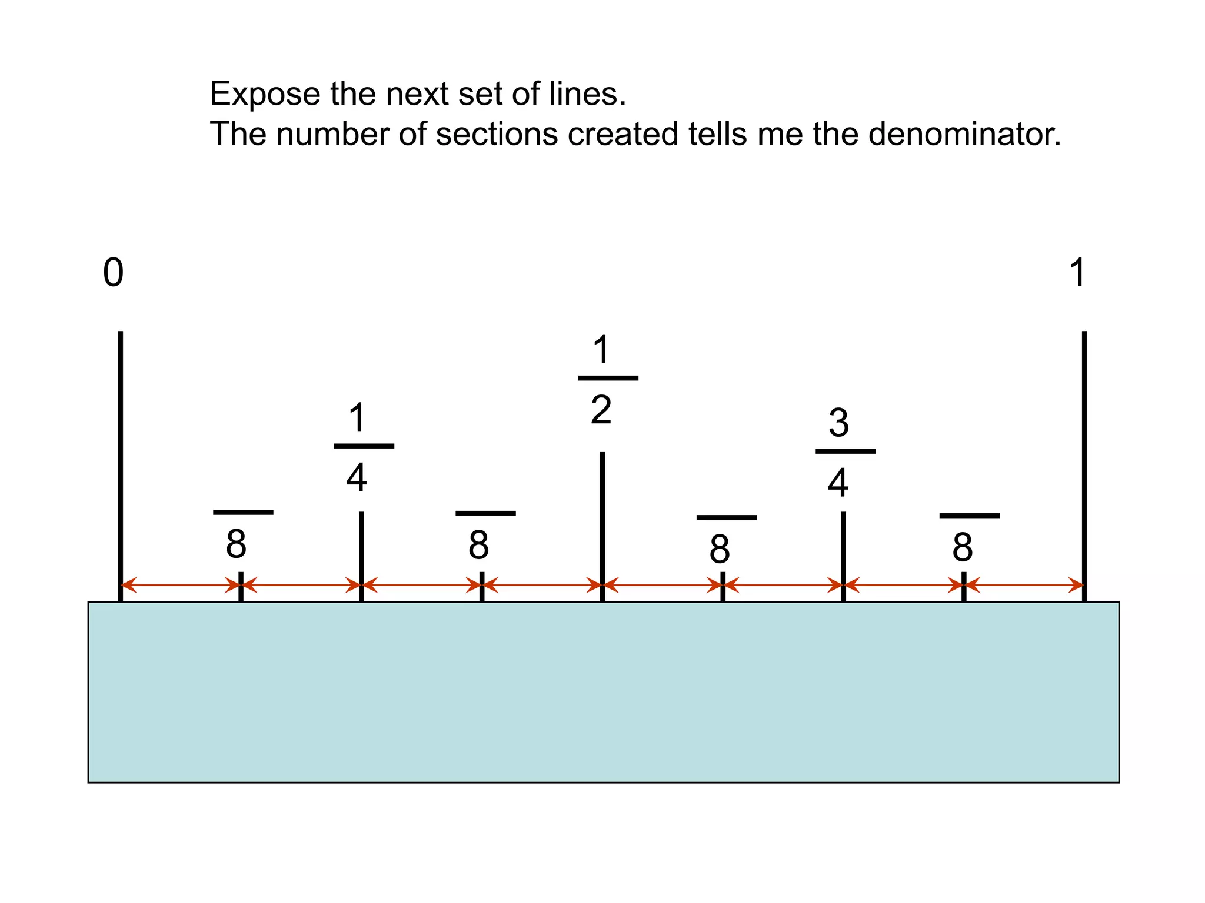

Slide 16
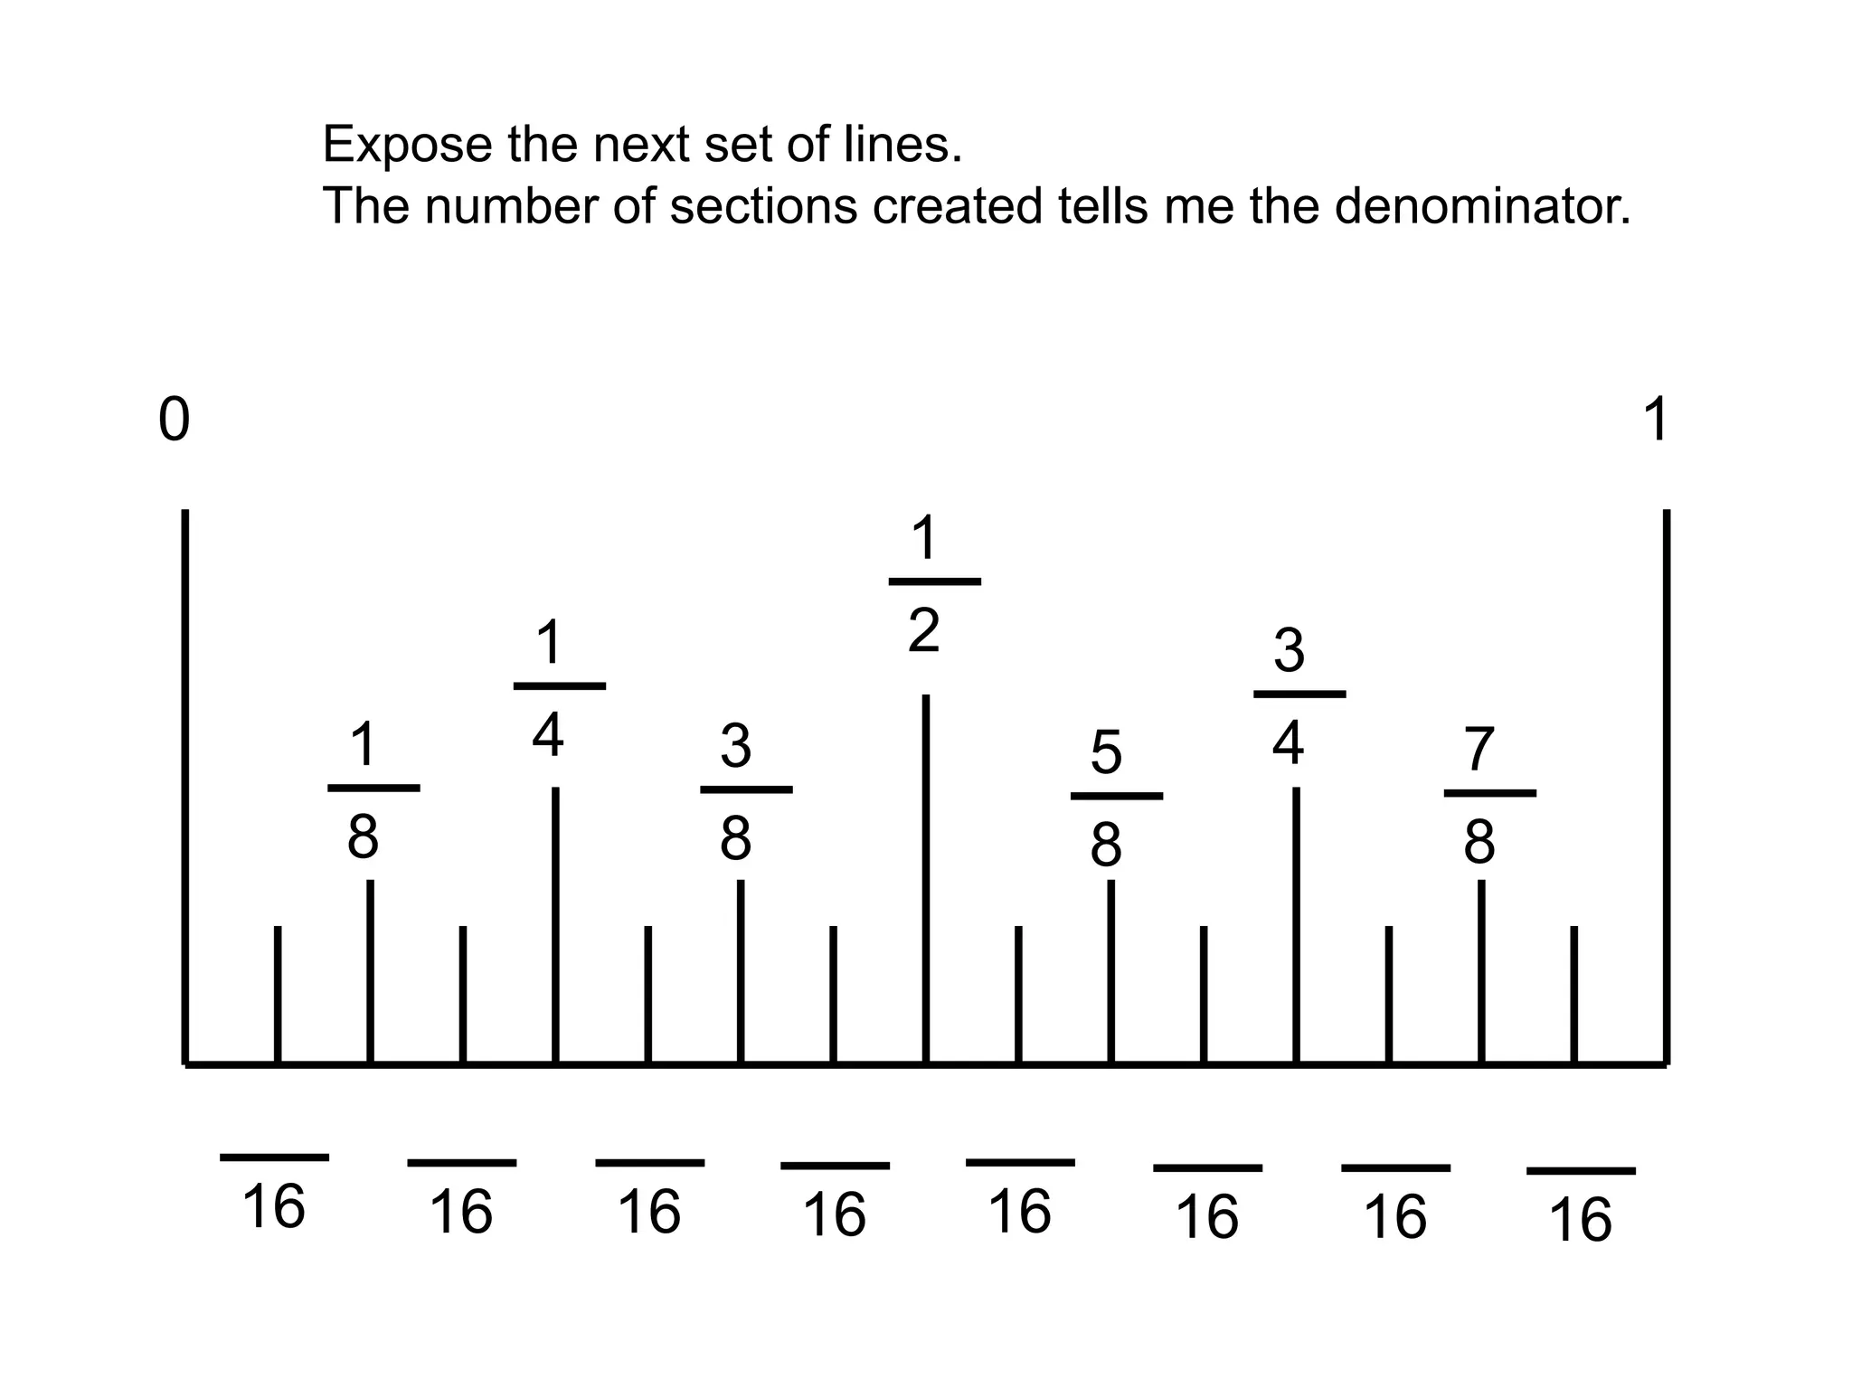

Slide 17
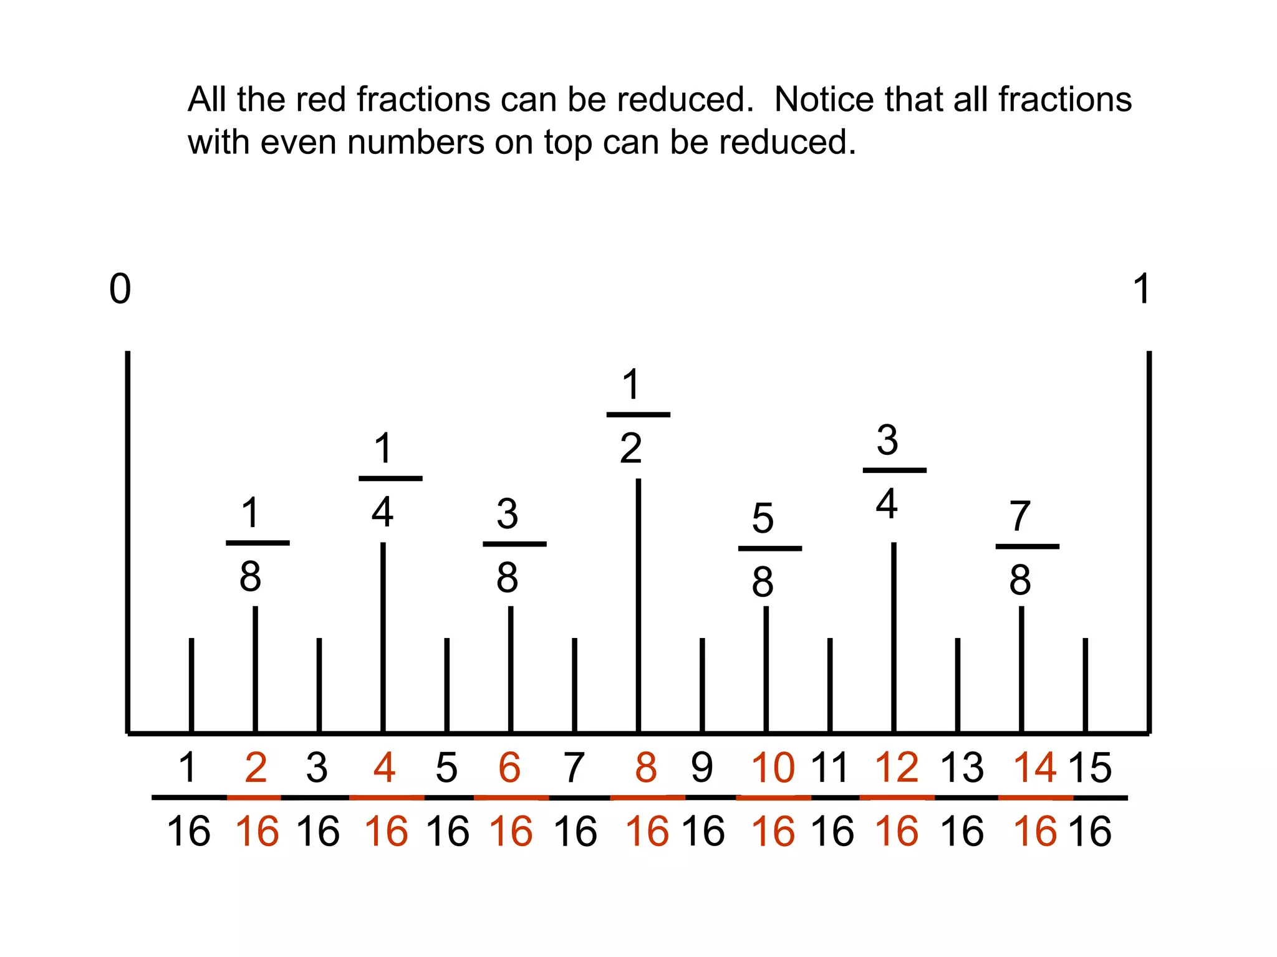

Slide 18
Some Conversions that you
Should Know (English System):
1 foot = 12 inches
1 yard = 3 feet
1 Rod = 5.5 yards
1 mile = 1760 yards, or 320 rods, or 5,280 feet
1 gallon = 16 cups
1 gallon = 4 quarts

Slide 19
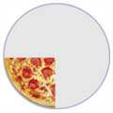
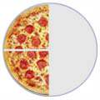
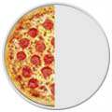
Adding Fractions
¼ | + | ¼ | = | 2/4 | = | ½

Slide 20
Three Simple Steps to Add Fractions
Step 1: Make sure the bottom numbers (the denominators) are the same.
Step 2: Add the top numbers (the numerators), put that answer over the denominator.
Step 3: Simplify the fraction (if needed)

Slide 21
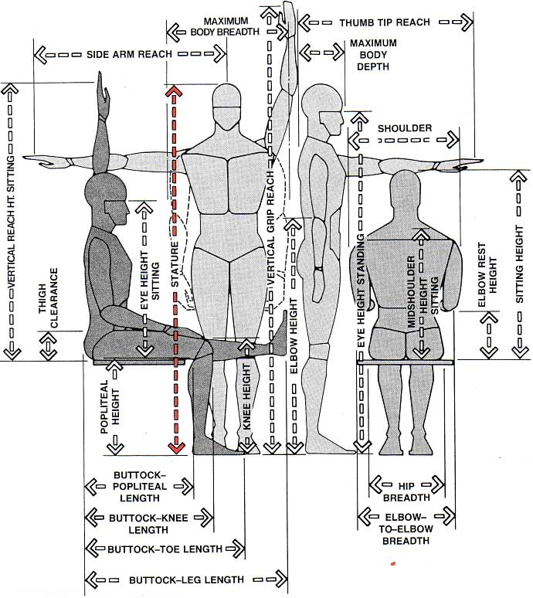
Anthropometrics
How many different ways can we measure a human? Weight, length, width, strength, reach, circumference, others
The study of human measurement is called anthropometrics
Anthropometry is the science that defines physical measures of a person's size, form, and functional capacities.

Slide 22
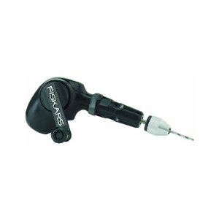
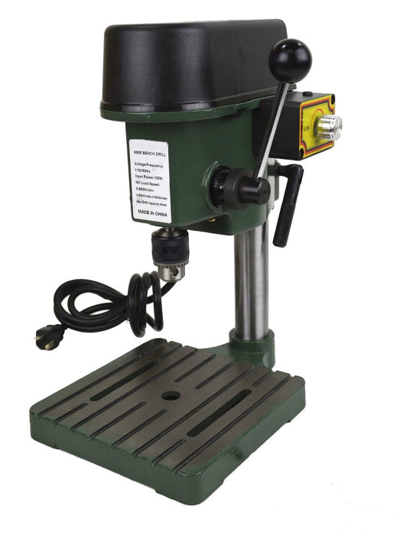
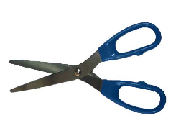
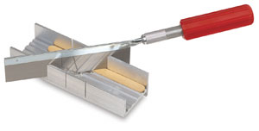
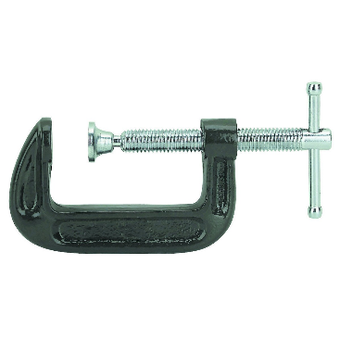
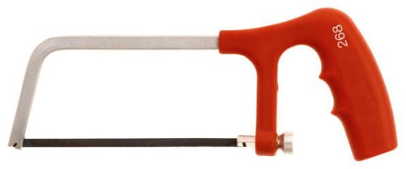
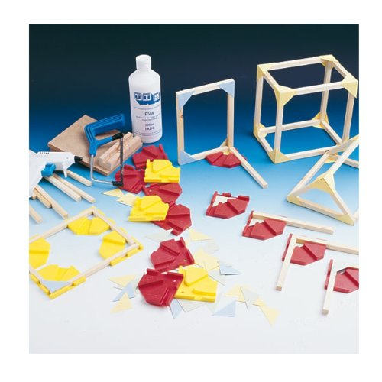
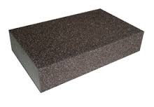
Tools
Scissors
Razor Saw
Hand Drill
Miter Box
Drill Press
Hack Saw
C-clamp
Sanding Sponge
Lynx Jointer

Slide 23
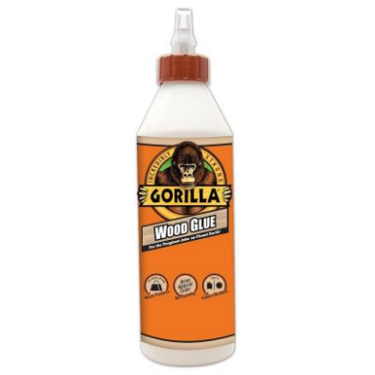
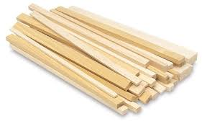
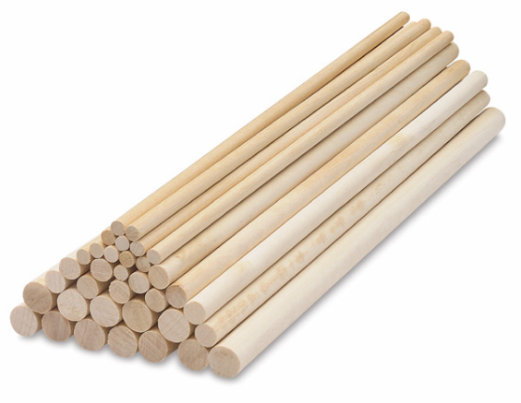

Materials
Wood Glue
Wood (Dimensional Lumber)
Notecard/Cardstock
Dowel Rods

Slide 24

Processes
Gluing
Sanding
Measuring
Cutting
Drilling
Clamping

