Slide 1
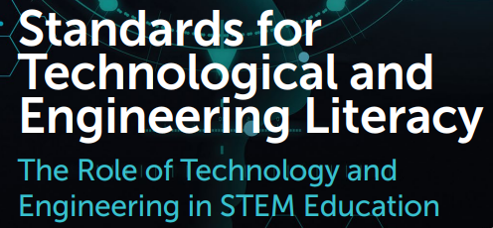

Slide 2

The International Technology and Engineering Educators Association (ITEEA) outlines eight Standards for Technological and Engineering Literacy (STEL) to guide education in technology and engineering.
These standards, detailed in the 2020 publication Standards for Technological and Engineering Literacy: The Role of Technology and Engineering in STEM Education, provide a framework for fostering technological and engineering literacy across all grade levels.

Slide 3
STEL - 1 - Nature and Characteristics of Technology and Engineering
Understanding the scope, core concepts, and relationships between technology, engineering, and other disciplines.
STEL - 2 Core Concepts of Technology and Engineering
Exploring systems, processes, and resources integral to technology and engineering.
STEL - 3 - Integration of Knowledge, Technologies, and Practices
Applying interdisciplinary knowledge and processes to solve problems and innovate.
STEL – 4 - Impacts of Technology
Analyzing the positive and negative effects of technology on individuals, society, and the environment.

Slide 4
STEL - 5 - Influence of Society on Technological Development
Examining how societal needs, values, and demands shape technological advancements.
STEL – 6 - History of Technology
Understanding the historical development and evolution of technology and engineering.
STEL – 7 - Design in Technology and Engineering Education
Engaging in design processes to develop solutions to problems using critical thinking and creativity.
STEL – 8 - Applying, Maintaining, and Assessing Technological Products and Systems
Using, managing, and evaluating technological products and systems effectively and safely.

Slide 5
Standard 6: History of Technology
Grades PreK-2
A. Discuss how the way people live and work has changed throughout history because of technology.
Grades 3-5
B. Create representations of the tools people made, how they cultivated food, made clothing, and built shelters to protect themselves.
Grades 6-8
C. Compare various technologies and how they have contributed to human progress.
D. Engage in a research and development process to simulate how inventions and innovations have evolved through systematic tests and reﬁnements.
E. Verify how specialization of function has been at the heart of many technological improvements.

